Slide 1
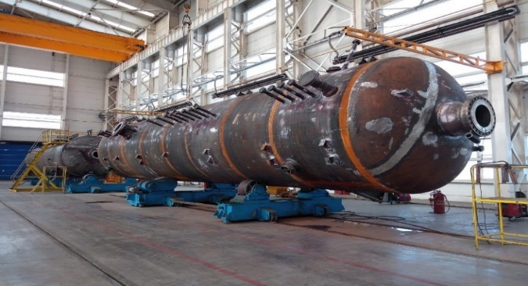
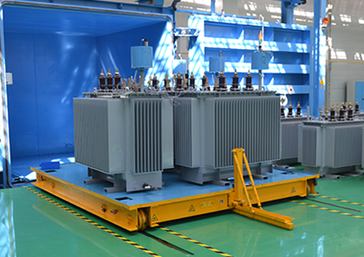
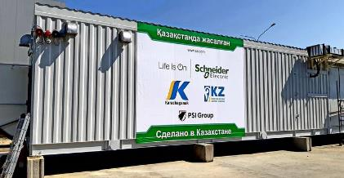
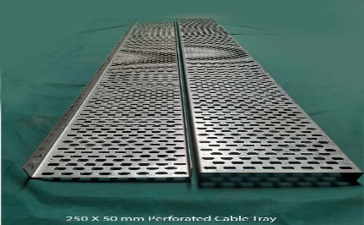
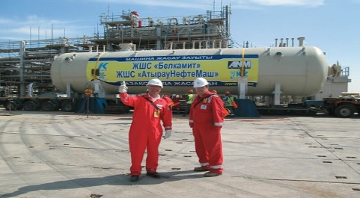
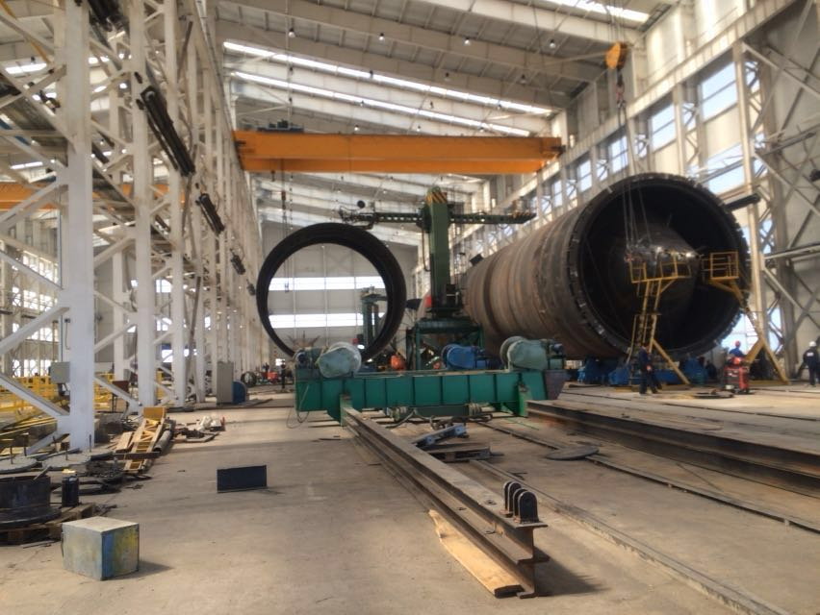
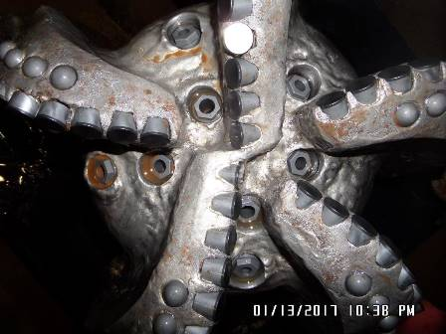
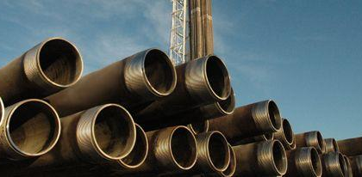
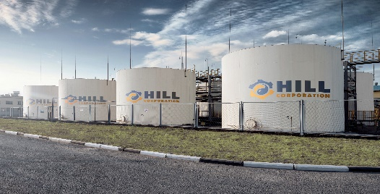
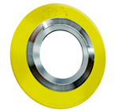
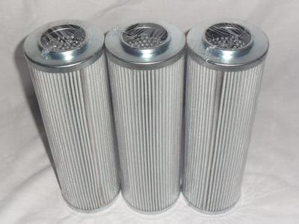
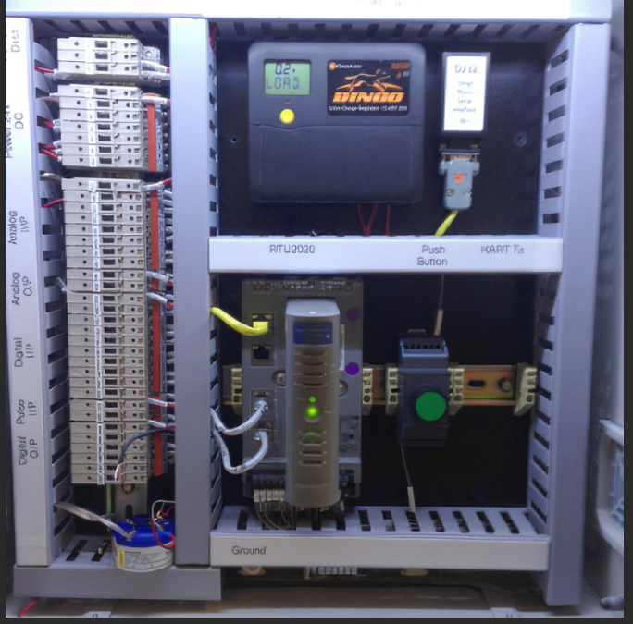
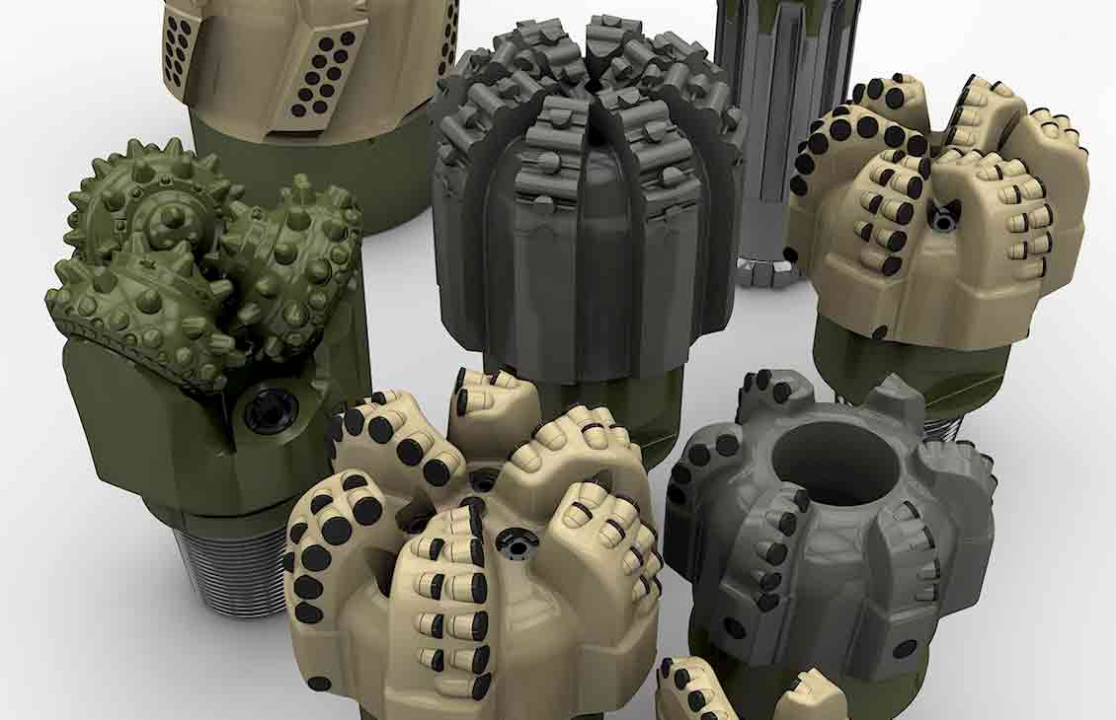
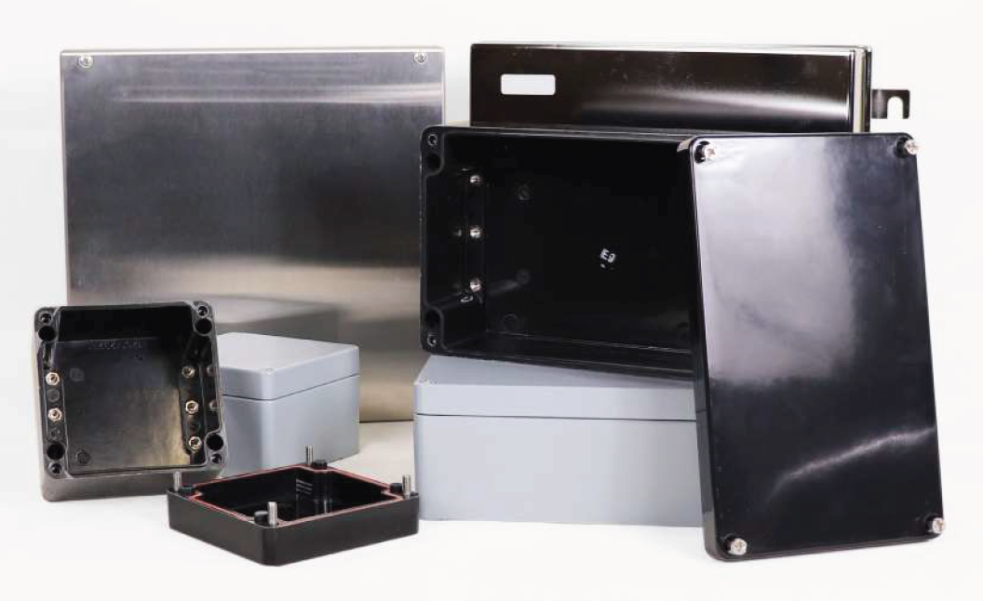
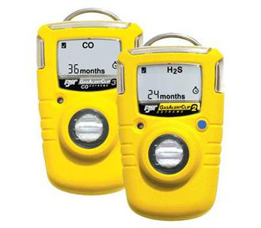
INITIATIVES
THICK WALL PRESSURE VESSELS - ATYRAUNEFTEMASH
ELECTRICAL EQUIPMENT –
ALAGEUM
MODULAR SUBSTATIONS – SCHNEIDER ELECTRIC AT PSI
CABLE TRAYS –
CENTECH
3 PHASE SEPARATOR –
BYELKAMIT, ANM
GAS DEHYDRATION COLUMN - ATYRAUNEFTEMASH
16’’ PDC DRILL BITS – ZMS
OCTG PIPES –
Kazakhstan Pipe Threaders
LUBRICANTS –
HILL CORPORATION
GASKETS –
NOVUS SEALING CASPIAN
FILTERS – K-FILTER LLP
REMOTE TELEMETRY UNIT - SPINDLEMARK LLP (HONEYWELL)
17 1/2’’ PDC DRILL BITS – ZMS
JUNCTION BOX –
SIGMA SOLUTIONS
H2S DETECTORS –
BORKIT SAFETY (HONEYWELL)
- one time supply
- long term contract
- waiting for company demand
- in process

