Slide 1
KPO TECHNICAL WEBINAR ON INSTRUMENTATION
WITH THE PARTICIPATION OF THE IMB CENTER
KARACHAGANAK PETROLEUM OPERATING B.V

Slide 2
DISCLAIMER
The information contained in these slides is made available for consideration. It represents KPO's preliminary description of the company’s demands as presently envisaged, but KPO reserves the right to change this information in the course of planning and implementing the projects, and KPO cannot be held responsible for any loss, damage or expense arising from reliance on this information. The information will not form part of any agreement between KPO and contractors participating in the workshop.
Today's engagement is one of many steps which KPO and its stakeholders are taking to develop local content.

Slide 3
INSTRUMENTATION - AGENDA
А – Project Execution Department
Overview
Instrument Requirements
Types
Packaged Instrument
KPO Previously Used Instruments and Forecasts
B - Operations Field Department
Technical characteristics:
Planned forecast for the consumption of Instrumentation materials

Slide 4
Engineering and Technical Authority

Slide 5
Overview
Technical Workshop on Instrumentation world class expertise – world class asset
Section A
Instrumentation
1

Slide 6
Instrumentation Overview
Objective:
The goal of this presentation is to provide a clear understanding of the instrument requirements used in KPO. We will explore instruments types, material requirements and the KPO specific and international standards of KPO.

Slide 7
Instrument Requirement
Technical Workshop on Instrumentation world class expertise – world class asset
Section A
Instrumentation
2

Slide 8
Specifications overview
All instrumentation shall be in accordance with the latest version of national (RoK) and international laws, legislation and regulations, and shall comply with KPO specifications and standards and applicable international codes and standards.
The following international standards ASME/ANSI, API, CUTR, IEC, ISA, ISO etc. are used by KPO.
S/N | Document Number | Title
1 | KPO-00-INS-SPC-00009 | General Instrumentation Specification
2 | KPO-00-ENG-SPC-00033 | Specification for Power and Control, Instrumentation and Telecommunication Cable
3 | KPO-00-INS-STD-00012 | Schedule of Standard Cable Types
4 | KPO-00-INS-STD-00019 | Schedule of standard cable Glands and accessories
5 | KPO-00-INS-SPC-00018 | Instrument Specification for Junction Boxes
6 | KPO-00-INS-STD-00024 | Instrument Installation – Standard Hook Ups

Slide 9
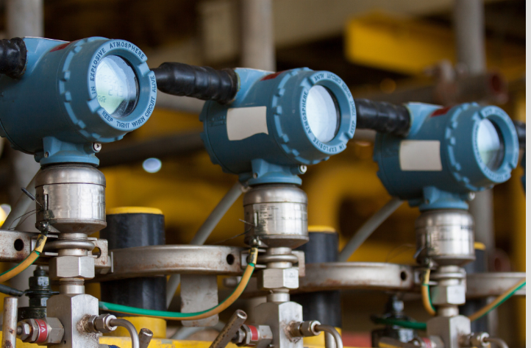
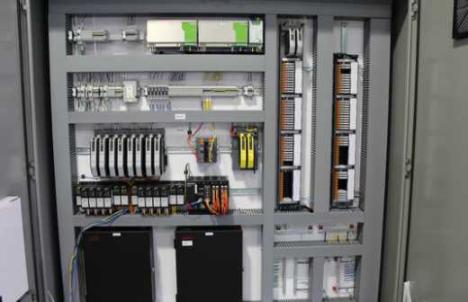
Instrument requirements
General Requirements
Ambient Temperature: -40/+50 Deg C / +22-30 Deg C
Mixture of intrinsically safe (Exi), explosion proof (Exd) and improved protection (Exe)
Ingress protection: IP65/IP44
Smart type ‘HART’
Accuracy
20 years lifecycle/ Spare parts support
Min. flange rating 300#
Material Requirements:
In-line field instruments with wetted parts in contact with fluids containing H2S shall align with KPO sour specifications and be NACE ISO 15156/MR0175 standards certified. Wetted parts for sour service, shall be INC 625 or C276.
Measuring instrumentation housing/body (non contact items) is SS316 as a minimum.
Items shall conform to the related instrument datasheets
Certification:
All Measuring Instruments shall have Pattern approval Certificate - Metrology Certificate from the Committee of Technical Regulation of the Ministry of Industry and New Technologies of the Republic of Kazakhstan (be in RoK Metrology register).
All field mounted instrument and control equipment shall be certified to comply with the technical regulations of the Eurasian Economic Union (EAC CU TR)
SIL2 requirements for safety instruments

Slide 10
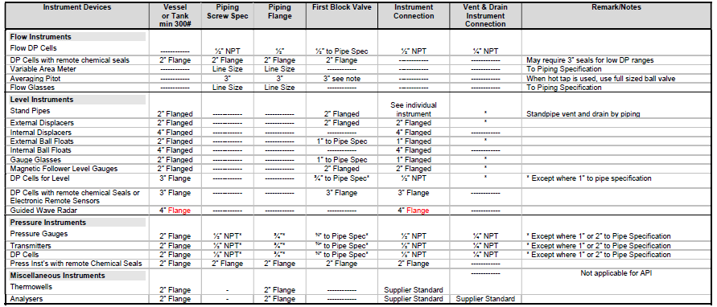
Installation details
All taper threads shall be in accordance with ANSI B1.20.1 (NPT). For connections to vessels or standpipes. Refer following table for guide to sizes and types of instrument connections.

Slide 11
Types
Technical Workshop on Instrumentation world class expertise – world class asset
Section A
Instrumentation
3

Slide 12


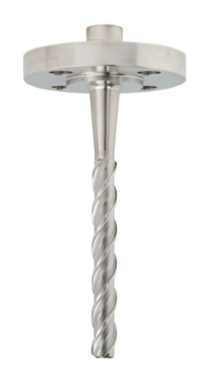
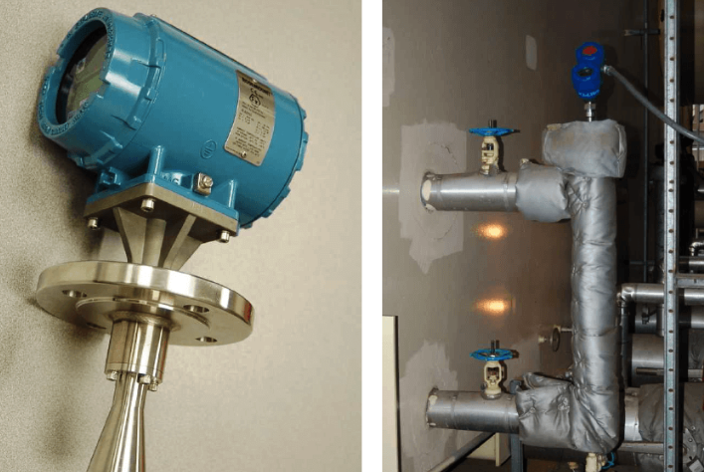
Instrument types
Flow Measurements
The method of flow metering for control and measurement shall be based on Magnetic, Coriolis, Ultrasonic and differential pressure measurement across orifice plates, in accordance with ISO 5167.
Pressure Measurements
Pressure gauges for general applications shall be minimum 150mm in diameter
All gauges shall be full safety pattern fitted with shatterproof safety glass.
Temperature Measurements
Transmitters are RTDs /Thermocouples and Gauge is bi-metallic
Sensing elements shall be installed in thermowells. Thermowells shall be solid drilled and tapered.
The wake frequency, where calculated shall be to ASME Performance Test Code 19.3. Thermowells with helical strakes/Scruton shall be considered as the first choice for critical process conditions.
Level Measurements
Magnetic Level gauges
Guided Wave Radar/Radar
Displacer
Differential pressure
Ultrasonic

Slide 13
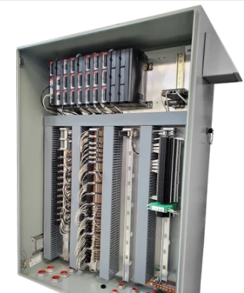
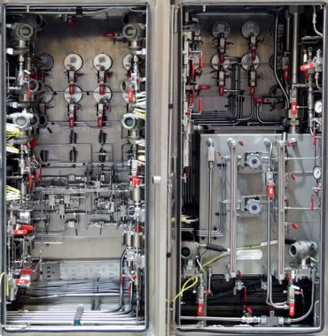
Packaged Instruments and accessories
The manufacturing of packaged instrument equipment's i.e. Remote telemetry Units, Wellhead control panels, system panels etc. includes engineering and design, supply, installation/wiring, testing, certification, FAT/SAT.
These type of packaged equipment's as example consist wiring, cabling, tubing, fittings, glands, terminal blocks, instruments, control logic, IO blocks etc.
Instruments accessories manufacture:
Tubing/fittings: Parker A-lok metric
Glands: CMP
Cables/wiring: IEC standard
Terminals: Weidmuller
Panels: ‘Rittal’ and similiar
Junction box: EAC certified
Cable trays: hot dip galvanised/1.5 thickness etc.
RTU/PLC
WHCP

Slide 14
Instrument Frequently Used and Forecast
Technical Workshop on Instrumentation world class expertise – world class asset
Section A
Instrumentation
4

Slide 15
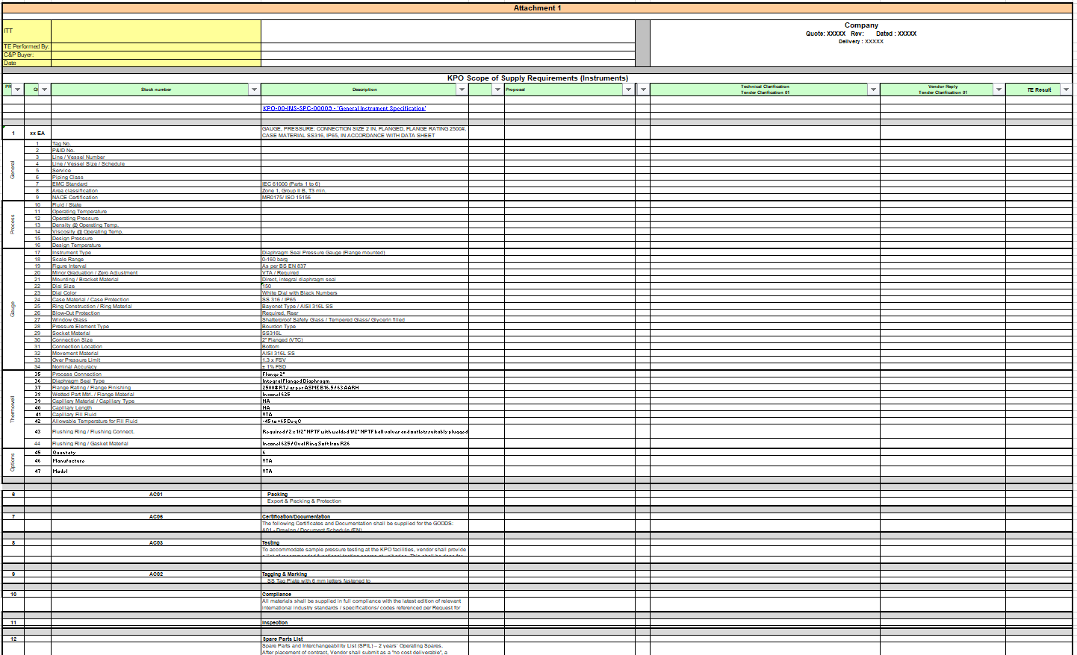
Instrument – Documents TBE
Typical document requirement during the bid phase exchange between PED Eng. department and C&P department.
Required information from Company Specification
Column reserve to tenderers for confirm/deviate
Column reserve to Company for accept or reject the clarification by tenderers

Slide 16
Instrument – Documents TBE
Typical document requirement during the bid phase exchange between PED Eng. department and C&P department.
With BID:
Preliminary General Arrangement
Sizing Calculations (WFC (thermowells stress analysis), Flow orifice etc)
Marked manufacture catalogues and datasheets
For Manufacturing:
Fabrication Schedule
Instrument datasheet
General Arrangement
Sizing Calculations
Instrument schedule (I/O list) - PKG
Electrical Single line diagram/schematic – PKG
PID - PKG

Slide 17
Operations Field

Slide 18
Review of Instrumentation materials
Instrumentation materials
3

Slide 19
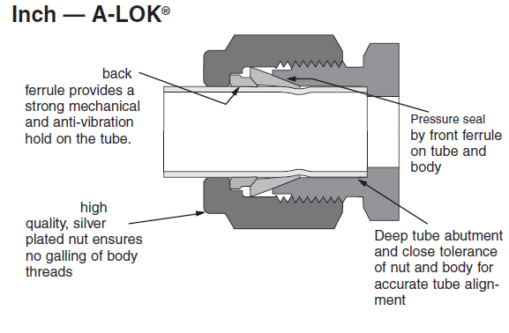
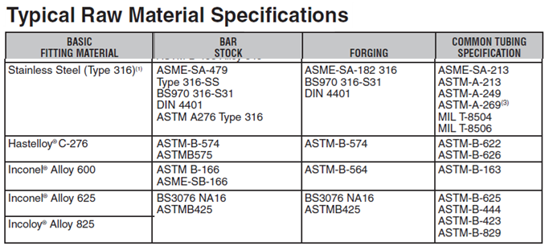
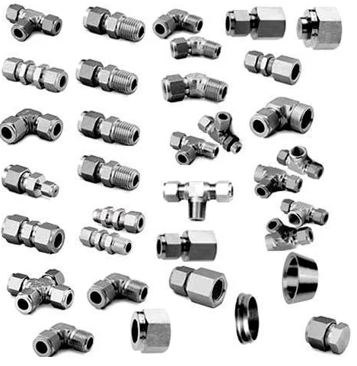
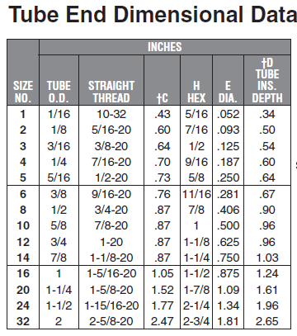
Instrumentation Fittings
Instrumentation fittings with the A-Lok system refer to a specific type of tube fittings designed for secure and leak-free connections in instrumentation, control, and process systems. These fittings provide high-quality sealing with minimal maintenance, ensuring reliable performance in critical systems like instrumentation, pneumatic, and hydraulic applications. A-Lok fittings are used in tubing systems for instrumentation, process control, and analytical applications, especially where high precision and safety are essential. This includes use in measuring devices, control systems, and fluid transmission lines.

Slide 20
Overview of IMB Center's activities
KPO TECHNICAL WEBINAR ON Instrumentation

Slide 21














SCOPE OF ACTIVITIES
DATA PROCESSING & CONSOLIDATION
ADVOCACY ISSUES
Major Operators
Consolidation of efforts provision of quantitative and technical data
Government
Facilitation and stimulation
Preferences & subsidies
LOCAL MARKET ANALYSIS & CAPACITY DEVELOPMENT
LOCALIZATION
& TECHNOLOGY TRANSFER
Machine building industry
Capacity development, international standards, Technology transfer

Slide 22
Commodities of interest
In our analyses of demands and identifying localization priorities, we utilize the FPAL coding system
FPAL Commodity Codes
Commodity Group A
Commodity Group B
Commodity Group C
Commodity Group D
1.01
Drilling Equipment
1.09
Electrical Equipment and Materials
1.04
Pumps and Seals
1.02
Material and Product Handling Equipment
1.03
Compressors / Expanders / Blowers and Accessories
1.02
Material and Product Handling Equipment
1.10
Instrumentation / Process Control Equipment / Materials
1.11
Process Filters
1.07
Heat Exchangers / Heat Transfer Equipment
1.05
Drivers and Accessories
2.02
Valves and Accessories
1.12
HVAC
1.16
Firefighting Equipment
2.03
Steel / Metal Materials
2.01
Line pipe
2.07
Chemical / Oils / Paints
2.11
Workshop and Handtools
2.99
Other Products / Equipment and Materials
2.08
Insulation / Refractory Materials
Procurement in above commodity groups accounts for over 75% of all procurement of goods by three Operators **
* According to the statistical data of Situational-analytical center of the Fuel and Energy complex of the Republic of Kazakhstan

Slide 23



















PROGRESS UNDER COMMODITY GROUPS
Commodity Group A
Commodity Group B
Commodity Group C
Commodity Group D
Demands analysis
35,000 items analysed
55,000 items analysed
7,000 items analysed
TBC
High demand goods identified
19 types of goods
18 types of goods
27 types of goods
TBC
Market analysis, longlist from available resources
more than 90
manufacturers identified
more than 100
manufacturers identified
more than 80
manufacturers identified
TBC
Site surveys, manufacturers who expressed interest
72 site surveys conducted
61 site surveys conducted
41 site surveys conducted
TBC
Shortlisting, manufacturers producing types of goods with high demands
23 manufacturers shortlisted
16 manufacturers shortlisted
In process
TBC
Capacity development
8 CDPs developed
3 CDPs developed
TBC
TBC
Implementation
of capacity development
3 recommended
manufacturers
2 recommended manufacturers
TBC
TBC
Recommendations to Operators

Slide 24
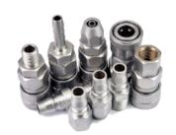

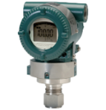
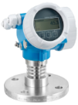
Consolidated Demands: Instrumentation
INSTRUMENTATION
Instrument Tubing and Fittings
34,793 ea,pk
Temperature
instruments
16,743 ea
Pressure
instruments
19,849 ea
Level
instruments
2,761 ea

Slide 25



technicalsupport@imbc.kz
+ 7 (7172) 39-99-66
www.imbc.kz
The range and specificity of services for assistance in the development of the potential of manufacturers, offered by IMBC, are limited and are subject to provision on an individual basis, depending on the readiness of the manufacturer to supply their manufactured goods in line with the requirements of the Operators.
Assistance from IMBC does not oblige any retaliatory action from the potential manufacturer. The services of IMBC do not represent a guarantee of the successful participation and / or successful award of Contracts to the manufacturer in the procurement processes of the Operators.

Slide 26
KPO Supplier Database

Slide 27
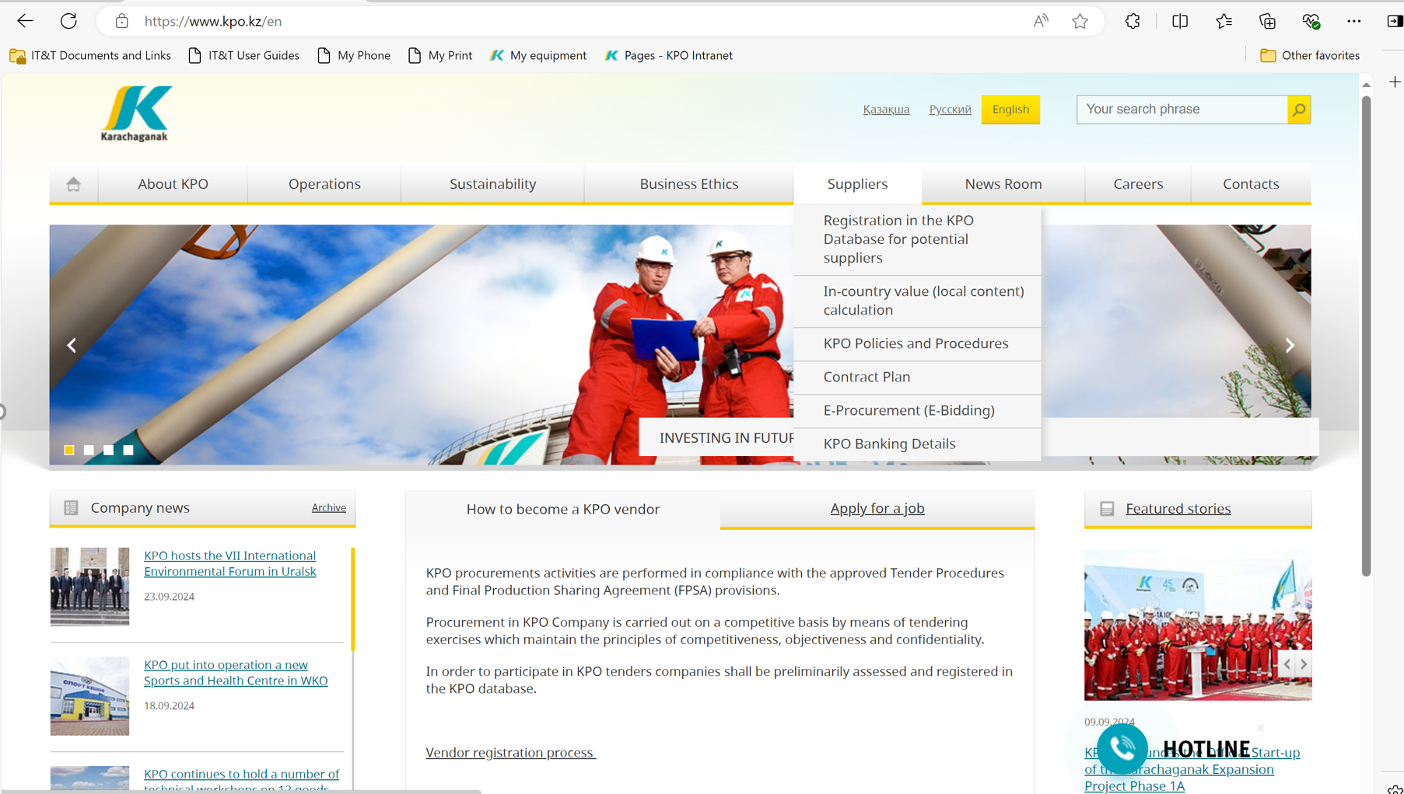
KPO SUPPLIERS DATABASE

Slide 28
VENDOR REGISTRATION
All potential suppliers shall be registered in KPO Database
REGISTRATION PROCESS
REGISTRATION
Provision of information on:
Technical Competency
Work Experience in the declared categories of goods and / or works and / or services
Personnel Availability
Financial Turnover
etc.
ETHICAL DUE DILIGENCE
Define an Ethical Due Diligence level in accordance with KPO Legal requirements:
Compliance with Kazakhstan and Foreign legislation
Compliance with Company internal regulations
Submission of potential suppliers shareholder lists
Vendor registration in KPO Vendor Database does not guarantee the participation in a tender or contract award, but suggests that a registered company may be considered as a market research participant for provision of goods, works and services for further pre-qualification process or tender as the need arises.
07/10/2024 CONFIDENTIAL KARACHAGANAK PETROLEUM OPERATING B.V.

Slide 29
VENDOR REGISTRATION
To register in KPO Vendor Database, potential supplies shall:
  Download a questionnaire on KPO website – https://kpo.kz/ru/postavshchikam/registracija-v-baze-dannykh-postavshchikov-kpo
  Fill in the questionnaire for the preliminary vendor assessment and indicate activity codes
  Attach copies of required documents
  Submit the completed pack of documents for vendor assessment and registration by e-mail at MIVQ@kpo.kz
  Contact phone: +7 (711336) ext. 4943, 4946, 2192
  KPO encourages Suppliers to update registration data on an ongoing basis, related to:
    Work Experience in the declared categories of goods, works, services
    Certification, accreditation
    Reorganization
    Contact persons
07/10/2024 CONFIDENTIAL KARACHAGANAK PETROLEUM OPERATING B.V.

Slide 30
MARKET RESEARCH
Purpose
  Define potential suppliers of goods, works, services who can perform as per KPO requirements
  Ensure free competition for KPO tenders
PROCESS
Demand determination and vendor searching
Issue of Invitation Letter for Expression of Interest
Market Intelligence Report
Approved
Tender List
Approvals
07/10/2024 CONFIDENTIAL KARACHAGANAK PETROLEUM OPERATING B.V.

Slide 31
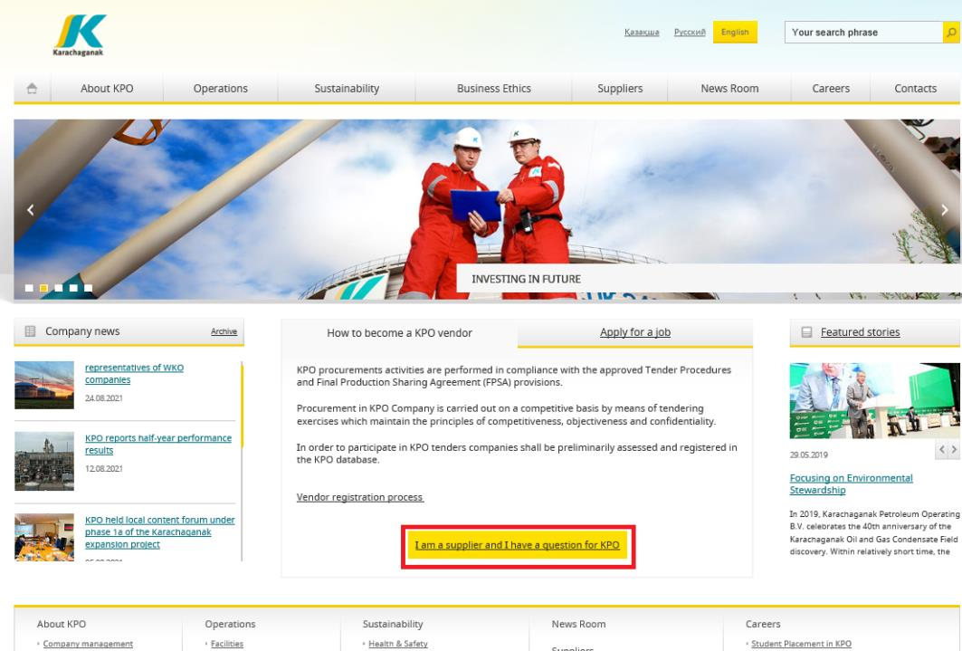
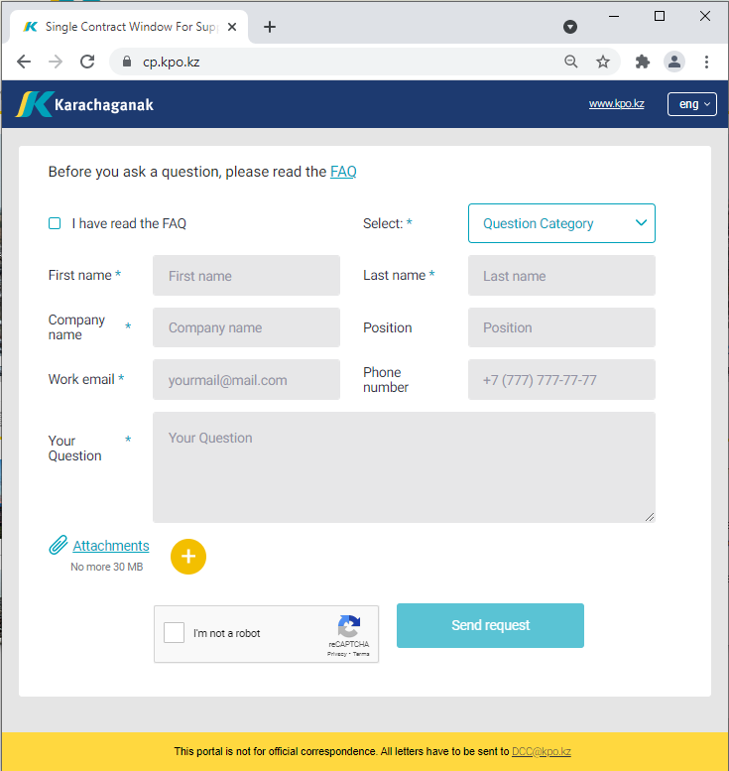
‘’SINGLE WINDOW’’ SYSTEM
07/10/2024 CONFIDENTIAL KARACHAGANAK PETROLEUM OPERATING B.V.

Slide 32
Procurement
Process

Slide 33
PROCUREMENT PROCESS
KPO shall perform the procurement activities in accordance with:
  the Final Production Sharing Agreement (confidential and intended only for the use of KPO, its Shareholders and the Republic) and the Joint Operating Committee’s Tender Procedures (JOC)
  current legislation
  approved budget and work program
PROCESS
MARKET RESEARCH / PREQUALIFICATION
INVITATION
TO TENDER
TENDERING PERIOD
TENDER DUE DATE
EVALUATION OF TENDERS
CONTRACT AWARD
CONTRACT
SIGNING
CONTRACT
PERFORMANCE

Slide 34
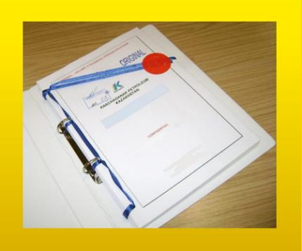



MAXIMUM ATTENTION SHALL BE PAID TO
TENDER PACKAGES SUBMISSION REQUIREMENTS
TENDER PACKAGES SUBMISSION REQUIREMENTS THROUGH E-BIDDING SYSTEM
(Link to the instructions)
INSTRUCTIONS
TO TENDERERS
TENDER DUE DATE / TIME

Slide 35
TENDER DOCUMENTATION CONTENTS
Cover letter
Forms, that shall be mandatorily signed, stamped and provided within timeframe specified:
Tender Acknowledgement and Confidentiality Agreement
Form of Tender
Certificate of Corporate Ownership and Declaration of Compliance
A package of documents related directly to the tender subject itself
Instructions to Tenderers
Form of Contract includes:
Form of Agreement
Schedule A – General Terms and Conditions
Schedule B – Scope of Goods/Services to be Supplied and Specifications
Schedule C – Compensation and Payment
Schedule D – Health, Safety and Environment (HSE) requirements
Schedule E – Special Conditions
Schedule F – Statement of Local Content
Schedule H – Industrial Relations
Questionnaire for Tender Participants
List of goods and technical delivery conditions (if applicable)
Instructions for preparing a tender proposal:
Instructions to Tender Participants
Bid marking template

Slide 36
Local Content
Mechanisms

Slide 37








SUPPORTING MECHANISMS FOR LOCAL COMPANIES
TRIAL ORDER
EARLY TENDER
KAZAKH TENDER
Tenders for testing a trial batch of GOODs from Kazakhstani suppliers
Contract is concluded for the supply of GOODS with a suspensive condition or with a long-term delivery schedule
Tenders exclusively among Kazakhstani Suppliers. The goal is to award contracts to Kazakhstani suppliers of GWS
CONTRACT IN EXCHANGE FOR INVESTMENTS (UNDER REVISION)
  A contract in exchange for investment is a long-term contract concluded on a Single source basis, under which the supplier undertakes to produce goods of local origin that are the subject of a procurement contract in the territory of the Republic of Kazakhstan

Slide 38
Thank you!

