Slide 1
KPO TECHNICAL WEBINAR ON COMPRESSORS WITH THE PARTICIPATION OF THE IMB CENTER
KARACHAGANAK PETROLEUM OPERATING B.V

Slide 2
DISCLAIMER
The information contained in these slides is made available for consideration. It represents KPO's preliminary description of the company’s demands as presently envisaged, but KPO reserves the right to change this information in the course of planning and implementing the projects, and KPO cannot be held responsible for any loss, damage or expense arising from reliance on this information. The information will not form part of any agreement between KPO and contractors participating in the workshop.
Today's engagement is one of many steps which KPO and its stakeholders are taking to develop local content.
18/04/2025 КАРАЧАГАНАК ПЕТРОЛИУМ ОПЕРЕЙТИНГ Б.В.

Slide 3
FANS AND COMPRESSORS

Slide 4
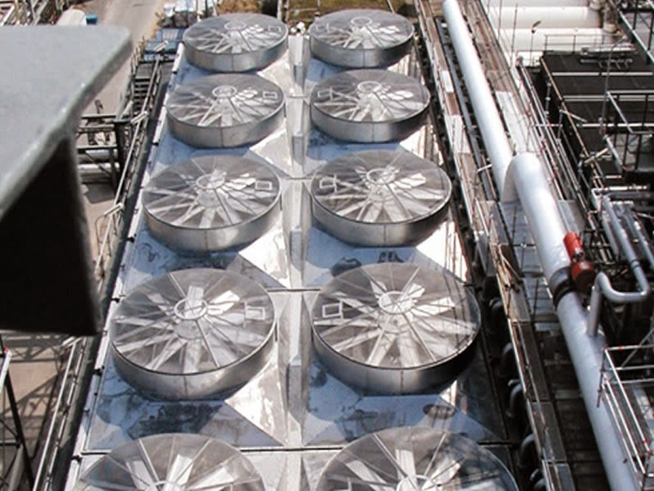
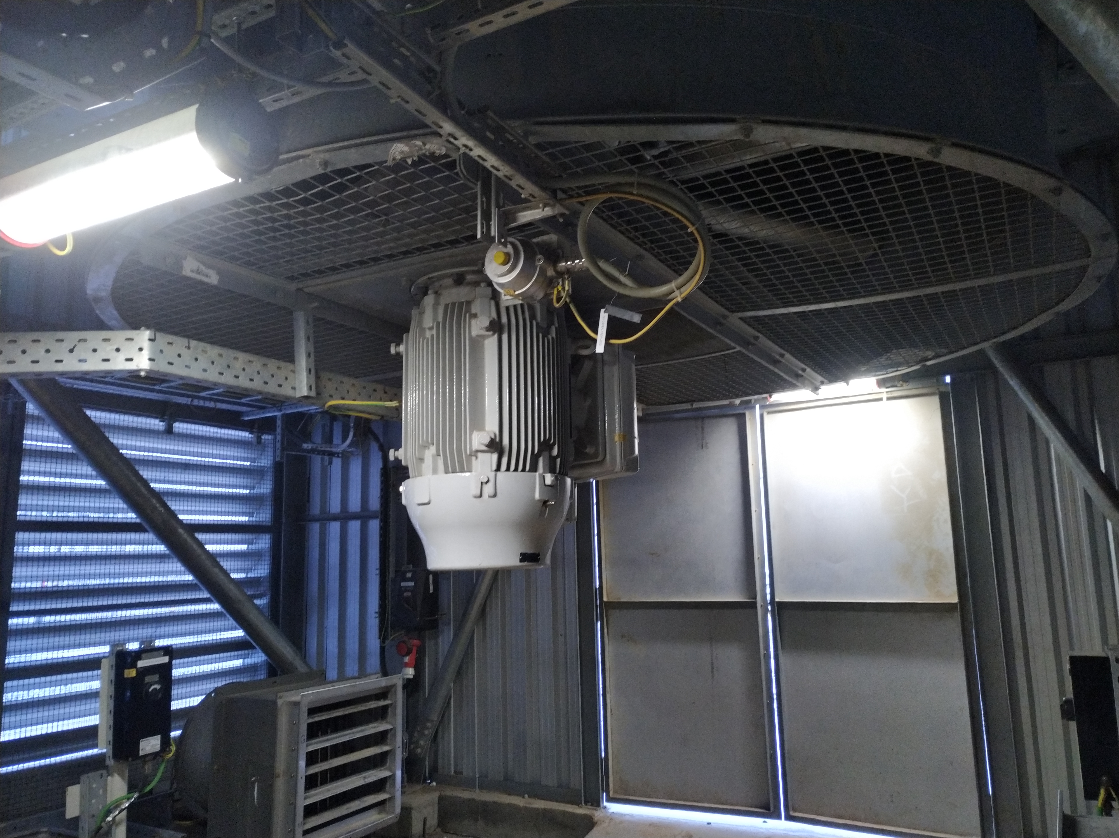
FAN OVERVIEW
  Purpose:
  Cooling fans is to blow cold air and drive hot air out of the environment.
  The main benefit of using air cooler is the elimination of an auxiliary water supply
  Fundamental Components:
  Motor
  Rotor shaft
  Impeller blades
  Pulleys and Belt/Gearbox
  Bearings
  Various Accessories:
  Vibration switches/sensors
  Lovers (manual or automatic)
  Configurations:
  Forced type – fans located below bundles
  Induced type - fans located above bundles
18/04/2025 КАРАЧАГАНАК ПЕТРОЛИУМ ОПЕРЕЙТИНГ Б.В.

Slide 5
FANS MAINTENANCE STRATEGY
280
Fans are installed over KPO Facilities, cooling process and auxiliary fluids
PM
6 Months preventive maintenance inspection is conducted:
Visual inspection
Greasing
Belt tensioning
Failure Mode
Frequent Failures:
Belts
High Vibration
Pulley
18/04/2025 КАРАЧАГАНАК ПЕТРОЛИУМ ОПЕРЕЙТИНГ Б.В.

Slide 6


COMPRESSORS OVERVIEW
Centrifugal Compressors (API 617)
Working Principle: Uses a rotating impeller to accelerate gas, which is then diffused to increase pressure.
Fundamental Components: Impeller, Seals, shaft, bearing and etc.
Reciprocating Compressors (API 618)
Working Principle: Uses pistons driven by a crankshaft to compress
gas in a cylinder.
Fundamental Components: Cylinder, Piston, Crankshaft etc.
18/04/2025 КАРАЧАГАНАК ПЕТРОЛИУМ ОПЕРЕЙТИНГ Б.В.

Slide 7
CENTRIFUGAL COMPRESSORS
Service | Manufacturer | Pressure output | Speed
Acid Gas Compressor | BORSIG (MAN Turbo) | 102.6 Bar | 14530 RPM
Flash Gas Compressor | MAN Turbo | 49 Bar | 14604 RPM
Sour Gas Compressor | MAN Turbo | 81 Bar | 14604 RPM
Reinjection Compressor | Nuovo Pignone | 430 Bar | 11370 RPM
PM
  3 Year Minor inspection:
  Alignment check
  Bearing Inspection
  DGS inspection
  6 Year Major inspection:
  Alignment check
  Bearing Inspection
  DGS inspection
  Rotor inspection
  Diaphragm inspection
18/04/2025 КАРАЧАГАНАК ПЕТРОЛИУМ ОПЕРЕЙТИНГ Б.В.

Slide 8
RECIPROCATING COMPRESSORS
Service | Manufacturer | Pressure output
Flash Gas Compressor | KNOX WESTERN | 83 Bar
Flash Gas Compressor | HAUG | 48 Bar
PM
  12M Refurbishment of Cylinder Valves:
  Replacement of soft parts
  Spring inpsection
  12M Refurbishment of pressure and wiper packings:
  Inspection of Piston and Rider rings
  Pressure packings and Oil Wiper Packing replacement
18/04/2025 КАРАЧАГАНАК ПЕТРОЛИУМ ОПЕРЕЙТИНГ Б.В.

Slide 9
Overview of IMB Center's activities
KPO TECHNICAL WEBINAR ON COMPRESSORS

Slide 10














SCOPE OF ACTIVITIES
DATA PROCESSING & CONSOLIDATION
ADVOCACY ISSUES
Major Operators
Consolidation of efforts provision of quantitative and technical data
Government
Facilitation and stimulation
Preferences & subsidies
LOCAL MARKET ANALYSIS & CAPACITY DEVELOPMENT
LOCALIZATION
& TECHNOLOGY TRANSFER
Machine building industry
Capacity development, international standards, Technology transfer

Slide 11
Commodities of interest
In our analyses of demands and identifying localization priorities, we utilize the FPAL coding system
FPAL Commodity Codes
Commodity Group A
Commodity Group B
Commodity Group C
Commodity Group D
1.01
Drilling Equipment
1.09
Electrical Equipment and Materials
1.04
Pumps and Seals
1.02
Material and Product Handling Equipment
1.03
Compressors / Expanders / Blowers and Accessories
1.02
Material and Product Handling Equipment
1.10
Instrumentation / Process Control Equipment / Materials
1.11
Process Filters
1.07
Heat Exchangers / Heat Transfer Equipment
1.05
Drives and Accessories
2.02
Valves and Accessories
1.12
HVAC
1.16
Firefighting Equipment
2.03
Steel / Metal Materials
2.01
Line pipe
2.07
Chemical / Oils / Paints
2.11
Workshop and Handtools
2.99
Other Products / Equipment and Materials
2.08
Insulation / Refractory Materials
Procurement in above commodity groups accounts for over 75% of all procurement of goods by three Operators **
* According to the statistical data of Situational-analytical center of the Fuel and Energy complex of the Republic of Kazakhstan

Slide 12












PROGRESS UNDER COMMODITY GROUPS
Commodity Group A
Commodity Group B
Commodity Group C
Commodity Group D
Demands analysis
35 000 items analysed
55 000 items analysed
7 000 items analysed
12 000 items analysed
High demand goods identified
22 types of goods
19 types of goods
27 types of goods
39 types of goods
Market analysis, longlist from available resources
more than 90
manufacturers identified
more than 100
manufacturers identified
more than 80
manufacturers identified
more than 150
manufacturers identified
Site surveys, manufacturers who expressed interest
81 site surveys conducted
73 site surveys conducted
50 site surveys conducted
55 site surveys conducted
Shortlisting, manufacturers producing types of goods with high demands
23 manufacturers shortlisted
16 manufacturers shortlisted
In process
TBC
Summarized Technical Requirements
12 STRs developed
8 STRs developed
In process
TBC
Capacity development
10 CDPs developed
4 CDPs developed
TBC
TBC
Implementation
of capacity development
3 recommended
manufacturers
2 recommended
manufacturers
TBC
TBC
Localization Cases
13 LC cases developed with investors
5 LC cases developed with investors
4 LC cases developed with investors
1 LC cases developed with investors
Recommendations to Operators

Slide 13
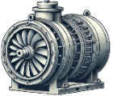
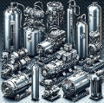
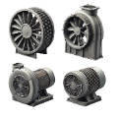
Demand: COMPRESSORS & ACCESSORIES
COMPRESSORS & SPARES
Compressors (centrifugal, scroll, reciprocating, screw type, etc.)
144 ea
Other compressors (atomizing, mobile, zero air, hermetic, piston, refrigerant, scroll)
342 ea/asy/set
Blowers & fans (axial, centrifugal, air & heat blower)
1,628 ea/set

Slide 14



infoimbc@imbc.kz
+ 7 (7172) 39-99-66
www.imbc.kz
The range and specificity of services for assistance in the development of the potential of manufacturers, offered by IMBC, are limited and are subject to provision on an individual basis, depending on the readiness of the manufacturer to supply their manufactured goods in line with the requirements of the Operators.
Assistance from IMBC does not oblige any retaliatory action from the potential manufacturer. The services of IMBC do not represent a guarantee of the successful participation and / or successful award of Contracts to the manufacturer in the procurement processes of the Operators.

Slide 15
KPO Supplier Database

Slide 16
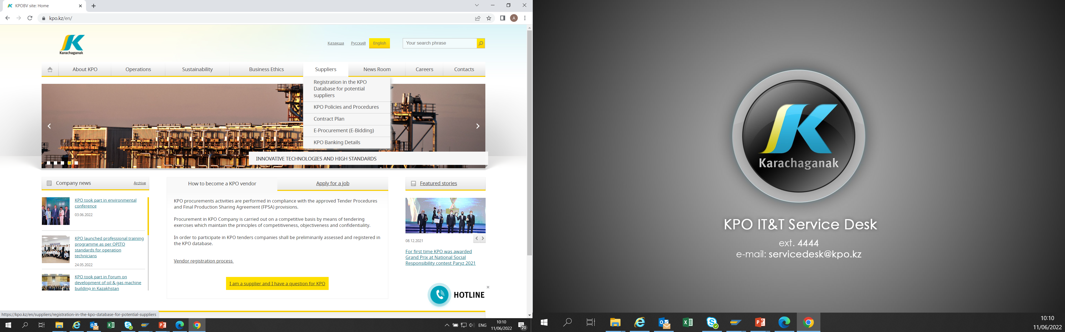
KPO SUPPLIERS DATABASE
18/04/2025 КАРАЧАГАНАК ПЕТРОЛИУМ ОПЕРЕЙТИНГ Б.В.

Slide 17
VENDOR REGISTRATION
All potential suppliers shall be registered in KPO Database
REGISTRATION PROCESS
REGISTRATION
Provision of information on:
Technical Competency
Work Experience in the declared categories of goods and / or works and / or services
Personnel Availability
Financial Turnover
etc.
ETHICAL DUE DILIGENCE
Define an Ethical Due Diligence level in accordance with KPO Legal requirements:
Compliance with Kazakhstan and Foreign legislation
Compliance with Company internal regulations
Submission of potential suppliers shareholder lists
Vendor registration in KPO Vendor Database does not guarantee the participation in a tender or contract award, but suggests that a registered company may be considered as a market research participant for provision of goods, works and services for further pre-qualification process or tender as the need arises.
18/04/2025 КАРАЧАГАНАК ПЕТРОЛИУМ ОПЕРЕЙТИНГ Б.В.

Slide 18
VENDOR REGISTRATION
To register in KPO Vendor Database, potential supplies shall:
  Download a questionnaire on KPO website – https://kpo.kz/ru/postavshchikam/registracija-v-baze-dannykh-postavshchikov-kpo
  Fill in the questionnaire for the preliminary vendor assessment and indicate activity codes
  Attach copies of required documents
  Submit the completed pack of documents for vendor assessment and registration by e-mail at MIVQ@kpo.kz
  Contact phone: +7 (711336) ext. 4943, 4946, 2192
  KPO encourages Suppliers to update registration data on an ongoing basis, related to:
    Work Experience in the declared categories of goods, works, services
    Certification, accreditation
    Reorganization
    Contact persons
18/04/2025 КАРАЧАГАНАК ПЕТРОЛИУМ ОПЕРЕЙТИНГ Б.В.

Slide 19
MARKET RESEARCH
Purpose
  Define potential suppliers of goods, works, services who can perform as per KPO requirements
  Ensure free competition for KPO tenders
PROCESS
Demand determination and vendor searching
Issue of Invitation Letter for Expression of Interest
Market Intelligence Report
Approved
Tender List
Approvals
18/04/2025 КАРАЧАГАНАК ПЕТРОЛИУМ ОПЕРЕЙТИНГ Б.В.

Slide 20
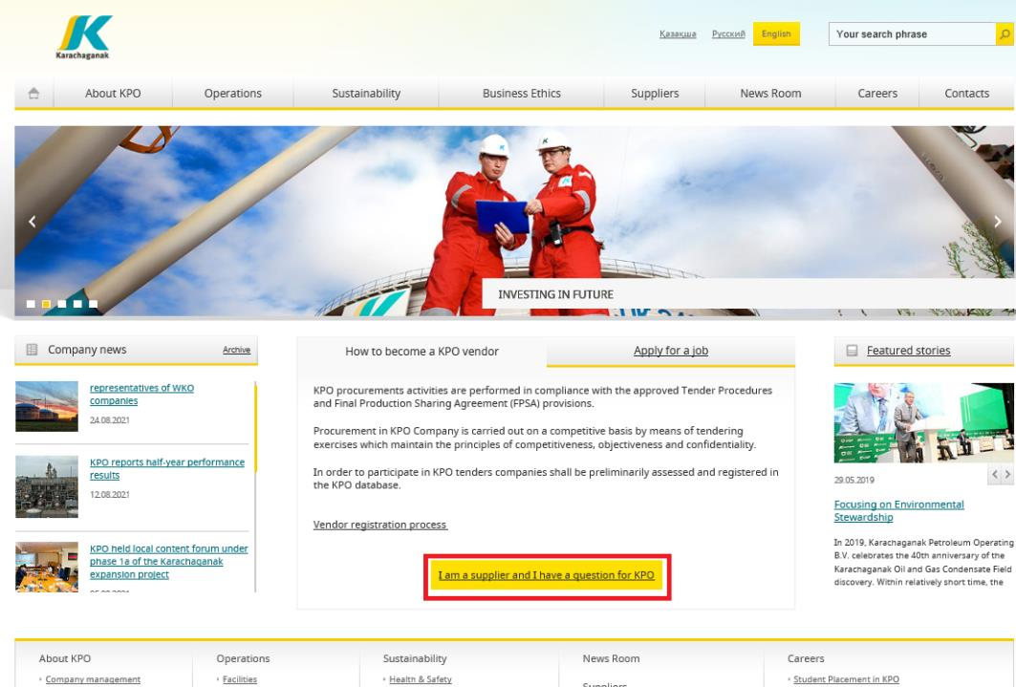
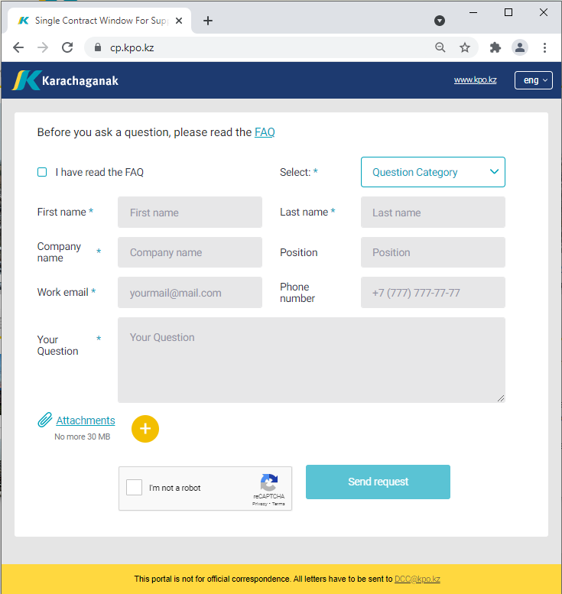
‘’SINGLE WINDOW’’ SYSTEM
18/04/2025 КАРАЧАГАНАК ПЕТРОЛИУМ ОПЕРЕЙТИНГ Б.В.

Slide 21
Asset Zhakupov
Contracts and Procurement
Expert
Procurement Process
21

Slide 22
PROCUREMENT PROCESS
KPO shall perform the procurement activities in accordance with:
  the Final Production Sharing Agreement (confidential and intended only for the use of KPO, its Shareholders and the Republic) and the Joint Operating Committee’s Tender Procedures (JOC)
  current legislation
  approved budget and work program
PROCESS
MARKET RESEARCH / PREQUALIFICATION
INVITATION
TO TENDER
TENDERING PERIOD
TENDER DUE DATE
EVALUATION OF TENDERS
CONTRACT AWARD
CONTRACT
SIGNING
CONTRACT
PERFORMANCE
18/04/2025 КАРАЧАГАНАК ПЕТРОЛИУМ ОПЕРЕЙТИНГ Б.В.

Slide 23




MAXIMUM ATTENTION SHALL BE PAID TO
TENDER PACKAGES SUBMISSION REQUIREMENTS
TENDER PACKAGES SUBMISSION REQUIREMENTS THROUGH E-BIDDING SYSTEM
(Link to the instructions)
INSTRUCTIONS
TO TENDERERS
TENDER DUE DATE / TIME
18/04/2025 КАРАЧАГАНАК ПЕТРОЛИУМ ОПЕРЕЙТИНГ Б.В.

Slide 24
TENDER DOCUMENTATION CONTENTS
Cover letter
Forms, that shall be mandatorily signed, stamped and provided within timeframe specified:
Tender Acknowledgement and Confidentiality Agreement
Form of Tender
Certificate of Corporate Ownership and Declaration of Compliance
A package of documents related directly to the tender subject itself
Instructions to Tenderers
Form of Contract includes:
Form of Agreement
Schedule A – General Terms and Conditions
Schedule B – Scope of Goods/Services to be Supplied and Specifications
Schedule C – Compensation and Payment
Schedule D – Health, Safety and Environment (HSE) requirements
Schedule E – Special Conditions
Schedule F – Statement of Local Content
Schedule H – Industrial Relations
Questionnaire for Tender Participants
List of goods and technical delivery conditions (if applicable)
Instructions for preparing a tender proposal:
Instructions to Tender Participants
Bid marking template
18/04/2025 КАРАЧАГАНАК ПЕТРОЛИУМ ОПЕРЕЙТИНГ Б.В.

Slide 25
KPO General HSE requirements

Slide 26

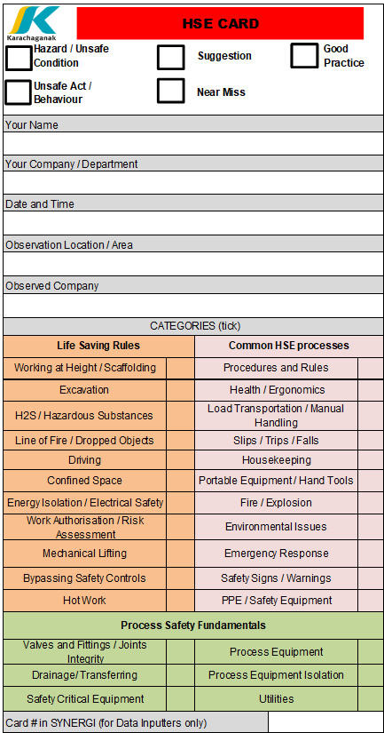


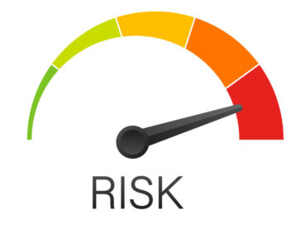
KPO GENERAL HSE REQUIREMENTS
2 EXECUTION OF THE CONTRACT
Leadership and Commitment
HSE policy
Planning
  HSE Legislation
  Risk Management
Support
  HSE Personnel
  HSE Competence Requirements
  HSE Training and
  Induction
  HSE Communications
  HSE Meetings
  HSE Procedures
1 GENERAL PROVISIONS
Scope
Contractor HSE Plan
Compliance
1
2
Implementation
  Equipment Maintenance and Inspection
  Occupational Health and Hygiene
  Environment
  Road Transport Safety
  PPE Requirements
  Emergency Response Interaction
  Subcontractor management
Control and Monitoring
  HSE Observations and Reporting
  Incident Investigation
  HSE Audits and Inspections
  Safety Reporting
  Environmental Reporting
3
3 MINIMUM LIST OF HSE PROCEDURES FOR COMPLIANCE BY CONTRACTOR
18/04/2025 КАРАЧАГАНАК ПЕТРОЛИУМ ОПЕРЕЙТИНГ Б.В.

Slide 27
Local Content
Mechanisms
27

Slide 28








SUPPORTING MECHANISMS FOR LOCAL COMPANIES
TRIAL ORDER
EARLY TENDER
KAZAKH TENDER
Tenders for testing a trial batch of GOODs from Kazakhstani suppliers
Contract is concluded for the supply of GOODS with a suspensive condition or with a long-term delivery schedule
Tenders exclusively among Kazakhstani Suppliers. The goal is to award contracts to Kazakhstani suppliers of GWS
CONTRACT IN EXCHANGE FOR INVESTMENTS (UNDER REVISION)
  A contract in exchange for investment is a long-term contract concluded on a Single source basis, under which the supplier undertakes to produce goods of local origin that are the subject of a procurement contract in the territory of the Republic of Kazakhstan
18/04/2025 КАРАЧАГАНАК ПЕТРОЛИУМ ОПЕРЕЙТИНГ Б.В.

Slide 29
Thank you!
29

