Slide 1
KPO TECHNICAL WEBINAR ON LINEPIPES&PIPING AND INSULATION MATERIALS
WITH THE PARTICIPATION OF THE IMB CENTER
KARACHAGANAK PETROLEUM OPERATING B.V

Slide 2
DISCLAIMER
The information contained in these slides is made available for consideration. It represents KPO's preliminary description of the KPO demands as presently envisaged, but KPO reserves the right to change this information in the course of planning and implementing the projects, and KPO cannot be held responsible for any loss, damage or expense arising from reliance on this information. The information will not form part of any agreement between KPO and business partners participating in the workshop.
Today's engagement is one of many steps which KPO and its stakeholders are taking to develop local content.

Slide 3
LINE PIPE / Piping – AGENDA
A: Piping
Overview
Piping Materials & Testing Req.
Specification overview
Piping Frequently Used and Forecast
B: Line Pipe
Overview
Type of Line Pipe
Line Pipe Specification
Line Pipe Datasheet
C: Line Pipe External Coating
Overview
Type of Line Pipe Coating
Coating specification requirements

Slide 4
Project Execution Directorate
Engineering and Technical Authority Department

Slide 5
Overview
Technical Workshop on Piping / Pipelines and Insulation materials world class expertise – world class asset
Section A
Piping
1

Slide 6
Piping Overview
Objective:
The goal of this presentation is to provide a clear understanding of the piping materials used in KPO for both sour and non-sour services, and how they comply with ASME standards. We will explore historical development, material requirements, restrictions, and international specifications.
Importance:
KPO operates in a demanding environment where piping systems are subjected to extreme conditions. Compliance with ASME standards is necessary to ensure safety, integrity, and longevity of piping systems.

Slide 7
Piping Materials & Testing Req.
Technical Workshop on Piping / Pipelines and Insulation materials world class expertise – world class asset
Section A
Piping
2

Slide 8
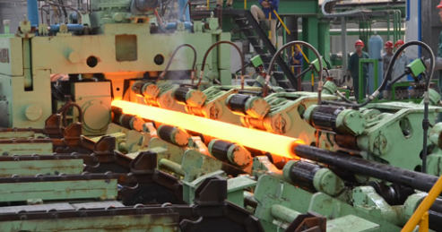
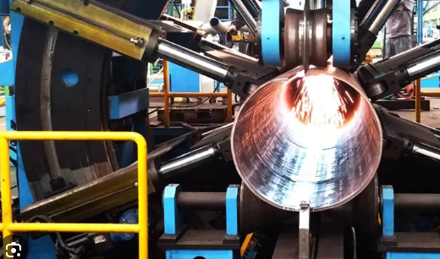
Piping Material and Testing requirement
Sour Service Materials:
For sour service, we use materials that comply with NACE MR0175/ISO 15156 standards to prevent sulphide stress cracking.
Common materials include high-performance alloys (e.g., Inconel 625 / 825) and carbon steels with controlled hardness (e.g. A333 gr.6)
Material Selection Factors:
Corrosion resistance, temperature, and pressure ratings.
Resistance to sulphide stress cracking (SSC) in sour service.
Construction type:
Seamless Pipe (SMLS):
  Manufactured without a seam or a weld, produced by extruding a solid steel billet through a piercing rod to create a hollow tube.
Electric Fusion Welded Pipe (EFW):
  Produced by rolling plate and then joining the edges by electric fusion welding. Includes subcategories such as Double Submerged Arc Welded (DSAW) and High-Frequency Welded (HFW).
Electric Resistance Welded Pipe (ERW):
  Manufactured by rolling a metal plate or strip and welding the seam with electric resistance heating. ERW pipes are commonly used in lower-pressure systems.

Slide 9
Piping Material and Testing requirement
Material | Code Reference | Test Required (By Manufacturer) | Remarks (Service/MAWP)
Low-Temperature Carbon Steel (A333 Gr. 6) | ASME B31.3, ASME B16.5, NACE MR0175 | Tensile Test, Charpy Impact Test (-45°C), Hardness Test (By Manufacturer) | Sour and non-sour service, suitable for low-temperature applications (down to -45°C). MAWP typically up to 1440 psi.
Carbon Steel (A671 CC 60) | ASME B31.3, ASME B16.5, NACE MR0175 | Ultrasonic Test, Tensile Test, Charpy Impact Test (-45°C) (By Manufacturer) | Sour and non-sour service, primarily for welded pressure piping. MAWP varies with wall thickness, typically up to 1500 psi.
Stainless Steel 304/304L (A312/A358 TP304/304L) | ASME B31.3, ASME B16.5, NACE MR0175 | PMI, Intergranular Corrosion Test, Tensile Test (By Manufacturer) | Non-sour service, good general corrosion resistance. MAWP typically up to 1000 psi, depending on schedule and size.
Stainless Steel 316/316L (A312/A358 TP316/316L) | ASME B31.3, ASME B16.5, NACE MR0175 | PMI, Intergranular Corrosion Test, Tensile Test (By Manufacturer) | Sour and non-sour service, excellent resistance to chloride and acidic environments. MAWP up to 1000 psi for general use.
Inconel 625 (B444) | ASME B31.3, NACE MR0175 | Tensile Test, Corrosion Resistance Test (By Manufacturer) | Sour service, high resistance to H2S, chloride stress, and pitting corrosion. MAWP can exceed 5000 psi in critical services.
Incoloy 825 (B423) | ASME B31.3, NACE MR0175 | Corrosion Resistance Test, Tensile Test (By Manufacturer) | Sour service, highly resistant to sulfuric and phosphoric acids. MAWP typically up to 4000 psi in high-pressure systems.
Alloy 20 (B729-N08020) | ASME B31.3, NACE MR0175 | Intergranular Corrosion Test, Tensile Test (By Manufacturer) | Sour and non-sour service, excellent resistance to sulfuric acid corrosion. MAWP up to 2000 psi depending on size and thickness.
Titanium Gr. 2 (B337) | ASME B31.3, NACE MR0175 | Tensile Test, Corrosion Resistance Test (By Manufacturer) | Sour service, extreme corrosion resistance in oxidizing environments. MAWP typically up to 1500 psi.
ASTM A182/A336 F22 Modified | ASME B31.3 chapter IX, NACE MR0175 KPO-80-PIP-SPC-00004-E *Custom Made for KPO | KPO-80-PIP-SPC-00004-E | Material it is designed for high pressure, 605 bar, sour service with ambient temperature as low as -45°C

Slide 10
Specification Overview
Technical Workshop on Piping / Pipelines and Insulation materials world class expertise – world class asset
Section A
Piping
3

Slide 11
Company specification to comply
Size and Schedule:
  Piping size is governed by nominal pipe size (NPS), which refers to the outside diameter, while the schedule indicates wall thickness.
  Common pipe sizes range from NPS ½” to NPS 48”, with schedules ranging from 10 to XXS.
  Custom schedule for specific project for Sour Service: Higher schedules (thicker walls) are used to withstand the more aggressive environment, especially in higher pressure ratings.
Temperature and Pressure Limits:
  ASME codes specify temperature and pressure limits for materials. For example, carbon steel can be used at temperatures up to 427°C (800°F) for non-sour service but has limitations in sour environments.
  Flange Ratings (ASME B16.5): Define pressure-temperature limits for different materials and flange types.
S/N | Document Number | Title | Rev.
1 | KPO-00-PIP-SPC-00005-ER | Technical Supply Requirements Pipe, Fittings and Flanges | C8
2 | KPO-00-PIP-SPC-00008-E | Specification for Piping, Forgings, Castings and Plate for Sour Service | C5
3 | KPO-80-PIP-SPC-00004-E | Company Specification. High Pressure Piping Materials Specification for 2 1/4 Cr-1 Mo. (F22 M) | A4
4 | KPO-00-ENG-SPC-00017-ER | Positive Materials Identification | A3
5 | KPO-00-PIP-SPC-00022-E | Colour Coding for Piping Components | A1

Slide 12
Project Execution Directorate
Engineering and Technical Authority Department

Slide 13
Overview
Technical Workshop on Insulation materials and Pipelines world class expertise – world class asset
LINEPIPE
Part 2
1

Slide 14
Overview
KPO specifications are significantly more complex than standard industry requirements, primarily due to the.
challenging fluid conditions (high H2S content) and extreme temperatures encountered
Historical Development: Over the past 20 years, KPO b.v. has developed Line Pipe specifications and datasheets tailored to our projects. The Line Pipe specification is based on international standard API 5L PSL2 + specific requirements for line pipe in high H2S service.
Diverse Reequipments: Our specifications is vary in requirements and level of details, reflecting the complexity of our operations.
Material Restrictions: Seamless line pipe is used mainly because of fluid compatibility issues. This will be detailed in the following slides.
Compliance: It is imperative that all technical and material details on the datasheets are followed in accordance with the associated specifications

Slide 15
LinePipe Key Features
Technical Workshop on Insulation materials and Pipelines world class expertise – world class asset
Linepipe
2

Slide 16
LinePipe Key Features - General
KPO b.v. mainly utilize various sizes of X60 seamless Linepipe for Gathering and Gas Re-injection systems (KPO-00-PLS-SPC-00003).
In addition to linepipe, the pipeline design requires hot induction bends along the pipeline route.
Hot induction bends is fabricating from linepipe with thicker wall thickness (mother pipe) (KPO-00-PLS-SPC-00007)
The minimum mother pipe wall thickness after bending shall be not less than the minimum wall thickness of the run pipe.
Service Condition: Designed for high pressure and sour service (350 barg, 475 barg 605 barg)
Material Requirements: Linepipe & Induction bends properties shall meet the requirements of NACE MR0175/ISO 15156
Manufacturing Compliance: Linepipe & Induction bends shall be manufactured in accordance with the relevant COMPANY Specification and Data Sheet.
Approved Mills: KPO-approved mills for line pipe materials are Tenaris, KSP Steel (only 10”, 23.8mm WT), PM Piping. Any other mills must undergo the Company qualification approval process as per KPO specifications.
The specification General requirements:
API 5L X60Q SMLS – Quenched and tempered (seamless)
Chemical composition: as per API 5L Annex H (amended by Company specification requirements)
Line pipe shall meet: API 5L PSL2 requirements (Sour Service)
Impact test: MDMT minus 45 degC
Hardness test: as per Company specification requirements

Slide 17
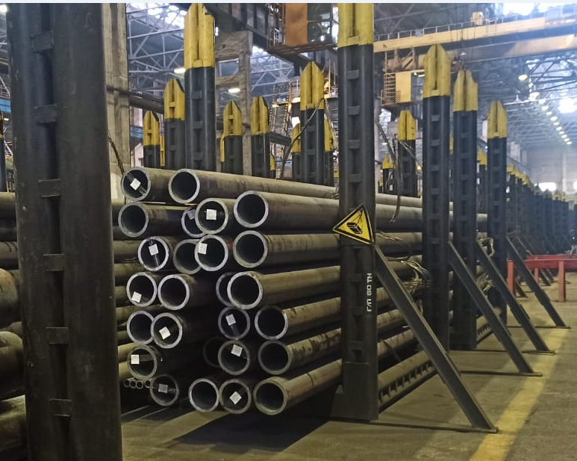
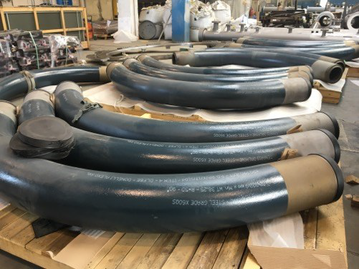
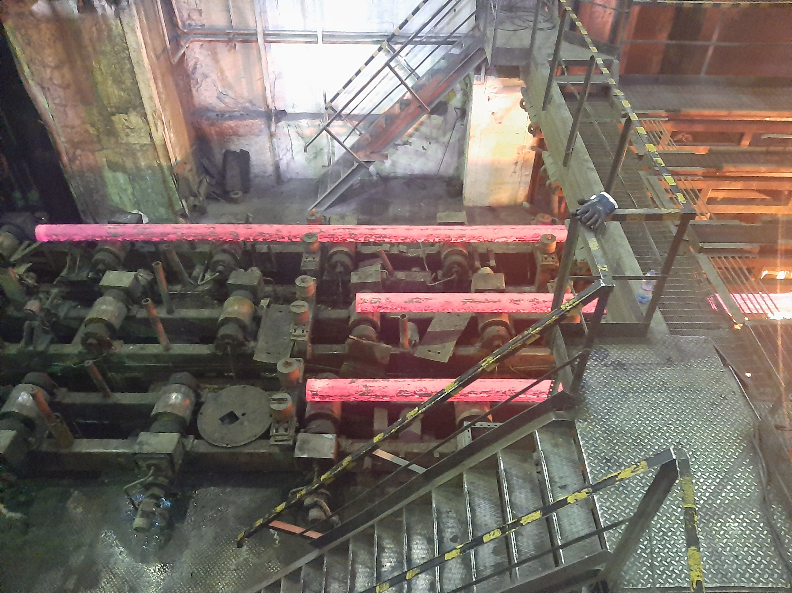
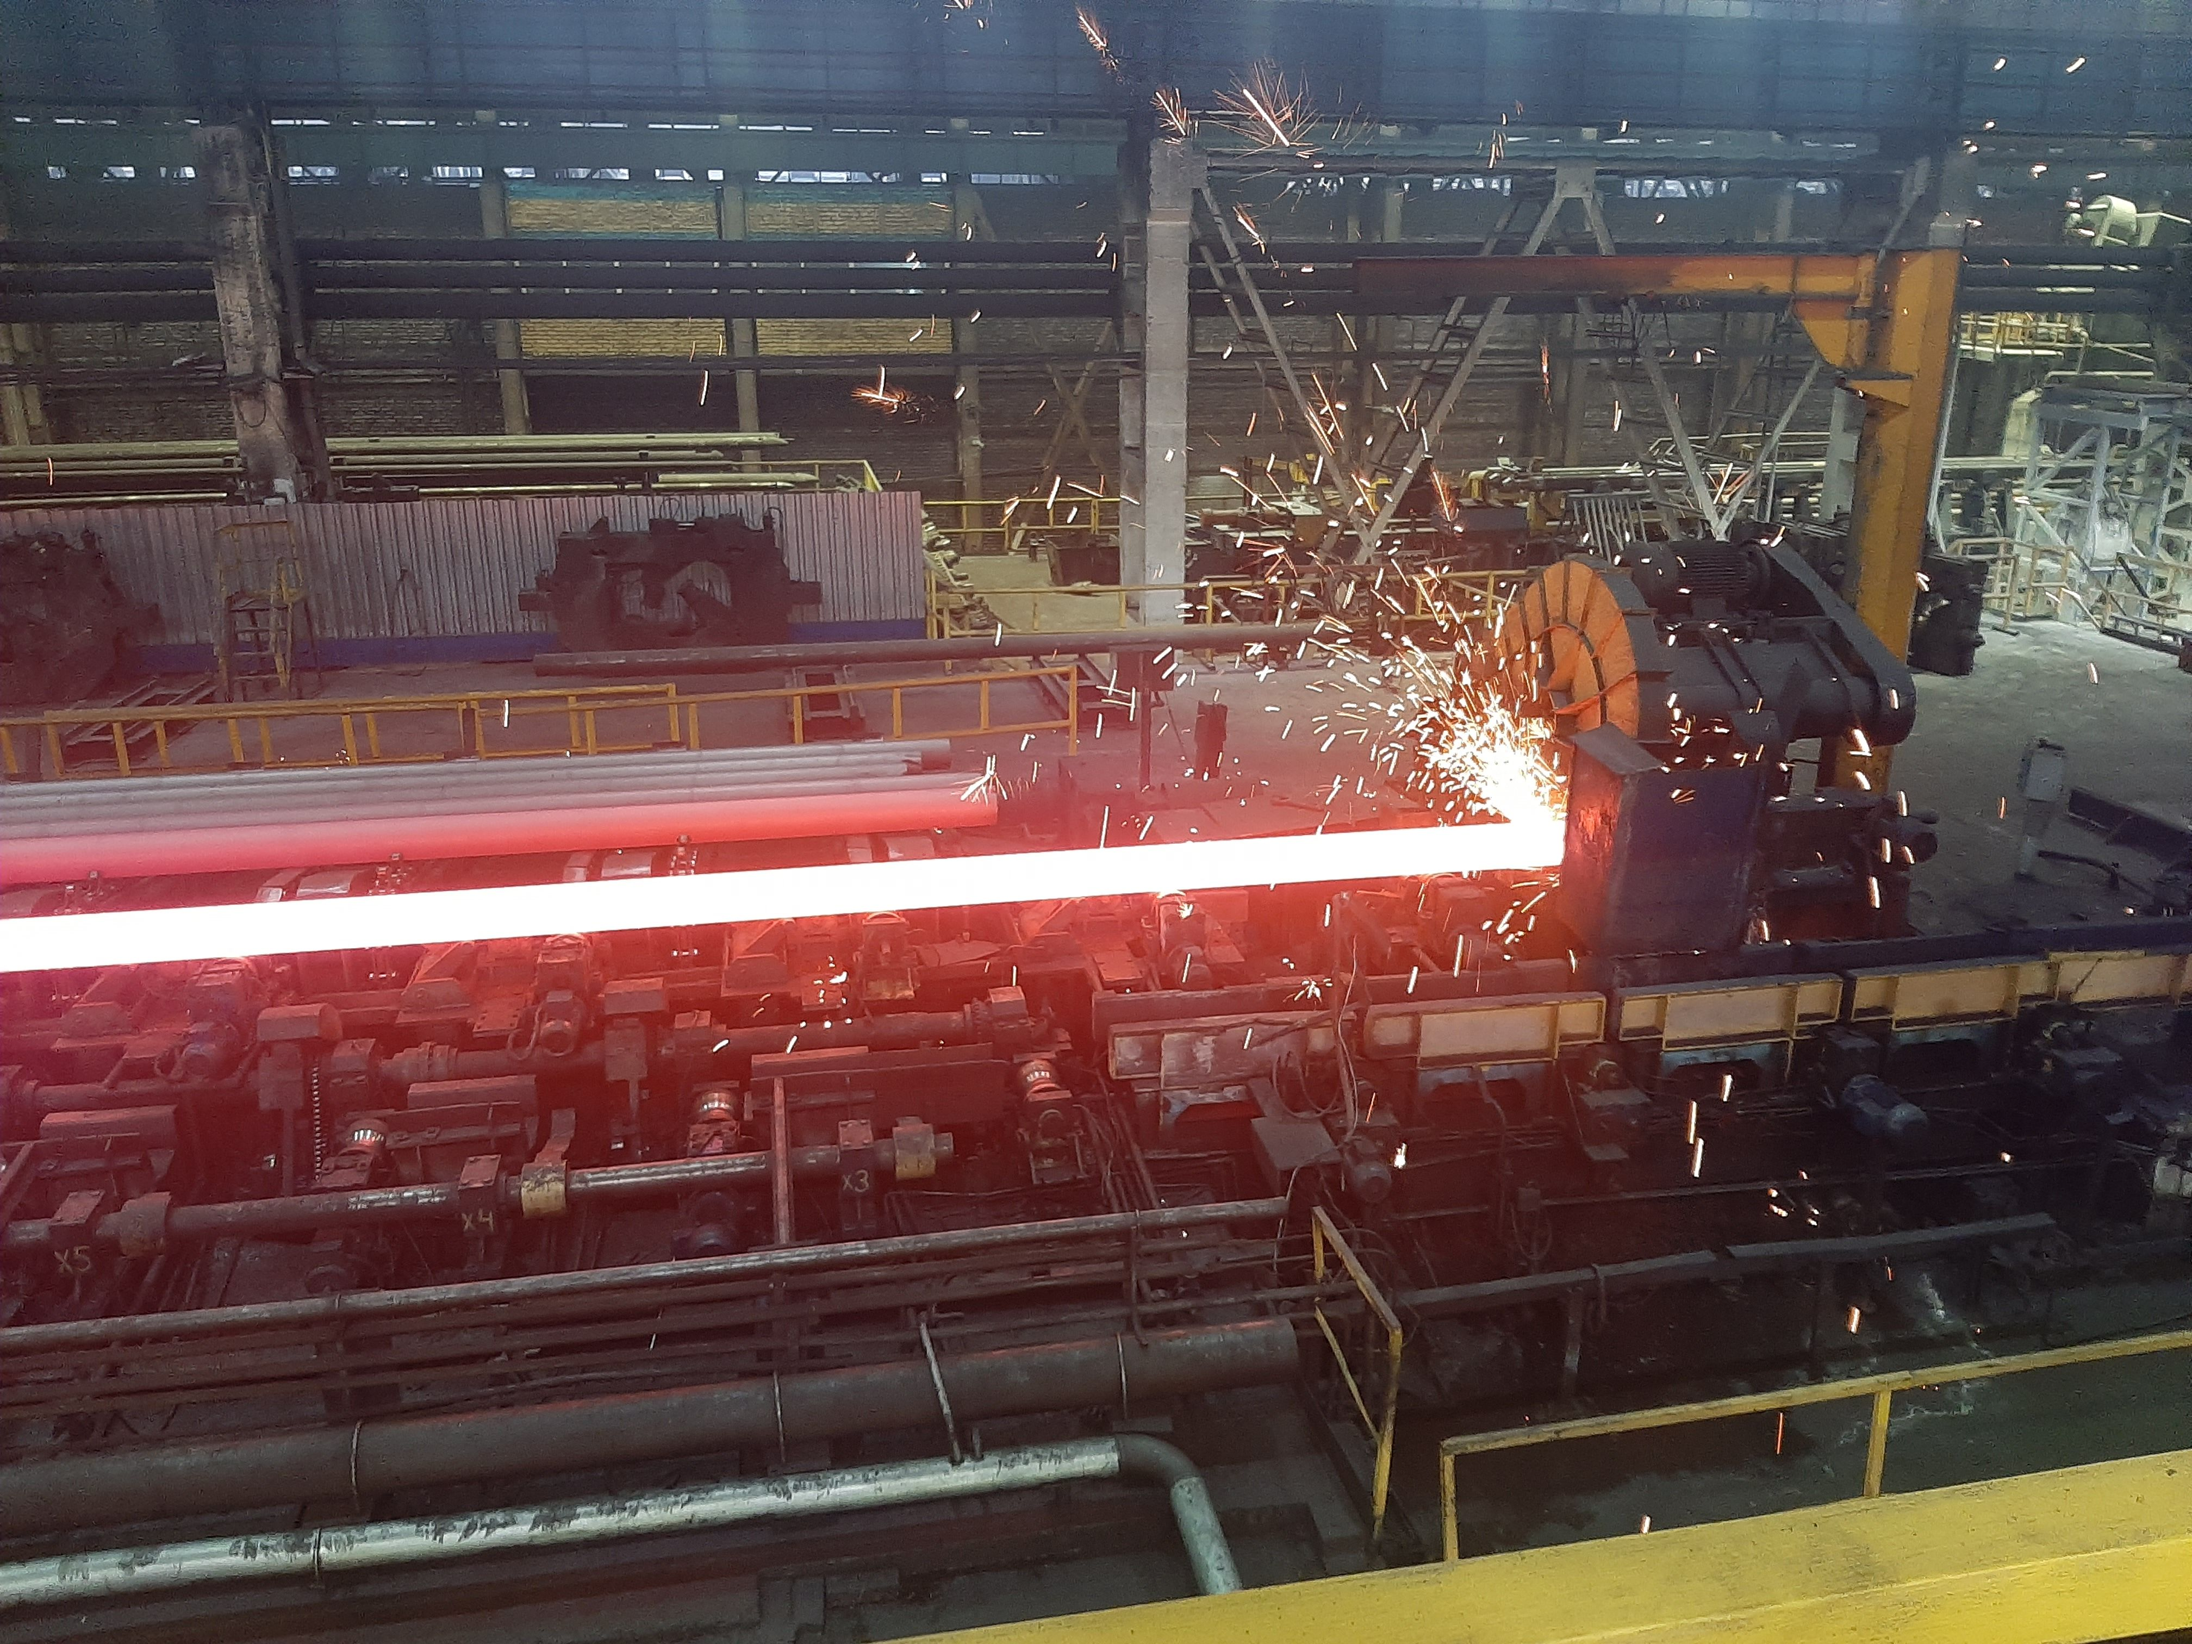
LinePipe Key Features - General
X60 Linepipe size which mainly used for the Projects:
Linepipe Size, inch | Wall thickness, mm
6 | 15.8 / 18.3
8 | 25.4 / 29 / 31.8 / 35.4
10 | 23.8 / 28.6
12 | 35 / 42.5
14 | 11.1 / 14.3
16 | 31.5 / 36.53
20”,24”

Slide 18
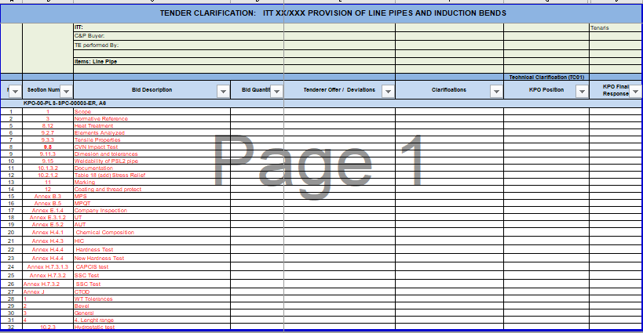
LinePipe Key Features – Documents TBE
Typical document requirement during the bid phase exchange between PED Eng. department and C&P department.
Required information from Company Specification
Column reserve to tenderers for confirm/deviate
Column reserve to Company for accept or reject the clarification by tenderers

Slide 19
Specification Overview
Technical Workshop on Insulation materials and Pipelines world class expertise – world class asset
LINEPIPE COATING
3

Slide 20
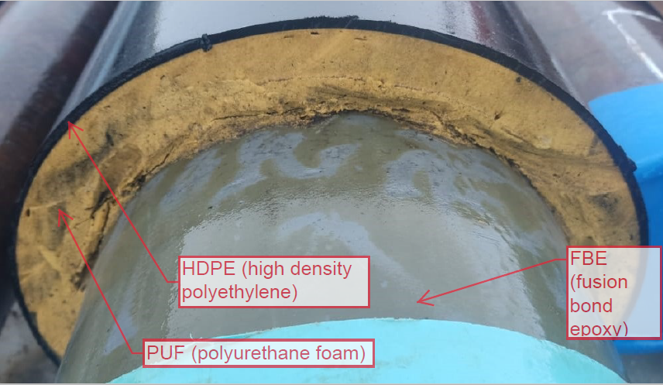
LinePipe Coating Key Features - General
One of the main threats to pipelines is corrosion caused by water, chemicals, and soil conditions. Coating provide a barrier to prevent this. KPO pipelines requires specific type of coating as such as: Thermally insulation, Dual Fusion Epoxy coating.
Dual FBE Coating Requirements (ISO 21809-2) and COMPANY specification requirements (KPO-00-PLS-SPC-00019-ER):
Coating thickness: 1st layer minimum 450 µm; 2nd layer maximum 860 µm
Temperature rating: -40°C / +110 °C
Thermally Insulation Coating Requirements (ISO 21809-2 , KPO-00-PLS-SPC-00018-ER):
FBE Coating thickness: minimum 450 µm;
Temperature rating: -40°C / +110 °C
PUF: Density ≥150 kg/m3 / ≥60kg/m3
Max operating temperature: 110°C
HDPE: Thickness 4-5mm; density ≥940kg/m3
Note: More detailed requirements specified in Company specification
Pre-qualification tests for FBE coating application is one of the main requirements of the COMPANY Specification.

Slide 21
Specification Overview - Core Technical Specifications
All material shall be supplied in full compliance with the LinePipe, Induction Bends and Coating Specifications and Data Sheets, reference in RFQ or PR line item, as well as the following KPO documentation :
S/N | Document Number | Title | Rev.
1 | KPO-00-PLS-SPC-00003-E | Specification for API5L Seamless Linepipe for Sour Service | A7
2 | KPO-00-PLS-SPC-00007-ER | Specification For Pipeline Induction Bends. | A1
3 | KPO-00-PLS-SPC-00018-ER | Specification for Pipeline Coating and Thermal Insulation | A5
4 | KPO-00-PLS-SPC-00019-ER | Specification for Fusion Bonded Epoxy Coating | A3
5 | KPO-10-PLS-DTS-00001-ER | Gathering System – Linepipe. Line Pipe Data Sheet | A7
6 | KPO-10-PLS-DTS-00003-ER | Induction Bend Data Sheet for Gathering Lines | C8
7 | KPO-8B-PLS-DTS-00003-ER | Sour gas Re-Injection – Linepipes. Data Sheet | A7
8 | KPO-8B-PLS-DTS-00005-ER | Induction Bend Data Sheet for Sour Gas Re-injection System | A1
9 | KPO-00-QAC-SPC-00001-E | Supplier Welding Procedure Approval & Welding Quality Reequipments. | A4
10 | KPO-AL-LGT-SPC-00001-E | I_01_Packing and Shipping Instructions | A8
11 | KPO-AL-LGT-SPC-00002-E | I_02_Import Instructions | A7

Slide 22
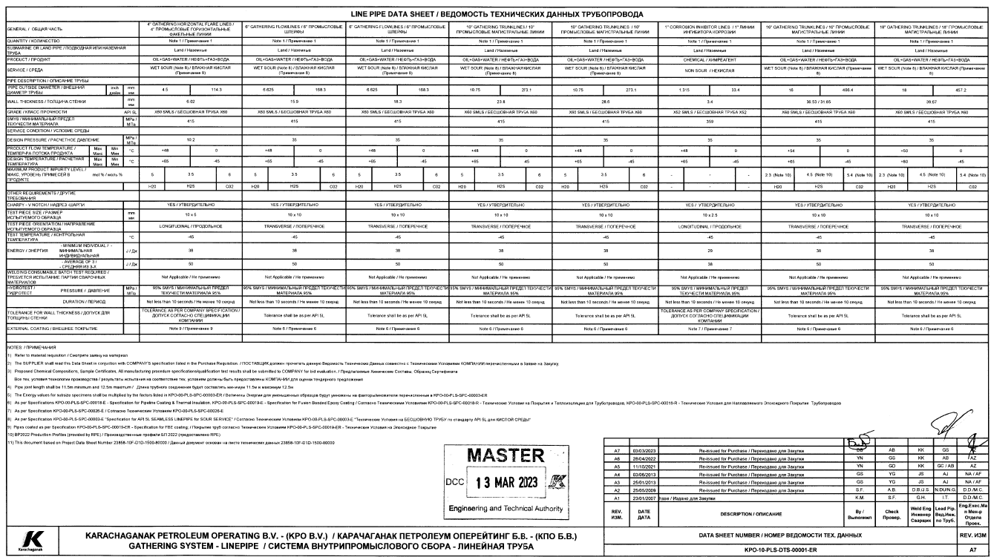
Specifications & Data sheet
Data sheets includes ( Example attached)
Size, WT, Grade of Linepipe
Service Condition
Design Parameters
Hydrotest Pressure
Coating requirements
Standards & Certifications compliance
23/09/2024 KARACHAGANAK PETROLEUM OPERATING B.V

Slide 23
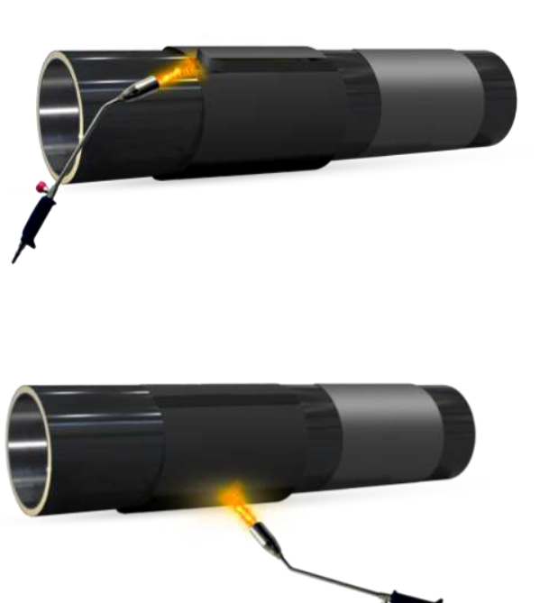
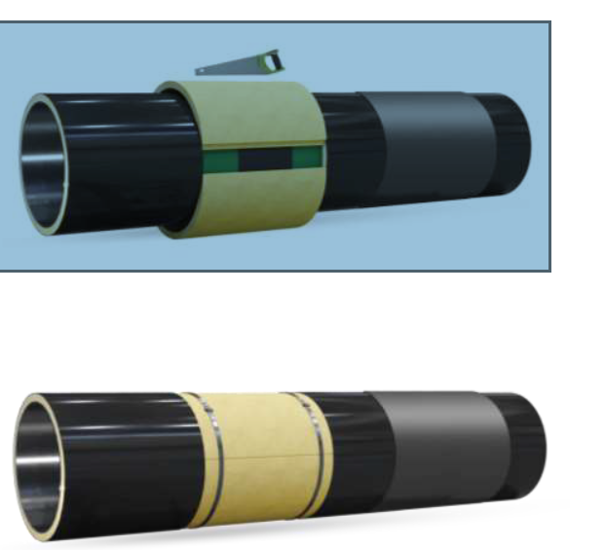
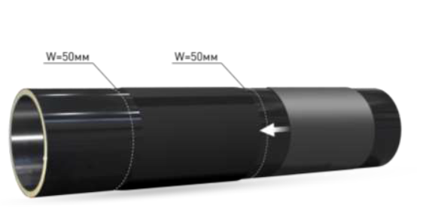
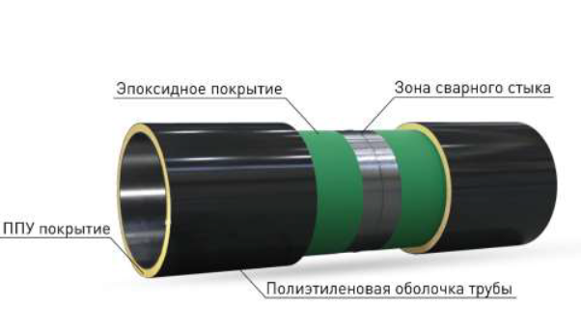
Field Joint Reparation Kit
In pipeline system, filed joint represent the areas where individual pipeline sections are welded together.
These area if joints is bare and requires restoring the protective coating which is Field Joint reparation Kits (FJRK).
The Field Joint Reparation Kits required for Thermally Insulated and FBE coated pipelines.
FJRK for Thermally Insulated pipelines and FBE coated pipelines shall be according to COMPANY specification requirements (KPO-00-PLS-SPC-00027-ER)
A Pre-Production Trial / Pre-Production Test (PPT) shall be performed at the actual site of production field joint coating using the personnel mobilised for production FJC application in order to take into account the environmental and other site specific effects on the coating application.
Manufactures: KPO mainly uses Canusa or TIAL products.

Slide 24
Operations Field department

Slide 25
Insulation materials overview
Insulation materials
3

Slide 26
General Information
KPO is currently using a range of insulation materials, used in various facilities, units and pipelines of the company.
The materials are critical for the process and are aimed to reduce losses of heat in pipelines and equipment, what is extremely important for maintaining the product temperature and preventing hydrocarbons crystallisation, which, in its turn, helps to improve energy efficiency of the systems.
Proper selection of insulation materials contributes to reducing energy costs as additional heating or cooling requirement is reduced. Use of insulation materials ensure safety of personnel, reducing risks of burns from hot surfaces and providing required protection when working with toxic or flammable substances.
All insulating materials must comply with established quality and safety standards and both to local and international norms, provided to ensure their reliability and efficiency.
We have developed required technical specifications for insulation materials, which we are ready to present to you for review and making decisions.
The details will be provided on the next slides.

Slide 27
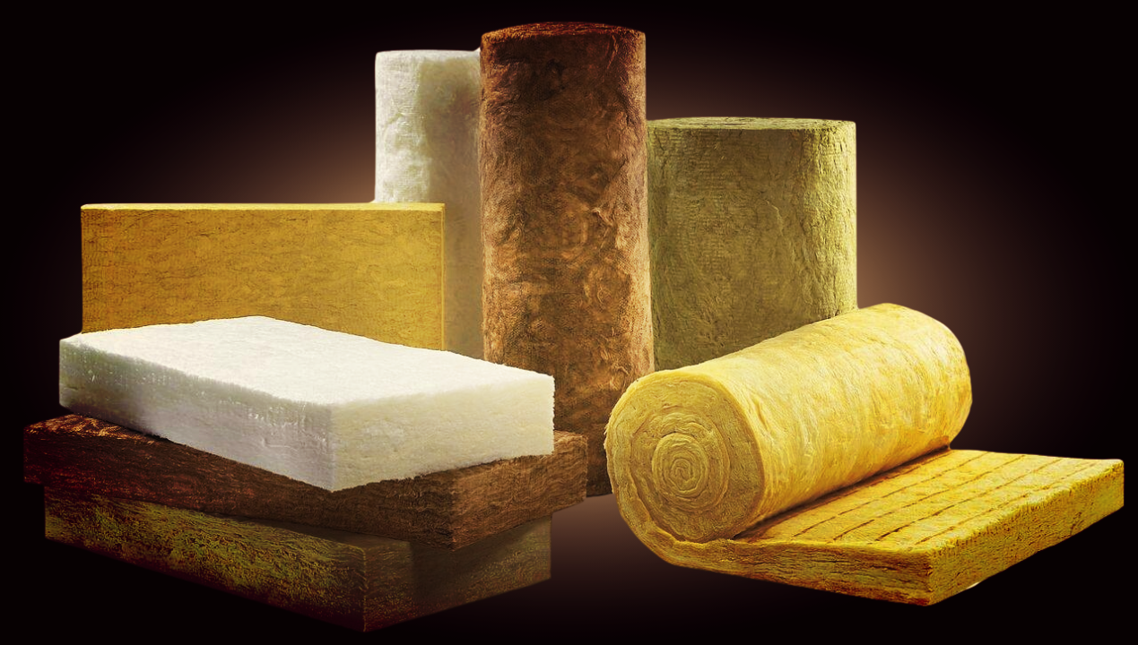
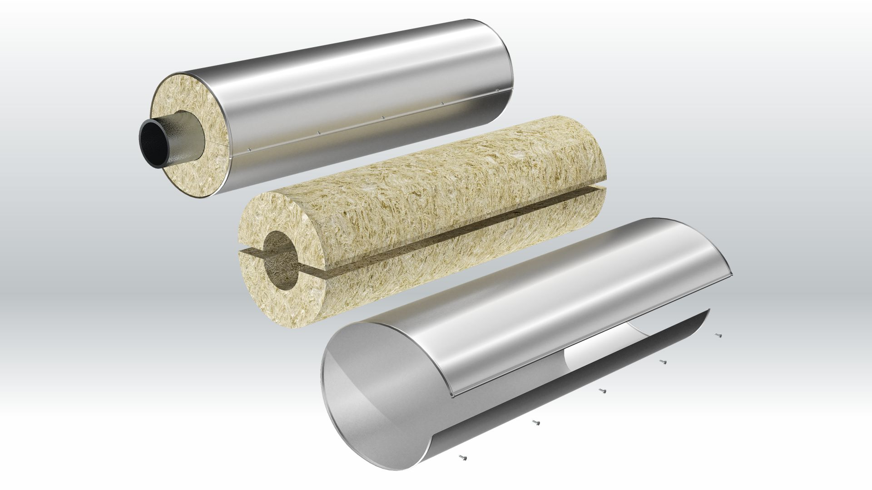
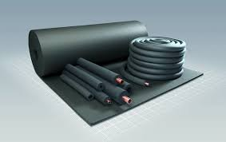
Basic specifications of insulation materials –
General information
To cover KPO needs, various insulation material types such as mineral wool in rolls and mats, aluminium insulation, foam rubber insulation are used.
Use of these insulation materials in the oil and gas industry increases process safety and efficiency and minimises the environmental impact.

Slide 28
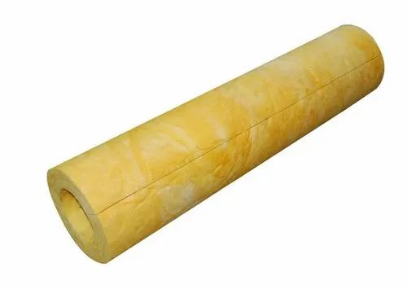
Technical characteristics: Mineral wool cylinder
A mineral wool cylinder is a non-flammable heat insulation cylinder of non-organic insulation nature, made of rock melt, sedimentary rocks, volcanic scoria, smelter slug, industrial silicate wastes. Mineral wool used for manufacturing of the cylinders is produced in accordance with GOST and TSs of manufacturing plants. Mineral wool cylinders are used to provide heat insulation of the pipelines with the outer diameter from 18 mm to 1420 mm with the transported media temperature range from -1800⁰C to +7000⁰C. Mineral wool cylinders are used for heating insulation of gas and oil pipelines.
Technical specifications
Density of layer | 100 kg/м3
Maximum operating temperature: t⁰C | up to +600⁰C
Internal diameter: | 18 mm
Wall thickness: | 50 mm
Length: | 1-1.2 m.
The material complies with the procedure: | KPO-00-PIP-SPC-00020-E

Slide 29
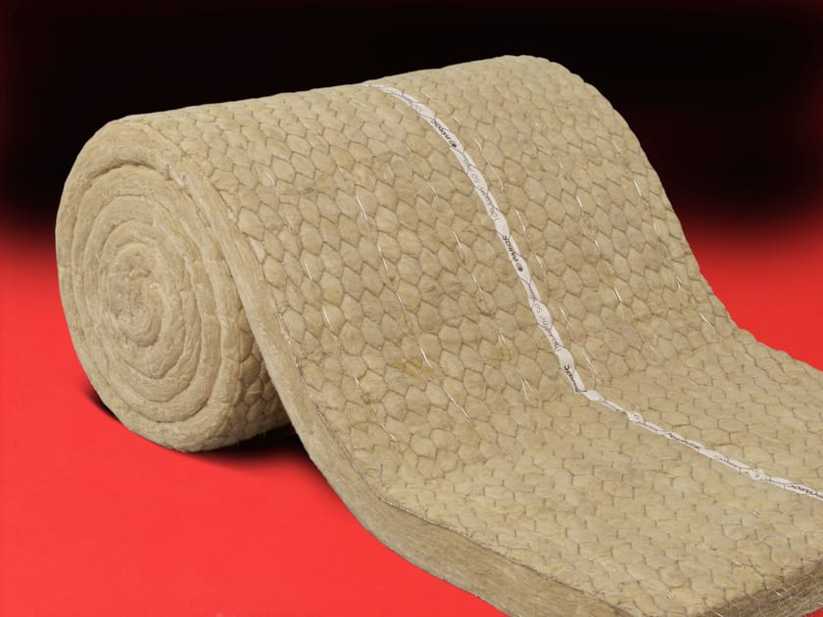
Technical specifications: wire-sewed mineral wool mat
The sewed mat МП-125, made of mineral wood on the basis of the basalt rock, is manufactured according to the GOST 21880-2011 and is used as common technical insulation for equipment and pipelines operated in the temperature range from -170°С to +450°С.
Technical specifications
Density of layer: | 100 kg/м3
Maximum operating temperature: | up to +600⁰C
Dimensions: | 4000 mm x 1000 mm
Thickness of layer: | 50 mm
Length: | 1-1.2 m.
The material complies with the procedure: | KPO-00-PIP-SPC-00020-E
Supplied in: | Rolls

Slide 30
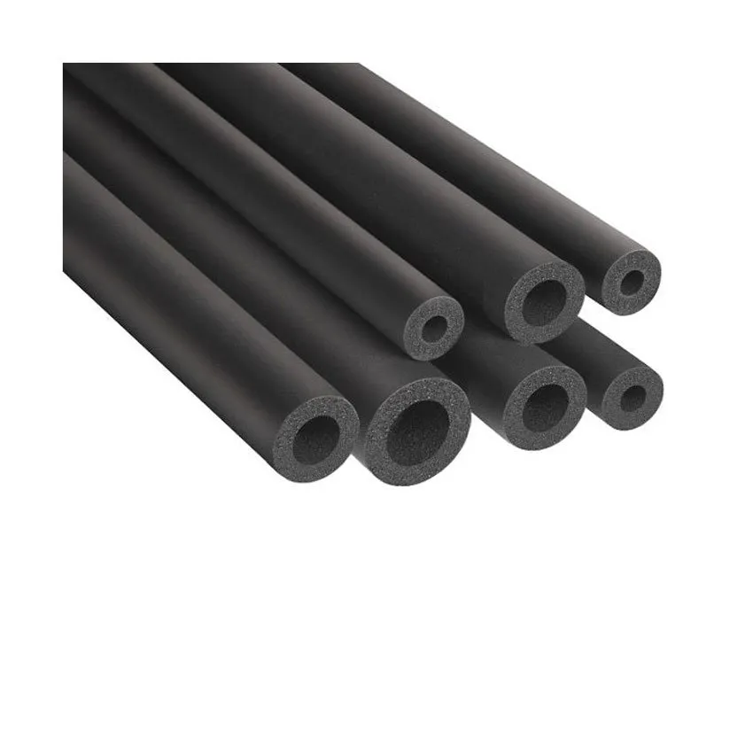
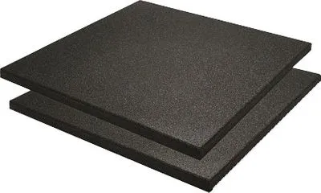
Technical specification: foam rubber heat insulation
Density of foam rubber insulation – 40-80 kg/m3. Presence of open pores not exceeding 10% is allowed. Various types of insulation materials allow operating an item in the temperature range from -200⁰C to +175⁰C; for this, they are used to ensure heating insulation not only for heating, water supply and air conditioning systems, but also for process pipelines. Foam rubber insulation is processable, resistant to chemicals and water, and capable of ensuring up to 70% of energy saving, as well as reliable long-lasting protection of pipelines from condensation.
Technical specifications
Material: | Tube
Maximum operating temperature: | -40⁰С/+125C
Diameter: | 10 mm; 15 mm; 22 mm; 28 mm; 35 mm; 48 mm; 60 mm; 89 mm; 114 mm; 168 mm;
Wall thickness: | 19 mm
Colour: | Black
Supplied in: | Sheets
Maximum operating temperature: | -40⁰С/+125⁰C
Width: | 1 meter
Length: | 6 meters
Sheet thickness | 25 mm
Colour: | Black

Slide 31
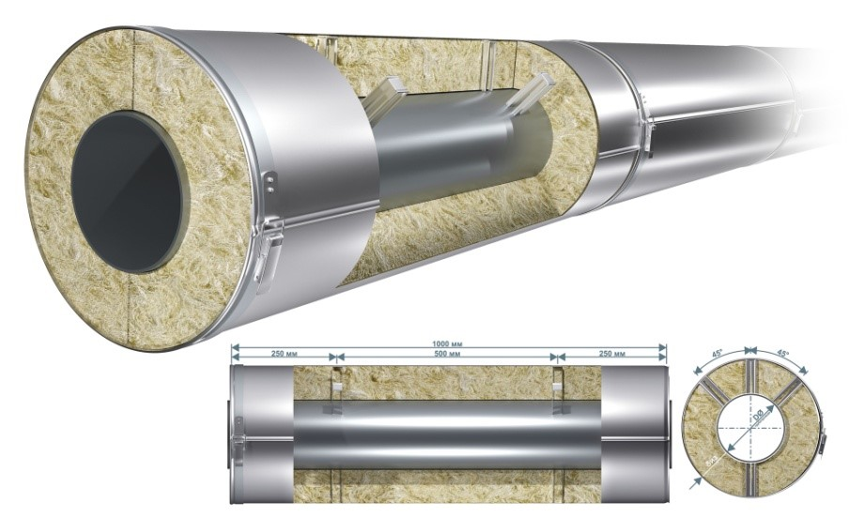
Technical specifications: тaluminium sheet
An aluminium sheet is a low-value and, compared with rolls of steel and other metals and alloys, light-weight material. An aluminium sheet is easy to treat, and ready items are durable, corrosion-resistant, highly strong from mechanical and atmospheric points of view.
An aluminium sheet is necessary for the media, which required corrosion-resistance. Tapes are used to provide insulation of pipeline structures, they ensure waterproofing for water, oil and gas pipeline systems.
Technical specifications
Width | 0.914-1 m
Length | 30 meters
Thickness | 1.2 mm
Moisture barrier, type: | Polysurlyn
Requirements for aluminium: | Alloy 5005 or 3003-H14 or H16 Temper as per ASTM B209, an alternative according to the GOST ВД1 АМ
Barrier requirements:
Thickness: | 76 microns

Slide 32
Requirements to insulation materials
The following certificates must be provided by a manufacturer in the process of the given materials supply:
Certificate of Conformity from the manufacturer (confirming compliance of filters to set standards and specifications);
Certificate of Conformity to Standards (confirming the insulation materials to be manufactured in compliance with international standards as ASTM, BS, EN, ISO, etc.);
Certificate of Origin: confirming the country of origin;
Certificate 3.1 (for metal items): According to the Standard 10204, the Act of Acceptance confirms the goods, supplied to a client, to comply with the requirements set in the purchase order. Relevant testing results (e.g. strength test) shall be enclosed to the document;
The supplied goods comply with the requirement set in the procedure KPO-00-PIP-SPC-00020-E.
Note: Requirements to certificates will be additionally discussed at the stage of concluding a contract between KPO and a potential insulation materials manufacturer.

Slide 33
Overview of IMB Center's activities
KPO TECHNICAL WEBINAR ON Linepipes & piping and
insulation materials

Slide 34














SCOPE OF ACTIVITIES
DATA PROCESSING & CONSOLIDATION
ADVOCACY ISSUES
Major Operators
Consolidation of efforts provision of quantitative and technical data
Government
Facilitation and stimulation
Preferences & subsidies
LOCAL MARKET ANALYSIS & CAPACITY DEVELOPMENT
LOCALIZATION
& TECHNOLOGY TRANSFER
Machine building industry
Capacity development, international standards, Technology transfer

Slide 35
Commodities of interest
In our analyses of demands and identifying localization priorities, we utilize the FPAL coding system
FPAL Commodity Codes
Commodity Group A
Commodity Group B
Commodity Group C
Commodity Group D
1.01
Drilling Equipment
1.09
Electrical Equipment and Materials
1.04
Pumps and Seals
1.02
Material and Product Handling Equipment
1.03
Compressors / Expanders / Blowers and Accessories
1.02
Material and Product Handling Equipment
1.10
Instrumentation / Process Control Equipment / Materials
1.11
Process Filters
1.07
Heat Exchangers / Heat Transfer Equipment
1.05
Drivers and Accessories
2.02
Valves and Accessories
1.12
HVAC
1.16
Firefighting Equipment
2.03
Steel / Metal Materials
2.01
Line pipe
2.07
Chemical / Oils / Paints
2.11
Workshop and Handtools
2.99
Other Products / Equipment and Materials
2.08
Insulation / Refractory Materials
Procurement in above commodity groups accounts for over 75% of all procurement of goods by three Operators **
* According to the statistical data of Situational-analytical center of the Fuel and Energy complex of the Republic of Kazakhstan

Slide 36



















PROGRESS UNDER COMMODITY GROUPS
Commodity Group A
Commodity Group B
Commodity Group C
Commodity Group D
Demands analysis
35,000 items analysed
55,000 items analysed
7,000 items analysed
12,000 items analysed
High demand goods identified
19 types of goods
18 types of goods
27 types of goods
TBC
Market analysis, longlist from available resources
more than 90
manufacturers identified
more than 100
manufacturers identified
more than 80
manufacturers identified
TBC
Site surveys, manufacturers who expressed interest
72 site surveys conducted
61 site surveys conducted
41 site surveys conducted
TBC
Shortlisting, manufacturers producing types of goods with high demands
23 manufacturers shortlisted
16 manufacturers shortlisted
In process
TBC
Capacity development
8 CDPs developed
3 CDPs developed
TBC
TBC
Implementation
of capacity development
3 recommended
manufacturers
2 recommended manufacturers
TBC
TBC
Recommendations to Operators

Slide 37
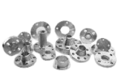
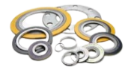


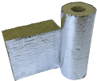
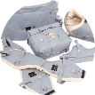
Linepipes & piping and insulation materials
LINEPIPES & PIPING PRODUCTS
Seamless, plastic, GOST Linepipe
821,958 m
Tubes, Fittings and Flanges
20,301 ea/pk
Gaskets and packings
84,529 ea/pk/box
Fastenings
108,442 ea/pk/box
INSULATION / REFRACTORY MATERIALS
Insulation (mineral wool)
95 782 rl, m, m2
Insulation (foam, jacket, sheet, fiber, blanket)
89 163 m, ea, m2, rl

Slide 38



technicalsupport@imbc.kz
+ 7 (7172) 39-99-66
www.imbc.kz
The range and specificity of services for assistance in the development of the potential of manufacturers, offered by IMBC, are limited and are subject to provision on an individual basis, depending on the readiness of the manufacturer to supply their manufactured goods in line with the requirements of the Operators.
Assistance from IMBC does not oblige any retaliatory action from the potential manufacturer. The services of IMBC do not represent a guarantee of the successful participation and / or successful award of Contracts to the manufacturer in the procurement processes of the Operators.

Slide 39
KPO Supplier Database

Slide 40
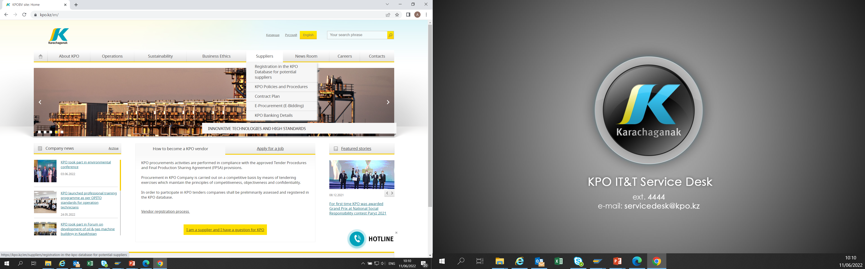
KPO SUPPLIERS DATABASE

Slide 41
VENDOR REGISTRATION
All potential suppliers shall be registered in KPO Database
REGISTRATION PROCESS
REGISTRATION
Provision of information on:
Technical Competency
Work Experience in the declared categories of goods and / or works and / or services
Personnel Availability
Financial Turnover
etc.
ETHICAL DUE DILIGENCE
Define an Ethical Due Diligence level in accordance with KPO Legal requirements:
Compliance with Kazakhstan and Foreign legislation
Compliance with Company internal regulations
Submission of potential suppliers shareholder lists
Vendor registration in KPO Vendor Database does not guarantee the participation in a tender or contract award, but suggests that a registered company may be considered as a market research participant for provision of goods, works and services for further pre-qualification process or tender as the need arises.

Slide 42
VENDOR REGISTRATION
To register in KPO Vendor Database, potential supplies shall:
  Download a questionnaire on KPO website – https://kpo.kz/ru/postavshchikam/registracija-v-baze-dannykh-postavshchikov-kpo
  Fill in the questionnaire for the preliminary vendor assessment and indicate activity codes
  Attach copies of required documents
  Submit the completed pack of documents for vendor assessment and registration by e-mail at MIVQ@kpo.kz
  Contact phone: +7 (711336) ext. 4943, 4946, 2192
  KPO encourages Suppliers to update registration data on an ongoing basis, related to:
    Work Experience in the declared categories of goods, works, services
    Certification, accreditation
    Reorganization
    Contact persons

Slide 43
MARKET RESEARCH
Purpose
  Define potential suppliers of goods, works, services who can perform as per KPO requirements
  Ensure free competition for KPO tenders
PROCESS
Demand determination and vendor searching
Issue of Invitation Letter for Expression of Interest
Market Intelligence Report
Approved
Tender List
Approvals

Slide 44
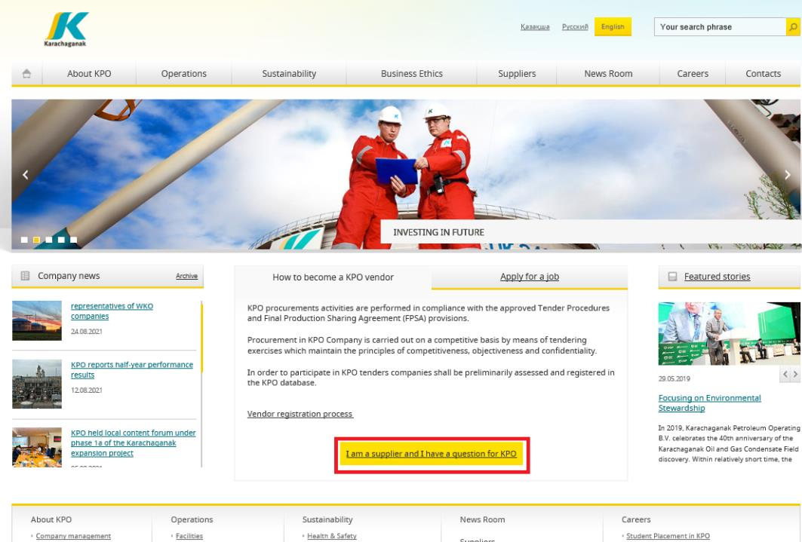
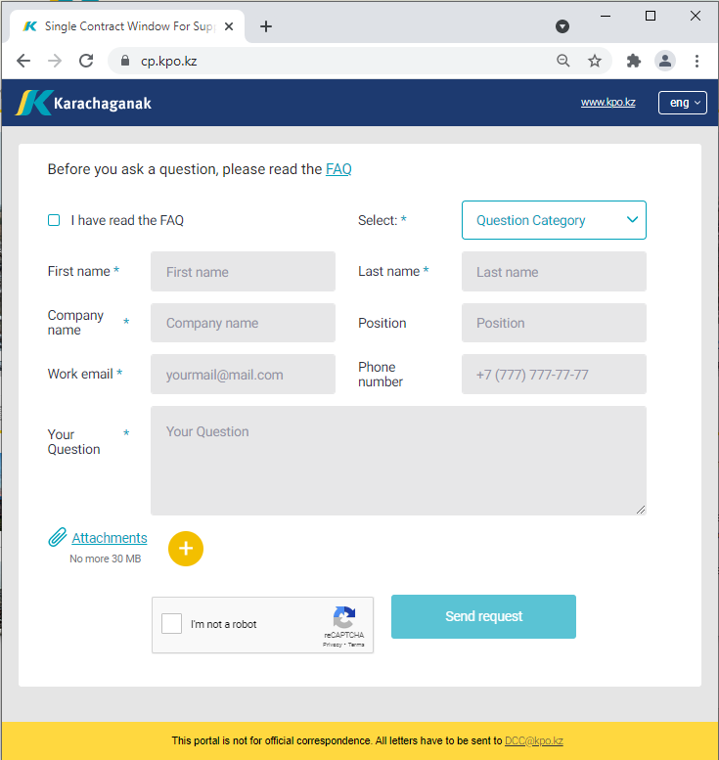
‘’SINGLE WINDOW’’ SYSTEM

Slide 45
Procurement
Process
23/09/2024 KARACHAGANAK PETROLEUM OPERATING B.V

Slide 46
PROCUREMENT PROCESS
KPO shall perform the procurement activities in accordance with:
  the Final Production Sharing Agreement (confidential and intended only for the use of KPO, its Shareholders and the Republic) and the Joint Operating Committee’s Tender Procedures (JOC)
  current legislation
  approved budget and work program
PROCESS
MARKET RESEARCH / PREQUALIFICATION
INVITATION
TO TENDER
TENDERING PERIOD
TENDER DUE DATE
EVALUATION OF TENDERS
CONTRACT AWARD
CONTRACT
SIGNING
CONTRACT
PERFORMANCE

Slide 47
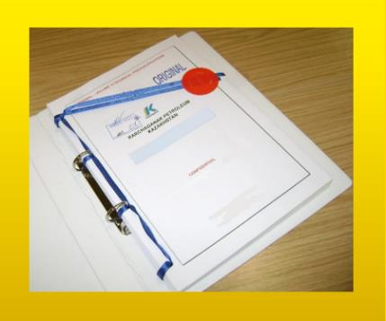



MAXIMUM ATTENTION SHALL BE PAID TO
TENDER PACKAGES SUBMISSION REQUIREMENTS
TENDER PACKAGES SUBMISSION REQUIREMENTS THROUGH E-BIDDING SYSTEM
(Link to the instructions)
INSTRUCTIONS
TO TENDERERS
TENDER DUE DATE / TIME

Slide 48
TENDER DOCUMENTATION CONTENTS
Cover letter
Forms, that shall be mandatorily signed, stamped and provided within timeframe specified:
Tender Acknowledgement and Confidentiality Agreement
Form of Tender
Certificate of Corporate Ownership and Declaration of Compliance
A package of documents related directly to the tender subject itself
Instructions to Tenderers
Form of Contract includes:
Form of Agreement
Schedule A – General Terms and Conditions
Schedule B – Scope of Goods/Services to be Supplied and Specifications
Schedule C – Compensation and Payment
Schedule D – Health, Safety and Environment (HSE) requirements
Schedule E – Special Conditions
Schedule F – Statement of Local Content
Schedule H – Industrial Relations
Questionnaire for Tender Participants
List of goods and technical delivery conditions (if applicable)
Instructions for preparing a tender proposal:
Instructions to Tender Participants
Bid marking template

Slide 49
Local Content
Mechanisms

Slide 50
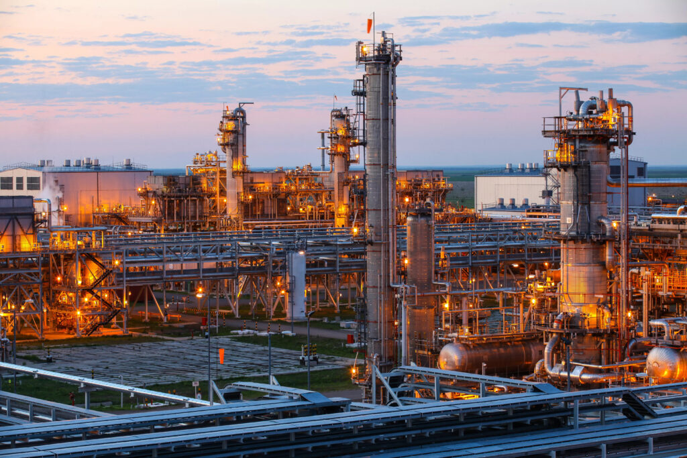







SUPPORTING MECHANISMS FOR LOCAL COMPANIES
TRIAL ORDER
EARLY TENDER
KAZAKH TENDER
Tenders for testing a trial batch of GOODs from Kazakhstani suppliers
Contract is concluded for the supply of GOODS with a suspensive condition or with a long-term delivery schedule
Tenders exclusively among Kazakhstani Suppliers. The goal is to award contracts to Kazakhstani suppliers of GWS
CONTRACT IN EXCHANGE FOR INVESTMENTS (UNDER REVISION)
  A contract in exchange for investment is a long-term contract concluded on a Single source basis, under which the supplier undertakes to produce goods of local origin that are the subject of a procurement contract in the territory of the Republic of Kazakhstan

Slide 51
Thank you!
23/09/2024 KARACHAGANAK PETROLEUM OPERATING B.V

