Slide 1
KPO TECHNICAL WEBINAR ON DRIVES WITH THE PARTICIPATION OF THE IMB CENTER
KARACHAGANAK PETROLEUM OPERATING B.V

Slide 2
DISCLAIMER
The information contained in these slides is made available for consideration. It represents KPO's preliminary description of the company’s demands as presently envisaged, but KPO reserves the right to change this information in the course of planning and implementing the projects, and KPO cannot be held responsible for any loss, damage or expense arising from reliance on this information. The information will not form part of any agreement between KPO and contractors participating in the workshop.
Today's engagement is one of many steps which KPO and its stakeholders are taking to develop local content.
28/03/2025 KARACHAGANAK PETROLEUM OPERATING B.V

Slide 3
Electric drives and components

Slide 4
PRESENTATION CONTENT
Introduction.
Types of electric motors used in KPO
Technical requirements to electric motors
  Degree of ingress protection (IP), in accordance with IEC 60529
  Requirements to the international standards IEC 60079
  Ambient temperature requirements
  Noise level requirements in accordance with ISO 1680
  Electrical insulation requirements in accordance with IEC 60034-18.
Electric motors maintenance execution strategy in KPO.
Technical requirements to bearings in KPO B.V. Requirements to the ball bearings in accordance with ISO R281.
6. Most commonly used bearings in electric motors at KPO B.V.
28/03/2025 KARACHAGANAK PETROLEUM OPERATING B.V

Slide 5
INTRODUCTION
The purpose of this presentation is to familiarize participants with the technical requirements for electric motors used at KPO: OEMs, as well as specifications and forecasted demand for critical components, such as bearings.
The presentation is aimed at:
Clarification of the technical requirements for electric motors used at KPO, based on applicable standards and the document “Specification for Low Voltage Induction Motors – KPO-00-ELT-SPC-00016-ER”;
Providing information on the most commonly used bearings in electric motors, including their specifications and consumption.
28/03/2025 KARACHAGANAK PETROLEUM OPERATING B.V

Slide 6
TYPES OF ELECTRIC MOTORS USED AT KPO
At KPO production sites, over 2,200 low-voltage (400V/690V) electric motors with a power rating of up to 315 kW are in operation, along with 51 ea. 6kV electric motors.
These include OEMs such as:
ABB
ATB
Brook Hansen
Brook Crompton
CEMP
Euromotori
HEW
INGERSOLL-RAND
LOHER
MARELLI MOTORI
ROTOR
SUD ELECTRIK AG
WEG
28/03/2025 KARACHAGANAK PETROLEUM OPERATING B.V

Slide 7
TECHNICAL REQUIREMENTS TO ELECTRIC MOTORS
Degree of ingress protection (IP), in accordance with IEC 60529 (Degrees of protection provided by enclosures):
The minimum enclosure protection rating must be IP55.
Applied in Kazakhstan and EAEU countries through GOST 14254-2015, which is its equivalent.
Requirements to the international standards IEC 60079:
If the technical documentation states that the motor is intended for use in hazardous area, the motor and all of its components must comply with the requirements of the approved certification body and must bear nameplates and markings in accordance with the relevant sections of IEC 60079.
IEC 60079 is an international standard that sets requirements for electrical equipment used in explosive atmospheres (oil, gas, chemical industries). It includes zone classification, protection methods (Ex d, Ex e, Ex i, Ex p, etc.), and requirements for the installation, operation, and maintenance of Ex equipment. In Kazakhstan, IEC 60079 is applied through GOST 60079 and TR CU 012/2011 "On the safety of equipment intended for use in explosive atmospheres". The supply of equipment for use in Ex zones is subject to mandatory certification under ATEX (ATEX 2014/34/EU) or GOST/TR CU.
28/03/2025 KARACHAGANAK PETROLEUM OPERATING B.V

Slide 8
TECHNICAL REQUIREMENTS TO ELECTRIC MOTORS
Ambient temperature:
According to the document - Specification for Low Voltage Induction Motors (KPO-00-ELT-SPC-00016-R), the motors must be designed to operate at ambient temperatures from -40С to +40С.
ISO Noise level requirements in accordance with ISO 1680 (Acoustics. Test code for the measurement of airborne noise emitted by rotating electrical machines):
It regulates test conditions, sound pressure measurement methods, and procedures for evaluating acoustic performance.
The maximum noise level must not exceed 77 dB.
28/03/2025 KARACHAGANAK PETROLEUM OPERATING B.V

Slide 9
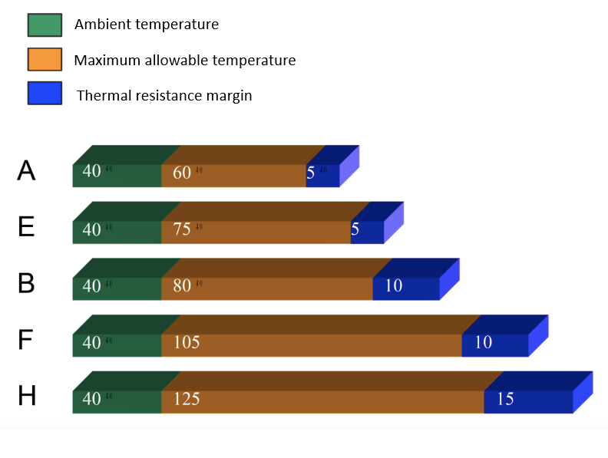
TECHNICAL REQUIREMENTS TO ELECTRIC MOTORS
Electrical insulation requirements in accordance with IEC 60034-18 – Rotating electrical machines. Guidelines for evaluation of electrical insulation.
All insulating materials must be at least Class F, as specified in IEC 60034-18
28/03/2025 KARACHAGANAK PETROLEUM OPERATING B.V

Slide 10
ELECTRIC MOTORS MAINTENANCE EXECUTION STRATEGY
Maintenance of electric motors is carried out in accordance with strategy KPO-AL-MAI-GTS-00014-ER, which prescribes a maintenance interval of once every 48 months. As part of the maintenance, replacement of bearings is performed, the integrity and compliance of the EX enclosure with IEC 60079 standards is verified, and electrical parameter diagnostics are carried out at the KPO Workshop.
If non-compliance with technical requirements is identified, the electric motor is sent for overhaul to a specialized Workshop of Business partner. If restoration is not possible, a new electric motor with identical technical specifications is procured.
28/03/2025 KARACHAGANAK PETROLEUM OPERATING B.V

Slide 11
TECHNICAL REQUIREMENTS FOR BEARINGS
Requirements to the ball bearings in accordance with ISO R281R281 (Ball bearings. Dynamic load rating and rated service life):
Rolling bearings must be of type C3 .
Bearings must have B10 service life of at least 40,000 hours, calculated in accordance with ISO R281.
ISO 281 is an international standard that specifies methods of calculating the rated service life of rolling bearings based on dynamic loading and operating conditions. It defines the B10 (L10) service life, at which at least 90% of the bearings in a batch are expected to remain operational, taking into account factors such as lubrication, temperature, and contamination. .
28/03/2025 KARACHAGANAK PETROLEUM OPERATING B.V

Slide 12
CONSUMPTION FORECAST
Demand forecast for the most commonly used bearings in maintenance operations:
MODEL | 2025-2026 (quantity, ea.)
6203 ZZ C3 | 110
6204 ZZ C3 | 88
6206 ZZ C3 | 70
6208 ZZ C3 | 36
6212 ZZ C3 | 40
6213 ZZ C3 | 20
6306 ZZ C3 | 44
6308 ZZ C3 | 120
6309 ZZ C3 | 84
6310 ZZ C3 | 44
6311 ZZ C3 | 22
6312 C3 | 150
6313 C3 | 38
6319 C3 | 20
28/03/2025 KARACHAGANAK PETROLEUM OPERATING B.V

Slide 13
Maintenance &
Spare Parts Strategy

Slide 14
Content
Summary
Gas Turbines - Maintenance activities
Steam Turbines - Maintenance activities
Diesel Engines – Maintenance activities
Gear Boxes – Maintenance activities
28/03/2025 KARACHAGANAK PETROLEUM OPERATING B.V

Slide 15
CONTENT SUMMARY
Maintenance & Spare Parts Strategy:
Overview of strategies and alignment with local content requirements.
Equipment Overviews & Maintenance
Gas Turbines (MS5002D, PG6561B)
Steam Turbines (353T, 503E)
Diesel Engines
Gearboxes (Flender, MAAG, Voith)
Each section includes general overviews and maintenance activities.
28/03/2025 KARACHAGANAK PETROLEUM OPERATING B.V

Slide 16
KPO Gas Turbines Overview
1

Slide 17
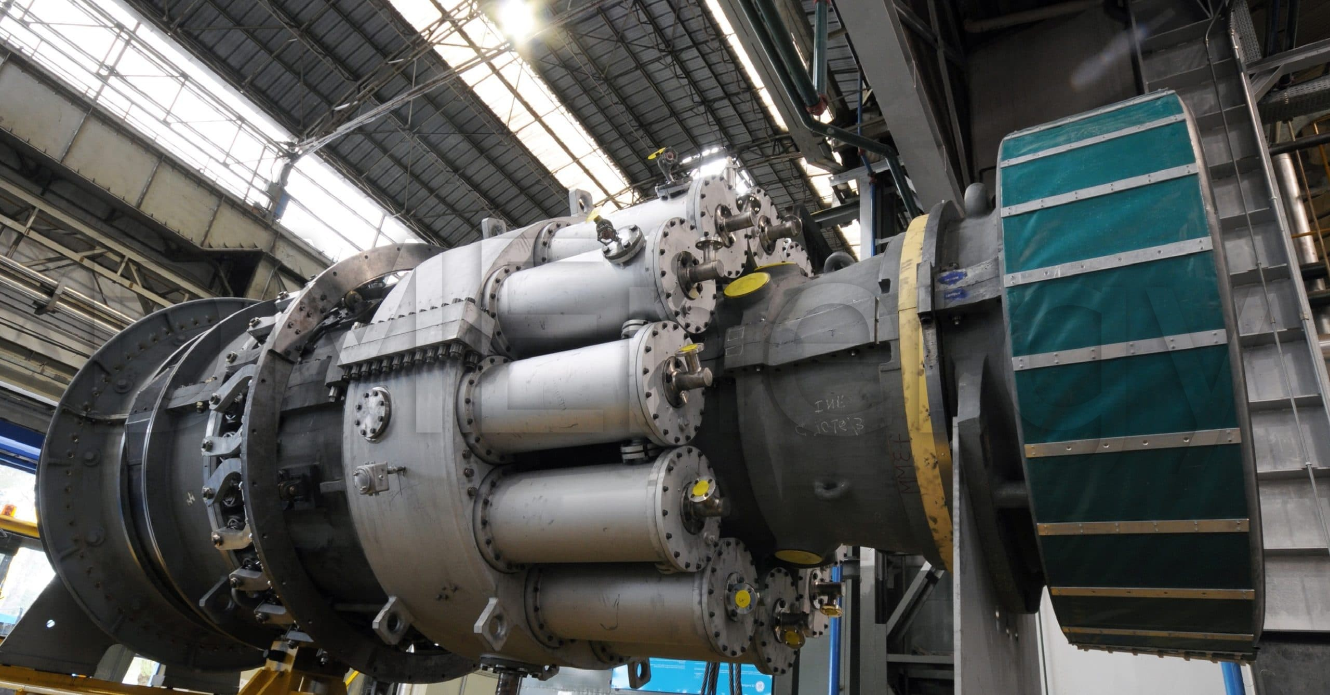
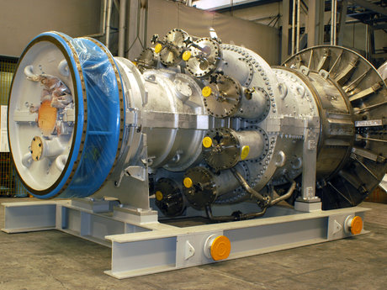
GAS TURBINE OVERVIEW
OEM | Type | Power Range
General Electric (x5) | MS5002D dual shaft* | 32.5MW
General Electric (x4) | PG6561B single shaft* | 36.3MW
G .T. MS5002D
G .T. PG6561B
28/03/2025 KARACHAGANAK PETROLEUM OPERATING B.V

Slide 18
MAINTENANCE ACTIVITIES ON THE
GAS TURBINE MS5002D
Activities | Periodicity | Used Spares
LTPI Liner & Transition pieces inspections | 24 k HRS Will be combined with HGPI | Cap & Liner Transition Pieces Primary Burners Secondary Burners Cross Fire Tubes Consumables
HGPI Hot Gas Inspections | 32 k HRS | LTPI spares* + 1st Stage Nozzle Set 1st Stage Bucket 1st Stage Cover Plate Set 1st Stage Shroud Set Consumables
Major Over Haul | 64 kHRS | HGPI spares* + 1st&2nd Stage Nozzle Set 1st&2nd Stage Bucket 1st&2nd Stage Cover Plate Set 1st&2nd Stage Shroud Set Consumables
28/03/2025 KARACHAGANAK PETROLEUM OPERATING B.V

Slide 19
MAINTENANCE ACTIVITIES ON THE
GAS TURBINE PG6561B
Activities | Periodicity | Used Spares
Combustion Inspection | 12k HRS will be moved 24k HRS | Cap & Liner Transition Pieces Primary Burners Secondary Burners Cross Fire Tubes Consumables
Major Over Haul | 48 k HRS | Combustion Insp spares* + 1st&2nd&3rd Stage Nozzle Set 1st&2nd&3rd Stage Bucket 1st&2nd&3rd Cover Plate Set 1st&2nd&3rd Stage Shroud Set Consumables
28/03/2025 KARACHAGANAK PETROLEUM OPERATING B.V

Slide 20
KPO Steam Turbines Overview
2

Slide 21
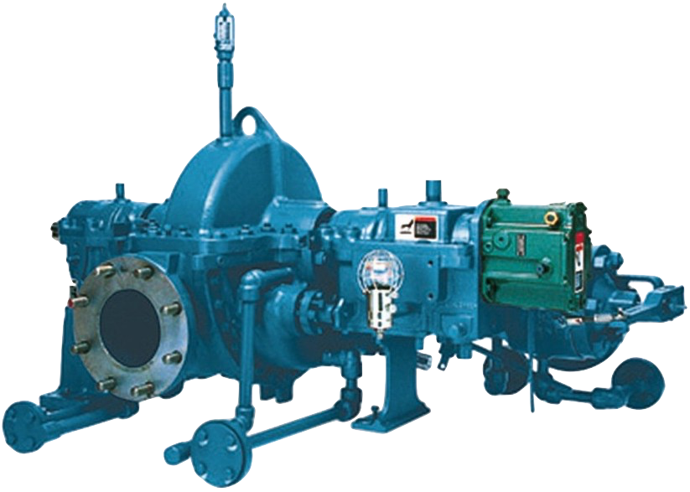
STEAM TURBINES OVERVIEW
OEM | Type | Power Range
Dresser Rand (x2) | 353T | 375 kW
Dresser Rand (x4) | 503E | 203 kW
Steam Turbine
28/03/2025 KARACHAGANAK PETROLEUM OPERATING B.V

Slide 22
MAINTENANCE ACTIVITIES OF
STEAM TURBINES TYPE 353T
Activities | Periodicity | Used Spares
Partial Inspection | 1Y | Oil Oil filter
Major Overhaul | 6Y | Rotor (Optional) Bearings Rings Valves Governor valve Bushing Stem Consumables
28/03/2025 KARACHAGANAK PETROLEUM OPERATING B.V

Slide 23
MAINTENANCE ACTIVITIES OF STEAM TURBINES 503E
Activities | Periodicity | Used Spares
Partial Inspection | 1Y | Oil
Major Overhaul | 6Y | Rotor (Optional) Bearings Rings Valves Governor valve Bushing Stem Consumables
28/03/2025 KARACHAGANAK PETROLEUM OPERATING B.V

Slide 24
KPO Diesel Engines Overview
3

Slide 25
DIESEL ENGINES OVERVIEW
OEM | Type | Power Range
John Deere | 4045HF158 | 112kW
Caterpillar (x5) | 3408 | 377kW
Caterpillar | 3516-TA-EPG | 1710kW
Perkins | 4012-46 TAG2A | 1331kW
General Electric Co. (x2) | 25Z06567 | 3028kW
General Electric Co. | GE 12 V 250 / VEE | 3028kW
Patterson (x2) | 3406B | 314kW
28/03/2025 KARACHAGANAK PETROLEUM OPERATING B.V

Slide 26
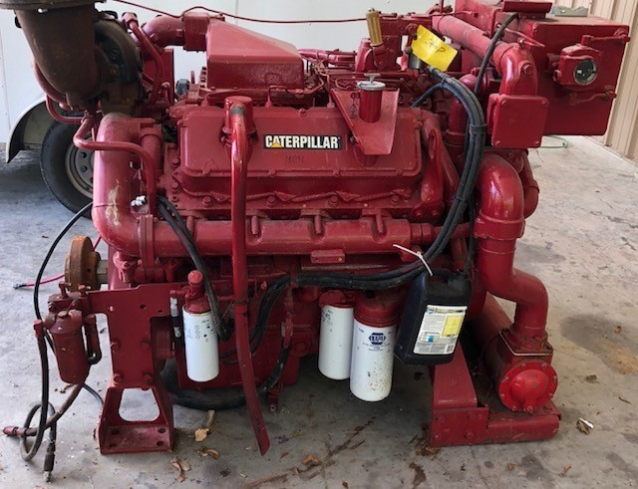
DIESEL ENGINE OVERVIEW
Diesel Engine: 3408
28/03/2025 KARACHAGANAK PETROLEUM OPERATING B.V

Slide 27
MAINTENANCE ACTIVITIES ON THE DIESEL ENGINES
Activities | Periodicity | Used Spares
Partial Inspection | 6M | Air / Oil / Fuel filters
Full Overhaul | 36M | Belt, Fuel pump, Radiator Cap, Rocker Cover gasket, O-ring, Seal ring, Injector gasket, Injector, Oil Cap
28/03/2025 KARACHAGANAK PETROLEUM OPERATING B.V

Slide 28
KPO Gears Boxes Overview
4

Slide 29
GEAR BOXES OVERVIEW
OEM | Type
Flender | TX32/5X
Flender (x2) | TX32/4X
Flender (x9) | TX80/9X
MAAG (x5) | GB-50/2
Flender (x5) | GF51BE
Voith (x4) | FLUIDRIVE-GST50
Voith (x4) | A609
Flender (x4) | TRL65CV
28/03/2025 KARACHAGANAK PETROLEUM OPERATING B.V

Slide 30
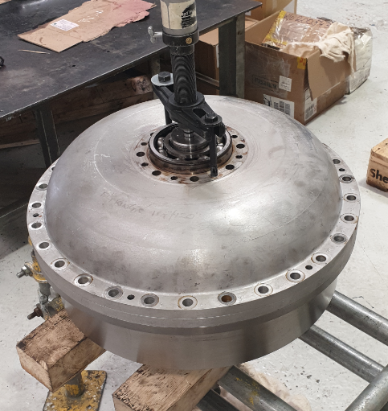
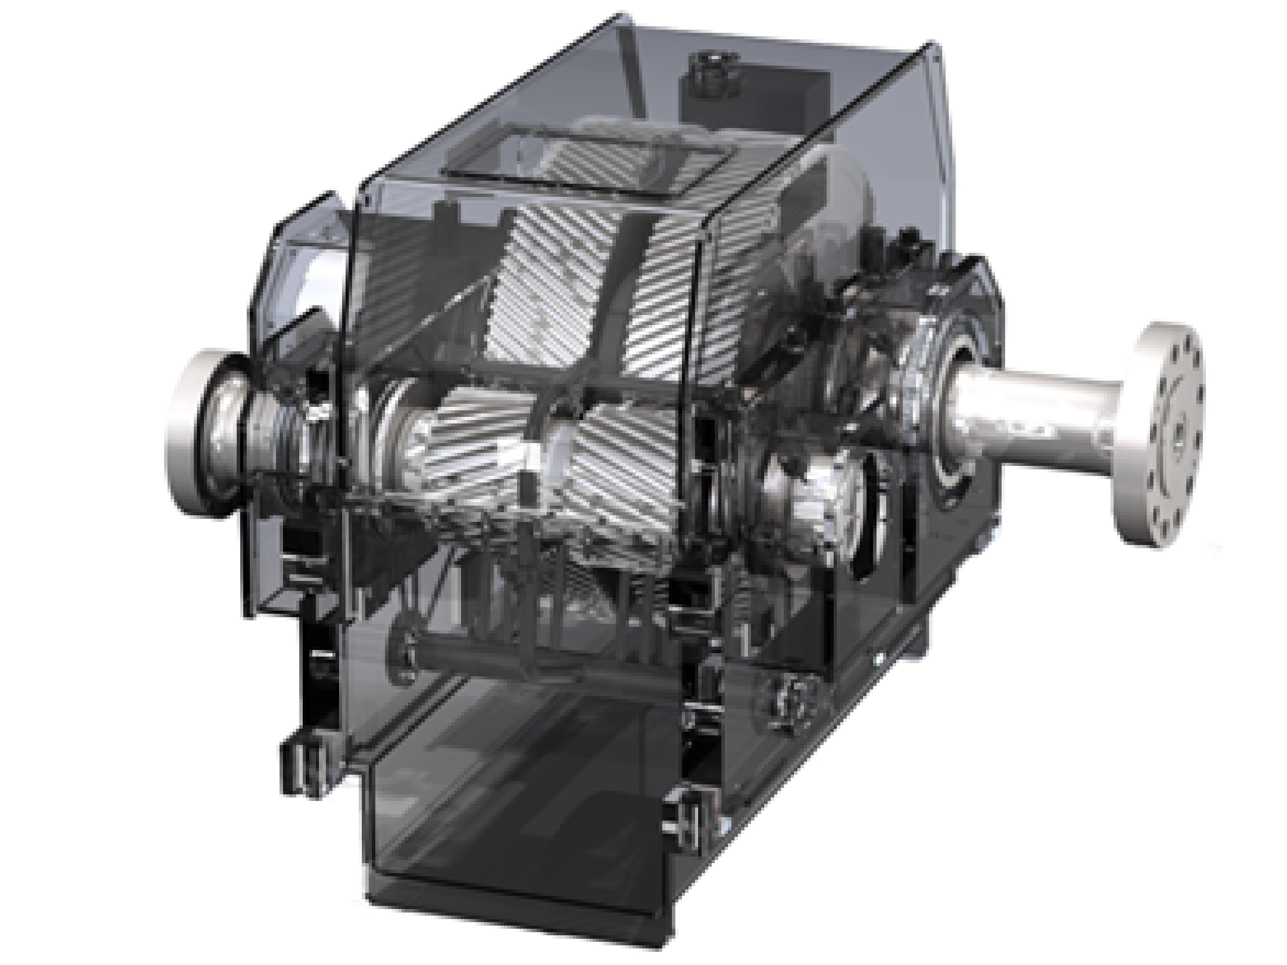
GEAR BOXES & FLUID OVERVIEW
Fluid Coupling
GST 50
Gear Box
TX80/9X
28/03/2025 KARACHAGANAK PETROLEUM OPERATING B.V

Slide 31
MAINTENANCE ACTIVITIES ON
FLUID COUPLING (Voith:GST50)
Activities | Periodicity | Used Spares
Full Overhaul | 48000 HRS | Shaft input (optional) Shaft output (optional) Geroter Gear Coupling Oil pump (optional) Consumables
28/03/2025 KARACHAGANAK PETROLEUM OPERATING B.V

Slide 32
MAINTENANCE ACTIVITIES ON OTHER GEAR BOXES
Activities | Periodicity | Used Spares
Full Overhaul | 48000 HRS | Bearings Gear set (optional) Shaft coupling (optional) Oil pump Consumables
28/03/2025 KARACHAGANAK PETROLEUM OPERATING B.V

Slide 33
Overview of IMB Center's activities
KPO TECHNICAL WEBINAR ON DRIVES

Slide 34














SCOPE OF ACTIVITIES
DATA PROCESSING & CONSOLIDATION
ADVOCACY ISSUES
Major Operators
Consolidation of efforts provision of quantitative and technical data
Government
Facilitation and stimulation
Preferences & subsidies
LOCAL MARKET ANALYSIS & CAPACITY DEVELOPMENT
LOCALIZATION
& TECHNOLOGY TRANSFER
Machine building industry
Capacity development, international standards, Technology transfer
34

Slide 35
Commodities of interest
In our analyses of demands and identifying localization priorities, we utilize the FPAL coding system
FPAL Commodity Codes
Commodity Group A
Commodity Group B
Commodity Group C
Commodity Group D
1.01
Drilling Equipment
1.09
Electrical Equipment and Materials
1.04
Pumps and Seals
1.02
Material and Product Handling Equipment
1.03
Compressors / Expanders / Blowers and Accessories
1.02
Material and Product Handling Equipment
1.10
Instrumentation / Process Control Equipment / Materials
1.11
Process Filters
1.07
Heat Exchangers / Heat Transfer Equipment
1.05
Drives and Accessories
2.02
Valves and Accessories
1.12
HVAC
1.16
Firefighting Equipment
2.03
Steel / Metal Materials
2.01
Line pipe
2.07
Chemical / Oils / Paints
2.11
Workshop and Handtools
2.99
Other Products / Equipment and Materials
2.08
Insulation / Refractory Materials
Procurement in above commodity groups accounts for over 75% of all procurement of goods by three Operators **
* According to the statistical data of Situational-analytical center of the Fuel and Energy complex of the Republic of Kazakhstan
35

Slide 36












PROGRESS UNDER COMMODITY GROUPS
Commodity Group A
Commodity Group B
Commodity Group C
Commodity Group D
Demands analysis
35 000 items analysed
55 000 items analysed
7 000 items analysed
12 000 items analysed
High demand goods identified
22 types of goods
19 types of goods
27 types of goods
39 types of goods
Market analysis, longlist from available resources
more than 90
manufacturers identified
more than 100
manufacturers identified
more than 80
manufacturers identified
more than 150
manufacturers identified
Site surveys, manufacturers who expressed interest
81 site surveys conducted
73 site surveys conducted
50 site surveys conducted
55 site surveys conducted
Shortlisting, manufacturers producing types of goods with high demands
23 manufacturers shortlisted
16 manufacturers shortlisted
In process
TBC
Summarized Technical Requirements
12 STRs developed
8 STRs developed
In process
TBC
Capacity development
10 CDPs developed
4 CDPs developed
TBC
TBC
Implementation
of capacity development
3 recommended
manufacturers
2 recommended
manufacturers
TBC
TBC
Localization Cases
13 LC cases developed with investors
5 LC cases developed with investors
4 LC cases developed with investors
1 LC cases developed with investors
Recommendations to Operators
36

Slide 37
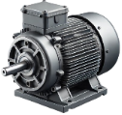
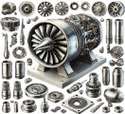
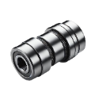
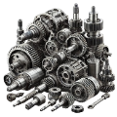
Demand: DRIVES & ACCESSORIES
DRIVES & ACCESSORIES
Electric motors (1 phase, 3 phase, Induction Hazardous, etc.), Spares
1,857 ea/asy/kit
Gas turbine Spares, Accessories, Consumables (Repair kit, Dryer, Filters, Gaskets, Helicoil, Cap, Liner, etc.)
2,720 ea/asy/kit
Couplers
404 ea/kit
Gear Boxes, Spares, Accessories, Consumables (Shaft, Gear, Disk, circlip, etc.)
1,962 ea/kit/pac
37

Slide 38



infoimbc@imbc.kz
+ 7 (7172) 39-99-66
www.imbc.kz
The range and specificity of services for assistance in the development of the potential of manufacturers, offered by IMBC, are limited and are subject to provision on an individual basis, depending on the readiness of the manufacturer to supply their manufactured goods in line with the requirements of the Operators.
Assistance from IMBC does not oblige any retaliatory action from the potential manufacturer. The services of IMBC do not represent a guarantee of the successful participation and / or successful award of Contracts to the manufacturer in the procurement processes of the Operators.
38

Slide 39
KPO Supplier Database

Slide 40
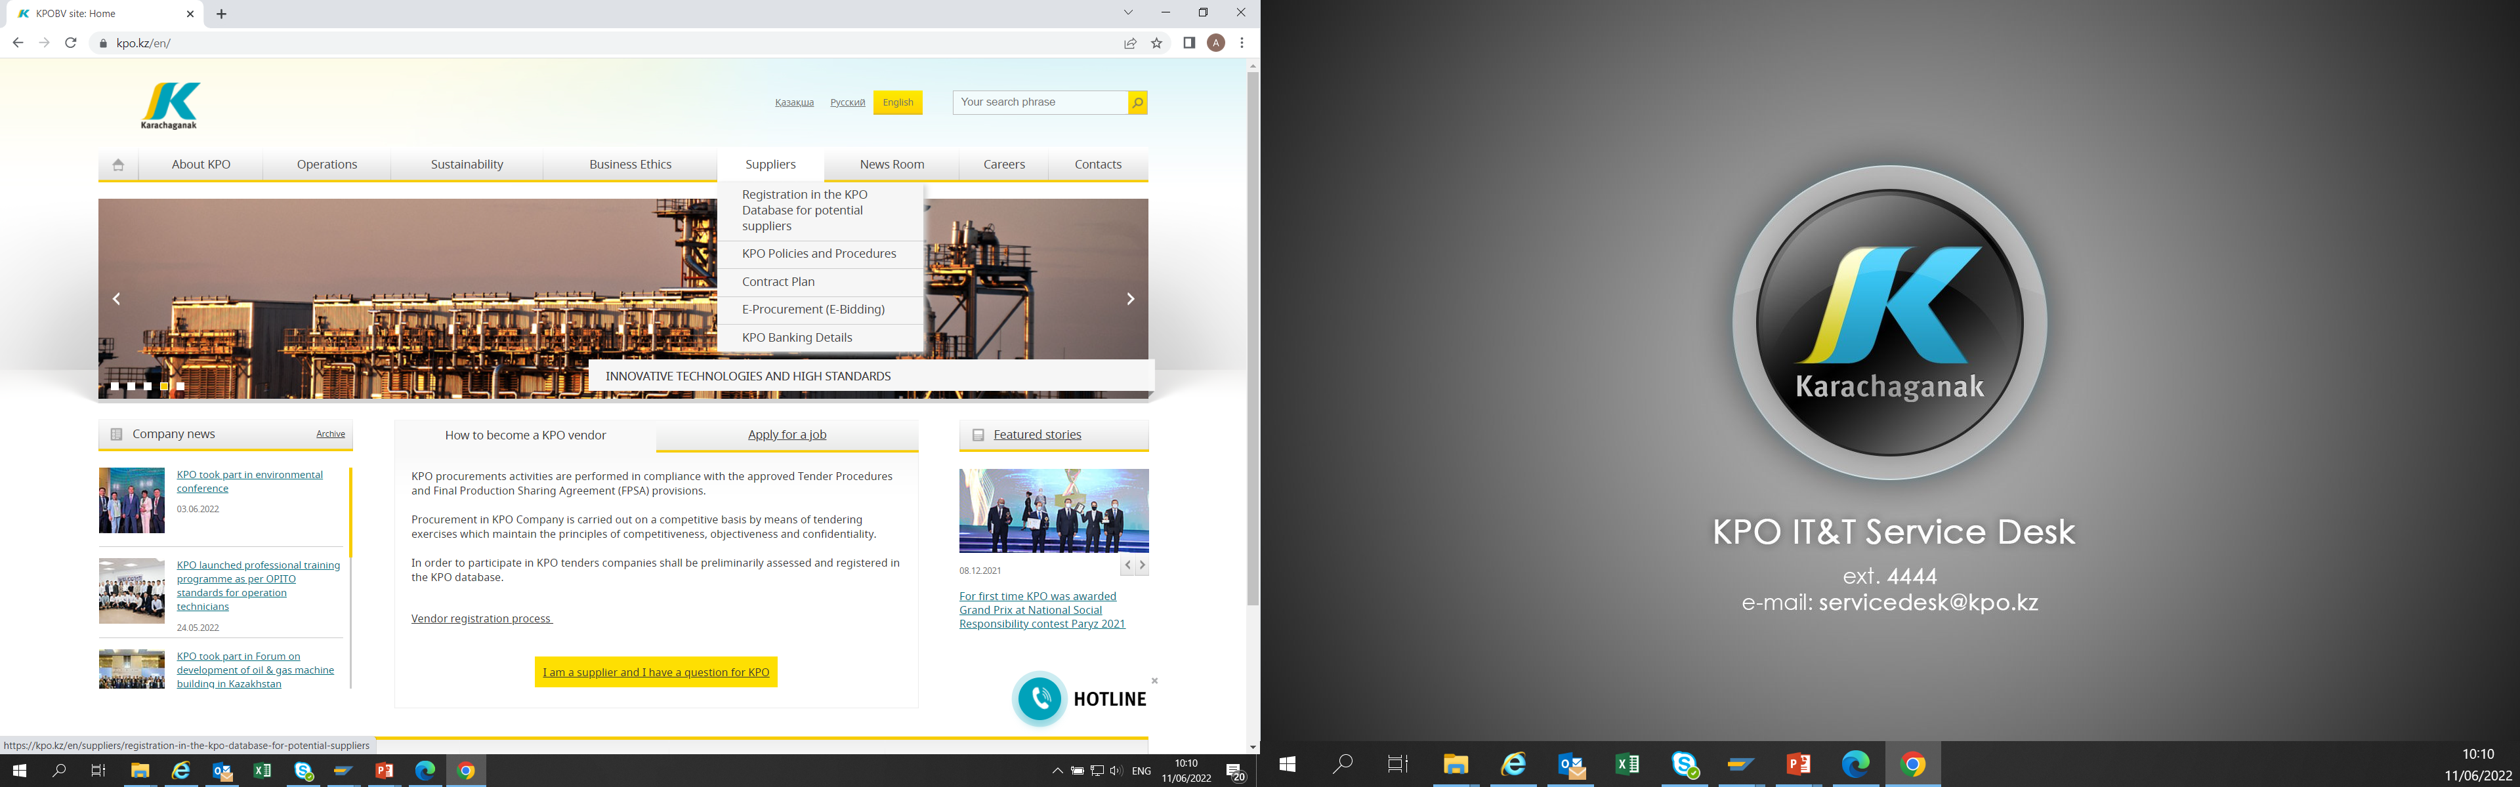
KPO SUPPLIERS DATABASE
28/03/2025 KARACHAGANAK PETROLEUM OPERATING B.V

Slide 41
VENDOR REGISTRATION
All potential suppliers shall be registered in KPO Database
REGISTRATION PROCESS
REGISTRATION
Provision of information on:
Technical Competency
Work Experience in the declared categories of goods and / or works and / or services
Personnel Availability
Financial Turnover
etc.
ETHICAL DUE DILIGENCE
Define an Ethical Due Diligence level in accordance with KPO Legal requirements:
Compliance with Kazakhstan and Foreign legislation
Compliance with Company internal regulations
Submission of potential suppliers shareholder lists
Vendor registration in KPO Vendor Database does not guarantee the participation in a tender or contract award, but suggests that a registered company may be considered as a market research participant for provision of goods, works and services for further pre-qualification process or tender as the need arises.
28/03/2025 KARACHAGANAK PETROLEUM OPERATING B.V

Slide 42
VENDOR REGISTRATION
To register in KPO Vendor Database, potential supplies shall:
  Download a questionnaire on KPO website – https://kpo.kz/ru/postavshchikam/registracija-v-baze-dannykh-postavshchikov-kpo
  Fill in the questionnaire for the preliminary vendor assessment and indicate activity codes
  Attach copies of required documents
  Submit the completed pack of documents for vendor assessment and registration by e-mail at MIVQ@kpo.kz
  Contact phone: +7 (711336) ext. 4943, 4946, 2192
  KPO encourages Suppliers to update registration data on an ongoing basis, related to:
    Work Experience in the declared categories of goods, works, services
    Certification, accreditation
    Reorganization
    Contact persons
28/03/2025 KARACHAGANAK PETROLEUM OPERATING B.V

Slide 43
MARKET RESEARCH
Purpose
  Define potential suppliers of goods, works, services who can perform as per KPO requirements
  Ensure free competition for KPO tenders
PROCESS
Demand determination and vendor searching
Issue of Invitation Letter for Expression of Interest
Market Intelligence Report
Approved
Tender List
Approvals
28/03/2025 KARACHAGANAK PETROLEUM OPERATING B.V

Slide 44
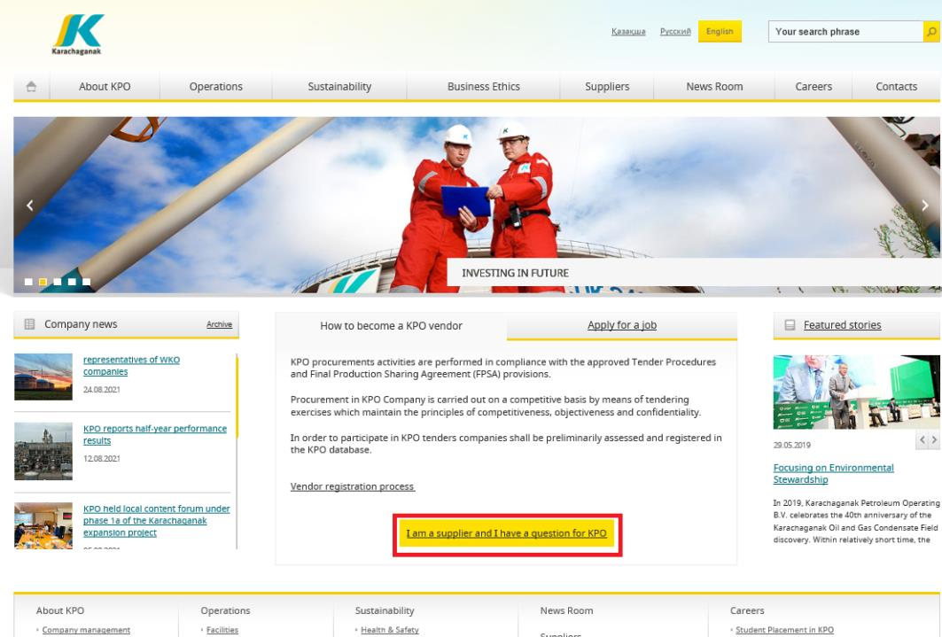
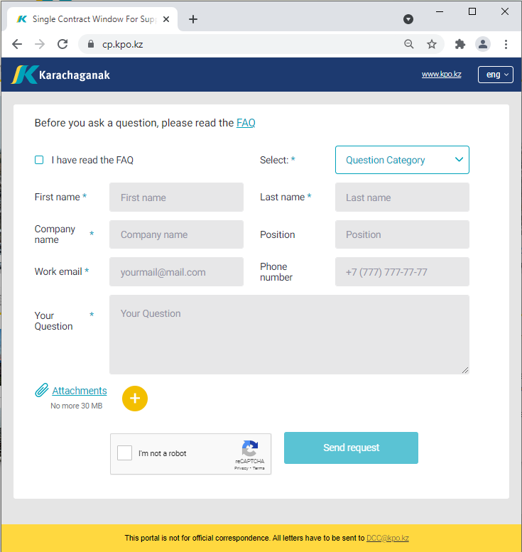
‘’SINGLE WINDOW’’ SYSTEM
28/03/2025 KARACHAGANAK PETROLEUM OPERATING B.V

Slide 45
Procurement
Process
45

Slide 46
PROCUREMENT PROCESS
KPO shall perform the procurement activities in accordance with:
  the Final Production Sharing Agreement (confidential and intended only for the use of KPO, its Shareholders and the Republic) and the Joint Operating Committee’s Tender Procedures (JOC)
  current legislation
  approved budget and work program
PROCESS
MARKET RESEARCH / PREQUALIFICATION
INVITATION
TO TENDER
TENDERING PERIOD
TENDER DUE DATE
EVALUATION OF TENDERS
CONTRACT AWARD
CONTRACT
SIGNING
CONTRACT
PERFORMANCE
28/03/2025 KARACHAGANAK PETROLEUM OPERATING B.V

Slide 47
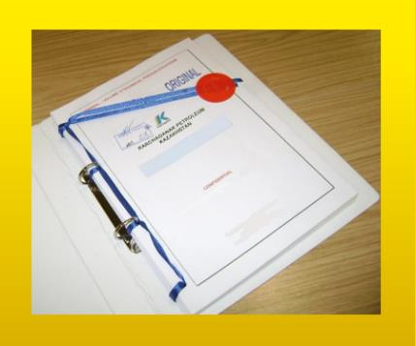



MAXIMUM ATTENTION SHALL BE PAID TO
TENDER PACKAGES SUBMISSION REQUIREMENTS
TENDER PACKAGES SUBMISSION REQUIREMENTS THROUGH E-BIDDING SYSTEM
(Link to the instructions)
INSTRUCTIONS
TO TENDERERS
TENDER DUE DATE / TIME
28/03/2025 KARACHAGANAK PETROLEUM OPERATING B.V

Slide 48
TENDER DOCUMENTATION CONTENTS
Cover letter
Forms, that shall be mandatorily signed, stamped and provided within timeframe specified:
Tender Acknowledgement and Confidentiality Agreement
Form of Tender
Certificate of Corporate Ownership and Declaration of Compliance
A package of documents related directly to the tender subject itself
Instructions to Tenderers
Form of Contract includes:
Form of Agreement
Schedule A – General Terms and Conditions
Schedule B – Scope of Goods/Services to be Supplied and Specifications
Schedule C – Compensation and Payment
Schedule D – Health, Safety and Environment (HSE) requirements
Schedule E – Special Conditions
Schedule F – Statement of Local Content
Schedule H – Industrial Relations
Questionnaire for Tender Participants
List of goods and technical delivery conditions (if applicable)
Instructions for preparing a tender proposal:
Instructions to Tender Participants
Bid marking template
28/03/2025 KARACHAGANAK PETROLEUM OPERATING B.V

Slide 49
KPO General HSE requirements

Slide 50

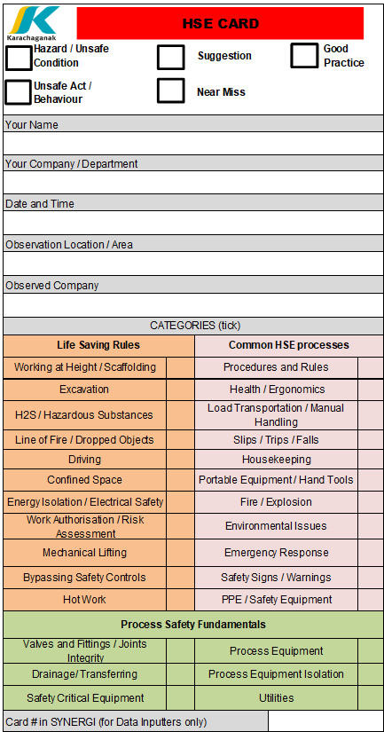


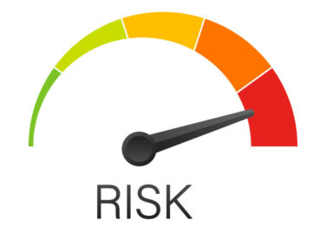
KPO GENERAL HSE REQUIREMENTS
2 EXECUTION OF THE CONTRACT
Leadership and Commitment
HSE policy
Planning
  HSE Legislation
  Risk Management
Support
  HSE Personnel
  HSE Competence Requirements
  HSE Training and
  Induction
  HSE Communications
  HSE Meetings
  HSE Procedures
1 GENERAL PROVISIONS
Scope
Contractor HSE Plan
Compliance
1
2
Implementation
  Equipment Maintenance and Inspection
  Occupational Health and Hygiene
  Environment
  Road Transport Safety
  PPE Requirements
  Emergency Response Interaction
  Subcontractor management
Control and Monitoring
  HSE Observations and Reporting
  Incident Investigation
  HSE Audits and Inspections
  Safety Reporting
  Environmental Reporting
3
3 MINIMUM LIST OF HSE PROCEDURES FOR COMPLIANCE BY CONTRACTOR
28/03/2025 KARACHAGANAK PETROLEUM OPERATING B.V

Slide 51
Local Content
Mechanisms
51

Slide 52
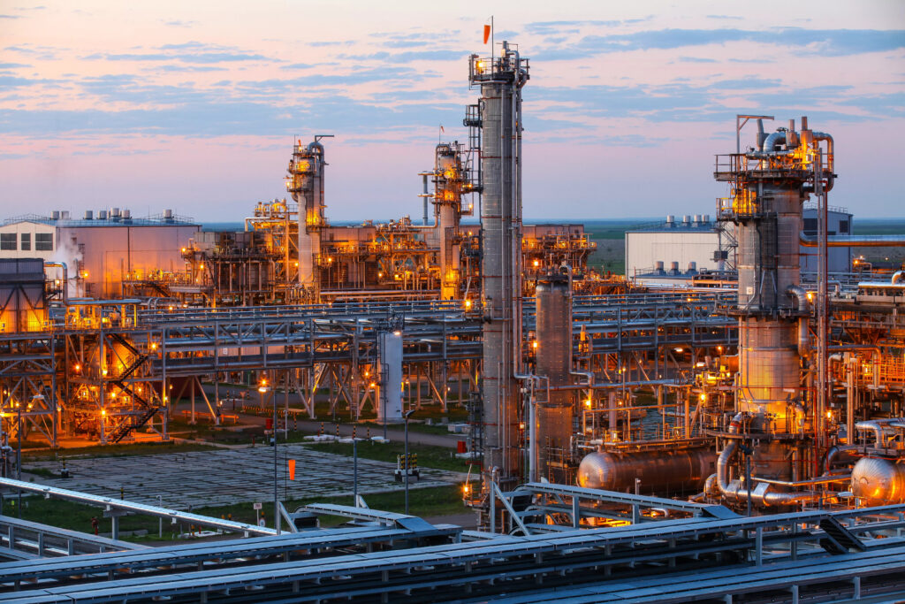







SUPPORTING MECHANISMS FOR LOCAL COMPANIES
TRIAL ORDER
EARLY TENDER
KAZAKH TENDER
Tenders for testing a trial batch of GOODs from Kazakhstani suppliers
Contract is concluded for the supply of GOODS with a suspensive condition or with a long-term delivery schedule
Tenders exclusively among Kazakhstani Suppliers. The goal is to award contracts to Kazakhstani suppliers of GWS
CONTRACT IN EXCHANGE FOR INVESTMENTS (UNDER REVISION)
  A contract in exchange for investment is a long-term contract concluded on a Single source basis, under which the supplier undertakes to produce goods of local origin that are the subject of a procurement contract in the territory of the Republic of Kazakhstan
28/03/2025 KARACHAGANAK PETROLEUM OPERATING B.V

Slide 53
Thank you!
53

