Slide 1
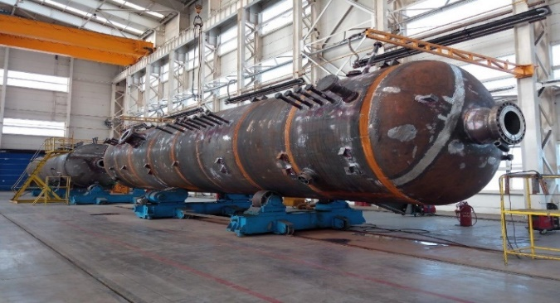
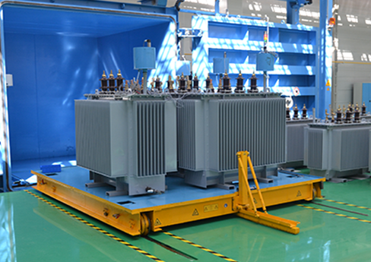
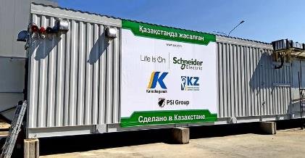
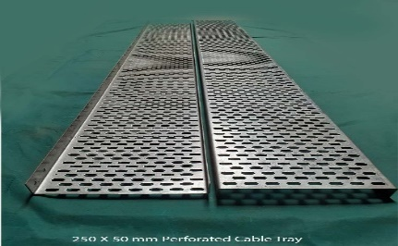
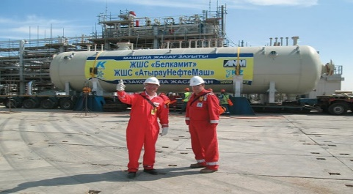
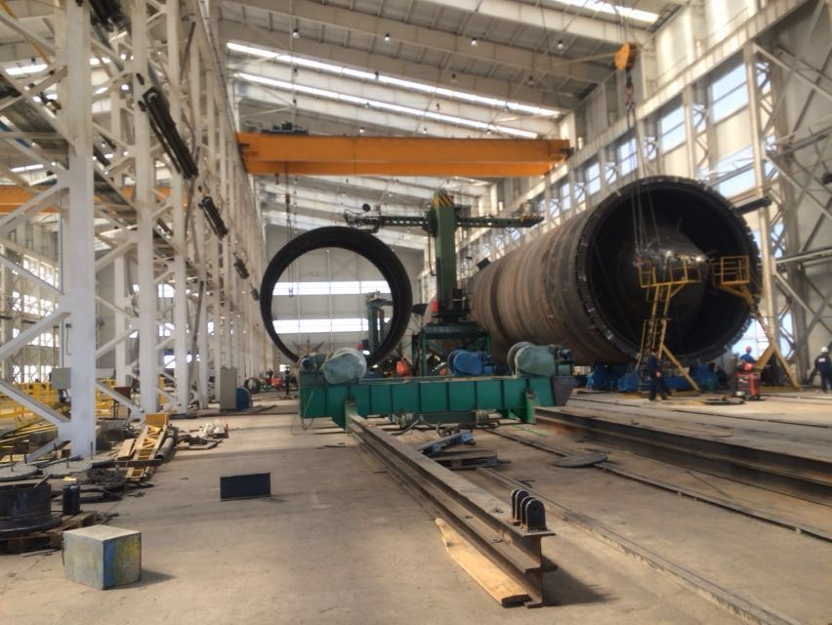
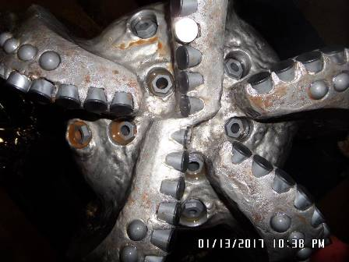
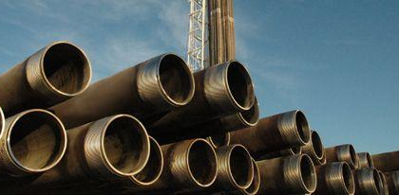
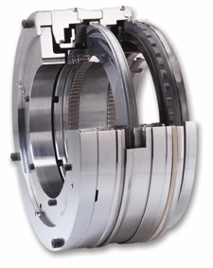
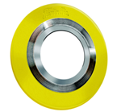
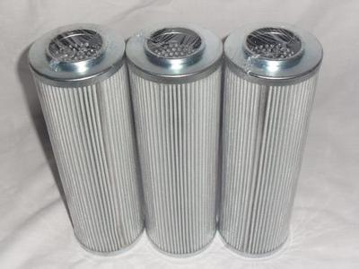
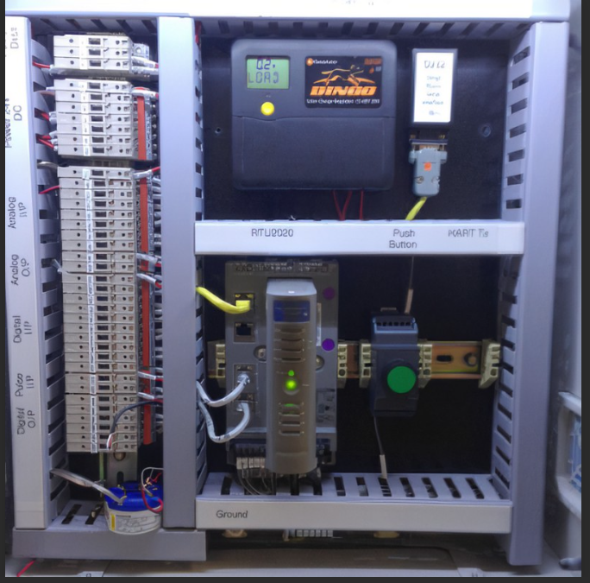
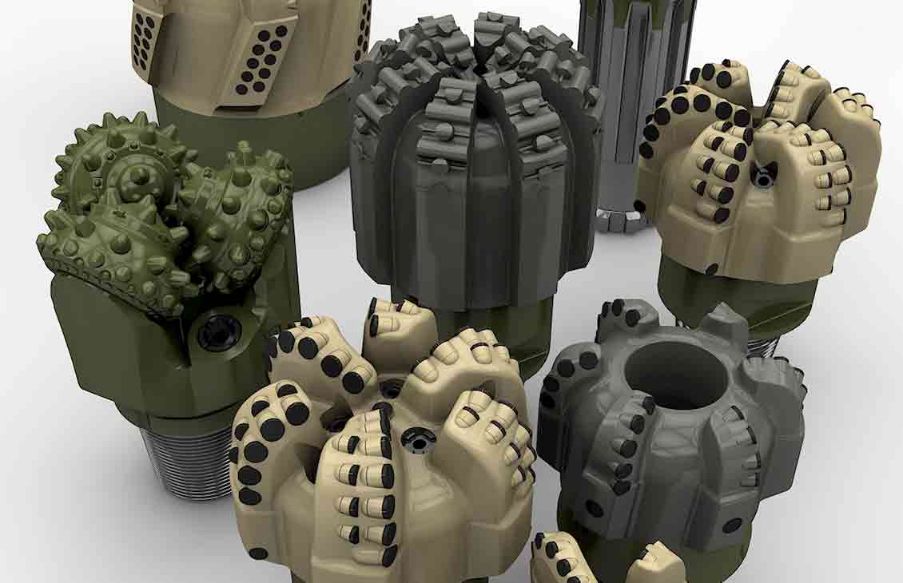
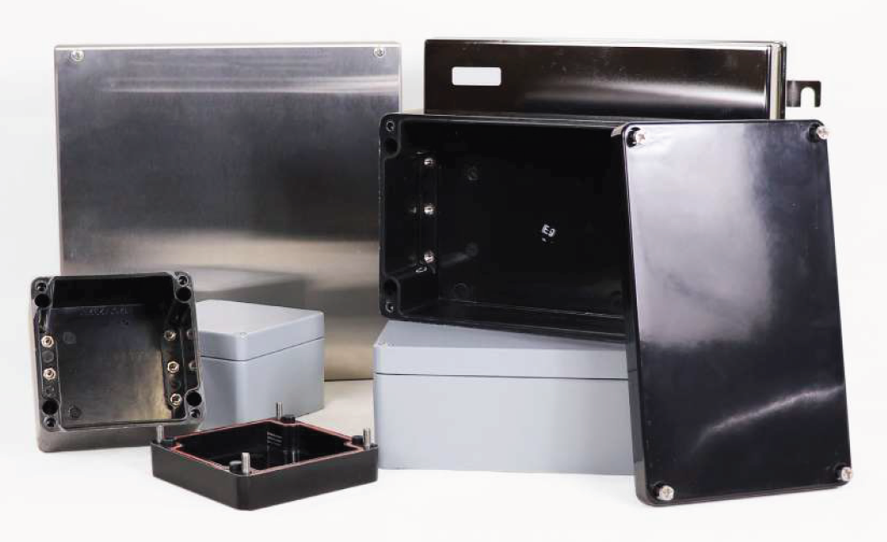
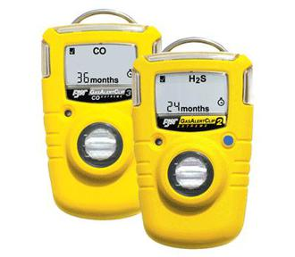
SUCCESSFUL CASES OF LOCALIZATION OF GOODS
Thick wall pressure Vessels
Electrical Equipment
Modular Substation
Cable Trays
3 phase separator
Gas Dehydration column
16’’ PDC Drill Bits
OCTG Pipes
Piping Bulks(Flanges)
Gaskets
Filters
Remote Telemetry unit
17 ½’’ PDC Drill Bits
Junction Box
H2S Detectors
КОНФИДЕНЦИАЛЬНАЯ КАРАЧАГАНАК ПЕТРОЛИУМ ОПЕРЕЙТИНГ Б.В.

Slide 2
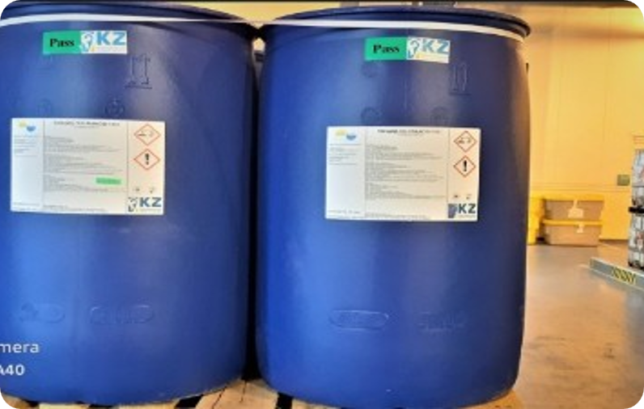
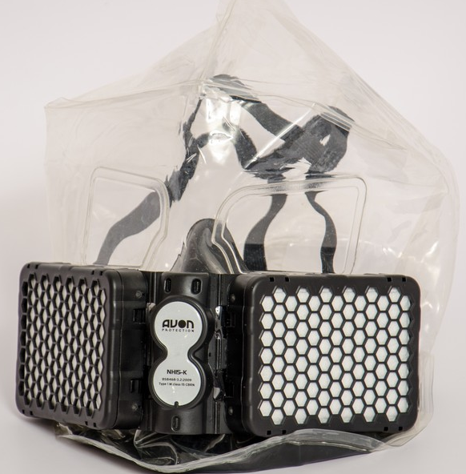
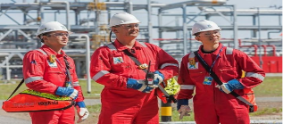
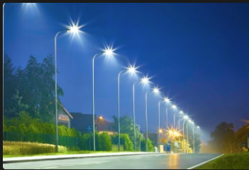
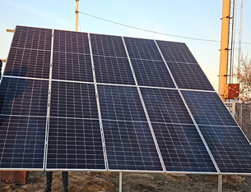
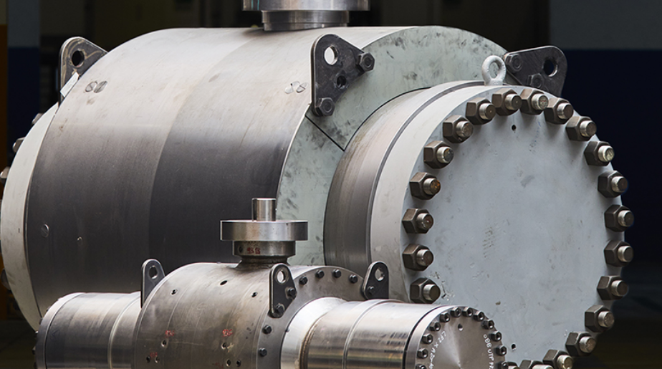
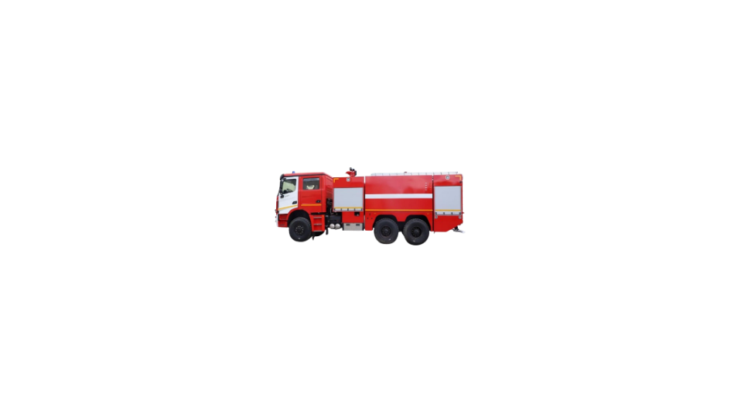
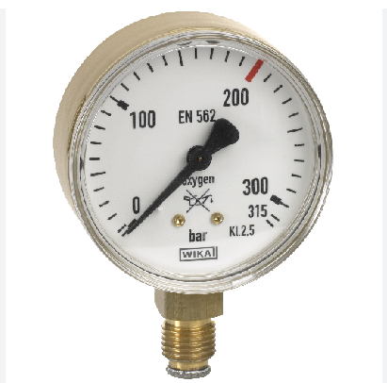
SUCCESSFUL CASES OF LOCALIZATION OF GOODS
Chemicals
Filter Hood
PPE (Personnel Protective Equipment)
Led Lamps
Solar Panels
Pressure Gauges
Valves
Fire Track
КОНФИДЕНЦИАЛЬНАЯ КАРАЧАГАНАК ПЕТРОЛИУМ ОПЕРЕЙТИНГ Б.В.

