Slide 1
KPO TECHNICAL WEBINAR ON ELECTRICAL EQUIPMENT
WITH THE PARTICIPATION OF THE IMB CENTER
KARACHAGANAK PETROLEUM OPERATING B.V.

Slide 2
WEBINAR RULES
  We will have a Facilitator to manage this event
  Everyone except Presenters will be muted
  If you want to ask a question, please type it in the comments box
  Try to hold questions to the end of the presentation
  Be open, honest and respectful
  Don’t
    use this webinar to market your company
    ask a question regarding any specific Tender/Contract
    expect total clarity and precise response to your every question

Slide 3
PROGRAM
  WELCOME SPEECH
  OVERVIEW OF ELECTRICAL EQUIPMENT IN KPO
  OVERVIEW OF THE IMBC ACTIVITIES
  KPO SUPPLIERS DATABASE
  KPO PROCUREMENT PROCESS
  LOCAL CONTENT MECHANISMS
  Q&A SESSION
3
19/11/2024 CONFIDENTIAL KARACHAGANAK PETROLEUM OPERATING B.V

Slide 4
DISCLAIMER
The information contained in these slides is made available for consideration. It represents KPO's preliminary description of the company’s demands as presently envisaged, but KPO reserves the right to change this information in the course of planning and implementing the projects, and KPO cannot be held responsible for any loss, damage or expense arising from reliance on this information. The information will not form part of any agreement between KPO and contractors participating in the workshop.
Today's engagement is one of many steps which KPO and its stakeholders are taking to develop local content.

Slide 5
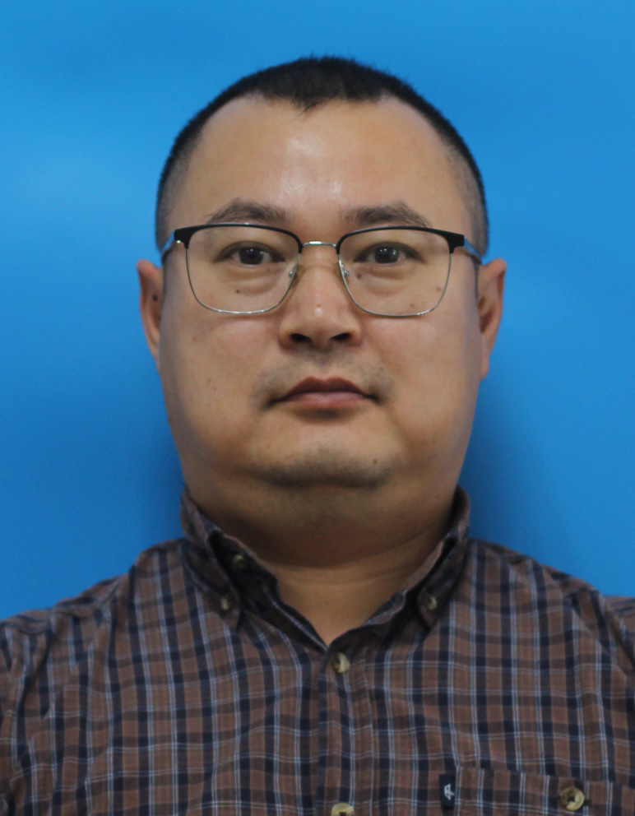
Electrical Commodities
Localization Prospects
Takhir Zhundubayev
Lead Electrical Engineer

Slide 6
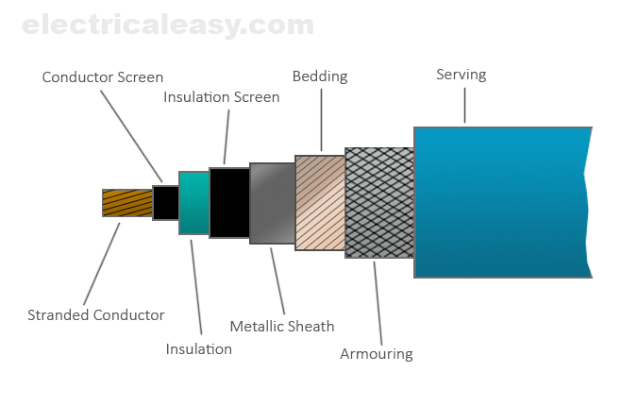
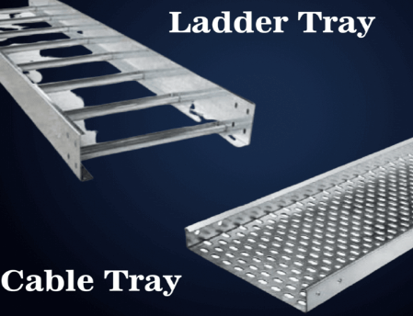

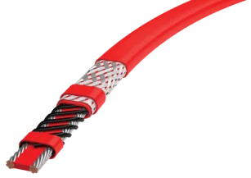
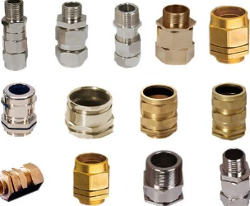

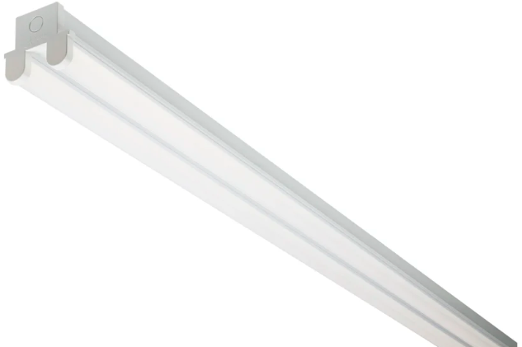
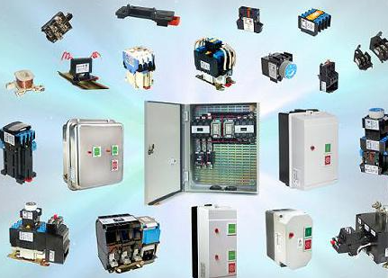

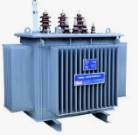
Electrical commodities
Electrical cables
Raceway system
Power cables (multicore & single core)
Earthing cables (single core)
Cable ladders / trays
Accessories (elbows, couplers, bolts, nuts, etc.)
Cable fittings
Heat Tracing
Cable glands
Cable stuffing glands
Multi Transit blocks
Heating Tapes
JBs & Tee boxes
Thermostats
Defined Electrical Goods
Lighting
Low Voltage Devices
Luminaires & Floodlights
Lamps (LED, HPS)
Accessories
Commutation devices MCBs & Fuses
Terminals and accessories
Ex JBs & Industrial JBs
Distribution Units
Distribution Boards
Switchboards
Power Transformers
Distribution Transformers
Packaged Transformer Substations
Accessories (bushings, etc.)

Slide 7
Power and Control Cables
Cable Design:
Cross-linked polyethylene core insulation, PVC sheath, galvanized round steel wire armour.
Abbreviation – Cu/XLPE/PVC/SWA/PVC.
Conductors:
Service condition:
Installation temperature up to -15⁰С.
Operating temperature up to -40⁰С.
Strands of annealed copper, round and profiled in cross-section.
The gaps between the wires must be filled with a non-hygroscopic filler.

Slide 8
Requirements for the supply of power cables
Cable Drum:
The drums should be wound with the largest possible continuous lengths of cables.
The purchase order number, purchase order item number, drum number and stock code must be clearly marked.
Accompanying documentation
Certificate of Origin.
Cable Data Sheet.
Cable test protocol.
Cable drums schedule in case of large order.
The ends of the cable must be sealed and preserved to the drum in such a way that both ends of the cable are accessible.

Slide 9
Cable tray / Cable ladders
Material:
Low-temperature steel grade S355J2G3, mild steel with silicon filler is also allowed upon approval.
Hot dip galvanized steel with a minimum galvanization thickness of 40 microns.
Service Condition
Cable trays and ladders, as well as their accessories, must be designed for outdoor use at temperatures from -40°C to +45°C.
Estimated service life of at least 20 years.
The minimum thickness of steel must be at least 1.5 mm.
The material must be resistant to the following atmospheres::
- sulphur oxide SO2 content – ​​0.5 mg/m³
- hydrogen sulfide content H2S – 0.008 mg/m³

Slide 10
Cable glands
Material:
Nickel plated brass, optional stainless steel.
Cable Gland Design
Explosion-proof design Ex-e, Ex-d, IP66 complete with lock nut, earth ring, IP washer and serrated washer.
Installation and operation:
All accessories, especially IP washers (nylon gaskets) must be suitable for minimum temperature up to -40°C.
The design shall be suitable for clamping cable armour made of round steel wire.

Slide 11
Junction Boxes
Material:
The material must be resistant to aggressive environments, for example fiberglass or stainless steel.
The material must have antistatic properties.
Junction box design:
The box shall be explosion-proof Ex-e, IP 66.
Paired terminals shall have a factory jumper.
The box shall be suitable for installation of Ex cable glands, all cable outlets shall have Ex certified plugs when supplied.
The material must be durable and withstand impact loads of up to 20 Nm.
A continuous grounding plate shall be installed inside the box and the grounding bolt shall be located outside.
The terminal block must be securely fixed to the DIN rail.

Slide 12
Self-regulating heating cables
Cable Design:
Outer insulating sheath made of modified polyethylene or fluoropolymer. Tinned copper braid.
Main characteristics:
Accessories:
Ех Line and Ambient Thermostats.
Ех boxes for heating cables splicing.
Voltage230В AC 50 Hz.
Explosion-proof design Ех-е.
Grounding conductors, self-regulating conductor core and nickel-plated copper conductors.
Type of heated surface – carbon steel, stainless steel, painted and unpainted metal.
Ех End seals.
Ех power boxes for power supply.

Slide 13
Outdoor distribution boards
Material:
Glass reinforced plastic (GRP), even if the Board is of industrial design, due to its high resistance to aggressive environments.
Design:
Operation at temperatures down to -40°C.
A gland plate for cable entry shall be provided in accordance with the Data Sheets.
Industrial or explosion-proof design. Ex-e housing is preferred, Ex-d only in the case specified above.
It must be possible to control the outgoing circuit breakers without opening the housing cover.
It is permissible to make the Incomer circuit breaker compartment from aluminium alloy (in case of Ex-d enclosure).
Rain protection in the form of a canopy shall be provided.
Internal heating of the panel shall be provided to maintain the operating temperature of the Circuit Breakers (-20°C).

Slide 14
Package Transformer Substations
Technical parameters:
Voltage 6/0.4 kV;
Design:
Special requirements:
A power meter for technical accounting of electricity with the possibility of connection to the automated system for commercial accounting of power consumption shall be installed.
The housing is IP55, the 6 kV side is equipped with a protective fuse and a surge arrester.
The LV side shall be equipped with an incoming CB and outgoing CBs according to typical Data sheets.
Range of applied nominal loads: 25, 63, 100, 160, 250 kVA.
High side connection via 6 kV overhead line.

Slide 15
Lighting
Lighting types:
Floodlight lighting on 12m Lighting Poles is used at new wells, RMSs and BVS;
Design:
Special Requirements:
Since KPO adheres to the principles of energy saving, all supplied lamps shall be with LED lamps.
Explosion-proof design for zone 2, housing IP 55 minimum.
The enclosure of lamps and lighting poles must be resistant to aggressive environments.
Local lighting designed to illuminate work areas, small passages when designing new facilities at brown field.
The use of industrial type lighting fixtures is permitted if specified in the design data sheets.
Operating temperature for outdoor luminaires from -40⁰С to +40⁰С.

Slide 16
Electrical materials forecast*
Category | 2025 | 2026 | 2027 | 2028 | 2029
Electrical cables | 28,208 | 28,189 | 28,195 | 28,192 | 28,186
Heat Tracing | 11,534 | 11,531 | 11,521 | 11,523 | 11,513
Lighting fixture and Lighting Poles | 678 | 674 | 672 | 670 | 667
Distribution Board | 27 | 33 | 25 | 25 | 24
Cable tray / Cable ladder | 13,546 | 13,522 | 13,523 | 13,523 | 13,499
Cable fittings | 9,076 | 9,067 | 9,051 | 9,058 | 9,035
Low Voltage Devices (junction boxes) | 470 | 501 | 419 | 422 | 379
* Quantity shown is indicative based on historical consumption

Slide 17
Company and RoK Technical requirements
СПЕЦИФИКАЦИИ КОМПАНИИ
ТРЕБОВАНИЯ РК
KPO-00-ENG-SPC-00033 – Power, Control, Instrument and Telecom cables.
KPO-00-ELT-SPC—00010 – Outdoor Type Power Transformer with Distribution Panel.
KPO-00-ELT-SPC-00019 – Distribution Boards.
KPO-00-ELT-SPC-00028 – Heat Tracing Cables.
KPO-00-ELT-SPC-00036 – Cable Trays, cable ladders and accessories.
KPO-00-ELT-SPC-00038 – Electrical Bulk Materials
KPO-00-ELT-SPC-00044 – Lighting and small power philosophy.
ГОСТ 31996-2012 – Кабели силовые с пластмассовой изоляцией на номинальное напряжение 0,66; 1 и 3 кВ.
ГОСТ 60332-3-24 – Испытания электрических и оптических кабелей в условиях воздействия пламени.
СТ РК 60502-1-2022 Кабели силовые с экструдированной изоляцией и кабельная арматура на номинальное напряжение от 1 до 30 кВ.
ГОСТ 11677-85 Трансформаторы силовые общие технические условия.
ГОСТ 20783-81 Кабельные лотки.
СН РК 4.04-07-2019 Электротехнические устройства.
Documentation and Certificates
Data sheets
Certificate of Origin
Electrical Test certificate for cables and DBs.
General Arrangement for JB and DBs
CT KZ certificate.
Equipment passport for DB.

Slide 18
Overview of IMB Center's activities
KPO TECHNICAL WEBINAR electrical EQUIPMENT AND MATERIALS

Slide 19














SCOPE OF ACTIVITIES
DATA PROCESSING & CONSOLIDATION
ADVOCACY ISSUES
Major Operators
Consolidation of efforts provision of quantitative and technical data
Government
Facilitation and stimulation
Preferences & subsidies
LOCAL MARKET ANALYSIS & CAPACITY DEVELOPMENT
LOCALIZATION
& TECHNOLOGY TRANSFER
Machine building industry
Capacity development, international standards, Technology transfer

Slide 20
Commodities of interest
In our analyses of demands and identifying localization priorities, we utilize the FPAL coding system
FPAL Commodity Codes
Commodity Group A
Commodity Group B
Commodity Group C
Commodity Group D
1.01
Drilling Equipment
1.09
Electrical Equipment and Materials
1.04
Pumps and Seals
1.02
Material and Product Handling Equipment
1.03
Compressors / Expanders / Blowers and Accessories
1.02
Material and Product Handling Equipment
1.10
Instrumentation / Process Control Equipment / Materials
1.11
Process Filters
1.07
Heat Exchangers / Heat Transfer Equipment
1.05
Drivers and Accessories
2.02
Valves and Accessories
1.12
HVAC
1.16
Firefighting Equipment
2.03
Steel / Metal Materials
2.01
Line pipe
2.07
Chemical / Oils / Paints
2.11
Workshop and Handtools
2.99
Other Products / Equipment and Materials
2.08
Insulation / Refractory Materials
Procurement in above commodity groups accounts for over 75% of all procurement of goods by three Operators **
* According to the statistical data of Situational-analytical center of the Fuel and Energy complex of the Republic of Kazakhstan

Slide 21



















PROGRESS UNDER COMMODITY GROUPS
Commodity Group A
Commodity Group B
Commodity Group C
Commodity Group D
Demands analysis
35,000 items analysed
55,000 items analysed
7,000 items analysed
12,000 items analysed
High demand goods identified
19 types of goods
18 types of goods
27 types of goods
39 types of goods
Market analysis, longlist from available resources
more than 90
manufacturers identified
more than 100
manufacturers identified
more than 80
manufacturers identified
more than 120
manufacturers identified
Site surveys, manufacturers who expressed interest
72 site surveys conducted
61 site surveys conducted
41 site surveys conducted
TBC
Shortlisting, manufacturers producing types of goods with high demands
23 manufacturers shortlisted
16 manufacturers shortlisted
In process
TBC
Capacity development
8 CDPs developed
3 CDPs developed
TBC
TBC
Implementation
of capacity development
3 recommended
manufacturers
2 recommended manufacturers
TBC
TBC
Recommendations to Operators

Slide 22
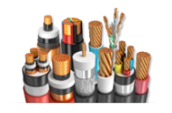
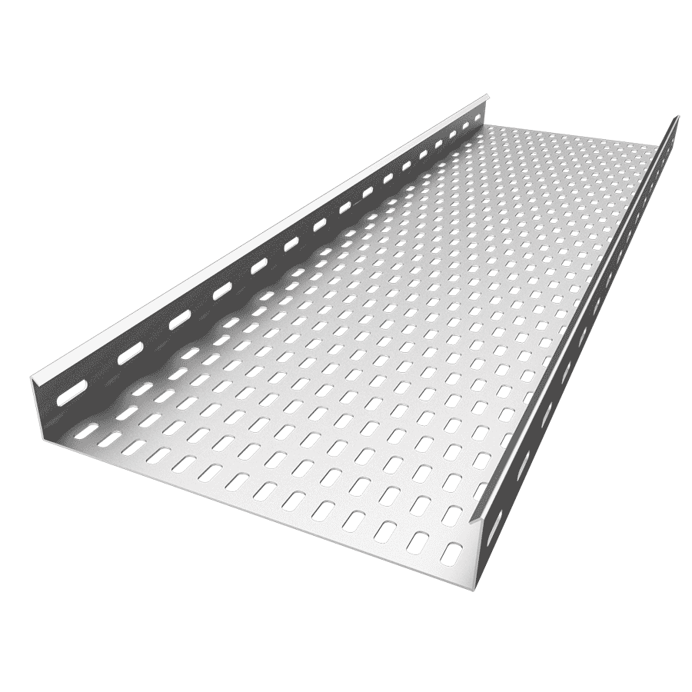
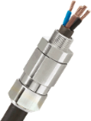
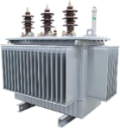
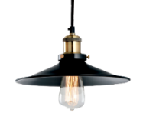
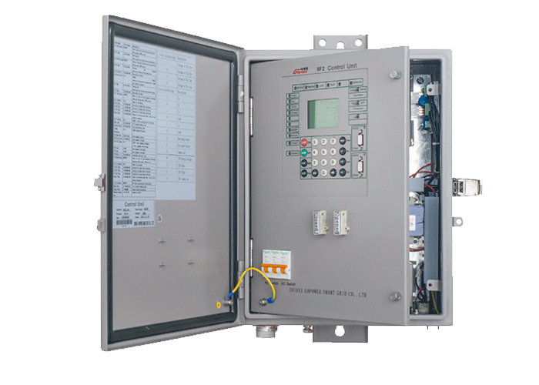
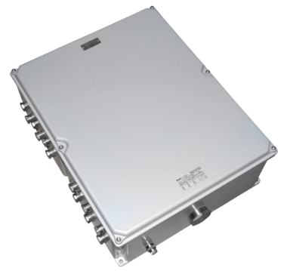
Electrical equipment and materials
ELECTRICAL
Cables, Cords,
Wires and Accessories
1,004,436 m,pk,drum
Cable Racks and Trays
38,395 ea,m,pk
Transits and Glands
64,390 ea,pk
Transformers and accessories
53/502 ea/asy
Lamps,
Lighting fixtures, Lighting Equipment
20,714 ea
Switch / Control equipment
99 ea,pk,box
Distribution Equipment and Materials
27,015 ea, pk

Slide 23



technicalsupport@imbc.kz
+ 7 (7172) 39-99-66
www.imbc.kz
The range and specificity of services for assistance in the development of the potential of manufacturers, offered by IMBC, are limited and are subject to provision on an individual basis, depending on the readiness of the manufacturer to supply their manufactured goods in line with the requirements of the Operators.
Assistance from IMBC does not oblige any retaliatory action from the potential manufacturer. The services of IMBC do not represent a guarantee of the successful participation and / or successful award of Contracts to the manufacturer in the procurement processes of the Operators.

Slide 24
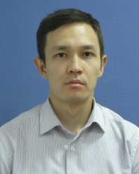
KPO Supplier Database
Merkhat Brekeyev
Senior Vendor Qualification Specialist

Slide 25
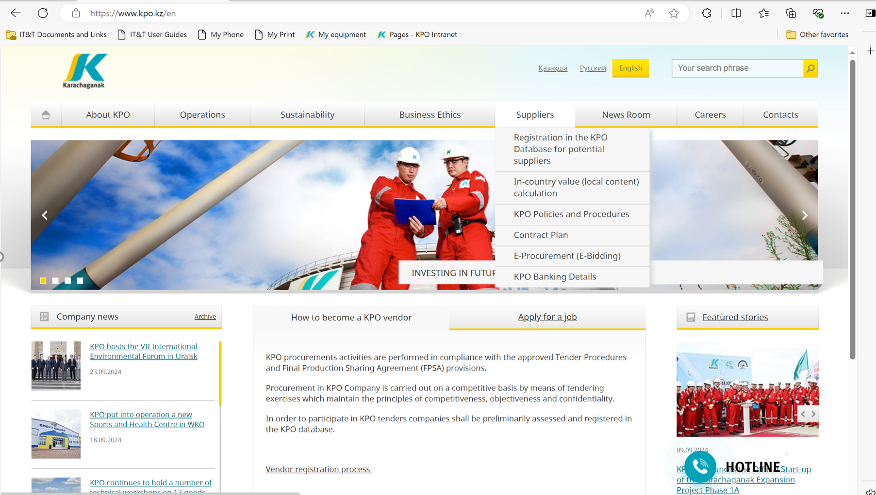
KPO SUPPLIERS DATABASE

Slide 26
VENDOR REGISTRATION
All potential suppliers shall be registered in KPO Database
REGISTRATION PROCESS
REGISTRATION
Provision of information on:
Technical Competency
Work Experience in the declared categories of goods and / or works and / or services
Personnel Availability
Financial Turnover
etc.
ETHICAL DUE DILIGENCE
Define an Ethical Due Diligence level in accordance with KPO Legal requirements:
Compliance with Kazakhstan and Foreign legislation
Compliance with Company internal regulations
Submission of potential suppliers shareholder lists
Vendor registration in KPO Vendor Database does not guarantee the participation in a tender or contract award, but suggests that a registered company may be considered as a market research participant for provision of goods, works and services for further pre-qualification process or tender as the need arises.

Slide 27
VENDOR REGISTRATION
To register in KPO Vendor Database, potential supplies shall:
  Download a questionnaire on KPO website – https://kpo.kz/ru/postavshchikam/registracija-v-baze-dannykh-postavshchikov-kpo
  Fill in the questionnaire for the preliminary vendor assessment and indicate activity codes
  Attach copies of required documents
  Submit the completed pack of documents for vendor assessment and registration by e-mail at MIVQ@kpo.kz
  Contact phone: +7 (711336) ext. 4943, 4946, 2192
  KPO encourages Suppliers to update registration data on an ongoing basis, related to:
    Work Experience in the declared categories of goods, works, services
    Certification, accreditation
    Reorganization
    Contact persons

Slide 28
MARKET RESEARCH
Purpose
  Define potential suppliers of goods, works, services who can perform as per KPO requirements
  Ensure free competition for KPO tenders
PROCESS
Demand determination and vendor searching
Issue of Invitation Letter for Expression of Interest
Market Intelligence Report
Approved
Tender List
Approvals

Slide 29
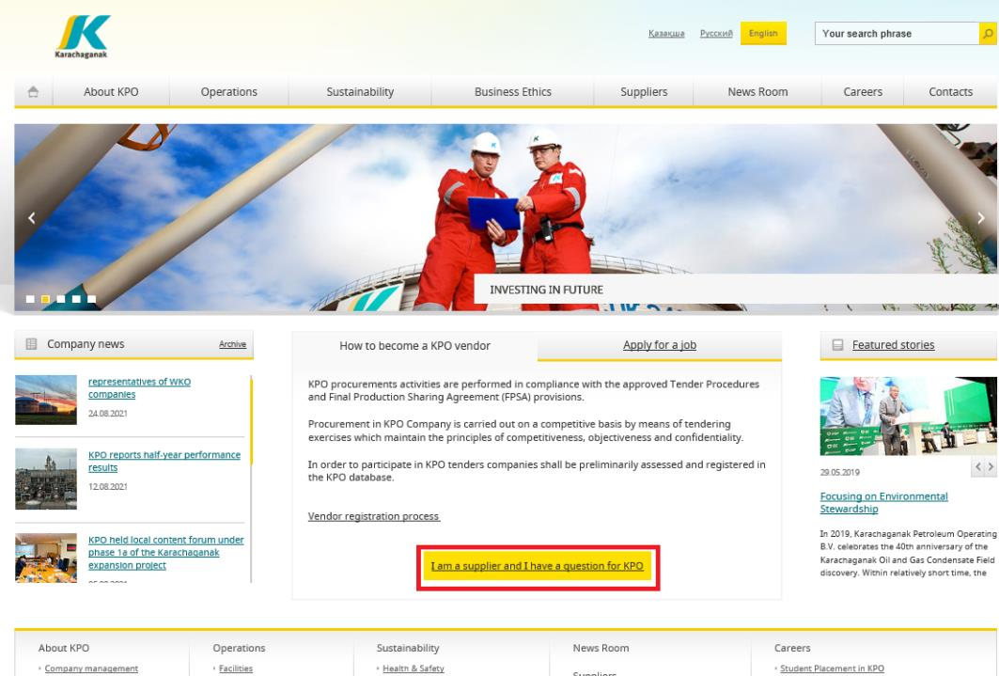
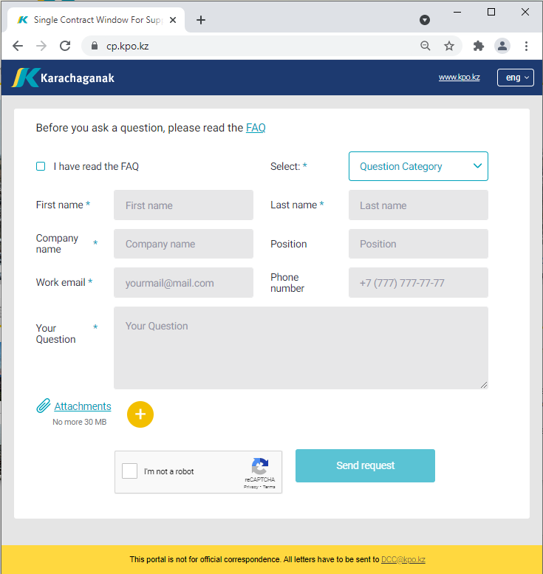
‘’SINGLE WINDOW’’ SYSTEM

Slide 30
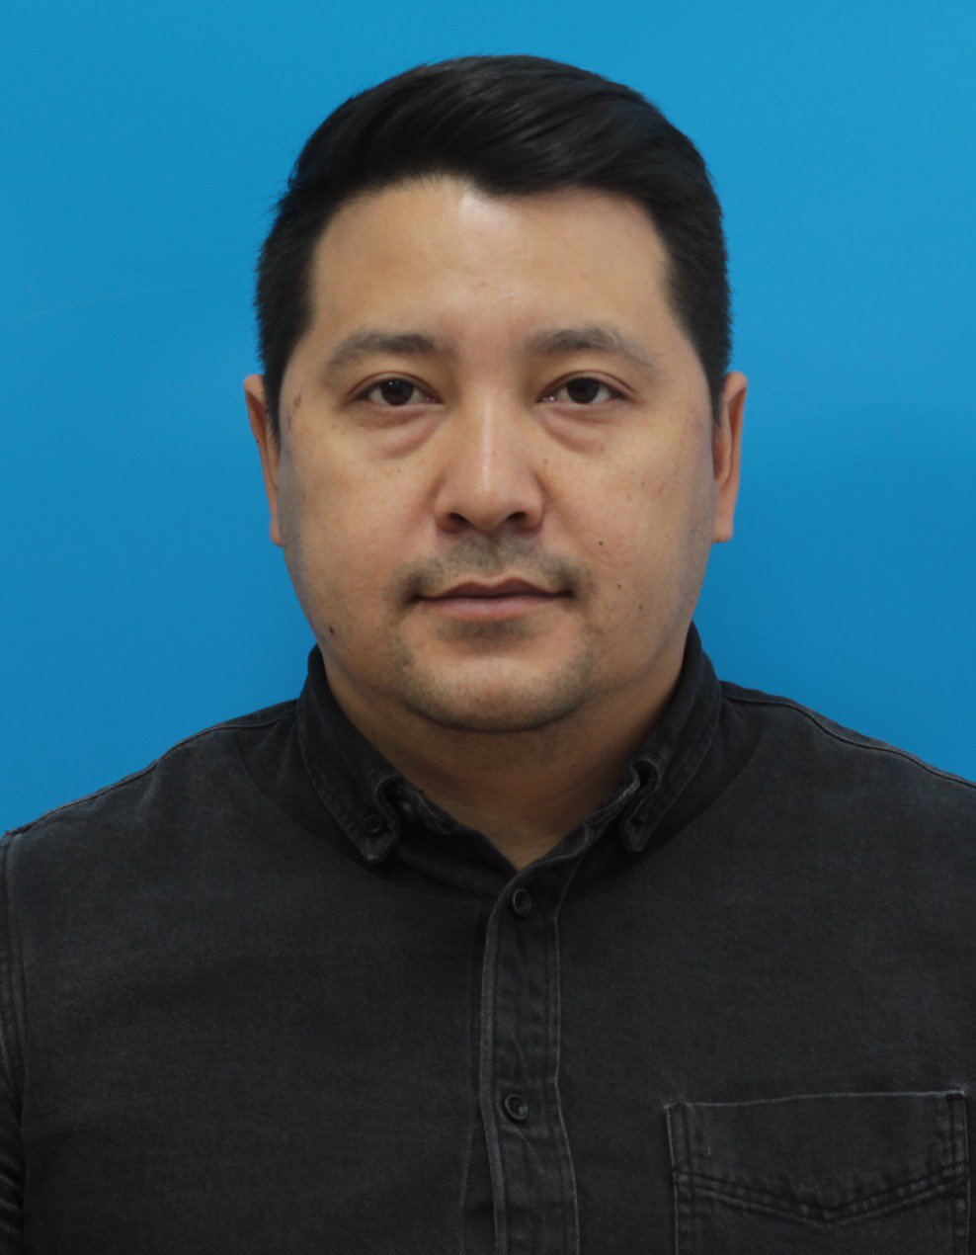
Asset Zhakupov
Contracts and Procurement
Expert
Procurement
Process

Slide 31
PROCUREMENT PROCESS
KPO shall perform the procurement activities in accordance with:
  the Final Production Sharing Agreement (confidential and intended only for the use of KPO, its Shareholders and the Republic) and the Joint Operating Committee’s Tender Procedures (JOC)
  current legislation
  approved budget and work program
PROCESS
MARKET RESEARCH / PREQUALIFICATION
INVITATION
TO TENDER
TENDERING PERIOD
TENDER DUE DATE
EVALUATION OF TENDERS
CONTRACT AWARD
CONTRACT
SIGNING
CONTRACT
PERFORMANCE

Slide 32
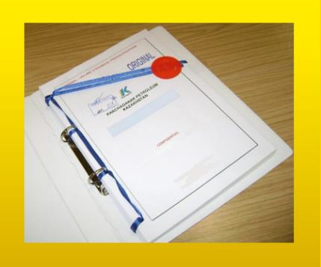



MAXIMUM ATTENTION SHALL BE PAID TO
TENDER PACKAGES SUBMISSION REQUIREMENTS
TENDER PACKAGES SUBMISSION REQUIREMENTS THROUGH E-BIDDING SYSTEM
(Link to the instructions)
INSTRUCTIONS
TO TENDERERS
TENDER DUE DATE / TIME

Slide 33
TENDER DOCUMENTATION CONTENTS
Cover letter
Forms, that shall be mandatorily signed, stamped and provided within timeframe specified:
Tender Acknowledgement and Confidentiality Agreement
Form of Tender
Certificate of Corporate Ownership and Declaration of Compliance
A package of documents related directly to the tender subject itself
Instructions to Tenderers
Form of Contract includes:
Form of Agreement
Schedule A – General Terms and Conditions
Schedule B – Scope of Goods/Services to be Supplied and Specifications
Schedule C – Compensation and Payment
Schedule D – Health, Safety and Environment (HSE) requirements
Schedule E – Special Conditions
Schedule F – Statement of Local Content
Schedule H – Industrial Relations
Questionnaire for Tender Participants
List of goods and technical delivery conditions (if applicable)
Instructions for preparing a tender proposal:
Instructions to Tender Participants
Bid marking template

Slide 34
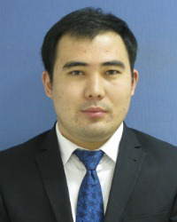
Yernar Ibrayev
Local Content Analyst
Local Content
Mechanisms

Slide 35








SUPPORTING MECHANISMS FOR LOCAL COMPANIES
TRIAL ORDER
EARLY TENDER
KAZAKH TENDER
Tenders for testing a trial batch of GOODs from Kazakhstani suppliers
Contract is concluded for the supply of GOODS with a suspensive condition or with a long-term delivery schedule
Tenders exclusively among Kazakhstani Suppliers. The goal is to award contracts to Kazakhstani suppliers of GWS
CONTRACT IN EXCHANGE FOR INVESTMENTS (UNDER REVISION)
  A contract in exchange for investment is a long-term contract concluded on a Single source basis, under which the supplier undertakes to produce goods of local origin that are the subject of a procurement contract in the territory of the Republic of Kazakhstan

Slide 36
Thank you!

Slide 37


