Slide 1
KPO TECHNICAL WEBINAR ON FIREFIGHTING EQUIPMENT, HANDLING EQUIPMENT
AND MATERIALS WITH THE PARTICIPATION OF THE IMB CENTER
KARACHAGANAK PETROLEUM OPERATING B.V

Slide 2
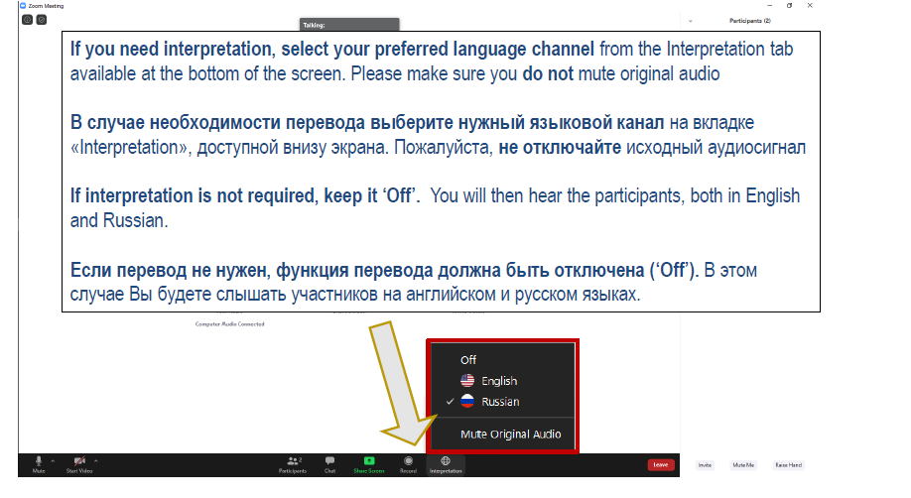
ЯЗЫКОВОЙ КАНАЛ/LANGUAGE CHANNEL

Slide 3
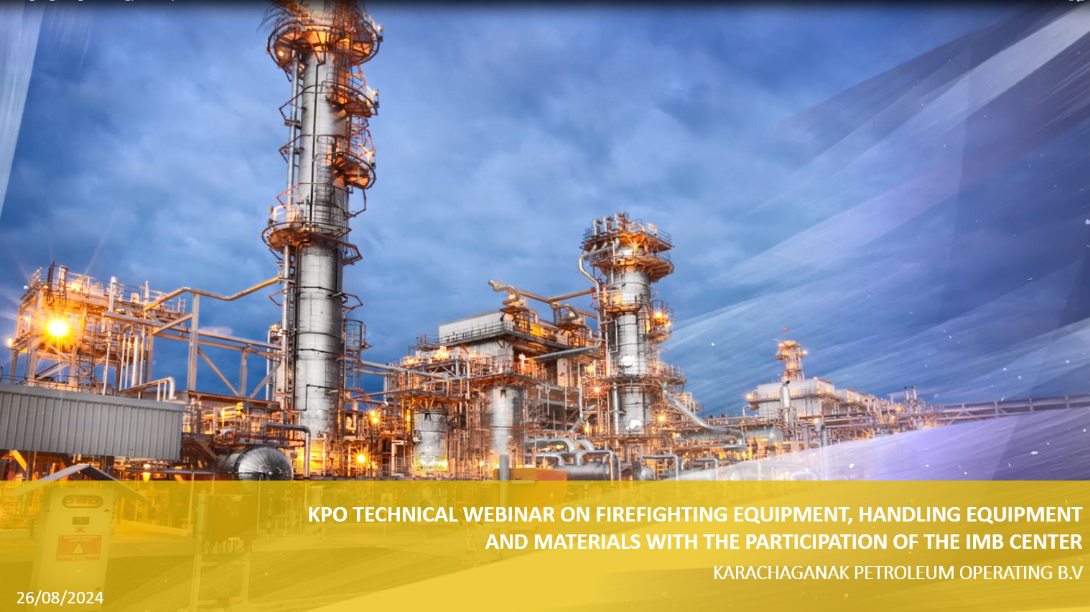
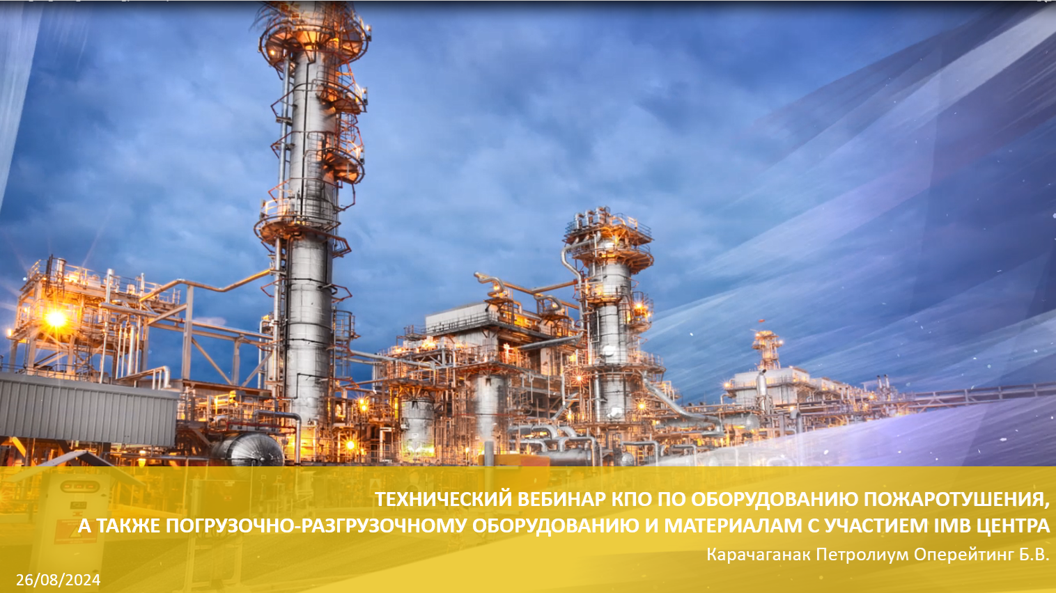
ЯЗЫК ПРЕЗЕНТАЦИИ/PRESENTATION LANGUAGE
  Content is available in Russian and English language; select the presenter displaying the content in your preferred language by clicking on the “View Options” tab at the top of the screen.
  Презентация доступна на русском и английском языке; выберите человека, представляющего содержание на предпочитаемом Вами языке, нажав “View Options” верхней части экрана.
  Damir Kazhushev – English language
  Yernar Ibrayev – Русский язык

Slide 4
WEBINAR RULES
  We will have a Facilitator to manage this event
  Everyone except Presenters will be muted
  If you want to ask a question, please type it in the comments box
  Try to hold questions to the end of the presentation
  Be open, honest and respectful
  Don’t
    use this webinar to market your company
    ask a question regarding any specific Tender/Contract
    expect total clarity and precise response to your every question
26/08/2024 CONFIDENTIAL KARACHAGANAK PETROLEUM OPERATING B.V

Slide 5
SAFETY MOMENT
  KPO Video

Slide 6
AGENDA
  WELCOME SPEECH
  OVERVIEW OF FIREFIGHTING EQUIPMENT USED IN KPO
  OVERVIEW OF HANDLING EQUIPMENT AND MATERIALS USED IN KPO
  OVERVIEW OF THE IMBC ACTIVITIES
  KPO SUPPLIERS DATABASE
  KPO PROCUREMENT PROCESS
  LOCAL CONTENT MECHANISMS
  Q&A SESSION
26/08/2024 CONFIDENTIAL KARACHAGANAK PETROLEUM OPERATING B.V
6

Slide 7
DISCLAIMER
The information contained in these slides is made available for consideration. It represents KPO's preliminary description of the KPO demands as presently envisaged, but KPO reserves the right to change this information in the course of planning and implementing the projects, and KPO cannot be held responsible for any loss, damage or expense arising from reliance on this information. The information will not form part of any agreement between KPO and business partners participating in the workshop.
Today's engagement is one of many steps which KPO and its stakeholders are taking to develop local content.
29/07/2024 CONFIDENTIAL KARACHAGANAK PETROLEUM OPERATING B.V

Slide 8
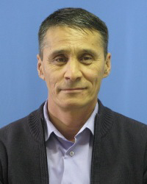
Operations HSE Department
Adil Makanov
Operations Laboratory Superintendent
26/08/2024 CONFIDENTIAL KARACHAGANAK PETROLEUM OPERATING B.V

Slide 9
FIRE FIGHTING AND RESCUE EQUIPMENT
  REVIEW OF THE BREATHING APPARATUS
  REVIEW OF THE PRIMARY FIRE EXTINGUISHING EQUIPMENT (FIRE EXTINGUISHERS)
  FIRE FIGHTING EQUIPMENT
  FIRE FIGHTING FOAMING AGENT
9

Slide 10
Review of the Breathing Apparatus
BREATHING APPARATUS
1

Slide 11
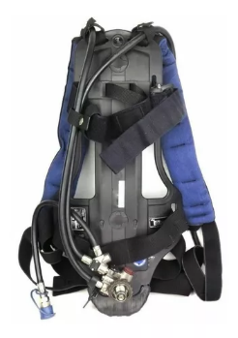
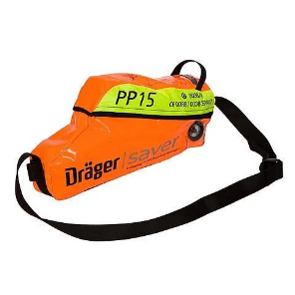
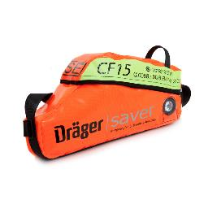
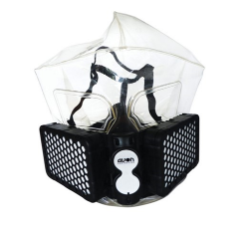
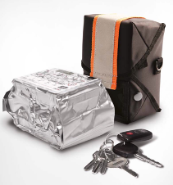
SELF-CONTAINED COMPRESSED AIR BREATHING APPRATUS
Definition and purpose of BA and Escape sets
Definition:
Self-contained compressed air breathing apparatus is an isolating breathing apparatus which is used during rescue operations, fire extinguishing and other situations when ambient air of the work area may pose an immediate risk to human life or/and health.
Escape breathing apparatus is a breathing apparatus with excess pressure intended to protect respiratory system of the person during emergency evacuation. It may be broadly used in the areas with oxygen deficiency / hypoxia, at high or unknown concentrations of toxic gasses that pose a threat to a person.
Filter hood -
is designed to protect personnel from hazardous and harmful chemical substances (hereinafter - hazardous chemicals) during emergency evacuation from the affected area.

Slide 12
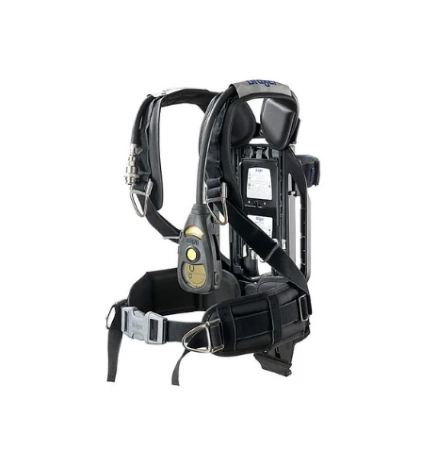
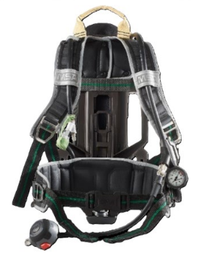
SELF-CONTAINED COMPRESSED AIR BREATHING APPARATUS
1. Self-contained compressed air breathing apparatus are divided into (SCBA)
Main technical specifications:
Compliance with requirements for fire rescue services EAEU TR 043/2017 “On requirements for fire safety and fire extinguishing means”
Certificate CT-KZ (CERTIFICATE OF ORIGIN) for the product manufactured in the territory of the RoK.
The apparatus is designed to be used at ambient temperature form -40 to +60 C;
Average pressure 6-11 bar;
Service life of the apparatus at least 10 years;
SCBA weight is 6 kg.
Waist strap with rotating sliding
mechanism.

Slide 13
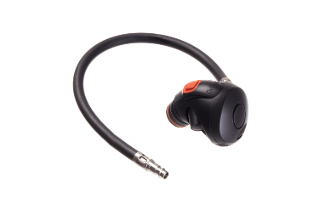
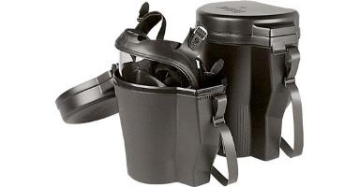
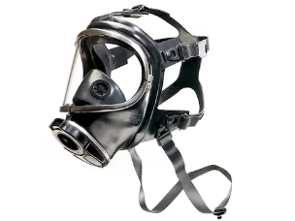
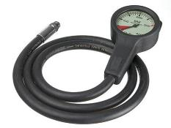
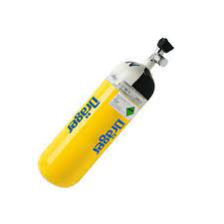
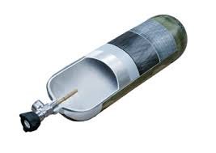
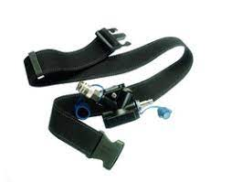
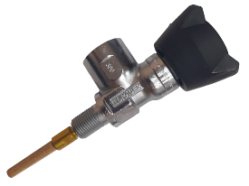
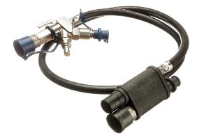
SELF-CONTAINED COMPRESSED AIR BREATHING APPARATUS
1. Self-contained compressed air breathing apparatus are divided into (SCBA)
Composition (SCBA)
Harness with swivel waist belt
Cylinder with a valve
Reducer with a safety valve
Lung demand valve
Warning device providing early alert when compressed air stock nears to end
in cylinder
Device for additional air supply (bypass, forced air supply on lung demand valve)
Pressure gauge
Facepiece with intercom
Exhalation valve
Bag (case) for facepiece main part
Appropriate labelling and documentation

Slide 14
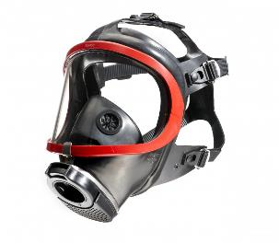
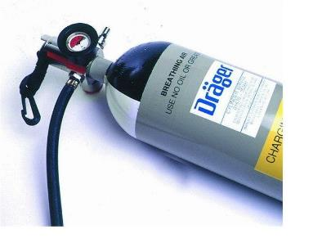
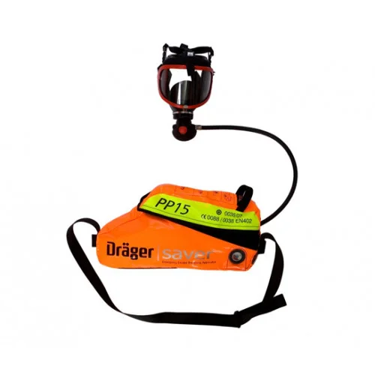
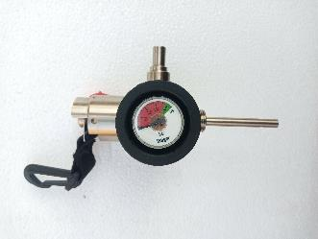
COMPRESSED AIR ESCAPE SET
2. Compressed air full face mask escape set
Main technical specifications
Certificate of conformity ТР ТС 019/2011
Certificate in accordance with EN 402:2003 (for mask type)
Facepiece requirements, full face mask GOST 12.4.293-2015 (EN 136:1998)
Operating temperature from -30 to +60 C
Protection time 15-20 min
Escape set weight no more than 5 kg.
Service life of the escape set at least 10 years
Composition (escape set)
Cylinder(s) with shut-off valve and automatic air supple activation
Reducer (regulator)
Facepiece - full face mask with lung demand valve
Pressure Indicator
Carrying bag and harness for storage and carrying (ergonomic design).
Appropriate labelling and documentation

Slide 15
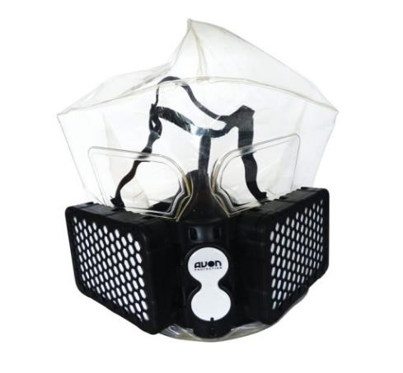
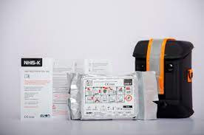
COMPRESSED AIR ESCAPE SET
3. Filter hood
Main technical specifications:
Certificate of conformity ТР ТС 019/2011
GOST 12.4.235 with class “B2” filter protection
Certificate CT-KZ ( certificate of origin) for the product, manufactured on the territory of the RoK.
Operating temperature from -40 to +60 C
В2 filters or AxB2ExKx combined filters compliant with GOST 12.4.235 (EN 14387:2008)
Air flow resistance during the constant flow rate of 95 l/m should not exceed 800 Pa when inhaling and 300 Pa when exhaling
Escape set components impacted by flame should not ignite within 5 seconds and should be free of burning once they are removed from the fire
Weight of the filter hood shall be less than 1 kg with package, including a carrying device
The shelf and service life shall be at least 5 years

Slide 16
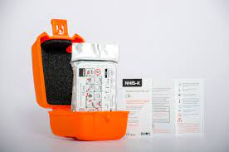
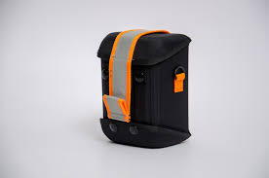

SELF-CONTAINED COMPRESSED AIR BREATHING APPARATUS
3. Filter hood
Components (of filter hood)
Facepiece - hood
Filter (s)
Package
Carrying device bag or (case)
Appropriate labelling and documentation

Slide 17
USAGE FORECAST FOR THE NEXT 2-3 YEARS
Description | 2025 | 2026 | 2027
 | Quantity (pcs)
SCBA | 250 | - | -­
Escape Set | 350 | - | -­
Filter Hood | 800 | 800 | 800
The above table is based on forecasts from KPO facilities and does not include unplanned usage and procurement by business partners working in the Karachaganak field

Slide 18
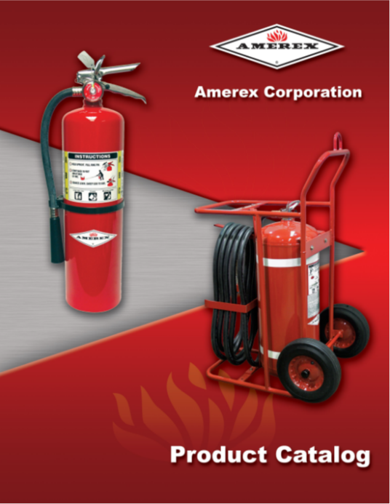
  Review of the primary fire extinguishing equipment (fire extinguishers)
FIRE EXTINGUISHERS
2
26/08/2024 CONFIDENTIAL KARACHAGANAK PETROLEUM OPERATING B.V

Slide 19
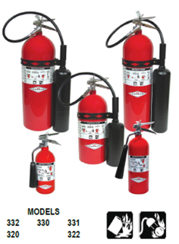
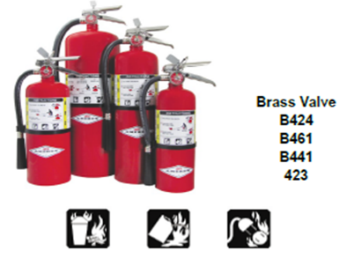
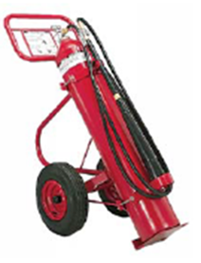
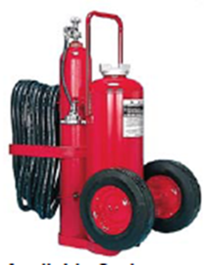
FIRE EXTINGUISHER CLASSIFICATION USED AT KPO FACILITIES
Fire extinguishers are divided into:
Portable (weighing up to 20 kg)
Mobile (weighing at least 20 kg, but no more than 400 kg., having one
or several loading pots for extinguishing agent which are
mounted on the trolley).

Slide 20







FIRE EXTINGUISHERS CLASSIFICATION USED AT KPO FACILITIES
Portable and mobile fire extinguishers depending on the extinguishing agent used, are classified for the following types:
Powder extinguisher -
for extinguishing fires
of classes A,B,C,D;
Carbon dioxide extinguishers -
for extinguishing fire
of classes B,C,E

Slide 21
SUPPORTING DOCUMENTATION REQUIREMENTS
Manufacturer’s data-sheet (in state and Russian languages).
Guidelines for use, maintenance and reloading from the manufacturer (in state and Russian languages).
Document confirming origin of this product
Portable fire extinguishers purchased for KPO shall comply with
technical requirements:
RoK standard GOST Р 51057
ЕАEU 043/2017 “On requirements for fire safety and fire extinguishing means”

Slide 22
USAGE FORECAST FOR THE NEXT 2-3 YEARS
Description | Total in KPO* | 2024 | 2025 | 2026 | 2027
 |  | Quantity
Powder fire extinguisher (8-10 kg powder) | 1528 | 12 | 9
Powder fire extinguisher (4-6 kg powder) | 321 | 8 | 5
Powder fire extinguisher (1-2 kg powder) | 216
Carbon dioxide fire extinguisher (3-5 kg. CO2) | 640 | 15 | 2
Carbon dioxide fire extinguisher (6-8 kg. CO2) | 137 | 5
Mobile dry powder fire extinguisher (40-80 kg of powder) | 276 | 6
Mobile carbon dioxide fire extinguisher (15-25 kg. CO2) | 71
Total: | 3189 | 46 | 16
Data in the table above based on the forecast from KPO facilities
*KPO facilities are fully provisioned
This forecast does apply to the procurement for the current and future capital construction projects of the field facilities.

Slide 23
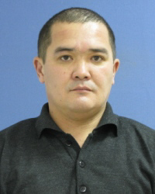
Operations HSE Department
Timurlan Yeskaliyev
Emergency Response Coordinator
26/08/2024 CONFIDENTIAL KARACHAGANAK PETROLEUM OPERATING B.V

Slide 24
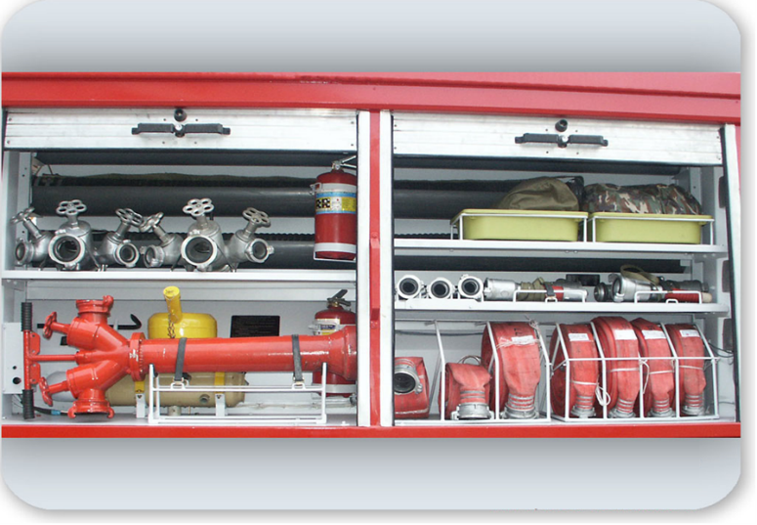
Review of the Fire fighting equipment
FIRE FIGHTING EQUIPMENT
3
26/08/2024 CONFIDENTIAL KARACHAGANAK PETROLEUM OPERATING B.V

Slide 25
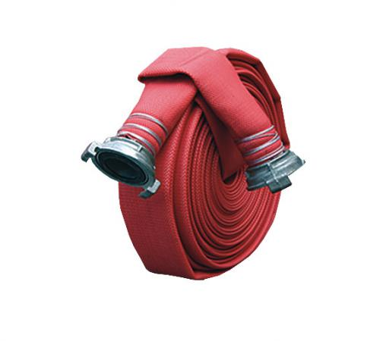
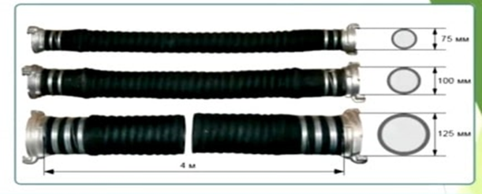
FIRE HOSES SPECIFICATIONS
Fire pressure hose specification
Pressure hoses 20 m with diameter of 51 mm, 66 mm, 77mm, 89mm, 150 mm
Designated for supply of fire-fighting media to the fire from the fire truck or a cabinet/valve.
Detailed specifications are available in the relevant GOST
Suction hose specification
Suction hose designed to collect water form water source using a fire pump.
Delivery-suction hose designed to collect water from a water source using a fire pump or fire extinguishing water supply system and transporting it for fire fighting purposes.
Design of both hoses is identical. Suction type hoses consist of several layers: inner rubber, intermediate textile (textile is laid in several layers) outer rubber. Wide temperature range, material durability, flexibility of the hose are the main requirements of the profile state standard for such products. In addition, the suction type hose should not “fold” when the water is not supplied from the pump.
Suction hoses: 4m length and 125 mm diameter
Pressure-suction hoses: 4 m length and 75 mm diameter.
Detailed specifications are available in the relevant GOST
26/08/2024 CONFIDENTIAL KARACHAGANAK PETROLEUM OPERATING B.V

Slide 26
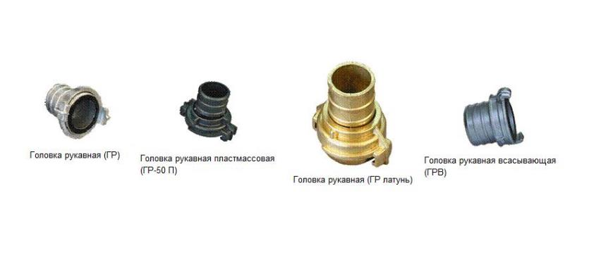
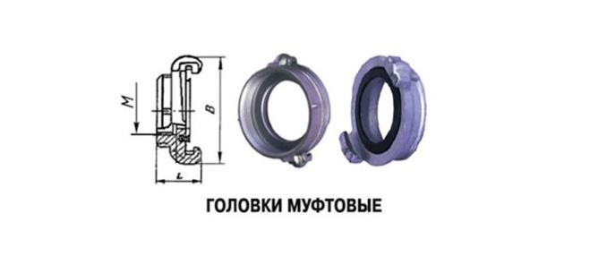
FIRE FIGHTING EQUIPMENT
Purpose of the head | Nominal diameter, type | MPa
Pressure fire-fighting heads for fire trucks | 25, 40, 50, 65, 40x50, 65x50, all types | 3.0
 | 25, 50x25, all types | 2.0
 | 40, 50, 65, 80, 90, 40x50, 65x50, 80x50, 80x65, all types | 1.6
 | 150, all types | 1.2
Pressure fire-fighting heads for internal fire hydrant | 40, 50, 65, all types | 1.0
Suction | ГРВ-80, ГМВ-80, ГЗВ-80, ГМВ-100, ГЗВ-100, ГМВ-125, ГЗВ-125 | 1.0
 | ГРВ-100; ГРВ-125; | 0.1
.
26/08/2024 CONFIDENTIAL KARACHAGANAK PETROLEUM OPERATING B.V

Slide 27
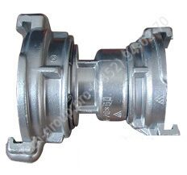
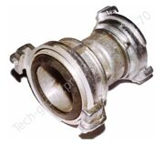
FIRE FIGHTING EQUIPMENT
Coupling adapter head ГП-50*65 (50*70)
Coupling adapter head ГП-50*65 (50*70)
Adapter head ГП-70*80 (65*80
Adapter head ГП-125*150, 100*125
Coupling pressure hose heads ГП are designed to connect pressure hoses between each other and with other equipment.
The fire heads consist of bushing made in the form of cap with recess for rubber sealing ring and cage which is freely put on the bearing part.
Heads are connected to the hoses using soft galvanised wire or rings.
All products can be manufactured in cold, temperate or tropical version GOST 15150.
Heads are available in various diameters; with male and female threads;
Supplied with O-rings
“
26/08/2024 CONFIDENTIAL KARACHAGANAK PETROLEUM OPERATING B.V

Slide 28
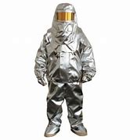
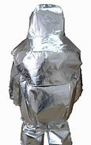
HEAT REFLECTIVE SUIT 200
Heat reflective suit - TOK 200. Purpose: to protect from high thermal effect in the vicinity of fire.
Performance characteristic of the ТОК-200
200 indicates that the suit will protect you in the area exposed to open flame of 200 °C at least 10 minutes.
Weight of the suit is from 8 to 10 kg according to size range.
Open flame resistance - at least 20 seconds.
Heat flux resistance, at least 18 kW -600 sec; 10 kW - 900 sec.
Durability in contact with hard surface heated up to 400 °С - not less than 5 seconds.
Infra-red attenuation coefficient - minimum 75% of the initial
Typical figure size as per GOST 17523-72. Typical figure height, cm. Size of the TOK-200
48-50 158-154/1 52-54 170-176/2 56-58182-188/3
26/08/2024 CONFIDENTIAL KARACHAGANAK PETROLEUM OPERATING B.V

Slide 29
HEAT REFLECTIVE SUIT -800
Heat reflective suit TOK-800 Purpose: to protect from high thermal effect in the vicinity of fire.
Performance characteristic of the ТОК-800
800 indicates that the suit will protect you in the area exposed to open flame of 200 °C at least 20 minutes.
Weight of the suit is from 16 to 20 kg according to size range.
Resistance to 800°C - at least 20 seconds.
Open flame resistance - at least 30 seconds.
Heat flux resistance, at least 18 kW – 960 sec; 25 kW – 240 sec. 40kW – 120 sec.
Durability in contact with hard surface heated up to 400 °С - not less than 5 seconds.
Infra-red attenuation coefficient - minimum 75% of the initial
Typical figure size as per GOST 17523-72. Typical figure height, cm. Size of the TOK-800
48-50 158-154/1 52-54 170-176/2 56-58 182-188/3
26/08/2024 CONFIDENTIAL KARACHAGANAK PETROLEUM OPERATING B.V

Slide 30
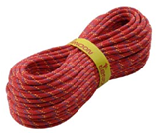
STATIC AND DYNAMIC ROPE FOR WORKING AT HEIGHT
Large margin of safety and wear resistance for use in the most severe conditions. . A type static rope – is the most durable and wear-resistant in its class.
Diameter is 10 mm
Braid shear 3 mm
Elongation (50-100 kg) 4.8 %.
Weight 69 g/m
Shrinkage 0%.
Strength 30 кN.
Strength with knots minimum 15 кN.
Type «А».
Dynamic rope 10.2 mm
The core and braid design absorbs the energy of the fall and ensures smooth braking in case of failure. Diameter is 10.2 mm
Weight 68 g/m
Number of tugs UIAA (with factor 2) – 7.
Maximum force of the 1st tug – 800 kg
26/08/2024 CONFIDENTIAL KARACHAGANAK PETROLEUM OPERATING B.V

Slide 31
TECHNICAL SPECIFICATIONS OF THE FIRE FIGHTING EQUIPMENT
51, 66,77 mm diameter pressure hoses purchased for KPO shall comply with technical requirements current GOST 7888-75
75 mm diameter deliver-suction hoses purchased for KPO shall comply with technical requirements of current GOST 5398-76
125 mm diameter suction hoses purchased for KPO shall comply with technical requirements of current GOST 5398-76
TECHNICAL REQUIREMENTS TO ESCAPE ROPES
Dynamic ropes purchased for KPO shall comply with technical requirements of current EN 892 or GOST P 58921
Static ropes purchased for KPO shall comply with technical requirements of current EN 1891
International standard “Labor safety standard system of personal protective equipment from falling from height”. Low tensile core ropes GOST EN 1891-2014.
Fire rescue ropes purchased for KPO shall comply with technical requirements of current RoK standard 1793-2008
26/08/2024 CONFIDENTIAL KARACHAGANAK PETROLEUM OPERATING B.V

Slide 32
USAGE FORECAST FOR THE NEXT 2-3 YEARS
FFE description | Unit of measure | 2025 | 2026 | 2027
 | Quantity
Pressure hoses d-51mm, d-66mm, d-77mm, d-150mm. | ea. | 50 | 30 | 20
Suction hose d-77mm, d-125mm, d-200mm. | ea. | 12 | 12 | 12
Adapter heads 50х70/50х80/80х70/80х77/150х125. | ea. | 60 | 60 | 60
Branching РТ-80 | ea. | 10 | 10 | 10
Suction mesh СВ-125 | ea. | 10 | 10 | 10
Heat reflective suit TOK-200 | ea. | 10 | 10 | 10
Backpack fire extinguisher РЛО | ea. | 16 | 12 | 12
Insulating gloves | ea. | 10 | 10 | 10
Dielectric mats | ea. | 10 | 10 | 10
Insulating footwear | ea. | 10 | 10 | 10
Static rope | m | 200 | 200 | 200
Dynamic rope | m | 200 | 200 | 200
Data in the table based on the forecast from provision of the fire brigades at KPO facilities
*KPO facilities are fully provisioned
26/08/2024 CONFIDENTIAL KARACHAGANAK PETROLEUM OPERATING B.V

Slide 33
FIRE-FIGHTING FOAM
FF foam concentrate should have properties and meet the requirements for creating a low, medium and high expansion foam, which will be used to control and eliminate water-immiscible hydrocarbon fires.
AFFF (6 %) – synthetic fluorinated film-forming foam for fighting liquid hydrocarbon fires with low expansion foam.
Fluorine-free synthetic foam. This foam type is used to eliminate Class A (flammable solids) and class B (flammable liquids) fires and creates low-medium expansion foam.
No | Testing Parameter | Specification
1 | Appearance | Liquid without precipitation and exfoliation
2 | Density @ 20°С, kg/м3 - not less - not more | 1000 1100
3 | Kinematic Viscosity @ 20 0С, мм2 ∙ s-1, not more | 10
4 | рН - not less - not more | 6.5 8.5
5 | Pour point, oС, not higher | minus 15
6 | Maximum storage temperature, ºС, не ниже | 45
7 | Minimum application temperature, oС, not higher than | minus 15
8 | Effect of freeze/thaw | No loss of performance
9 | Concentration of working solution for getting foam,% | 6
10 | 6% Foam expansion rate: not more | 20:1
11 | Stability of low expansion foam, s: | 180
12 | Extinguishment time for flammable liquids when supplying foam mixed with hard water at the flow rate of 0,059 ± 0,002 dm3/v2·s, s, not more than | 90
13 | Reignition time for the standardized fire after being extinguished by foam, s, not less than | 450
14 | Corrosion Activeness of foaming agent, mm per year, within limits | 0,01-0,05
15 | Compatibility with powder extinguishing agents | Yes
26/08/2024 CONFIDENTIAL KARACHAGANAK PETROLEUM OPERATING B.V

Slide 34
FIRE-FIGHTING FOAM – CONSUMPTION FORECAST
Type | 2024 | 2025 | 2026 | 2027
 | Volume (m3)
AFFF | 20 | 15 | 15 | 15
FFF | 20 | 15 | 15 | 15
The forecast is based on the annual consumption for testing of fixed automatic fire-suppression systems and mobile fire-fighting equipment.
Additional consumption is possible as a result of activation of automatic fire-suppression systems and unsatisfactory results of foam quality testing.
26/08/2024 CONFIDENTIAL KARACHAGANAK PETROLEUM OPERATING B.V

Slide 35
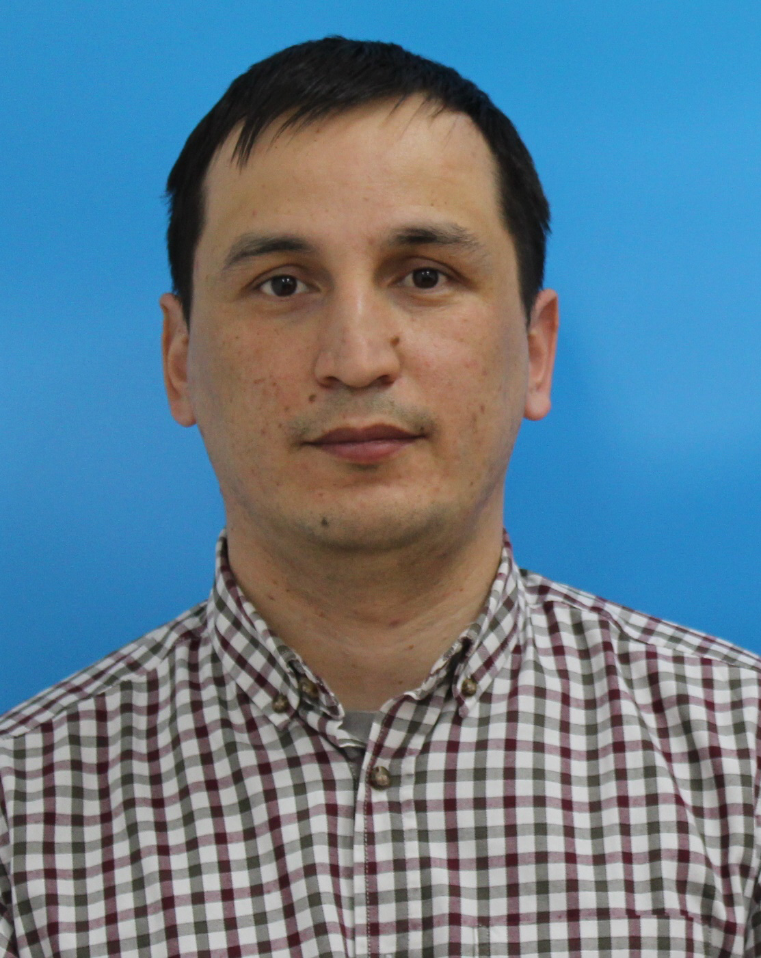
Bauyrzhan Auganbayev
Lead Lifting Operations and Maintenance Engineer
Special Transport and
Logistics Department
26/08/2024 CONFIDENTIAL KARACHAGANAK PETROLEUM OPERATING B.V

Slide 36
Overview of the removable holding devices
Removable holding devices
4
26/08/2024 CONFIDENTIAL KARACHAGANAK PETROLEUM OPERATING B.V

Slide 37
LIFTING GEARS
01
Webbing sling
02
Round webbing sling
03
Four leg chain sling
04
EYE BOLT
05
Bow shackle
06
Chain Block
07
Lever Hoist
08
Master Ring
09
Lifting clamps
37
26/08/2024 CONFIDENTIAL KARACHAGANAK PETROLEUM OPERATING B.V

Slide 38
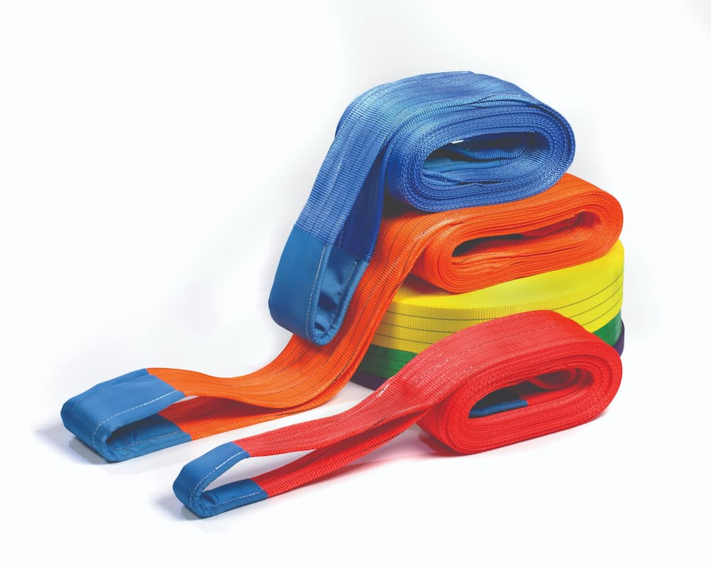
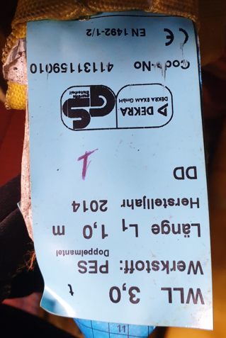
WEBBING SLING
All webbing slings must comply with EN 1492-1/2 standard
№ | Removable holding device or container name | Removable holding device lifting capacity (kg)
1 | Webbing sling 4m | 1000
2 | Webbing sling 5m | 1000
3 | Wwebbing sling 6m | 1000
4 | Webbing sling 8m | 1000
5 | Webbing sling 4m | 2000
6 | Webbing sling 5m | 2000
7 | Webbing sling 6m | 2000
8 | Webbing sling 8m | 2000
9 | Webbing sling 4m | 3000
10 | Webbing sling 5m | 3000
11 | Webbing sling 6m | 3000
12 | Webbing sling 8m | 3000
13 | Webbing sling 5m | 4000
14 | Webbing sling 6m | 4000
15 | Webbing sling 8m | 4000
16 | Webbing sling 6m | 5000

Slide 39
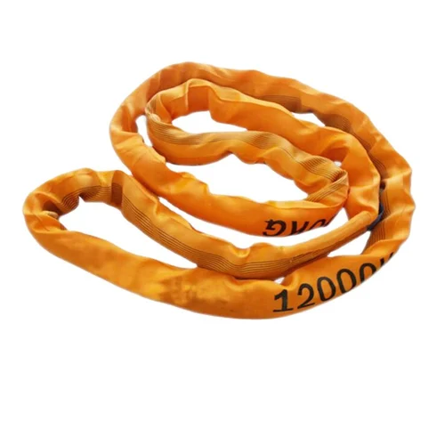
ROUND WEBBING SLING
Замените этот текст своим
№ | Removable holding device name | Removable holding device lifting capacity (kg)
1 | Round sling 1m | 1000 | 2000 | 3000 | 4000 | 5000 | 8000 | 10000
2 | Round sling 1,5m
3 | Round sling 2.5m
4 | Round sling 3m
5 | Round sling 4m
6 | Round sling 5m
7 | Round sling 6m
8 | Round Sling 8m
9 | Round Sling 10m
10 | Round Sling 12m

Slide 40
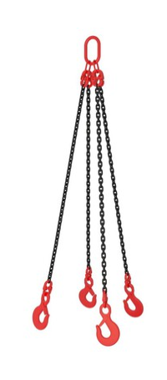
FOUR LEG CHAIN SLING
Замените этот текст своим
№ | Removable holding device name | Removable holding device lifting capacity (kg)
1 | Four leg chain sling | 11,200

Slide 41
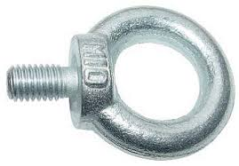

EYE BOLT
Замените этот текст своим
№ | Removable holding device or container name | Removable holding device lifting capacity (kg)
 | EYE BOLT | 400 | 500 | 635 | 1000 | 1180 | 1500 | 2000 | 2500 | 3000 | 3500 | 4000 | 5000 | 8000 | 10000
1 | EYE BOLT 1/2 |  |  |  |  | 1180
2 | EYE BOLT 3/4 |  |  |  |  |  |  |  | 2500
3 | EYE BOLT 3/5 |  |  |  |  |  |  |  | 2500
4 | EYE BOLT 3/8 |  |  | 635 |  |  |  |  | 2500
5 | EYE BOLT 5/8 |  |  |  |  |  | 1500
6 | EYE BOLT М30 |  |  |  |  |  |  | 2000 |  | 3000

Slide 42


BOW SHACKLE
Замените этот текст своим
Bow Screw Pin Shackle with no nut and pin is used for detachable connection of load
Bow Shackle with Safety Bolt and Pin for long-term securing of loads that do not require frequent opening of connecting elements and for man lifting as per procedure KPO-AL-HSE-PRO-00025
Removable holding device name | Removable holding device lifting capacity (kg)
Bow shackle | 3250 | 4000 | 4750 | 5750 | 6500 | 8500 | 9500 | 12000 | 17000 | 18000 | 25000 | 35000

Slide 43

CHAIN BLOCK
Chain hoists are hoisting devices that lift, secure and lower loads by cranking a chain that drives gearbox pinion shaft
Removable holding device name | Removable holding device lifting capacity (kg)
Chain Block | 2000
 | 3000
 | 5,000

Slide 44


LEVER HOIST
Ваш текст здесь
Ваш текст здесь
Removable holding device or container name | Removable holding device lifting capacity (kg)
Lever Hoist | 3,000
Lever hoist is used for lifting-lowering and holding loads when the operator stands near the hoist (wells, trenches, etc.).

Slide 45


MASTER RING
Ваш текст здесь
Ваш текст здесь
Master Ring used in rigging operations as an end element.
№ | Removable holding device name | Removable holding device lifting capacity (kg)
1 | Master Ring | 1,000
2 | Master Ring | 6,700
3 | Master Ring | 8,830
4 | Master Ring | 11,800
5 | Master Ring | 38,300
6 | Master Ring | 35,000

Slide 46






LIFTING CLAMPS
Ваш текст здесь
Ваш текст здесь
№ | Removable holding device name | Removable holding device lifting capacity (kg)
1 | CLAMP | 1,000
2 | CLAMP | 2,000
3 | CLAMP | 3,000
4 | CLAMP | 4,000
5 | CLAMP | 5,000
6 | CLAMP | 6,000
7 | CLAMP | 8,000

Slide 47
CONSUMPTION FORECAST
Category | Year 1 | Year 2 | Year 3 | Year 4 | Year 5
Eye Bolts | 76 | 28 | 36 | 84 | 32
Shackle | 84 | 32 | 40 | 84 | 32
Sling | 480 | 240 | 320 | 480 | 214
Grand Total | 640 | 300 | 396 | 648 | 278
* Quantity shown is indicative

Slide 48
Overview of IMB Center's activities
KPO TECHNICAL WEBINAR ON FIREFIGHTING EQUIPMENT,
HANDLING EQUIPMENT AND MATERIALS

Slide 49














SCOPE OF ACTIVITIES
DATA PROCESSING & CONSOLIDATION
ADVOCACY ISSUES
Major Operators
Consolidation of efforts provision of quantitative and technical data
Government
Facilitation and stimulation
Preferences & subsidies
LOCAL MARKET ANALYSIS & CAPACITY DEVELOPMENT
LOCALIZATION
& TECHNOLOGY TRANSFER
Machine building industry
Capacity development, international standards, Technology transfer

Slide 50
Commodities of interest
In our analyses of demands and identifying localization priorities, we utilize the FPAL coding system
FPAL Commodity Codes
Commodity Group A
Commodity Group B
Commodity Group C
Commodity Group D
1.01
Drilling Equipment
1.09
Electrical Equipment and Materials
1.04
Pumps and Seals
1.02
Material and Product Handling Equipment
1.03
Compressors / Expanders / Blowers and Accessories
1.02
Material and Product Handling Equipment
1.10
Instrumentation / Process Control Equipment / Materials
1.11
Process Filters
1.07
Heat Exchangers / Heat Transfer Equipment
1.05
Drivers and Accessories
2.02
Valves and Accessories
1.12
HVAC
1.16
Firefighting Equipment
2.03
Steel / Metal Materials
2.01
Line pipe
2.07
Chemical / Oils / Paints
2.11
Workshop and Handtools
2.99
Other Products / Equipment and Materials
2.08
Insulation / Refractory Materials
Procurement in above commodity groups accounts for over 75% of all procurement of goods by three Operators **
* According to the statistical data of Situational-analytical center of the Fuel and Energy complex of the Republic of Kazakhstan

Slide 51



















PROGRESS UNDER COMMODITY GROUPS
Commodity Group A
Commodity Group B
Commodity Group C
Commodity Group D
Demands analysis
35,000 items analysed
55,000 items analysed
7,000 items analysed
TBC
High demand goods identified
19 types of goods
18 types of goods
27 types of goods
TBC
Market analysis, longlist from available resources
more than 90
manufacturers identified
more than 100
manufacturers identified
more than 80
manufacturers identified
TBC
Site surveys, manufacturers who expressed interest
72 site surveys conducted
61 site surveys conducted
41 site surveys conducted
TBC
Shortlisting, manufacturers producing types of goods with high demands
23 manufacturers shortlisted
16 manufacturers shortlisted
In process
TBC
Capacity development
8 CDPs developed
3 CDPs developed
TBC
TBC
Implementation
of capacity development
3 recommended
manufacturers
2 recommended manufacturers
TBC
TBC
Recommendations to Operators

Slide 52

















Commodity group C
MATERIAL AND PRODUCT HANDLING EQUIPMENT
Slings & shackles
20 552 ea/pk
Rope (wire, fiber, PP)
69 497 m/ea
HEAT EXCHANGERS / HEAT TRANSFER EQUIPMENT
Shell & Tube heat exchangers & tube bundles
98 ea
Plate heat exchangers
82 ea
Air cooler fin fans
235 ea
SAFETY AND PROTECTION & FIREFIGHTING EQUIPMENT
H2S Detectors
71 680 ea
Masks, respirators & accessories
1,090,717 ea, pkg
SCBA & accessories
14,255 ea, pkg
Fire extinguishers
5 496 ea, pkg
Coveralls, jackets, vests
944,684 ea, pkg
INSULATION / REFRACTORY MATERIALS
Insulation (mineral wool)
95 782 rl, m, m2
Insulation (foam, jacket, sheet, fiber, blanket)
89 163 m, ea, m2, rl
CHEMICAL / OILS / PAINTS
Paints
739,872 kg, L, can, pk
Acids (hydrochloric, acetic, amino, nitric, sulfuric)
81,410,365 L, kg
Caustic soda
29,298,652 kg
Corrosion inhibitors
16,049,052 L, kg
Barytes
4,430,000 kg

Slide 53



technicalsupport@imbc.kz
+ 7 (7172) 39-99-66
www.imbc.kz
The range and specificity of services for assistance in the development of the potential of manufacturers, offered by IMBC, are limited and are subject to provision on an individual basis, depending on the readiness of the manufacturer to supply their manufactured goods in line with the requirements of the Operators.
Assistance from IMBC does not oblige any retaliatory action from the potential manufacturer. The services of IMBC do not represent a guarantee of the successful participation and / or successful award of Contracts to the manufacturer in the procurement processes of the Operators.

Slide 54

KPO Supplier Database
Anzor Bashayev
Supplier Performance Coordinator
26/08/2024 CONFIDENTIAL KARACHAGANAK PETROLEUM OPERATING B.V

Slide 55

KPO SUPPLIERS DATABASE
26/08/2024 CONFIDENTIAL KARACHAGANAK PETROLEUM OPERATING B.V

Slide 56
VENDOR REGISTRATION
All potential suppliers shall be registered in KPO Database
REGISTRATION PROCESS
REGISTRATION
Provision of information on:
Technical Competency
Work Experience in the declared categories of goods and / or works and / or services
Personnel Availability
Financial Turnover
etc.
ETHICAL DUE DILIGENCE
Define an Ethical Due Diligence level in accordance with KPO Legal requirements:
Compliance with Kazakhstan and Foreign legislation
Compliance with Company internal regulations
Submission of potential suppliers shareholder lists
Vendor registration in KPO Vendor Database does not guarantee the participation in a tender or contract award, but suggests that a registered company may be considered as a market research participant for provision of goods, works and services for further pre-qualification process or tender as the need arises.
26/08/2024 CONFIDENTIAL KARACHAGANAK PETROLEUM OPERATING B.V

Slide 57
VENDOR REGISTRATION
To register in KPO Vendor Database, potential supplies shall:
  Download a questionnaire on KPO website – https://kpo.kz/ru/postavshchikam/registracija-v-baze-dannykh-postavshchikov-kpo
  Fill in the questionnaire for the preliminary vendor assessment and indicate activity codes
  Attach copies of required documents
  Submit the completed pack of documents for vendor assessment and registration by e-mail at MIVQ@kpo.kz
  Contact phone: +7 (711336) ext. 4943, 4946, 2192
  KPO encourages Suppliers to update registration data on an ongoing basis, related to:
    Work Experience in the declared categories of goods, works, services
    Certification, accreditation
    Reorganization
    Contact persons
26/08/2024 CONFIDENTIAL KARACHAGANAK PETROLEUM OPERATING B.V

Slide 58
MARKET RESEARCH
Purpose
  Define potential suppliers of goods, works, services who can perform as per KPO requirements
  Ensure free competition for KPO tenders
PROCESS
Demand determination and vendor searching
Issue of Invitation Letter for Expression of Interest
Market Intelligence Report
Approved
Tender List
Approvals
26/08/2024 CONFIDENTIAL KARACHAGANAK PETROLEUM OPERATING B.V

Slide 59


‘’SINGLE WINDOW’’ SYSTEM
26/08/2024 CONFIDENTIAL KARACHAGANAK PETROLEUM OPERATING B.V

Slide 60

Daniyar Kassymkulov
Contracts and Procurement
Expert
Procurement
Process

Slide 61
PROCUREMENT PROCESS
KPO shall perform the procurement activities in accordance with:
  the Final Production Sharing Agreement (confidential and intended only for the use of KPO, its Shareholders and the Republic) and the Joint Operating Committee’s Tender Procedures (JOC)
  current legislation
  approved budget and work program
PROCESS
MARKET RESEARCH / PREQUALIFICATION
INVITATION
TO TENDER
TENDERING PERIOD
TENDER DUE DATE
EVALUATION OF TENDERS
CONTRACT AWARD
CONTRACT
SIGNING
CONTRACT
PERFORMANCE

Slide 62




MAXIMUM ATTENTION SHALL BE PAID TO
TENDER PACKAGES SUBMISSION REQUIREMENTS
TENDER PACKAGES SUBMISSION REQUIREMENTS THROUGH E-BIDDING SYSTEM
(Link to the instructions)
INSTRUCTIONS
TO TENDERERS
TENDER DUE DATE / TIME

Slide 63
TENDER DOCUMENTATION CONTENTS
Cover letter
Forms, that shall be mandatorily signed, stamped and provided within timeframe specified:
Tender Acknowledgement and Confidentiality Agreement
Form of Tender
Certificate of Corporate Ownership and Declaration of Compliance
A package of documents related directly to the tender subject itself
Instructions to Tenderers
Form of Contract includes:
Form of Agreement
Schedule A – General Terms and Conditions
Schedule B – Scope of Goods/Services to be Supplied and Specifications
Schedule C – Compensation and Payment
Schedule D – Health, Safety and Environment (HSE) requirements
Schedule E – Special Conditions
Schedule F – Statement of Local Content
Schedule H – Industrial Relations
Questionnaire for Tender Participants
List of goods and technical delivery conditions (if applicable)
Instructions for preparing a tender proposal:
Instructions to Tender Participants
Bid marking template

Slide 64

Yernar Ibrayev
Local Content Analyst
Local Content
Mechanisms
26/08/2024 CONFIDENTIAL KARACHAGANAK PETROLEUM OPERATING B.V

Slide 65








SUPPORTING MECHANISMS FOR LOCAL COMPANIES
TRIAL ORDER
EARLY TENDER
KAZAKH TENDER
Tenders for testing a trial batch of GOODs from Kazakhstani suppliers
Contract is concluded for the supply of GOODS with a suspensive condition or with a long-term delivery schedule
Tenders exclusively among Kazakhstani Suppliers. The goal is to award contracts to Kazakhstani suppliers of GWS
CONTRACT IN EXCHANGE FOR INVESTMENTS (UNDER REVISION)
  A contract in exchange for investment is a long-term contract concluded on a Single source basis, under which the supplier undertakes to produce goods of local origin that are the subject of a procurement contract in the territory of the Republic of Kazakhstan

Slide 66
Thank you!
26/08/2024 CONFIDENTIAL KARACHAGANAK PETROLEUM OPERATING B.V

Slide 67


