Slide 1
KPO TECHNICAL WEBINAR ON HEAT EXCHANGERS, PUMPS AND SEALS
WITH THE PARTICIPATION OF THE IMB CENTER
KARACHAGANAK PETROLEUM OPERATING B.V

Slide 2
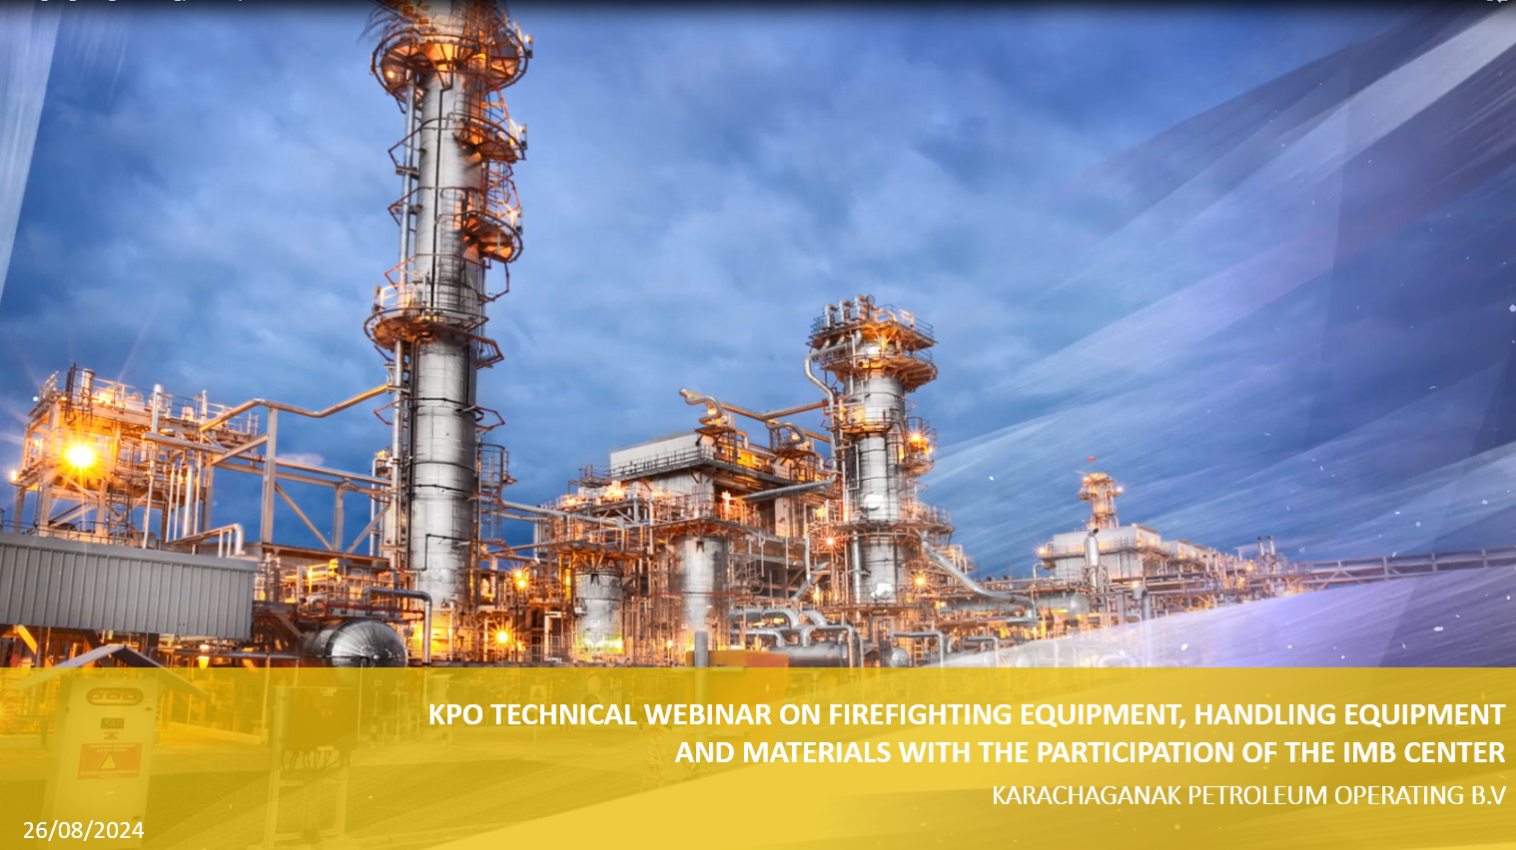
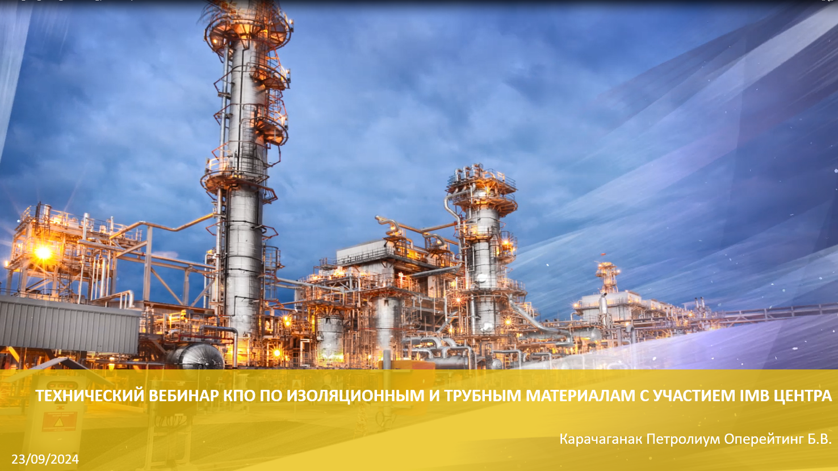
ЯЗЫК ПРЕЗЕНТАЦИИ/PRESENTATION LANGUAGE
  Content is available in Russian and English language; select the presenter displaying the content in your preferred language by clicking on the “View Options” tab at the top of the screen.
  Презентация доступна на русском и английском языке; выберите человека, представляющего содержание на предпочитаемом Вами языке, нажав “View Options” верхней части экрана.
  Yernar Ibrayev – English language
  Венера Апиева – Русский язык

Slide 3
WEBINAR RULES
  We will have a Facilitator to manage this event
  Everyone except Presenters will be muted
  If you want to ask a question, please type it in the comments box
  Try to hold questions to the end of the presentation
  Be open, honest and respectful
  Don’t
    use this webinar to market your company
    ask a question regarding any specific Tender/Contract
    expect total clarity and precise response to your every question

Slide 4
SAFETY MOMENT
  KPO Video

Slide 5
PROGRAM
  WELCOME SPEECH
  OVERVIEW OF HEAT EXCHANGERS, PUMPS AND SEALS IN KPO
  OVERVIEW OF THE IMBC ACTIVITIES
  KPO SUPPLIERS DATABASE
  KPO PROCUREMENT PROCESS
  LOCAL CONTENT MECHANISMS
  Q&A SESSION
5
21/10/2024 CONFIDENTIAL KARACHAGANAK PETROLEUM OPERATING B.V

Slide 6
DISCLAIMER
The information contained in these slides is made available for consideration. It represents KPO's preliminary description of the company’s demands as presently envisaged, but KPO reserves the right to change this information in the course of planning and implementing the projects, and KPO cannot be held responsible for any loss, damage or expense arising from reliance on this information. The information will not form part of any agreement between KPO and contractors participating in the workshop.
Today's engagement is one of many steps which KPO and its stakeholders are taking to develop local content.

Slide 7

Engineering and Technical Authority
Ivan Rekunov
Senior Packaged and Rotating
Equipment Engineering

Slide 8
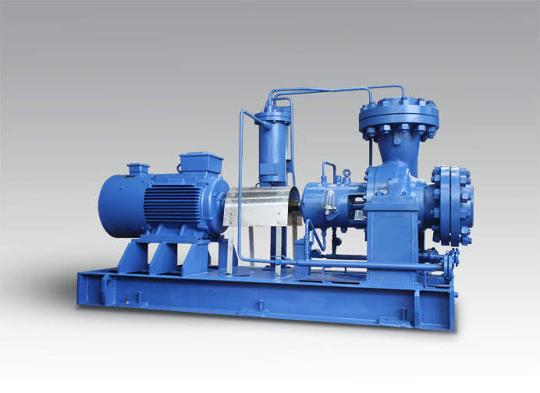
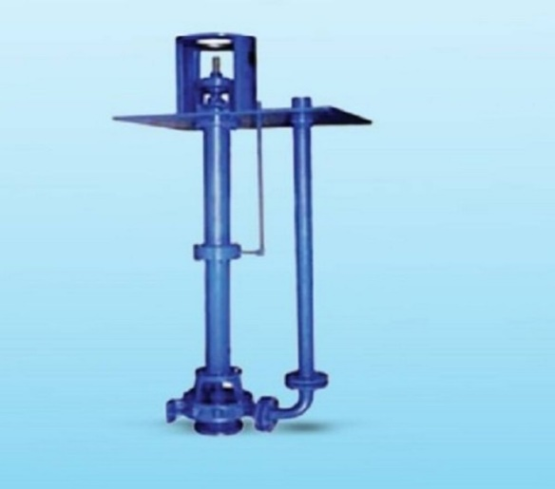
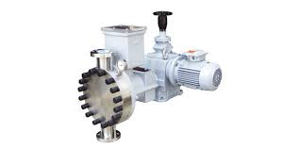
THE MOST COMMONLY USED EQUIPMENT IN KPO
Process Pumps
Centrifugal horizontal as per API 610
Centrifugal vertical as per API 610
Metering as per API 675
Examples of services
Slop, crude oil, spent caustic,
Condensate, etc
Examples of services
Oily water, storm water,
Methanol etc.
Examples of services
Corrosion/Wax inhibitors, etc
21/10/2024 CONFIDENTIAL KARACHAGANAK PETROLEUM OPERATING B.V
Notes:
Benefits to Having a Clean Desk Policy
Save Time and Money
A clean desk policy will encourage employees to use digital versions of documents, significantly reducing your organization’s costs of paper, ink toner, and printer maintenance.
Discourages Prying Eyes
Post-it notes are usually the worst culprit, containing names, phone numbers, and even user names and passwords visible in plain view. These habits encourage dishonest employees, cleaning crews, and maintenance staff to view information they should not have access to.
Reduce Stress
When your employees are organized they can spend more time concentrating on work rather than feeling stressed because they can’t find a report

Slide 9
KEY REQUIREMENTS
“Must to have” Pumps requirements
Valid API 610 license for pump manufacturing and API nomogram
Technical Expertise availability and involvement in Tendering
Availability of contracts with recognized Worldwide Motor Manufacturers
Ability to select/confirm a proper pump model as per Company Data sheet
Technical Documentation (API Data sheets, curves, GAs, detailed drawings, material certificates 3.1 as per BS EN 10204)
Decent similar Supply scope history at least for 3 successful installations over last 3 years
Availability of all material classes for pumps parts (table H1 – API 610, same for API 675)
Testing Facility, workshop availability
Guarantee
After Sales service available
21/10/2024 CONFIDENTIAL KARACHAGANAK PETROLEUM OPERATING B.V

Slide 10
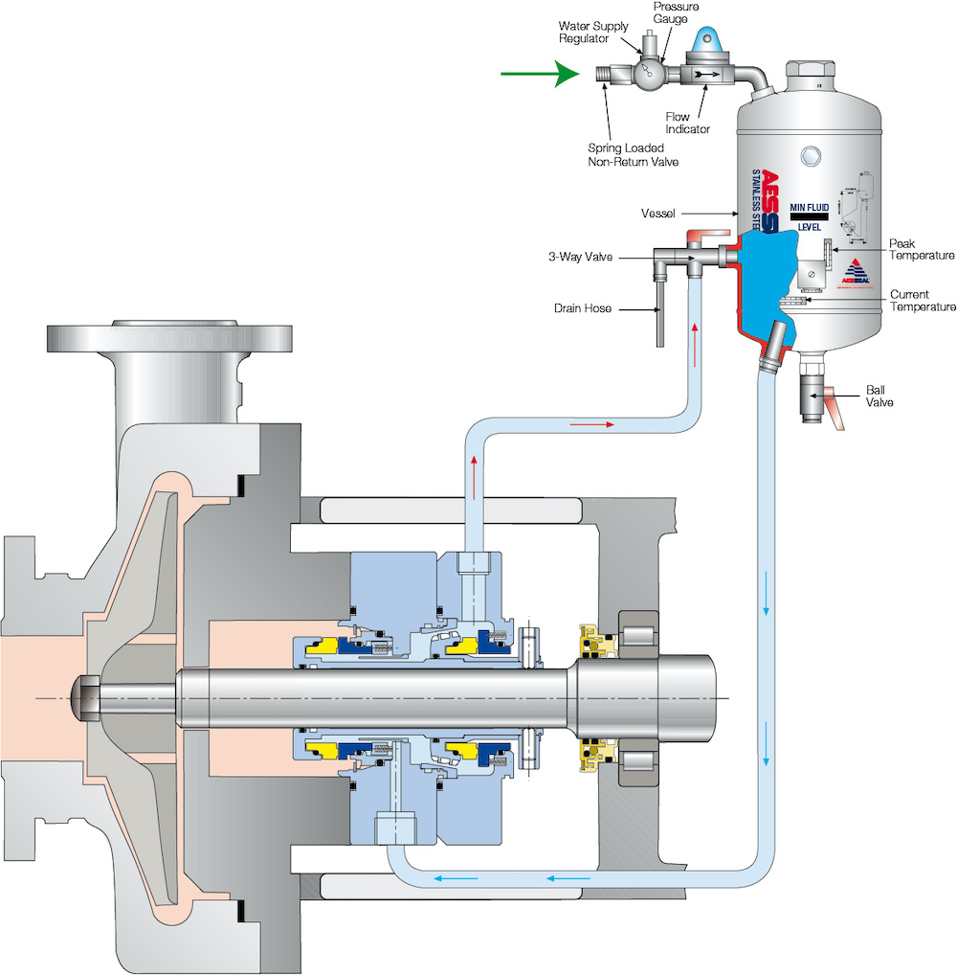
THE MOST COMMONLY USED EQUIPMENT IN KPO
Mechanical Seals for centrifugal Pumps, API pans as per API 682
Availability of contracts with recognized Worldwide Seals Manufacturers (John Crane,
Flowserve, Burgmann)
Technical Expertise availability and involvement in Tendering
Coupling from reputed manufacturers such as John Crane/Flexibox, Metastream.
Test certificates availability from Manufacturers
Technical Documentation (Data sheets, GAs, detailed drawings, material certificates 3.1 as per
BS EN 10204)
21/10/2024 CONFIDENTIAL KARACHAGANAK PETROLEUM OPERATING B.V

Slide 11
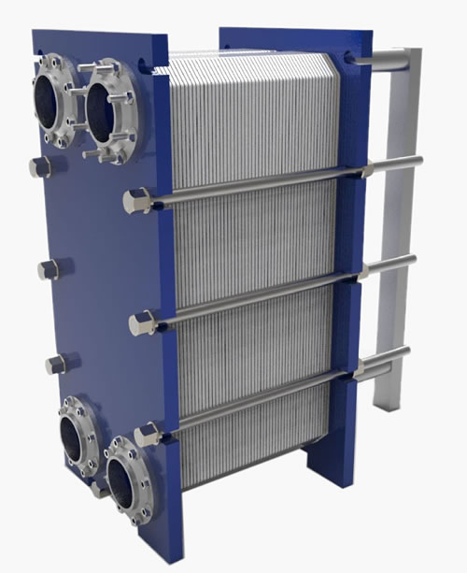
THE MOST COMMONLY USED EQUIPMENT IN KPO
Plate and Frame Heat Exchangers
Compliance to API 662
Technical Expertise availability and involvement in Tendering
Availability of thermal performance simulation reports
Technical Documentation (Data sheets, curves, GAs, detailed drawings, material certificates 3.1 as per
BS EN 10204, thermal performance, mech calculation reports
Testing Facility, workshop availability
Process guarantee
Decent similar Supply scope history at least for 3 successful installations over last 3 years
21/10/2024 CONFIDENTIAL KARACHAGANAK PETROLEUM OPERATING B.V

Slide 12
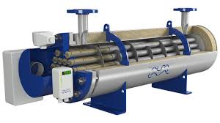
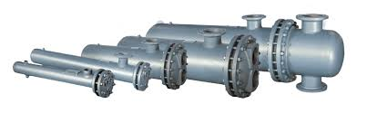
THE MOST COMMONLY USED EQUIPMENT IN KPO
Shell and tube Heat Exchangers as per TEMA standard
Valid ASME license (ASME u stamp) for vessel manufacturing
Technical Expertise availability and involvement in Tendering
Availability of Software for thermal performance simulation reports
Technical Documentation (Data sheets, GAs, detailed drawings, material certificates 3.1 as per BS EN 10204, thermal performance, mech calculation reports)
Testing Facility, workshop availability
Process guarantee
Decent similar Supply scope history at least for 3 successful installations over last 3 years
21/10/2024 CONFIDENTIAL KARACHAGANAK PETROLEUM OPERATING B.V

Slide 13
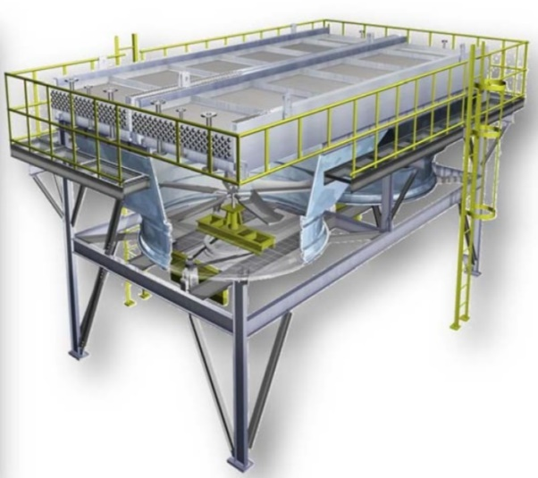
THE MOST COMMONLY USED EQUIPMENT IN KPO
Air cooled heat exchangers as per API 661
Technical Expertise availability and involvement in Tendering
Availability of contracts with recognized Worldwide Motor, Belts, Instrument Manufacturers.
Ability to select/confirm a proper configuration as per Company Data sheet
Technical Documentation (API 661 Data sheets, GAs, detailed drawings, material certificates 3.1 as per BS EN 10204)
Decent Supply history
Testing Facility, workshop availability
Process Guarantee
21/10/2024 CONFIDENTIAL KARACHAGANAK PETROLEUM OPERATING B.V

Slide 14
THE MOST COMMONLY USED EQUIPMENT IN KPO
3 Types of Heat Exchangers repair in KPO:
Minor Repair
Medium Repair
Full Repair
Minor repair – to be identified only after cleaning, visual QC inspection, NDT testing and pressure test when received tube bundle or heat exchanger. Should the tube bundle/ heat exchanger have tube leaks – less than 10% of total tube quantity then the welding plug installation repair
Medium repair – leaks thru the tube to tube sheet connection/ 10-25% of total tubes leaking. To be identified only after cleaning, visual QC inspection, NDT testing and pressure test when received tube bundle/ heat exchanger. Should the tube bundle/ heat exchanger have leaks thru the tube sheet connection, or 10-25% of tubes leaking, then the welding repair and re-tubing up to 10-25% of total tube quantity shall be performed
Full repair – more than 25 % tubes leaking of total tube quantity. To be identified only after cleaning, visual QC inspection, NDT testing and pressure test when received tube bundle/ heat exchanger. Should the tube bundle/ heat exchanger have more than 25% of tubes leaking then 100% of tubes re-tubing shall be performed
Service company should have following certificates:
ISO 9001: Quality Management System certification to ensure consistent quality in services
ASME Certifications: ASME Section IX: Qualification for welders and welding procedures. U Stamp : For the design and fabrication of pressure vessels. R-Stamp for repair
NACE Certification: For corrosion control and prevention, particularly important for heat exchangers
Safety Management System Certifications: Such as OHSAS 18001 or ISO 45001, to demonstrate commitment to occupational health and safety
AWS Certifications: For welding standards, particularly relevant for repairs and fabrication
21/10/2024 CONFIDENTIAL KARACHAGANAK PETROLEUM OPERATING B.V

Slide 15
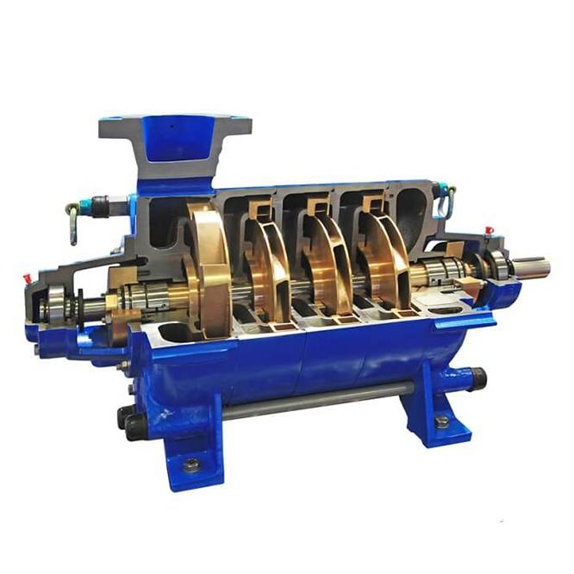
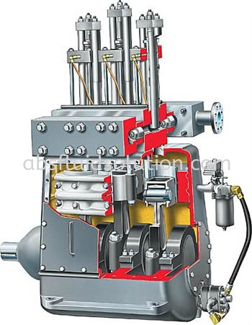
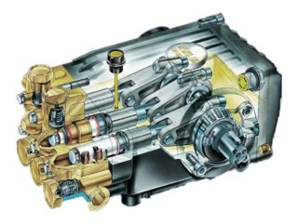
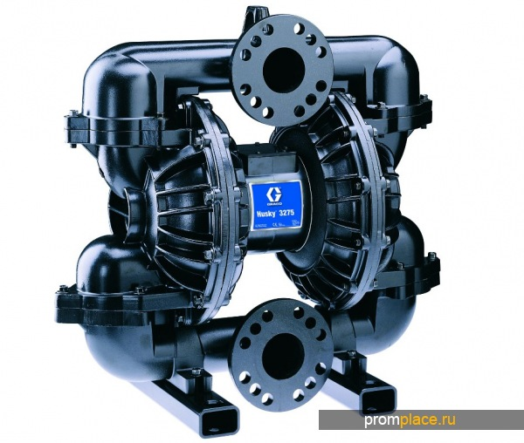
THE MOST COMMONLY USED EQUIPMENT IN KPO
Currently in service
Centrifugal pumps (about 500 ea)
Plunger/Piston pumps (about 40 ea)
Diaphragm pumps (about 200 ea)
Gear Pumps (about 20 ea)
21/10/2024 CONFIDENTIAL KARACHAGANAK PETROLEUM OPERATING B.V

Slide 16
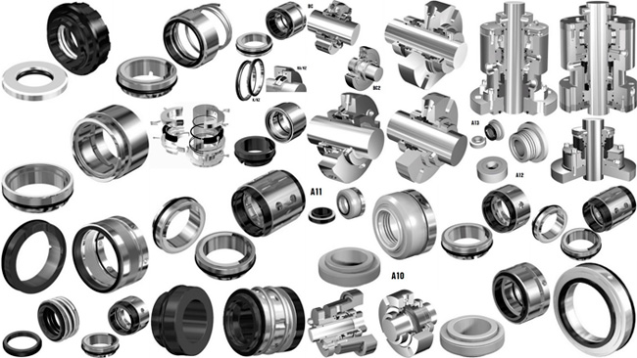
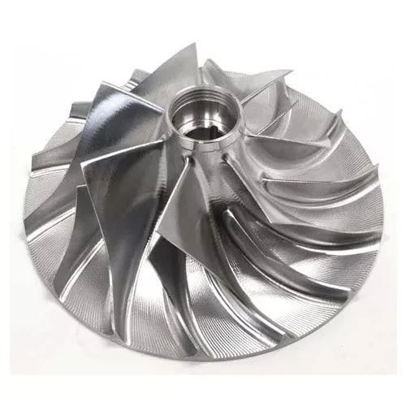

APPROXIMATE CONSUMPTION FOR THE NEXT 5 YERS
Description | 2025 | 2026 | 2027 | 2028 | 2029 | Total for 5Y
Impellers | 5 | 7 | 5 | 5 | 5 | 27
Bearings | 50 | 70 | 50 | 50 | 60 | 280
Gaskets | 250 | 300 | 250 | 250 | 270 | 1320
Shafts | 3 | 5 | 3 | 3 | 5 | 19
Other spares | 200 | 300 | 200 | 200 | 250 | 1150
Mechanical seals + spares | 1000 | 1400 | 1000 | 1000 | 1200 | 5600
21/10/2024 CONFIDENTIAL KARACHAGANAK PETROLEUM OPERATING B.V

Slide 17
KPO SPECIFICATIONS
KPO-00-MRE-SPC-00015 Centrifugal Pumps (API)
KPO-00-MRE-SPC-00016 Centrifugal Pumps (General Purpose)
KPO-00-MRE-SPC-00004 Specification for API 675 Controlled Volume Pump Skids
KPO-00-MVE-SPC-00001 Pressure Vessels
KPO-00-MHE-SPC-00001 Specification for Design & Fabrication Requirements for Shell & Tube Heat Exchangers
KPO-00-MHE-SPC-00003 Specification for Plate and Frame Heat Exchangers
KPO-00-MHE-SPC-00004 Design and Fabrication of Air Cooled Heat Exchangers
KPO-00-MEC-PRO-00005 Quality Control & Document Requirements for Mechanical Packages
21/10/2024 CONFIDENTIAL KARACHAGANAK PETROLEUM OPERATING B.V

Slide 18
Overview of IMB Center's activities
KPO TECHNICAL WEBINAR ON heat exchangers, pumps & seals

Slide 19














SCOPE OF ACTIVITIES
DATA PROCESSING & CONSOLIDATION
ADVOCACY ISSUES
Major Operators
Consolidation of efforts provision of quantitative and technical data
Government
Facilitation and stimulation
Preferences & subsidies
LOCAL MARKET ANALYSIS & CAPACITY DEVELOPMENT
LOCALIZATION
& TECHNOLOGY TRANSFER
Machine building industry
Capacity development, international standards, Technology transfer

Slide 20
Commodities of interest
In our analyses of demands and identifying localization priorities, we utilize the FPAL coding system
FPAL Commodity Codes
Commodity Group A
Commodity Group B
Commodity Group C
Commodity Group D
1.01
Drilling Equipment
1.09
Electrical Equipment and Materials
1.04
Pumps and Seals
1.02
Material and Product Handling Equipment
1.03
Compressors / Expanders / Blowers and Accessories
1.02
Material and Product Handling Equipment
1.10
Instrumentation / Process Control Equipment / Materials
1.11
Process Filters
1.07
Heat Exchangers / Heat Transfer Equipment
1.05
Drivers and Accessories
2.02
Valves and Accessories
1.12
HVAC
1.16
Firefighting Equipment
2.03
Steel / Metal Materials
2.01
Line pipe
2.07
Chemical / Oils / Paints
2.11
Workshop and Handtools
2.99
Other Products / Equipment and Materials
2.08
Insulation / Refractory Materials
Procurement in above commodity groups accounts for over 75% of all procurement of goods by three Operators **
* According to the statistical data of Situational-analytical center of the Fuel and Energy complex of the Republic of Kazakhstan

Slide 21



















PROGRESS UNDER COMMODITY GROUPS
Commodity Group A
Commodity Group B
Commodity Group C
Commodity Group D
Demands analysis
35,000 items analysed
55,000 items analysed
7,000 items analysed
12,000 items analysed
High demand goods identified
19 types of goods
18 types of goods
27 types of goods
39 types of goods
Market analysis, longlist from available resources
more than 90
manufacturers identified
more than 100
manufacturers identified
more than 80
manufacturers identified
more than 120
manufacturers identified
Site surveys, manufacturers who expressed interest
72 site surveys conducted
61 site surveys conducted
41 site surveys conducted
TBC
Shortlisting, manufacturers producing types of goods with high demands
23 manufacturers shortlisted
16 manufacturers shortlisted
In process
TBC
Capacity development
8 CDPs developed
3 CDPs developed
TBC
TBC
Implementation
of capacity development
3 recommended
manufacturers
2 recommended manufacturers
TBC
TBC
Recommendations to Operators

Slide 22



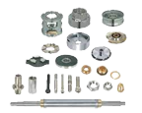
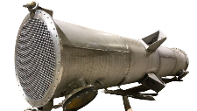
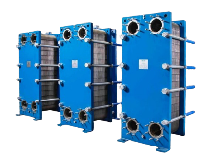
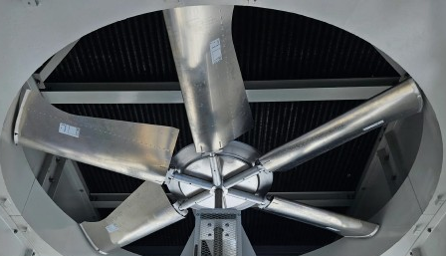
Pumps & seals, heat exchangers
PUMPS & SEALS
Centrifugal and rotary pumps
682 ea
Submersible pumps
124 ea
Diaphragm pumps
875 ea
Accessories and seals
17,462 ea
HEAT EXCHANGERS / HEAT TRANSFER EQUIPMENT
Shell & Tube heat exchangers & tube bundles
98 ea
Plate heat exchangers
82 ea
Air cooler fin fans
235 ea

Slide 23



technicalsupport@imbc.kz
+ 7 (7172) 39-99-66
www.imbc.kz
The range and specificity of services for assistance in the development of the potential of manufacturers, offered by IMBC, are limited and are subject to provision on an individual basis, depending on the readiness of the manufacturer to supply their manufactured goods in line with the requirements of the Operators.
Assistance from IMBC does not oblige any retaliatory action from the potential manufacturer. The services of IMBC do not represent a guarantee of the successful participation and / or successful award of Contracts to the manufacturer in the procurement processes of the Operators.

Slide 24
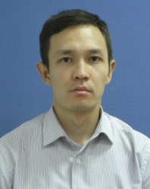
KPO Supplier Database
Merkhat Brekeyev
Senior Vendor Qualification Specialist

Slide 25
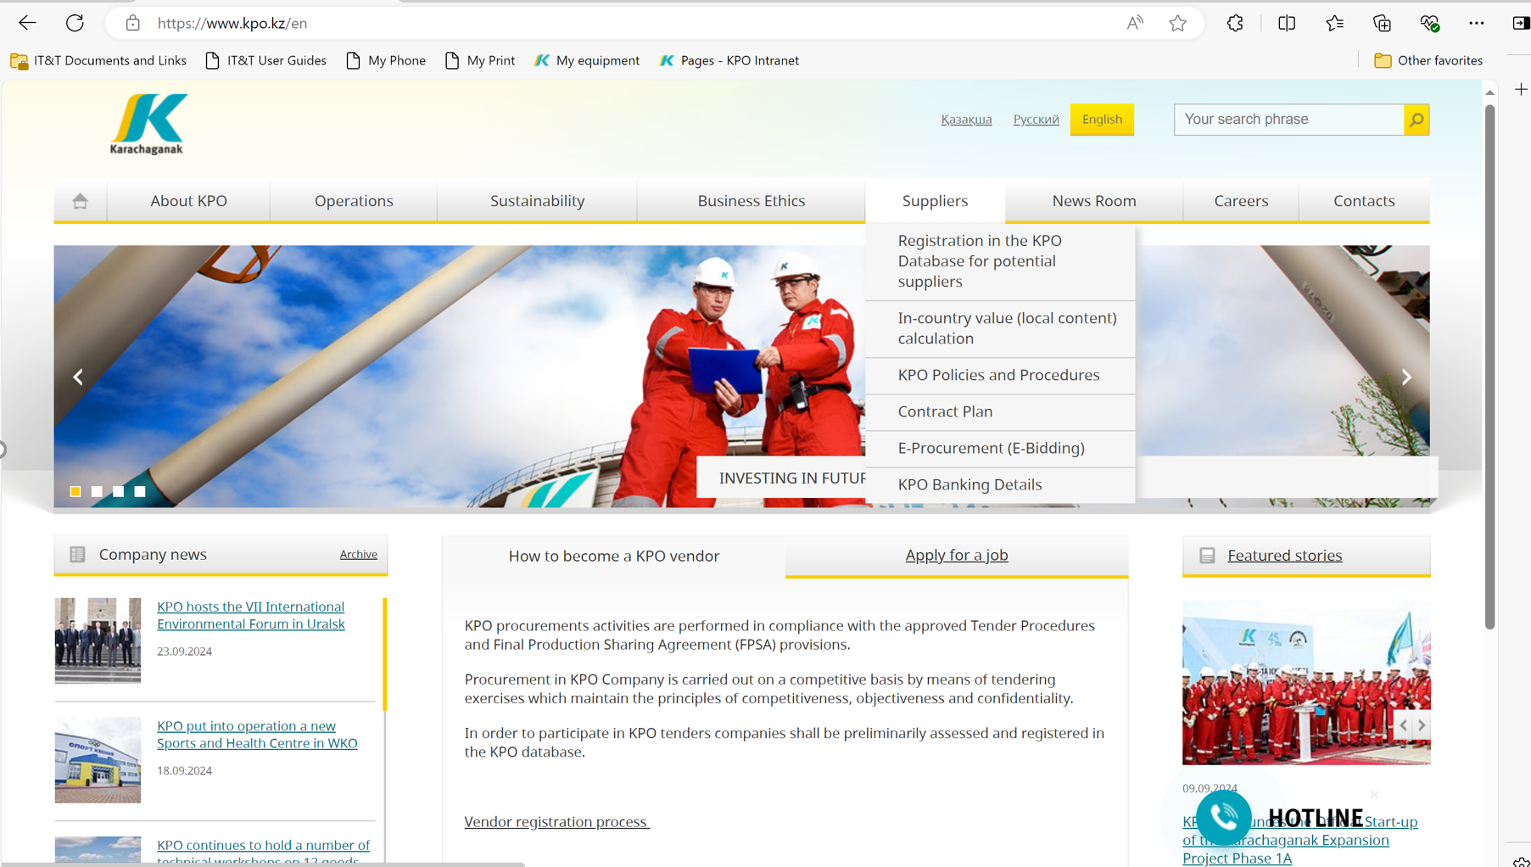
KPO SUPPLIERS DATABASE

Slide 26
VENDOR REGISTRATION
All potential suppliers shall be registered in KPO Database
REGISTRATION PROCESS
REGISTRATION
Provision of information on:
Technical Competency
Work Experience in the declared categories of goods and / or works and / or services
Personnel Availability
Financial Turnover
etc.
ETHICAL DUE DILIGENCE
Define an Ethical Due Diligence level in accordance with KPO Legal requirements:
Compliance with Kazakhstan and Foreign legislation
Compliance with Company internal regulations
Submission of potential suppliers shareholder lists
Vendor registration in KPO Vendor Database does not guarantee the participation in a tender or contract award, but suggests that a registered company may be considered as a market research participant for provision of goods, works and services for further pre-qualification process or tender as the need arises.

Slide 27
VENDOR REGISTRATION
To register in KPO Vendor Database, potential supplies shall:
  Download a questionnaire on KPO website – https://kpo.kz/ru/postavshchikam/registracija-v-baze-dannykh-postavshchikov-kpo
  Fill in the questionnaire for the preliminary vendor assessment and indicate activity codes
  Attach copies of required documents
  Submit the completed pack of documents for vendor assessment and registration by e-mail at MIVQ@kpo.kz
  Contact phone: +7 (711336) ext. 4943, 4946, 2192
  KPO encourages Suppliers to update registration data on an ongoing basis, related to:
    Work Experience in the declared categories of goods, works, services
    Certification, accreditation
    Reorganization
    Contact persons

Slide 28
MARKET RESEARCH
Purpose
  Define potential suppliers of goods, works, services who can perform as per KPO requirements
  Ensure free competition for KPO tenders
PROCESS
Demand determination and vendor searching
Issue of Invitation Letter for Expression of Interest
Market Intelligence Report
Approved
Tender List
Approvals

Slide 29
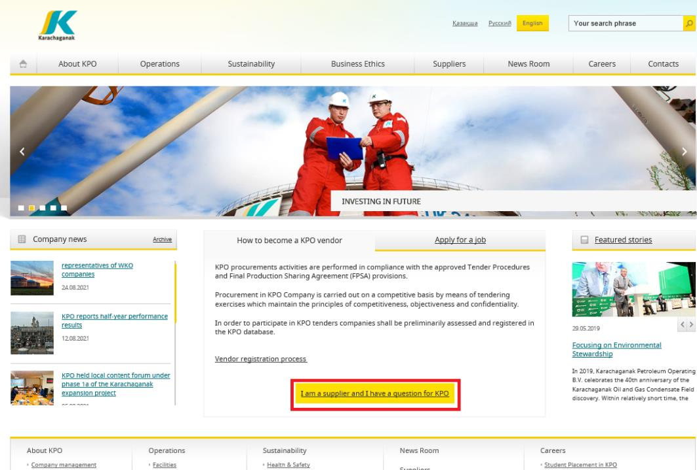
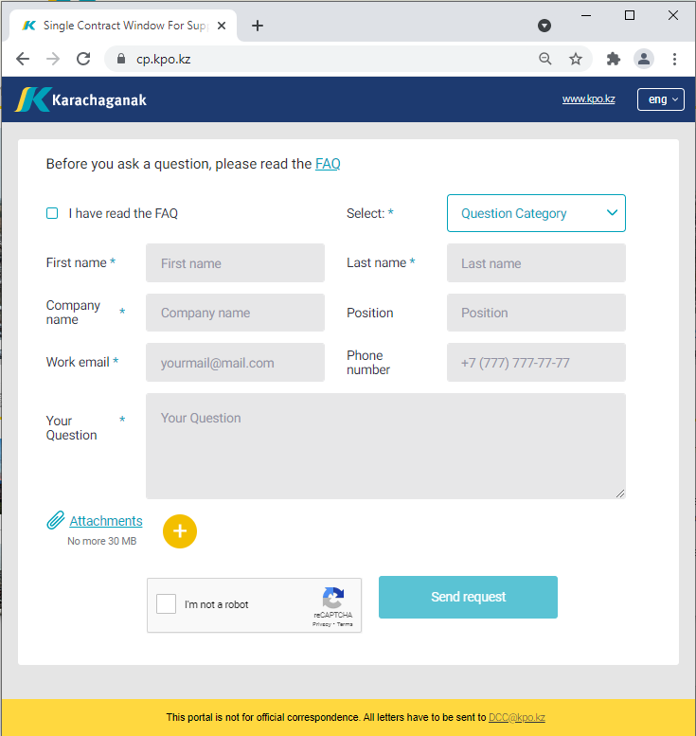
‘’SINGLE WINDOW’’ SYSTEM

Slide 30
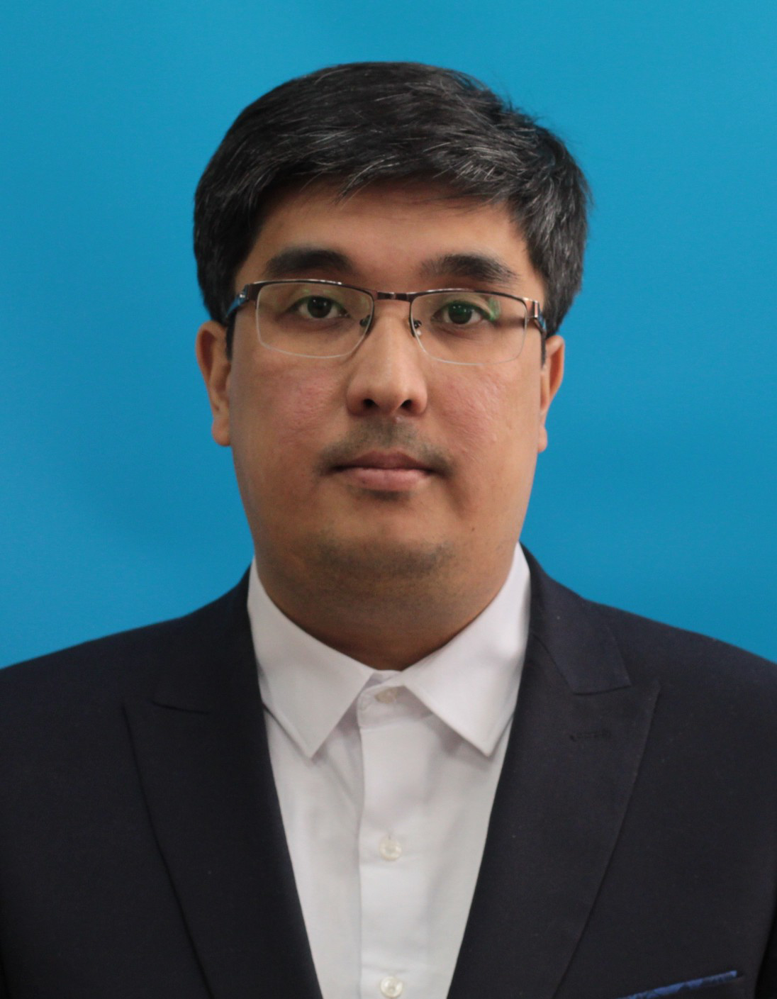
Daniyar Kassymkulov
Contracts and Procurement
Expert
Procurement
Process

Slide 31
PROCUREMENT PROCESS
KPO shall perform the procurement activities in accordance with:
  the Final Production Sharing Agreement (confidential and intended only for the use of KPO, its Shareholders and the Republic) and the Joint Operating Committee’s Tender Procedures (JOC)
  current legislation
  approved budget and work program
PROCESS
MARKET RESEARCH / PREQUALIFICATION
INVITATION
TO TENDER
TENDERING PERIOD
TENDER DUE DATE
EVALUATION OF TENDERS
CONTRACT AWARD
CONTRACT
SIGNING
CONTRACT
PERFORMANCE

Slide 32
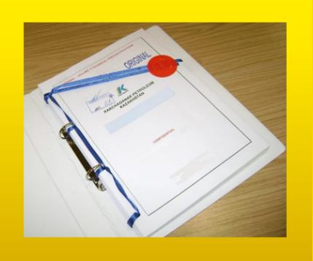



MAXIMUM ATTENTION SHALL BE PAID TO
TENDER PACKAGES SUBMISSION REQUIREMENTS
TENDER PACKAGES SUBMISSION REQUIREMENTS THROUGH E-BIDDING SYSTEM
(Link to the instructions)
INSTRUCTIONS
TO TENDERERS
TENDER DUE DATE / TIME

Slide 33
TENDER DOCUMENTATION CONTENTS
Cover letter
Forms, that shall be mandatorily signed, stamped and provided within timeframe specified:
Tender Acknowledgement and Confidentiality Agreement
Form of Tender
Certificate of Corporate Ownership and Declaration of Compliance
A package of documents related directly to the tender subject itself
Instructions to Tenderers
Form of Contract includes:
Form of Agreement
Schedule A – General Terms and Conditions
Schedule B – Scope of Goods/Services to be Supplied and Specifications
Schedule C – Compensation and Payment
Schedule D – Health, Safety and Environment (HSE) requirements
Schedule E – Special Conditions
Schedule F – Statement of Local Content
Schedule H – Industrial Relations
Questionnaire for Tender Participants
List of goods and technical delivery conditions (if applicable)
Instructions for preparing a tender proposal:
Instructions to Tender Participants
Bid marking template

Slide 34
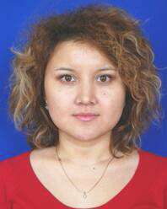
Venera Apiyeva
Local Content Interface and
Planning Coordinator
Local Content
Mechanisms

Slide 35








SUPPORTING MECHANISMS FOR LOCAL COMPANIES
TRIAL ORDER
EARLY TENDER
KAZAKH TENDER
Tenders for testing a trial batch of GOODs from Kazakhstani suppliers
Contract is concluded for the supply of GOODS with a suspensive condition or with a long-term delivery schedule
Tenders exclusively among Kazakhstani Suppliers. The goal is to award contracts to Kazakhstani suppliers of GWS
CONTRACT IN EXCHANGE FOR INVESTMENTS (UNDER REVISION)
  A contract in exchange for investment is a long-term contract concluded on a Single source basis, under which the supplier undertakes to produce goods of local origin that are the subject of a procurement contract in the territory of the Republic of Kazakhstan

Slide 36
Thank you!

Slide 37


