Slide 1

Operations Field department
Nurtayev Kairat Duisenbiyevich
Spare Parts Engineer
07/10/2024 CONFIDENTIAL KARACHAGANAK PETROLEUM OPERATING B.V.

Slide 2
Review of Instrumentation materials
Instrumentation materials
3
07/10/2024 CONFIDENTIAL KARACHAGANAK PETROLEUM OPERATING B.V.

Slide 3
General Information
KPO is currently using a range of Instrumentation systems equipment and materials, used in various Company facilities, trains and pipelines.
These materials and equipment play key role in production processes. Automation systems help reduce manual labour and improve operational efficiency.. This includes the use of Programmable logic controllers (PLC), Automated control systems (ACS) and SCADA systems to monitor processes in real time.
For fabrication of instrumentation equipment, various materials are used, such as stainless steel, plastics and composites, which ensure durability, resistance to corrosion and mechanical damage.
We have developed more detailed required technical specifications for most frequently used materials, which we are ready to present to you for review and making necessary decisions.
The details will be provided on the next slides.
CONFIDENTIAL KARACHAGANAK PETROLEUM OPERATING B.V.

Slide 4
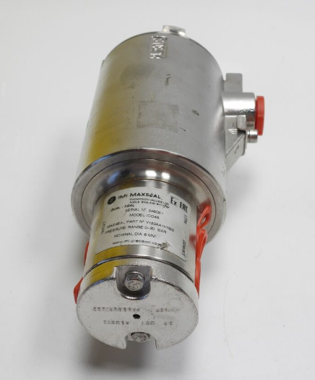
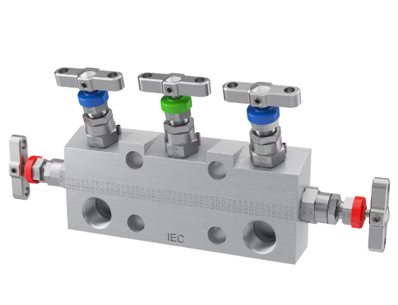
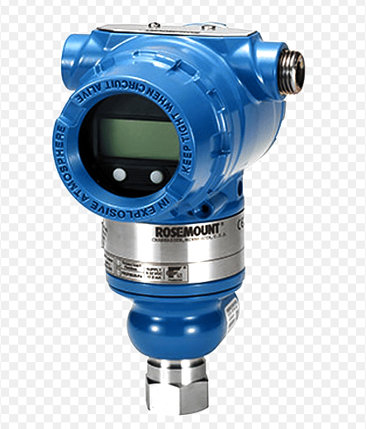
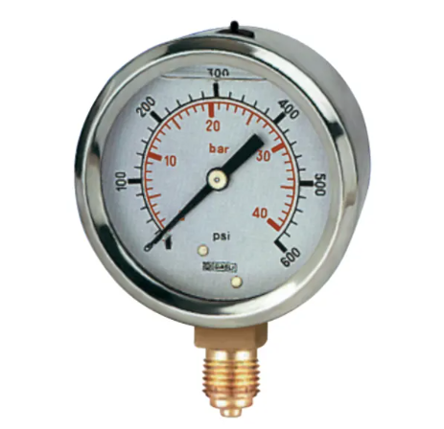
Main specifications of instrumentation materials and equipment - General information
Instrumentation includes various sensors, pressure gauges, manifolds, and measuring instruments such as temperature, level, and flow meters, as well as other devices. These devices enable precise control over production process parameters.
Company uses such materials related to the instrumentation system such as: pressure gauges, differential, level, temperature sensors, solenoid valves, fittings, thermocouples and thermowells, etc.
03/10/2024 CONFIDENTIAL KARACHAGANAK PETROLEUM OPERATING B.V.

Slide 5
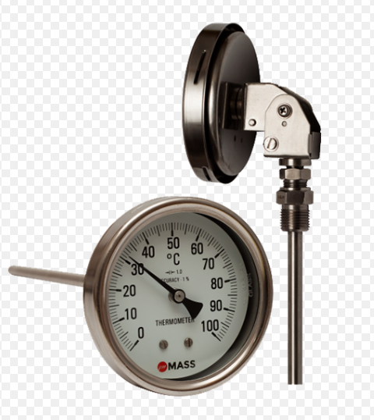
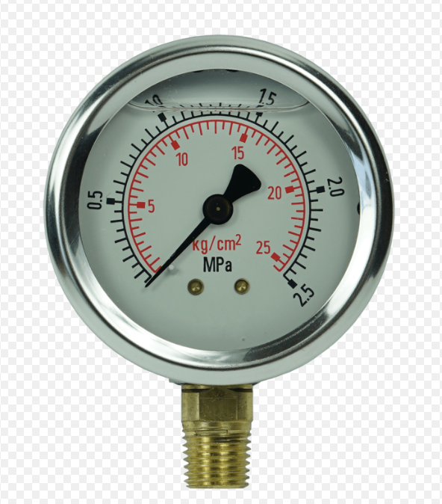
Technical characteristics: Temperature/pressure indicator
There are only two types of temperature sensors: contact and non-contact. It’s quite simple: contact temperature sensors measure by direct physical contact with the object being measured. Such sensors are suitable for measuring the temperature of solids, liquids, and gases. Pressure transmitter is a device used to measure pressure of a liquid or gas These devices consist of sensor membrane, protective capsule, filling fluid, capacitor sheet, connecting wires, and diaphragm seal.
Technical specifications
Type | Contact
Temperature range: | -50°C to +120°C
Dimension (diameter, NS): | 100/150/160mm
Dimension of thermocouple: | 160 mm x 6 mm
Material composition; | 316SS
Connection type: | Bottom - the connection is located at the bottom of the sensor; Central rear - the connection is positioned in the center of the rear side; Lower rear - the connection is located on the rear side, but in a lower position.
Technical specifications
Type | Membrane, Bourdon tube, electromechanical
Pressure range: | 0-10 bar
Type of liquid filling | Silicone/Glycerin
Dimension (diameter, NS): | 63/100/150/160mm
Material composition; | 316SS
Connection type: | Bottom - the connection is located at the bottom of the sensor; Central rear - the connection is positioned in the center of the rear side; Lower rear - the connection is located on the rear side, but in a lower position.
03/10/2024 CONFIDENTIAL KARACHAGANAK PETROLEUM OPERATING B.V.

Slide 6
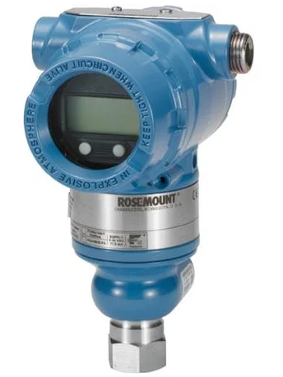
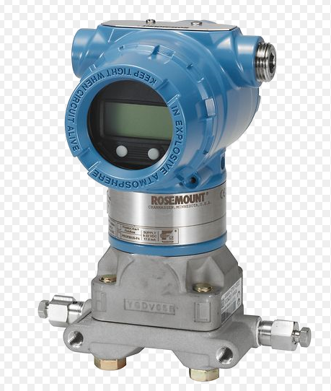
Technical characteristics: Pressure transducer
Pressure transducer is used in industry for continuous measurement of the pressure of a medium – liquid, gas (including oxygen), or steam. The obtained value is converted into an output signal – analogue or digital.
Depending on the type of pressure measured, pressure transducers are divided into several types. Such as: Gauge pressure transducer - These transducers measure the pressure created by any medium relative to atmospheric pressure. This type of pressure transducer is the most common and is used in almost all industries; Absolute pressure transducer - These transducers measure the pressure created by any medium relative to absolute vacuum.
Technical specifications
Gauge pressure range: | 250 bar
Range: | 0 – 1,4 / 138 bar
Calibrated: | 0-137.89 Bar
Power supply: | 10.5-32VDC
Diaphragm material: | Hastelloy C-276
O-Ring: | TFE GL
03/10/2024 CONFIDENTIAL KARACHAGANAK PETROLEUM OPERATING B.V.

Slide 7
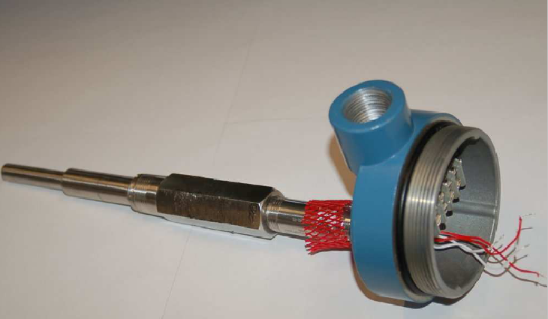
Technical characteristics: Thermowell
Thermowell (protective sleeve) is designed for installation of temperature sensors in processes facilities and provides protection against the destructive effects of the working medium. Thermowells with loose flanges allow the use of different materials for the immersion part (stem) and the flange For example, the flange material can be made from electroplated structural carbon steel, while the stem can be made from stainless steel or a heat-resistant, corrosion-resistant nickel-based alloy. Thermowell is also used to simplify the replacement of a temperature sensor.
Technical specifications
As per data sheet: | TW 95.10 / TW 95.11 / TW 95.12;
Type of protective sleeve: | Conical
Unit of measurement: | MM
Flange dimension: | ASME 1 ½”
Rated pressure: | Class 600
Connection to thermometer (N): | ½” NPT Female
Immersion length (U): | 280 mm
Head length (H): | 57 mm
Material | 316/316L stainless . steel
Flange material: | 316/316L stainless . steel
03/10/2024 CONFIDENTIAL KARACHAGANAK PETROLEUM OPERATING B.V.

Slide 8
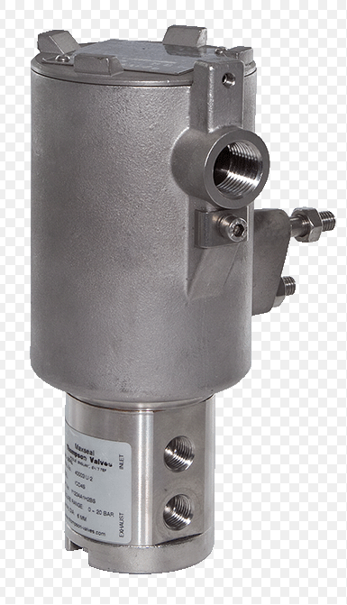
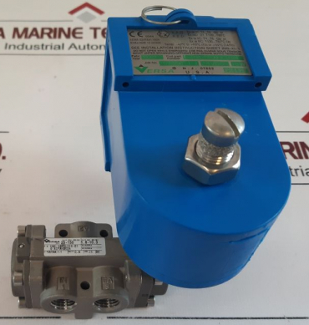
Technical characteristics: Solenoid Valve
Solenoid valve is a device designed for regulating the flow of all types of gases It consists of body and a solenoid with a core, which holds a disc or piston. When an electric voltage is applied to the solenoid coil of the valve, the magnetic core is pulled into the solenoid, causing the valve to open or close. The design of a solenoid valve is similar to that of a regular shut-off valve, but the opening and closing of the solenoid valve occur without any mechanical effort.
A solenoid valve (solenoid) is used both in complex industrial processes and in everyday household applications. It allows for the remote delivery of the required amount of liquid, air/steam, or gas at the right moment.
Technical specifications
Model: | ICO3S
Number of ports: | 3/2, with direct actuation
Connection. | ¼” NPT
Flange dimension: | ASME 1 ½”
Pressure range: | 0-12 bar
Temperature range: | -20С to +90С
Input/output voltage: | 24VDC
Release (opening/closing): | Manual Reset Button (Automatic)
Material | 316/316L stainless . steel
EX | EX IA (Zone 0)
03/10/2024 CONFIDENTIAL KARACHAGANAK PETROLEUM OPERATING B.V.

Slide 9
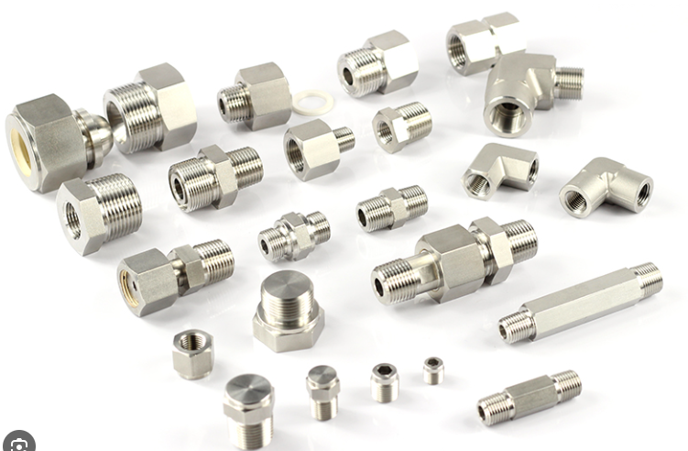
Technical characteristics: Fittings
Fitting is a connecting component used in the assembly of various pipelines. t may have threads on the external or internal surfaces, or it can be completely without thread.. The advantage of threaded systems is that they allow easy disassembly for cleaning individual components. Welded or glued components will be more difficult to disassemble. With the help of fittings, different sections of pipe can be quickly connected into a system, ensuring the necessary sealing.
Technical specifications
Name | Connector, Male:
Diameter (external): | 12 mm
Diameter and type of connection; | ½” NPT
Material: | 316/316L stainless . steel
Technical specifications
Name | Adapter, Straight
Diameter (external): | 8 mm
Type of installation: | Connection
Material: | 316/316L stainless . steel
Technical specifications
Name | Cross connector
Diameter (external): | 10 mm
Connection type: | A-LOK
Material: | 316/316L stainless . steel
03/10/2024 CONFIDENTIAL KARACHAGANAK PETROLEUM OPERATING B.V.

Slide 10
Planned forecast for the consumption of Instrumentation materials
This slide presents the consumption forecast for various types of Instrumentation system materials.
* Instrumentation materials
Description | Forecasted quantity for 1 year | Forecasted quantity for 2 years | Forecasted quantity for 3 years | Forecasted quantity for 4 years | Forecasted quantity for 5 years
TEE,UNION: 10MM OD,316 STAINLESS STEEL,A-LOK P/N ETM10-316 | 41.00 | 42.00 | 41.00 | 41.00 | 41.00
CONNECTOR, MALE: 12MM OD X 1/2"NPT, 316 STAINLESS STEEL | 7.00 | 7.00 | 7.00 | 7.00 | 6.00
TRANSMITTER,TEMPERATURE: TYPE TR10-B INDUSTRIAL RTD ASSEMBLY, CONNECTION HEAD: BSZ-H (ALUMINUM), | 0.00 | 1.00 | 0.00 | 0.00 | 0.00
GAUGE, PRESSURE: TYPE 233.30.160, RANGE 0...100 BARG, CASE FILLING SILICON OIL M50, WITH CAPILARYL-3M | 1.00 | 1.00 | 1.00 | 1.00 | 1.00
VALVE, SOLENOID: MODEL ICO3S, 3/2 WAY, DIRECT ACTING, 1/4" NPT, 316 SS ,24VDC | 2.00 | 2.00 | 2.00 | 2.00 | 1.00
FLOWMETER, ULTRASONIC: 16IN SCH 80 RF 600 TAG No 3-220-FT-006 In accordance with data sheet: AP/D/19/0267-D0037. | 1.00 | 0.00 | 0.00 | 0.00 | 1.00
TRANSMITTER, LEVEL: MODEL 409-T120-000, ELECTRONIC RADAR RCT SERIES, DREXELBROOK | 1.00 | 0.00 | 0.00 | 1.00 | 0.00
* Quantity shown is indicative.
CONFIDENTIAL KARACHAGANAK PETROLEUM OPERATING B.V.

Slide 11
Requirements for Instrumentation system materials
The following certificates shall be provided by manufacturer in the process of the Instrumentation materials and equipment supply:
Certificate of Conformity from the manufacturer
(Confirming compliance of material to set standards and specifications)
Certificate of Conformity to Standards (confirming the materials are manufactured in compliance with international standards as ASME, BS 10204, EU, ATEX, etc.)
Certificate of Origin: Confirming the country of origin.
Test Certificate (Pressure Test Certificate, Calibration Certificate): Confirming that the materials have undergone calibration, strength, and pressure tightness test.
Certificate 3.1 (for metal items): According to the Standard 10204, the Act of Acceptance confirms the goods, supplied to a client, to comply with the requirements set in the purchase order. Relevant testing results (e.g. strength test) shall be enclosed to the document.
Note: Requirements to certificates will be additionally discussed at the stage of concluding contract between KPO and potential instrumentation materials of local manufacturer.
03/10/2024 CONFIDENTIAL KARACHAGANAK PETROLEUM OPERATING B.V.

