Slide 1
KPO TECHNICAL WEBINAR ON STEEL AND METAL MATERIALS WITH THE PARTICIPATION OF THE IMB CENTER
KARACHAGANAK PETROLEUM OPERATING B.V

Slide 2
AGENDA
  WELCOME SPEECH
  OVERVIEW OF RANGES. PERSPECTIVES FOR LOCALIZATION IN KPO OPERATIONS
  OVERVIEW OF THE IMBC ACTIVITIES
  KPO SUPPLIERS DATABASE
  KPO PROCUREMENT PROCESS
  KPO GENERAL HSE REQUIREMENTS
  LOCAL CONTENT MECHANISMS
  Q&A SESSION
2
04/03/2025 CONFIDENTIAL KARACHAGANAK PETROLEUM OPERATING B.V

Slide 3
DISCLAIMER
The information contained in these slides is made available for consideration. It represents KPO's preliminary description of the KPO demands as presently envisaged, but KPO reserves the right to change this information in the course of planning and implementing the projects, and KPO cannot be held responsible for any loss, damage or expense arising from reliance on this information. The information will not form part of any agreement between KPO and business partners participating in the workshop.
Today's engagement is one of many steps which KPO and its stakeholders are taking to develop local content.

Slide 4
Steel sections. Localization perspectives.
1

Slide 5
CONTENT
Short description of the field
Introduction
Range as per GOST and Eurocode
Requirements for structural steel as per GOST
Requirements for structural steel as per Eurocode
Forecast of consumption of tons per year
Main requirements of Company’s Specifications.

Slide 6
SHORT DESCRIPTION OF THE FIELD
Karachaganak oil and gas condensate field (KOGCF)
Karachaganak oil and gas condensate field is located in Burlin District, West-Kazakhstan Oblast, near Aksay town. It is a part of the Pre-Caspian oil and gas basin. Discovered in 1979 year. Industrial development started in mid-80s. Currently the field is operated by Karachaganak Petroleum Operating b.v. (KPO b.v.)
Characteristics of the field:
Reservoir Area — 29×16 km
Upper boundary of a group of fields is located at 3526 m. Gas oil contact - at 4950 m; oil water contact - at 5150 m.
The initial reserves of the field consist of 1.35 trillion cubic metres of gas and 1.2 billion tonnes of oil and gas condensate.
As per information from the Ministry as of 1 January 2024, remaining reserves of oil - 253 million tons, gas – 791.7 billion cubic meters.

Slide 7
INTRODUCTION
For implementation of the projects Karachaganak oil and gas field requires more than 600 tons per year of different types of rolled metal products (beams, channels, angles, sheet metal, reinforcement bars and so on).
According to requirements during designing, rolled metal products shall be selected according to GOST of the Republic of Kazakhstan. For example, beams shall be selected as per GOST 26020-83. During review it is not possible to find a supplier or manufacturer according to GOST 26020-83 on the territory of the Republic of Kazakhstan. Suppliers of rolled metal products which correspond to GOST R 57837-2017 have been found. These products are manufactured in the Russian Federation, but since GOST R57837-2017 is not updated and is not valid in the territory of the Republic of Kazakhstan, its use is impossible.
In turn, lack of rolled metal products results in production losses as KPO is unable to procure the necessary products for implementation of the projects.
Based on the above, the purpose of this presentation is to allow you to find potential suppliers and manufacturers of the required rolled metal products in accordance with GOST requirements, or to organise an alternative supply of materials in accordance with Eurocode requirements.

Slide 8
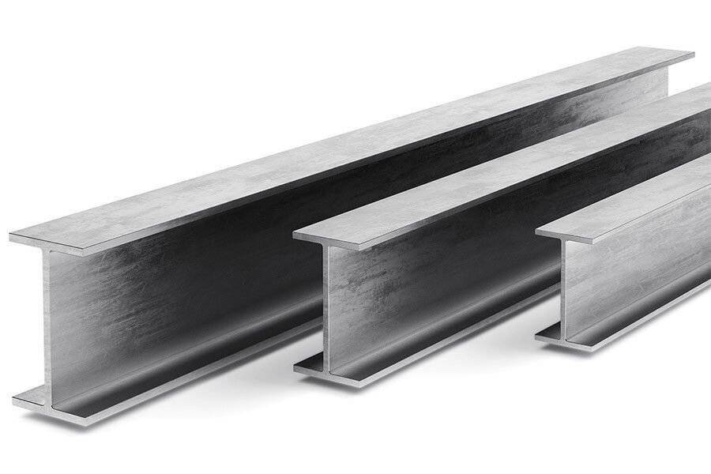
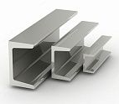
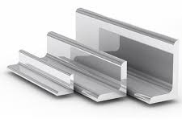

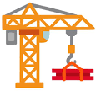

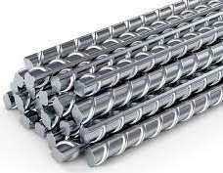
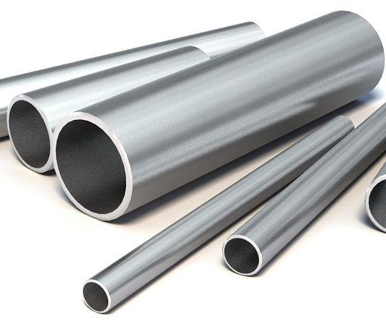
Range as per GOST and Eurocode
Beam
Channel
GOST 26020-83
BS EN10025:2004
GOST 8240-97
BS EN10025:2004
The stated materials
Angles
Hot-rolled steel sheets
GOST 8509-93
BS EN 10025:2004
GOST 19903-2015
BS EN10025:2004
Reinforcing bars
Pipe electric weld
GOST 34028-2016
GOST 10704-91
EN 10210-2

Slide 9
Range as per GOST and Eurocode
Beam: GOST 26020-83 / Eurocode BS EN 10025:2004
Channel: GOST 8240-97 / Eurocode BS EN10025:2004
Angle: GOST 8509-93 / Eurocode BS EN 10025:2004
Steel for rolled metal products should correspond to the requirements for structural steel as per GOST, Eurocode and Company. Metal structures shall be made from structural steel with 345 N/mm² of specified minimum yield strength as per GOST and 355 N/mm² as per Eurocode, suitable to operate under low temperatures (-40 > t > -50). Quality of rolled metal products shall be certified.
Steel for rolled metal products should correspond to the requirements for structural steel as per GOST, Eurocode and Company. Metal structures shall be made from structural steel with 345 N/mm² of specified minimum yield strength as per GOST and 355 N/mm² as per Eurocode, suitable to operate under low temperatures (-40 > t > -50). Quality of rolled metal products shall be certified.
Steel for rolled metal products should correspond to the requirements for structural steel as per GOST, Eurocode and Company. Metal structures shall be made from structural steel with 345 N/mm² of specified minimum yield strength as per GOST and 355 N/mm² as per Eurocode, suitable to operate under low temperatures (-40 > t > -50). Quality of rolled metal products shall be certified.

Slide 10
Range as per GOST and Eurocode
Hot-rolled steel sheets: GOST 19903-2015 / Eurocode BS EN10025:2004
Steel for rolled metal products should correspond to the requirements for structural steel as per GOST, Eurocode and Company. Metal structures shall be made from structural steel with 345 N/mm² of specified minimum yield strength as per GOST and 355 N/mm² as per Eurocode, suitable to operate under low temperatures (-40 > t > -50). Quality of rolled metal products shall be certified.
Pipe electric weld: GOST 10704-91 / Eurocode EN 10210-2
Reinforcing bars: ГОСТ 34028-2016
Technical specifications shall correspond to А240, А400, А500 classes. The quality of reinforcing bars shall be certified.
Steel for rolled metal products should correspond to the requirements for structural steel as per GOST, Eurocode and Company. Metal structures shall be made from structural steel with 345 N/mm² of specified minimum yield strength as per GOST and 355 N/mm² as per Eurocode, suitable to operate under low temperatures (-40 > t > -50). Quality of rolled metal products shall be certified.

Slide 11
Requirements for structural steel as per GOST
Metal structures shall be made from structural steel with 345 N/mm² of specified minimum yield strength, suitable to operate under low temperatures.
Steel grades of steel structures according to GOST - steel structures and facilities exposed to outdoor atmospheric temperatures.
All steels shall correspond to С345 grades and higher, suitable for operation under low temperatures.
(-40 > t > -50).
b) All grades shall correspond to requirements of GOST 27772-2021 «Rolled products for structural steel structures. General technical specifications.”
c) All steels shall undergo U-notch Charpy impact tests in accordance with GOST 9454-78 «Metals. Method of Charpy impact test under reduced, indoor and elevated temperatures”.
d) Steel of С345 grade and higher shall undergo U-notch Charpy impact test at -40ºC temperature. Minimum values of energy are 39 J/cm² with thickness from 4 mm to 10mm, 34 J/cm² with thickness above 10mm.
04/03/2025 CONFIDENTIAL KARACHAGANAK PETROLEUM OPERATING B.V

Slide 12
Requirements for structural steel as per GOST
Structural steel grades according to GOST – Structures and buildings inside heated facility
All steel shall be according to grades C255 and higher, and be suitable for operation at low temperatures (-20° > t > -30°).
All steel shall comply with GOST 27772-2021: “Rolled products for structural steelworks. General specifications”.
All steel shall be subject to impact testing with U-notch concentrator according to GOST 9454-78: “Metals. Impact bending test method at low, room and high temperatures”.
Steel grade С255 and higher shall be subject to Charpy V-notch impact test at a temperature of -20ºC. Minimum energy values are at average of 29 J/cm².
04/03/2025 CONFIDENTIAL KARACHAGANAK PETROLEUM OPERATING B.V

Slide 13
REQUIREMENTS FOR STRUCTURAL STEEL AS PER EUROCODE
Steel structures shall be made of structural steel with a minimum yield strength of 355 N/mm², suitable for operation at low temperatures.
Structural steel grades according to Eurocode for open structures and facilities
STRUCTURAL STEEL FOR COLD AMBIENCE (up to -45°C)
Material | Specified grade and standard* | Impact test temperature, Charpy V-notch values | Specific material restrictions | Application condition | Welding
Rolled sections and sheets up to and including 40 mm thick | BS EN 10025-3: S355NL | -45°C, 27J min average 20J min individual | Used material shall be fully deoxidized, not aged or cold worked | All structural elements | Impact test required @−45 °C
Hot rolled profiles and sheets up to 40 mm thick | BS EN 10025: 355EM | -45°C, 27J min average 20J min individual | As specified above | As specified above | As specified above
Handrails, vertical ladders and flooring (not less than 15 mm thick) | S EN 10025-1: S275J2 | -20°C, 27J min average 20J min individual |  | Only for handrails, vertical ladders and flooring
Nuts and bolts (diameter up to 30 mm) | **BS 3692: Gr 8.8 | -45°C, 27J min average 20J min individual |  | All bolts for structural connections
04/03/2025 CONFIDENTIAL KARACHAGANAK PETROLEUM OPERATING B.V

Slide 14
EUROCODE REQUIREMENTS FOR STRUCTURAL STEEL
Eurocode grades of structural steel for buildings and structures with heating system
STRUCTURAL STEEL FOR STEEL STRUCTURES INSIDE HEATED BUILDINGS (to -20°C)
Material | Indicated grade and standard* | Impact test temperature, Charpy V-Notch impact test | Specific material constraints | Conditions of use | Welding
Rolled sections and sheets up to and including 40 mm thick | BS EN 10025-1 S275JR or S355JR | -20°C, 27J min average 20J min individual | No | All structural elements | Impact test required @ -20°C
04/03/2025 CONFIDENTIAL KARACHAGANAK PETROLEUM OPERATING B.V

Slide 15
Consumption forecast, tons per annum*
Category | Year 1 | Year 2 | Year 3 | Year 4 | Year 5
Beam | 278 | 276 | 285 | 330 | 322
Channel | 184 | 174 | 182 | 235 | 215
Angle | 67 | 57 | 63 | 71 | 84
Rolled steel | 27 | 23 | 29 | 29 | 35
Pipe electric weld | 39 | 35 | 42 | 43 | 51
Reinforcing bar | 92 | 82 | 90 | 93 | 113
*The quantities are indicative and based on average historical consumption

Slide 16
Main requirements of the Company’s
Technical Specifications
COMPANY’S SPECIFICATIONS
ROK AND EUROCODE REQUIREMENTS
GOST 26020-83/BS EN10025:2004 - Hot-rolled steel 1-beam with parallel flange edges. Dimensions
GOST 8240-97/BS EN10025:2004 - Hot-rolled steel channels. Dimensions
GOST 8509-93/BS EN10025:2004 - Hot-rolled steel equal-leg angles. Dimensions
GOST 19903-2015 /BS EN10025:2004 - Hot-rolled steel sheets. Dimensions
GOST 10704-91/EN 10210-2 - Electrically welded steel line-weld tubes. Dimensions
GOST 34028-2016 - Reinforcing rolled products for reinforced concrete constructions. Specifications
ГОСТ 27772-2021 - Rolled products for structural steel constructions. General specifications
KPO-00-CVS-DTD-00104 – Steelworks details. General Notes.
KPO-00-CVS-SPC-00005 – Steelworks for Structures and Buildings – Materials and Fabrication.
KPO-00-CVS-STD-00001 – Concrete Details. General Notes.
KPO-00-ENG-DTD-00003-ER – Fencing Details.
KPO-00-CVS-DTD-00095 – Typical Details. Stairs.
KPO-00-CVS-DTD-00096 – Typical Details. Steel Handrails.
KPO-00-CVS-DTD-00097 – Typical Details. Steel Ladders.
KPO-00-CVS-DTD-00098 – Typical Details. Steel Flooring.
ACCOMPANYING DOCUMENTS
Material Specification
Product’s Certificate of Origin
Test Report.

Slide 17
THANK YOU FOR YOUR ATTENTION!
17
04/03/2025 КОНФИДЕНЦИАЛЬНО КАРАЧАГАНАК ПЕТРОЛИУМ ОПЕРЕЙТИНГ Б.В.

Slide 18
Overview of IMB Center's activities
KPO TECHNICAL WEBINAR ON Steel & metal materials
04/03/2025 CONFIDENTIAL KARACHAGANAK PETROLEUM OPERATING B.V

Slide 19














SCOPE OF ACTIVITIES
DATA PROCESSING & CONSOLIDATION
ADVOCACY ISSUES
Major Operators
Consolidation of efforts provision of quantitative and technical data
Government
Facilitation and stimulation
Preferences & subsidies
LOCAL MARKET ANALYSIS & CAPACITY DEVELOPMENT
LOCALIZATION
& TECHNOLOGY TRANSFER
Machine building industry
Capacity development, international standards, Technology transfer
19
04/03/2025 CONFIDENTIAL KARACHAGANAK PETROLEUM OPERATING B.V

Slide 20
Commodities of interest
In our analyses of demands and identifying localization priorities, we utilize the FPAL coding system
FPAL Commodity Codes
Commodity Group A
Commodity Group B
Commodity Group C
Commodity Group D
1.01
Drilling Equipment
1.09
Electrical Equipment and Materials
1.04
Pumps and Seals
1.02
Material and Product Handling Equipment
1.03
Compressors / Expanders / Blowers and Accessories
1.02
Material and Product Handling Equipment
1.10
Instrumentation / Process Control Equipment / Materials
1.11
Process Filters
1.07
Heat Exchangers / Heat Transfer Equipment
1.05
Drivers and Accessories
2.02
Valves and Accessories
1.12
HVAC
1.16
Firefighting Equipment
2.03
Steel / Metal Materials
2.01
Line pipe
2.07
Chemical / Oils / Paints
2.11
Workshop and Handtools
2.99
Other Products / Equipment and Materials
2.08
Insulation / Refractory Materials
Procurement in above commodity groups accounts for over 75% of all procurement of goods by three Operators **
20
* According to the statistical data of Situational-analytical center of the Fuel and Energy complex of the Republic of Kazakhstan
04/03/2025 CONFIDENTIAL KARACHAGANAK PETROLEUM OPERATING B.V

Slide 21












PROGRESS UNDER COMMODITY GROUPS
Commodity Group A
Commodity Group B
Commodity Group C
Commodity Group D
Demands analysis
35 000 items analysed
55 000 items analysed
7 000 items analysed
12 000 items analysed
High demand goods identified
22 types of goods
19 types of goods
27 types of goods
39 types of goods
Market analysis, longlist from available resources
more than 90
manufacturers identified
more than 100
manufacturers identified
more than 80
manufacturers identified
more than 150
manufacturers identified
Site surveys, manufacturers who expressed interest
81 site surveys conducted
73 site surveys conducted
50 site surveys conducted
55 site surveys conducted
Shortlisting, manufacturers producing types of goods with high demands
23 manufacturers shortlisted
16 manufacturers shortlisted
In process
TBC
Summarized Technical Requirements
12 STRs developed
8 STRs developed
In process
TBC
Capacity development
10 CDPs developed
4 CDPs developed
TBC
TBC
Implementation
of capacity development
3 recommended
manufacturers
2 recommended
manufacturers
TBC
TBC
Localization Cases
13 LC cases developed with investors
5 LC cases developed with investors
4 LC cases developed with investors
1 LC cases developed with investors
Recommendations to Operators
21
04/03/2025 CONFIDENTIAL KARACHAGANAK PETROLEUM OPERATING B.V

Slide 22
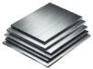





Demand: STEEL & METAL MATERIALS
STEEL & METAL MATERIALS
Plates & sheets (carbon, stainless steel, aluminium, inconel)
24,860 ea/kg/lg/sh/m2/pc
Bar alloy, Angle, Rods, Channels, Bar (hex, flat, bronze)
152,734 ea/lg/pk/kg/m
Bearings (ball, plain, thrust), Spares, Accessories
46,959 ea/pr/set
Fasteners (Anchors, anchor bolts, nuts, washers, pins, screws, bolts)
4,567,818 ea/set/cs/pk/st
Grating
1,589 st
V-belts, belts
3,261 ea
22
04/03/2025 CONFIDENTIAL KARACHAGANAK PETROLEUM OPERATING B.V

Slide 23



infoimbc@imbc.kz
+ 7 (7172) 39-99-66
www.imbc.kz
The range and specificity of services for assistance in the development of the potential of manufacturers, offered by IMBC, are limited and are subject to provision on an individual basis, depending on the readiness of the manufacturer to supply their manufactured goods in line with the requirements of the Operators.
Assistance from IMBC does not oblige any retaliatory action from the potential manufacturer. The services of IMBC do not represent a guarantee of the successful participation and / or successful award of Contracts to the manufacturer in the procurement processes of the Operators.
23
04/03/2025 CONFIDENTIAL KARACHAGANAK PETROLEUM OPERATING B.V

Slide 24
KPO Supplier Database
04/03/2025 CONFIDENTIAL KARACHAGANAK PETROLEUM OPERATING B.V

Slide 25
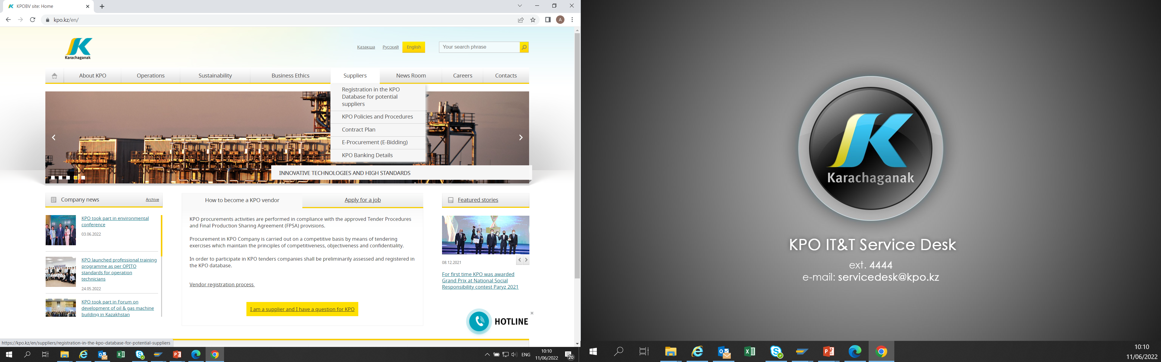
KPO SUPPLIERS DATABASE

Slide 26
VENDOR REGISTRATION
All potential suppliers shall be registered in KPO Database
REGISTRATION PROCESS
REGISTRATION
Provision of information on:
Technical Competency
Work Experience in the declared categories of goods and / or works and / or services
Personnel Availability
Financial Turnover
etc.
ETHICAL DUE DILIGENCE
Define an Ethical Due Diligence level in accordance with KPO Legal requirements:
Compliance with Kazakhstan and Foreign legislation
Compliance with Company internal regulations
Submission of potential suppliers shareholder lists
Vendor registration in KPO Vendor Database does not guarantee the participation in a tender or contract award, but suggests that a registered company may be considered as a market research participant for provision of goods, works and services for further pre-qualification process or tender as the need arises.

Slide 27
VENDOR REGISTRATION
To register in KPO Vendor Database, potential supplies shall:
  Download a questionnaire on KPO website – https://kpo.kz/ru/postavshchikam/registracija-v-baze-dannykh-postavshchikov-kpo
  Fill in the questionnaire for the preliminary vendor assessment and indicate activity codes
  Attach copies of required documents
  Submit the completed pack of documents for vendor assessment and registration by e-mail at MIVQ@kpo.kz
  Contact phone: +7 (711336) ext. 4943, 4946, 2192
  KPO encourages Suppliers to update registration data on an ongoing basis, related to:
    Work Experience in the declared categories of goods, works, services
    Certification, accreditation
    Reorganization
    Contact persons

Slide 28
MARKET RESEARCH
Purpose
  Define potential suppliers of goods, works, services who can perform as per KPO requirements
  Ensure free competition for KPO tenders
PROCESS
Demand determination and vendor searching
Issue of Invitation Letter for Expression of Interest
Market Intelligence Report
Approved
Tender List
Approvals

Slide 29
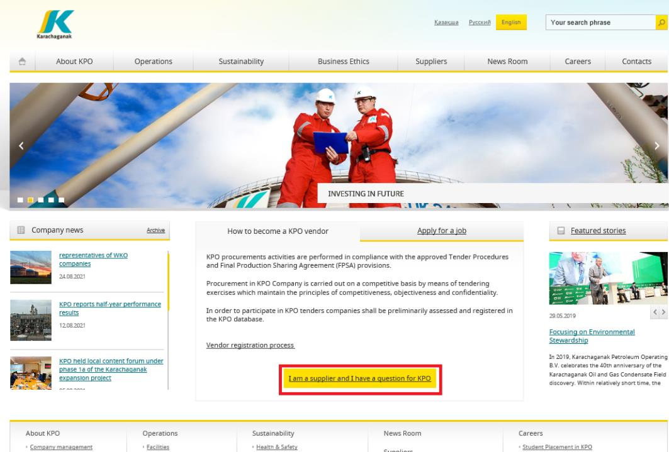
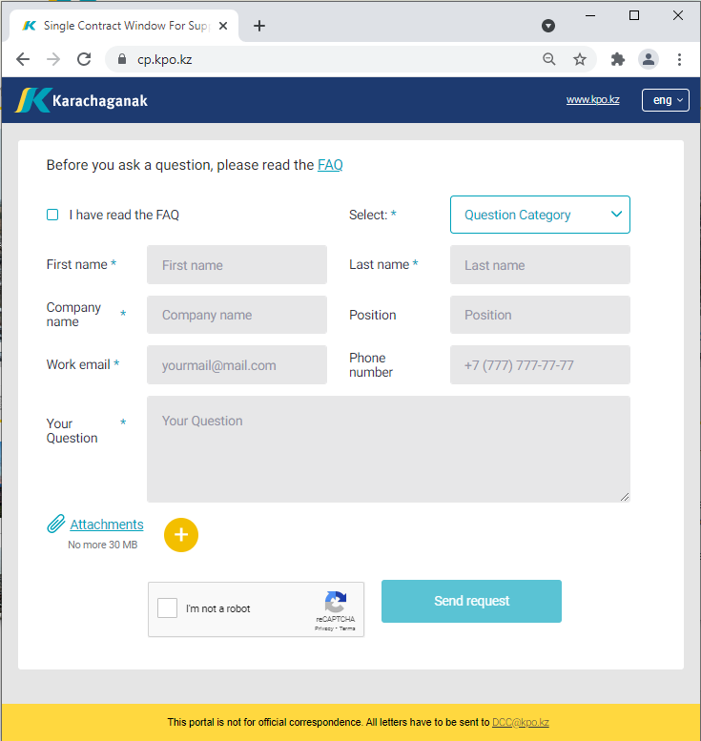
‘’SINGLE WINDOW’’ SYSTEM

Slide 30
Procurement
Process
30
04/03/2025 CONFIDENTIAL KARACHAGANAK PETROLEUM OPERATING B.V

Slide 31
PROCUREMENT PROCESS
KPO shall perform the procurement activities in accordance with:
  the Final Production Sharing Agreement (confidential and intended only for the use of KPO, its Shareholders and the Republic) and the Joint Operating Committee’s Tender Procedures (JOC)
  current legislation
  approved budget and work program
PROCESS
MARKET RESEARCH / PREQUALIFICATION
INVITATION
TO TENDER
TENDERING PERIOD
TENDER DUE DATE
EVALUATION OF TENDERS
CONTRACT AWARD
CONTRACT
SIGNING
CONTRACT
PERFORMANCE
04/03/2025 CONFIDENTIAL KARACHAGANAK PETROLEUM OPERATING B.V

Slide 32
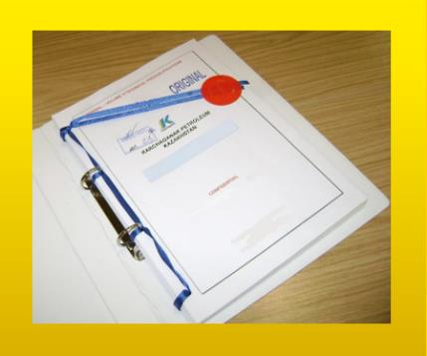



MAXIMUM ATTENTION SHALL BE PAID TO
TENDER PACKAGES SUBMISSION REQUIREMENTS
TENDER PACKAGES SUBMISSION REQUIREMENTS THROUGH E-BIDDING SYSTEM
(Link to the instructions)
INSTRUCTIONS
TO TENDERERS
TENDER DUE DATE / TIME
04/03/2025 CONFIDENTIAL KARACHAGANAK PETROLEUM OPERATING B.V

Slide 33
TENDER DOCUMENTATION CONTENTS
Cover letter
Forms, that shall be mandatorily signed, stamped and provided within timeframe specified:
Tender Acknowledgement and Confidentiality Agreement
Form of Tender
Certificate of Corporate Ownership and Declaration of Compliance
A package of documents related directly to the tender subject itself
Instructions to Tenderers
Form of Contract includes:
Form of Agreement
Schedule A – General Terms and Conditions
Schedule B – Scope of Goods/Services to be Supplied and Specifications
Schedule C – Compensation and Payment
Schedule D – Health, Safety and Environment (HSE) requirements
Schedule E – Special Conditions
Schedule F – Statement of Local Content
Schedule H – Industrial Relations
Questionnaire for Tender Participants
List of goods and technical delivery conditions (if applicable)
Instructions for preparing a tender proposal:
Instructions to Tender Participants
Bid marking template
04/03/2025 CONFIDENTIAL KARACHAGANAK PETROLEUM OPERATING B.V

Slide 34
KPO General HSE requirements
04/03/2025 CONFIDENTIAL KARACHAGANAK PETROLEUM OPERATING B.V

Slide 35

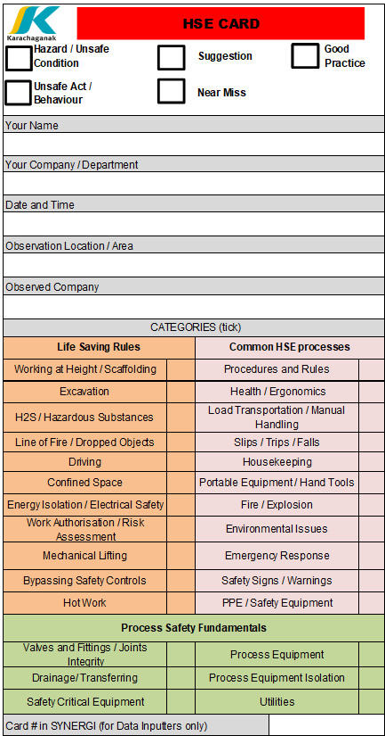


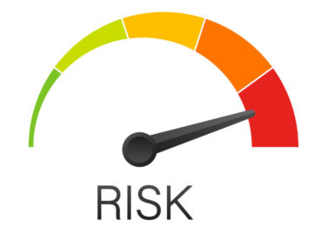
KPO General HSE requirements
2 EXECUTION OF THE CONTRACT
Leadership and Commitment
HSE policy
Planning
  HSE Legislation
  Risk Management
Support
  HSE Personnel
  HSE Competence Requirements
  HSE Training and
  Induction
  HSE Communications
  HSE Meetings
  HSE Procedures
1 GENERAL PROVISIONS
Scope
Contractor HSE Plan
Compliance
1
2
Implementation
  Equipment Maintenance and Inspection
  Occupational Health and Hygiene
  Environment
  Road Transport Safety
  PPE Requirements
  Emergency Response Interaction
  Subcontractor management
Control and Monitoring
  HSE Observations and Reporting
  Incident Investigation
  HSE Audits and Inspections
  Safety Reporting
  Environmental Reporting
3
3 MINIMUM LIST OF HSE PROCEDURES FOR COMPLIANCE BY CONTRACTOR

Slide 36
Local Content
Mechanisms
36
04/03/2025 CONFIDENTIAL KARACHAGANAK PETROLEUM OPERATING B.V

Slide 37
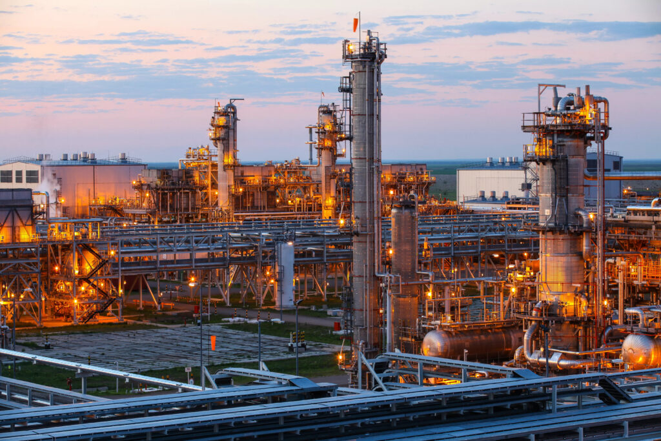







SUPPORTING MECHANISMS FOR LOCAL COMPANIES
TRIAL ORDER
EARLY TENDER
KAZAKH TENDER
Tenders for testing a trial batch of GOODs from Kazakhstani suppliers
Contract is concluded for the supply of GOODS with a suspensive condition or with a long-term delivery schedule
Tenders exclusively among Kazakhstani Suppliers. The goal is to award contracts to Kazakhstani suppliers of GWS
CONTRACT IN EXCHANGE FOR INVESTMENTS (UNDER REVISION)
  A contract in exchange for investment is a long-term contract concluded on a Single source basis, under which the supplier undertakes to produce goods of local origin that are the subject of a procurement contract in the territory of the Republic of Kazakhstan
04/03/2025 CONFIDENTIAL KARACHAGANAK PETROLEUM OPERATING B.V

Slide 38
Thank you!
38
04/03/2025 CONFIDENTIAL KARACHAGANAK PETROLEUM OPERATING B.V

