Slide 1
KPO VALVES TECHNICAL WEBINAR
KARACHAGANAK PETROLEUM OPERATING B.V
29/07/2024

Slide 2
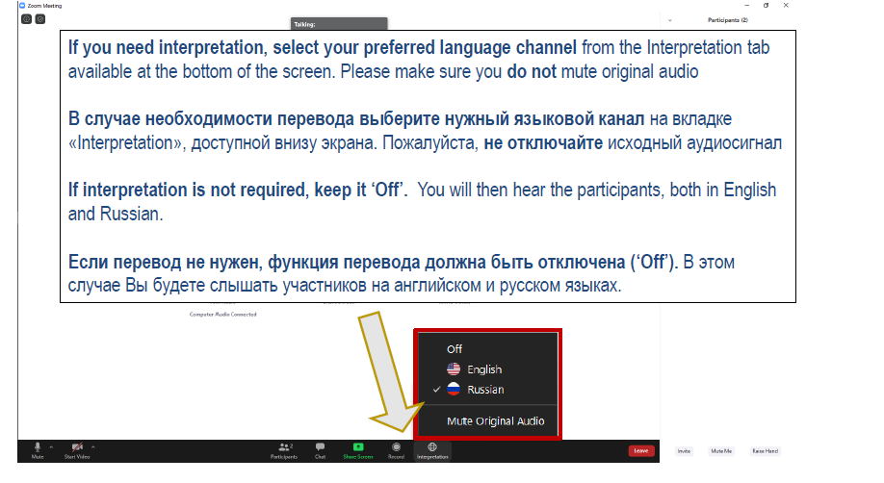
ЯЗЫКОВОЙ КАНАЛ/LANGUAGE CHANNEL
29/07/2024 CONFIDENTIAL KARACHAGANAK PETROLEUM OPERATING B.V

Slide 3
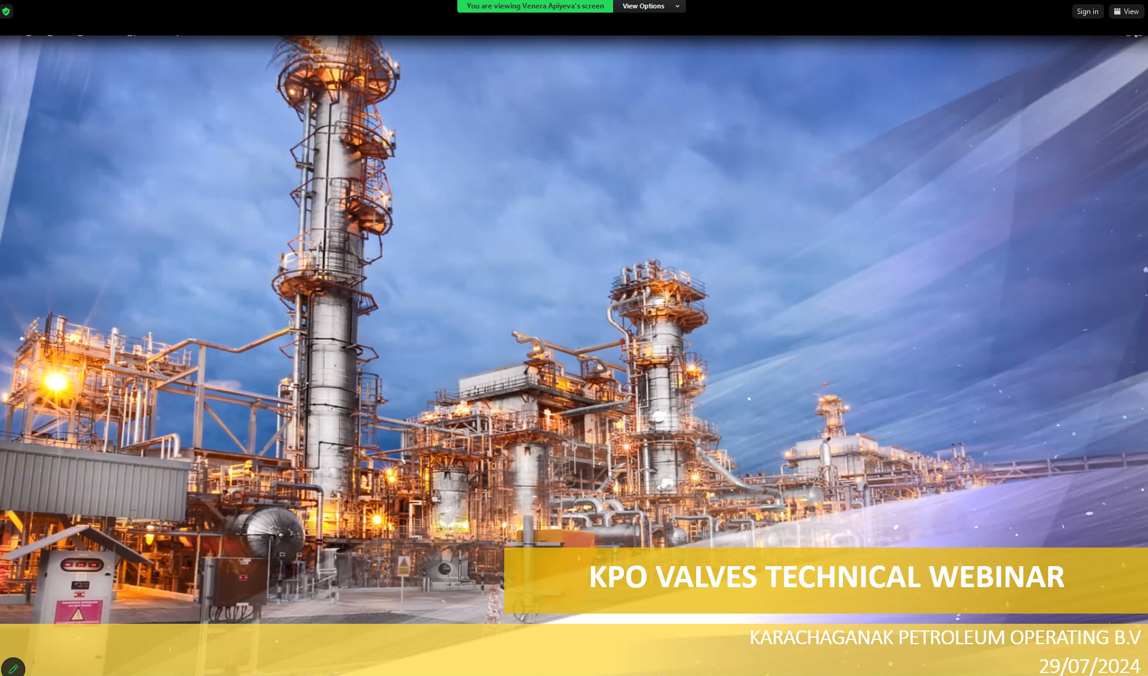
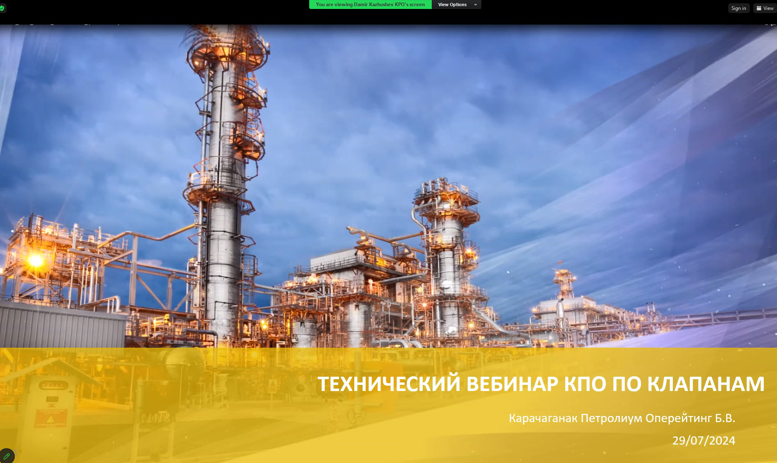
ЯЗЫК ПРЕЗЕНТАЦИИ/PRESENTATION LANGUAGE
  Content is available in Russian and English language; select the presenter displaying the content in your preferred language by clicking on the “View Options” tab at the top of the screen.
  Презентация доступна на русском и английском языке; выберите человека, представляющего содержание на предпочитаемом Вами языке, нажав “View Options” верхней части экрана.
  Venera Apiyeva – English language
  Damir Kazhushev – Русский язык
29/07/2024 CONFIDENTIAL KARACHAGANAK PETROLEUM OPERATING B.V

Slide 4
WEBINAR RULES
  We will have a Facilitator to manage this event
  Everyone except Presenters will be muted
  If you want to ask a question, please type it in the comments box
  Try to hold questions to the end of the presentation
  Be open, honest and respectful
  Don’t
    use this webinar to market your company
    ask a question regarding any specific Tender/Contract
    expect total clarity and precise response to your every question
29/07/2024 CONFIDENTIAL KARACHAGANAK PETROLEUM OPERATING B.V

Slide 5



KPO GOLDEN RULES
  You and I:
  Comply with the law, standards and procedures
  Intervene on unsafe or non-compliant actions
  Respect each other, our contractors and community
29/07/2024 CONFIDENTIAL KARACHAGANAK PETROLEUM OPERATING B.V

Slide 6
AGENDA
  WELCOME SPEECH
  WEBINAR RULES
  VALVE AND DATASHEET OVERVIEW
  KPO SUPPLIERS DATABASE
  KPO PROCUREMENT PROCESS
  LOCAL CONTENT MECHANISMS
  Q&A SESSION
29/07/2024 CONFIDENTIAL KARACHAGANAK PETROLEUM OPERATING B.V
6

Slide 7
ENGINEERING AND TECHNICAL AUTHORITY DEPARTMENT
1

Slide 8
DISCLAIMER
The information contained in these slides is made available for consideration. It represents KPO's preliminary description of the KPO demands as presently envisaged, but KPO reserves the right to change this information in the course of planning and implementing the projects, and KPO cannot be held responsible for any loss, damage or expense arising from reliance on this information. The information will not form part of any agreement between KPO and contractors participating in the workshop.
Today's engagement is one of many steps which KPO and its stakeholders are taking to develop local content.
29/07/2024 CONFIDENTIAL KARACHAGANAK PETROLEUM OPERATING B.V

Slide 9
VALVE AND DATASHEET OVERVIEW
SUMMARY
A: Manual Valves
Overview
Valve Key Features
Valve Specification
Valve Datasheet
B. Control & Isolation Valves
Overview
Control Valves
ESD & BVD
PSV
C: KPO Previously Used Valves and Forecasts
29/07/2024 CONFIDENTIAL KARACHAGANAK PETROLEUM OPERATING B.V

Slide 10
Overview
Manual Valves
1

Slide 11
Overview
KPO specifications are notably more intricate than standard industry requirements, primarily due to the challenging fluid conditions and extreme temperatures encountered.
Historical Development: Over the past 20 years, we have developed extensive piping material classes and valve datasheets tailored to our projects. Recently, new datasheets have been created to consolidate KPO's specifications.
Diverse Reequipments: Our specifications feature varied requirements and levels of detail, reflecting the complexity of our operations.
Material Restrictions: A specific list of prohibited materials is enforced due to fluid compatibility issues. These will be detailed in subsequent slides.
Compliance: It is imperative that all technical and material details on the datasheets are adhered to in strict accordance with the associated specifications.
29/07/2024 CONFIDENTIAL KARACHAGANAK PETROLEUM OPERATING B.V

Slide 12
Valve Key Features
Manual Valves
2

Slide 13
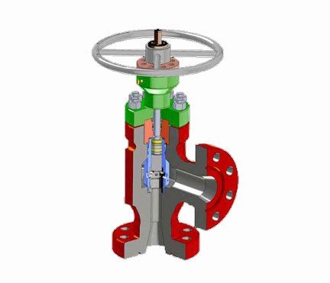
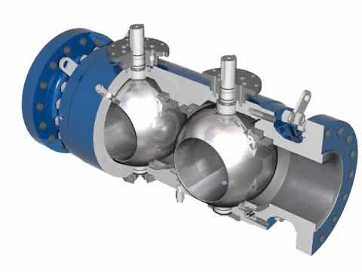
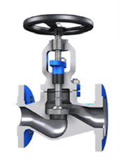
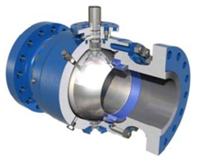
Valve Key Features - General
KPO utilize various types of valves to meet different operational needs such as :
Gate Valves, Globe Valves, Ball Valves, DBB Valves, Butterfly Valves, Check Valves and Choke valves.
Our valve specifications and datasheets are developed to meet RoK requirements and international standards.
To ensure reliability and safety, all valves undergo rigorous testing:
Hydrostatic Testing: Verifies that valves can withstand maximum operating pressures.
Leakage Testing: Ensures effective sealing under operational conditions.
Functional Testing: Confirms proper operation, including open/close cycles and response times.
Material Testing: Validates that the chemical and physical properties of materials meet required specifications.
➢Choke Valve
➢Ball
➢Check
➢DBB valve
➢Gate
➢Globe
29/07/2024 CONFIDENTIAL KARACHAGANAK PETROLEUM OPERATING B.V

Slide 14
Valve Key Features – Prohibited Materials
Certain materials are prohibited due to contact with process fluids (H2S) and operating conditions in a process services line:
UNS S17400 (17/4 PH Stainless Steel)
UNS S15500 (15.5 PH Stainless Steel)
316 Stainless Steel above 60°C
Stainless Steel 304/321/347 grades and other non-Mo containing austenitic grades
Any other Martensitic Stainless Steels (13% Cr, UNS S41426, F6A, CA6NM, UNS S41000, 410 Stainless, UNS S42400, F6NM, etc.)
UNS S45000 (Custom 450)
Any Monel (e.g. N05500/K-500), UNS N04400/Alloy 400)
Any Austenitic-Ferritic Duplex Stainless Steel (2205, 2507, F51, 44LN, UNS S31803, UNS S32760, etc.)
UNS N07750, Nickel Alloy X750
Copper based alloys
UNS S20910 (XM 19 / Nitronic 50)
29/07/2024 CONFIDENTIAL KARACHAGANAK PETROLEUM OPERATING B.V

Slide 15
Valve Key Features - Technical Supply Reequipments
Bids: Must include detailed valve drawings with clearly specified materials;
Flanges: RTJ flanges are required for Class 600 and higher, Welded flanges are not permitted;
Trim Material: All LTCS body valves must use Alloy 625 for trim for sour service line
Valve Operation: Must utilize lever/handwheel or gear operation, designed to handle up to 270N force at maximum
differential pressure. Reduce the turn to close by selecting a proper gear operator.
Bolts and Nuts:
LTCS body valves must use L7M/7M bolts and nuts.
SS body valves must use B8M/8M bolts and nuts.
F22M body valve must use A453 660/2HM
Alloy 625 Overlay: On lip seal areas, an Alloy 625 overlay with a thickness of 3mm shall be applied.
Temperature Suitability: All valve components must be suitable for operations at -45°C.
Bonnet Extension: All valves must include a bonnet extension for insulation, with the height specified on the datasheet.
Hard facing: Electroless Nickel Plating (ENP) is not allowed as a hard facing material. TCC and Stellite-6 it is approved by Company
Positive Material Identification (PMI): Required on both external and internal components, adhering to KPO specification
Inspection Reequipments for Cast Valves (Class 150 up to 600 ):
Visual examination.
Magnetic particle examination or dye penetrant examination of all accessible interior and exterior surfaces, including machined surfaces.
Radiography of critical areas.
Inspections must be performed on 10% of the total quantity of castings, with a minimum of one per unique size, pressure class, and type of valve.
29/07/2024 CONFIDENTIAL KARACHAGANAK PETROLEUM OPERATING B.V

Slide 16
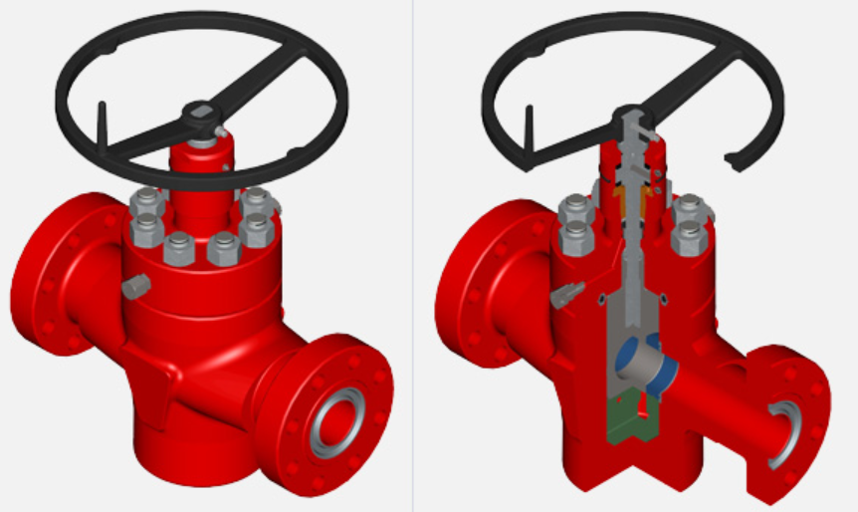
Valve Key Features - Technical Supply Reequipments
API 6A 10000 psi Valves:
Must be PR2 qualified (Appendix F).
Must comply with PSL 4.
These valves must be of forged design.
High-pressure F22 Mod forgings must adhere to a specific material specification.
29/07/2024 CONFIDENTIAL KARACHAGANAK PETROLEUM OPERATING B.V

Slide 17
Key Features - Technical Supply Reequipments F22 Mod.
KPO Specification for Valve Procurement for 2 1/4 Cr-1Mo (KPO-80-PIP-SPC-00005-E)
Service Condition: Designed for high pressure and sour service (605 bars).
Material Requirements: All materials, including stems, wedge segments, seats, and seals, must meet the requirements of NACE MR0175/ISO 15156.
Manufacturing Compliance: Valves must be manufactured in accordance with the relevant COMPANY Data Sheet. The selection of materials will be subject to review and acceptance based on COMPANY technical requirements.
Approved Mills: KPO-approved mills for raw materials are Ringmill, FAD, and Tubacex IBF. Any other mills must undergo the Company qualification approval process as per KPO specifications
29/07/2024 CONFIDENTIAL KARACHAGANAK PETROLEUM OPERATING B.V

Slide 18
Valve Key Features - Technical Supply Reequipments
Material Reequipments:
ASTM A350 LF2 Forgings:
All forgings must be supplied as Class 1, with an impact test temperature of -46°C.
The maximum hardness of any forging must be either as stated in the relevant product standard or 220HV (210HB), whichever is lower.
ASTM A694 Forgings:
Charpy impact testing at -45°C is mandatory.
Castings:
The sulphur content must be limited to a maximum of 0.025%.
The maximum hardness of any casting must be either as stated in the relevant product standard or 248 HV (22HRC, 237HB), whichever is lower.
Material Certification:
Material certificates for all pressure-containing components in Class 10000 service, including bolting and ring joint gaskets, must comply with BS EN 10204 3.2;
Material certificates for pressure-containing components originating from China or India must also comply with BS EN 10204 3.2
29/07/2024 CONFIDENTIAL KARACHAGANAK PETROLEUM OPERATING B.V

Slide 19
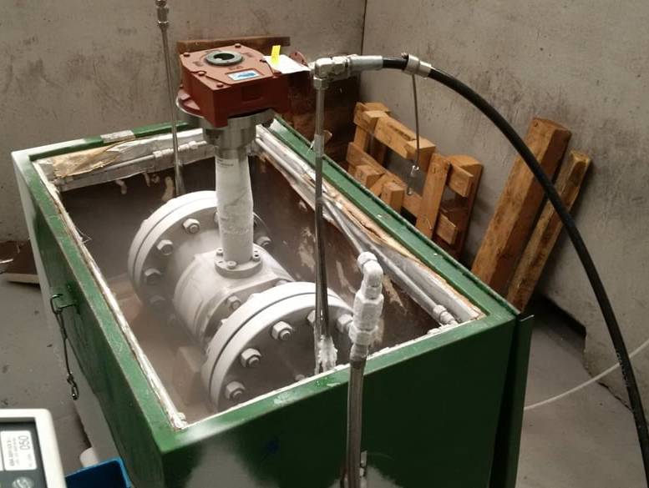
Valve Key Features - Technical Supply Reequipments
Low Temperature Testing Reequipments:
Type Test Acceptance:
Previously conducted type tests may be submitted for review to potentially waive this requirement
Type tests will be accepted if the valve and actuator tested are identical in design and material of construction to those being supplied from the production batch
Testing Procedure:
Batch Testing: For a batch of identical valves, test a single valve if no prior Low Temperature Testing (LTT) report is available or has been submitted and approved by the Company.
Unique Valve Testing: Conduct LTT for a single unique valve.
Exemptions: This test is not required for API 6A valves that have a valid PR2 qualification.
29/07/2024 CONFIDENTIAL KARACHAGANAK PETROLEUM OPERATING B.V

Slide 20
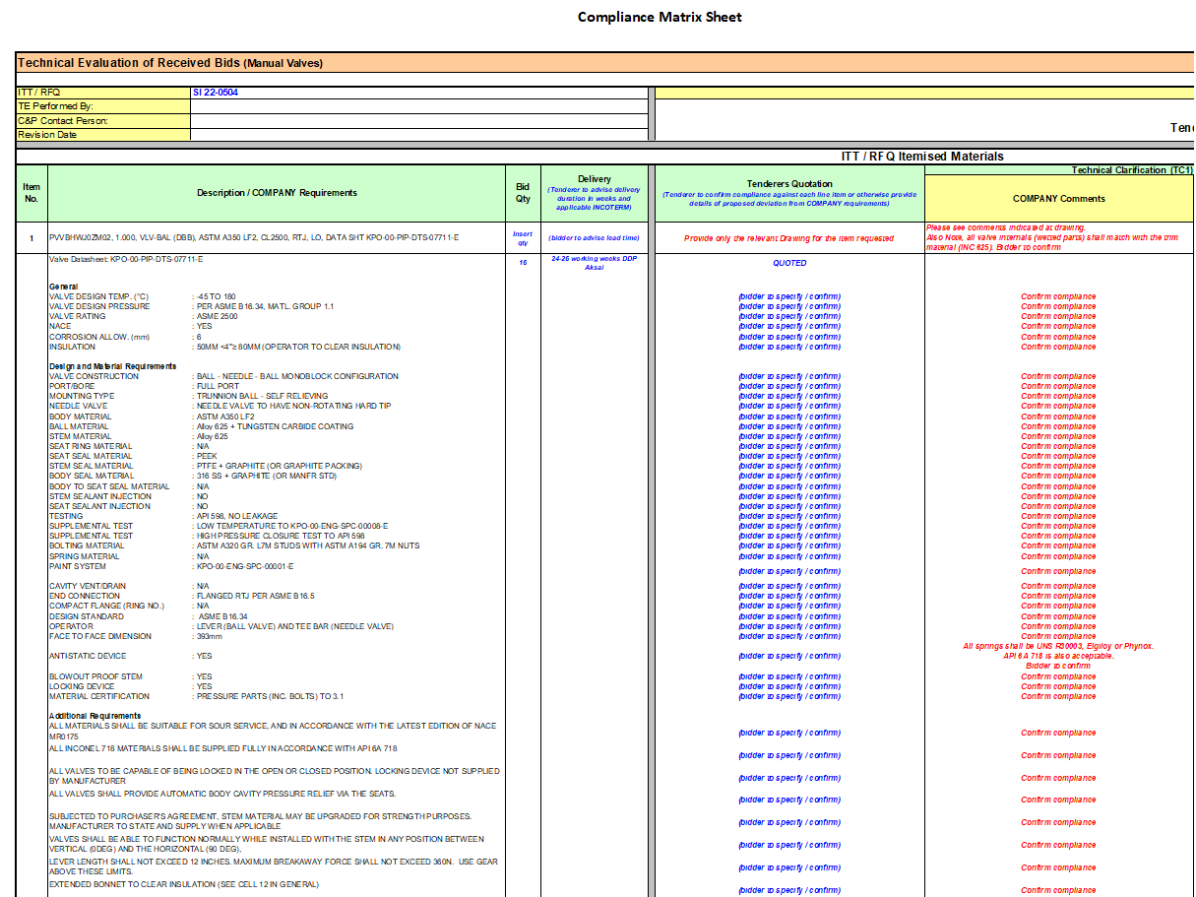
Valve Key Features – Documents TBE
Typical document requirement during the bid phase exchange between PED Eng. department and C&P department.
Required information from Company DTS
Column reserve to tenderers for confirm/deviate
Column reserve to Company for accept or reject the clarification by tenderers
29/07/2024 CONFIDENTIAL KARACHAGANAK PETROLEUM OPERATING B.V

Slide 21
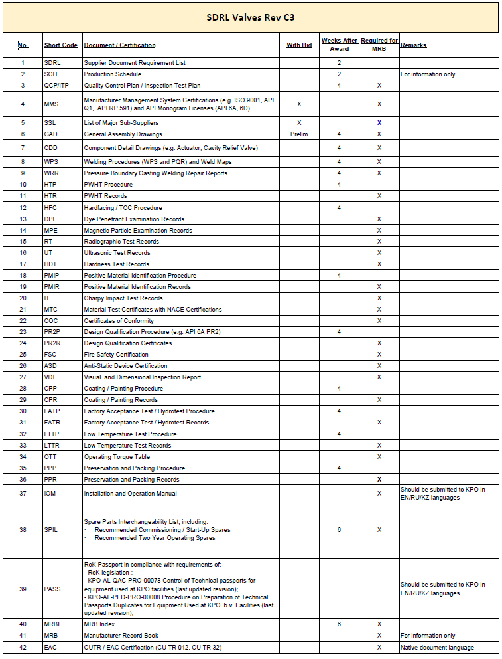
Valve Key Features – Documents MRB
Typical document requirement from bid phase up to the final MRB
29/07/2024 CONFIDENTIAL KARACHAGANAK PETROLEUM OPERATING B.V

Slide 22
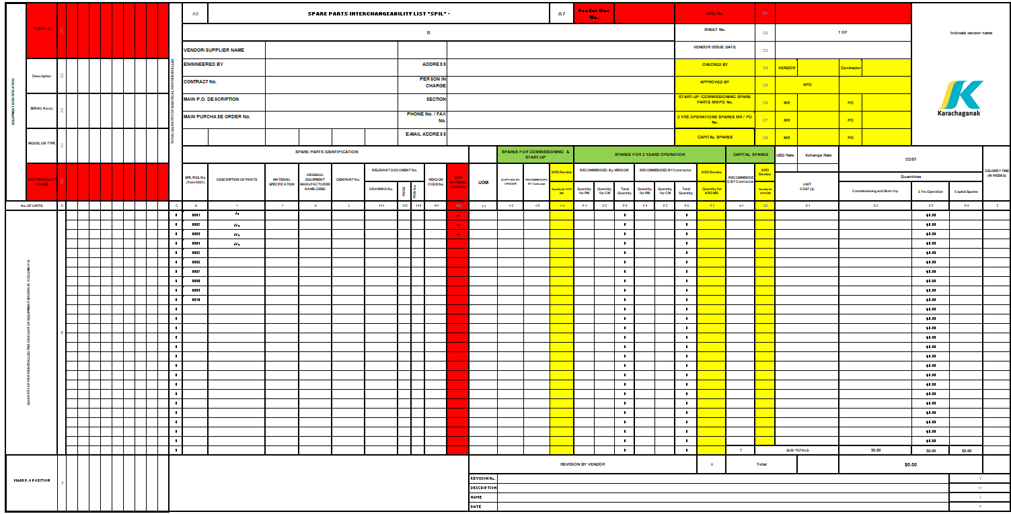
Valve Key Features – Documents SPIL
Typical document requirement is the Spare Parts Interchangeability List
29/07/2024 CONFIDENTIAL KARACHAGANAK PETROLEUM OPERATING B.V

Slide 23
Specification Overview
Manual Valves
3

Slide 24
Specification Overview - Core Technical Specifications
All material shall be supplied in full compliance with the valve datasheet reference in RFQ or PR line item, as well as the following KPO documentation :
S/N | Document Number | Title | Rev.
1 | KPO-00-ENG-SPC-00001-E | Technical Supply Reequipments Valves | C10
2 | KPO-00-ENG-SPC-00017-E | Company Specification. Positive Material Identification | A3
3 | KPO-00-ENG-SPC-00008-E | Specification for Low Temperature Testing of Valves. | A3
4 | KPO-00-ENG-SPC-00035-E | Specification for External and Internal Coatings | A1
5 | KPO-00-ENG-SCH-00001-E | SDRL (Supplier Document Reequipments List) - Valves | C3
6 | KPO-00-ENG-SCH-00004-E | Equipment Data Capture for CMMS | A2
7 | KPO-00-ENG-FRM-00001-E | Company Data Sheets - Example Valve Manufacturer . Quality Control Plan. | C3
8 | KPO-00-QAC-SPC-00001-E | Supplier Welding Procedure Approval & Welding Quality Reequipments. | A4
9 | KPO-00-PIP-SPC-00008-E | Specification for Piping, Forgings, Castings & Plate for Sour Service. | C5
10 | KPO-AL-LGT-SPC-00001-E | I_01_Packing and Shipping Instructions | A8
11 | KPO-AL-LGT-SPC-00002-E | I_02_Import Instructions | A7
29/07/2024 CONFIDENTIAL KARACHAGANAK PETROLEUM OPERATING B.V

Slide 25
Manual Valves
4
Valve and datasheet overview

Slide 26
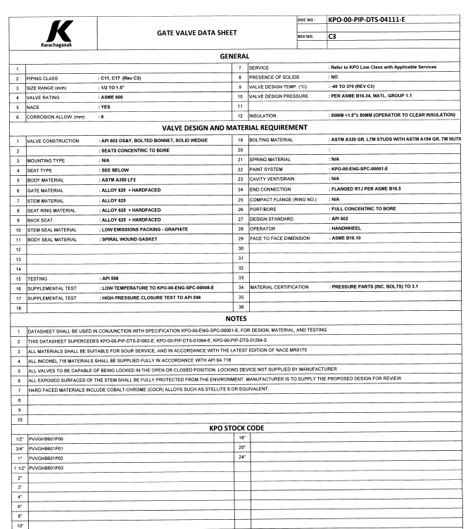
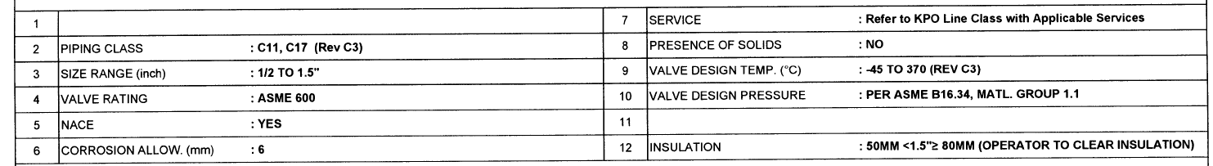
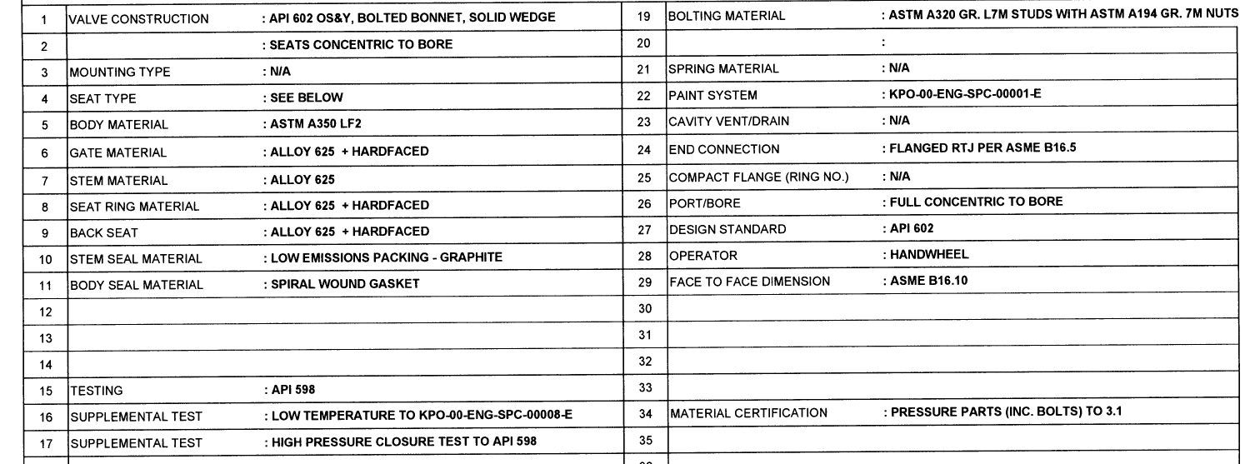
Valve and datasheet overview
A typical mechanical datasheet for a valve is generally divided into two main categories: General Information and Valve Design and Material Reequipments.
General information: such as PMC reference, size, pressure rating, design pressure and temperature
Valve design and material requirement:
Specify the Design code, materials for the main component, KPO and international standard to be comply and the mandatory testing .
29/07/2024 CONFIDENTIAL KARACHAGANAK PETROLEUM OPERATING B.V

Slide 27
Overview
Control & Isolation Valves
1

Slide 28
Overview & Aim
This workshop provides an overview for the types of valves used at KPO facilities.
These slides provide brief information & characteristics for each type of Control and ESD/BVD & PSV valves
The aim is for the Audience to familiarize with KPO type of valves commonly used
29/07/2024 CONFIDENTIAL KARACHAGANAK PETROLEUM OPERATING B.V

Slide 29
Control Valve Key Features
Control & Isolation Valves
2

Slide 30
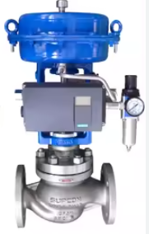
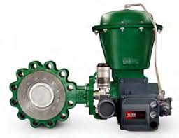
Control Valves
KPO control valve are primarily diaphragm pneumatic, top guided, cage guided, double port, 3 way and angle
Mainly used for flow, pressure, temperature & level control
Rotary ¼ turn Valve , globe, ball, butterfly
Instrument Air for sizing Actuator is between 4 -10 Barg
Pneumatic Control valve failure modes (close or open positions) are specified in the Instrument data sheet
Actuator can be either Directing & Reverse Acting
Valve Positioner I/P converter are Smart 4 -20 mAmp. Exia Classified
( Intrinsically safe) The position transmitters NAMUR NE43
Valve used in sour service H2S are NACE MR 0175 compliant
29/07/2024 CONFIDENTIAL KARACHAGANAK PETROLEUM OPERATING B.V

Slide 31
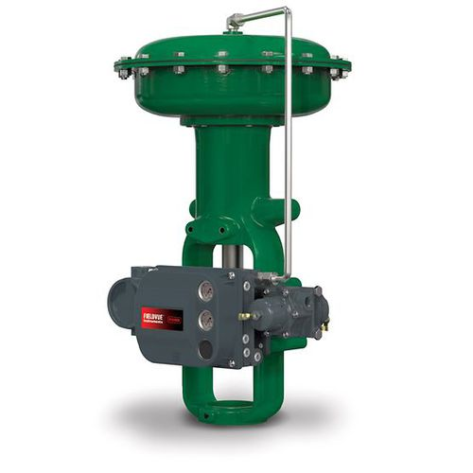
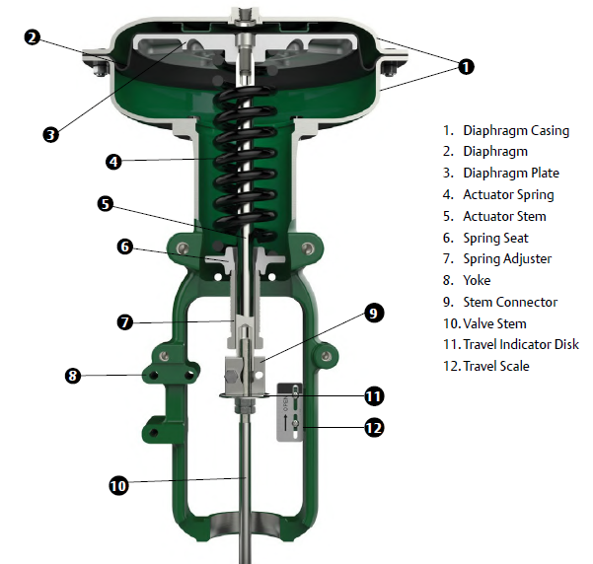
Actuators
A4
Air operated low temperature, spring-return & Diaphragm single or Double acting Actuator; Actuators & regulators must be rated at -40 to +45 C
Black body solar radiation temperature: +80°C; Relative humidity: 12% to 99%
Electrical components suitable for Zone 1 area, group IIB, temp. class T3 gas
Ex certification in line with "On the safety equipment for working in hazardous environments” (Custom Union Technical Regulation CUTR 012 / 2011).
Components in Hazardous areas to IEC 60079.
Electrical equipment shall be certified IP65 in accordance with IEC 60529.
Instrument air dew point is specified at -70 C°
Tubing ASTM A269 TP316 / 316L (dual grade) with hardness Rb90. Permissible outside diameter and wall thickness shall be 12mm OD x 1,5 mm WT (tubing between positioner and actuator is as per vendor design).
Compression fittings shall be PARKER A-LOK, double ferrule, SS316, metric sized.
29/07/2024 CONFIDENTIAL KARACHAGANAK PETROLEUM OPERATING B.V

Slide 32
Specifications & Data sheet
Data sheets includes ( Example attached)
Valve type ( plug & Globe, ¼ turn)
Process parameters
Mechanical , material & piping details
Actuator type and sizing
Preliminary CV Calculation
Electrical requirements
Standards & Certifications compliance
KPO-00-INS-SPC-00013-E- Control Valves
29/07/2024 CONFIDENTIAL KARACHAGANAK PETROLEUM OPERATING B.V

Slide 33
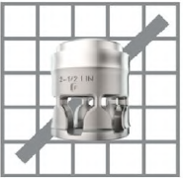
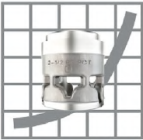
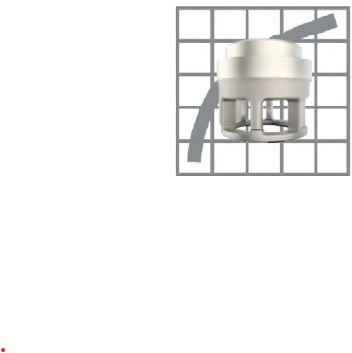
Cages
Modulating Control valves Trims are:
type Linear
Quick opening
Equal %
29/07/2024 CONFIDENTIAL KARACHAGANAK PETROLEUM OPERATING B.V

Slide 34
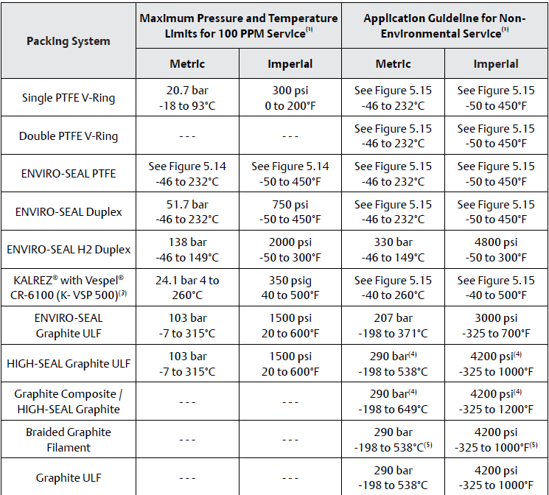
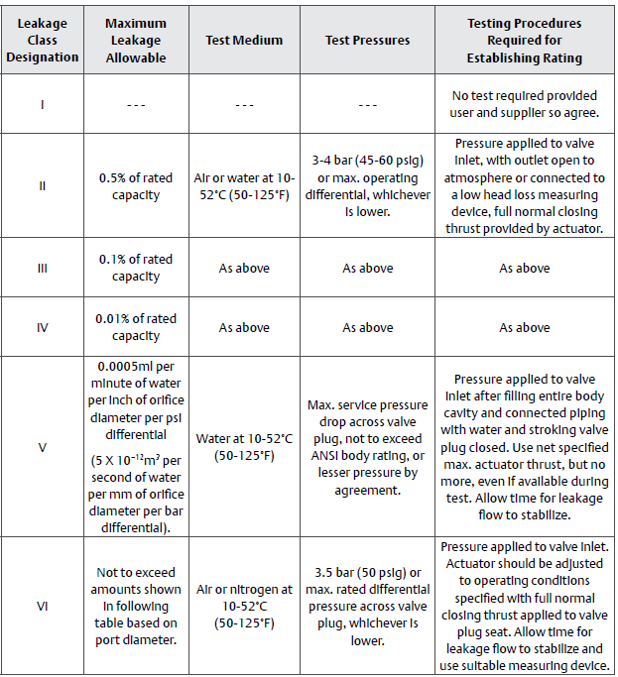
Control Valve Seat Leakage Classification
Packing as specified in Data sheets & table below
Typically are Class IV - ANSI/FCI 70-2 and IEC 60534-4)
29/07/2024 CONFIDENTIAL KARACHAGANAK PETROLEUM OPERATING B.V

Slide 35
ESD & BVD Key Features
Control & Isolation Valves
3

Slide 36
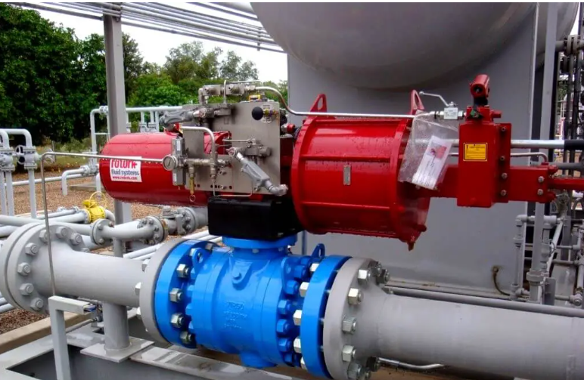
ESD & BVD Valves
Emergency Shutdown and Blow down Valves are Ball & fast acting
Fail Closed SDV- Fail Open BDV
Single Acting cylinder Or spring return
Double acting cylinder
Metal seats are used for shut-down valves
Solenoid are Air operated 4-10 Barg 24 Vdc Eexd rated
Shutdown valves form part of a SIS. SIL II rated or Higher
Limit switch are Eexia
Mechanical open close position fitted standard
29/07/2024 CONFIDENTIAL KARACHAGANAK PETROLEUM OPERATING B.V

Slide 37
Isolation Valves
Details for ESD valves in line with KPO KPO-00-INS-SPC-00012-E
Electrical equipment certified to IP 65 in accordance with IEC 60529.
All Emergency Shut Down valves (ESDV) and Blow Down Valves (BDV) are certified “FIRE SAFE” in accordance with BS / EN / ISO 12266-1, BS / EN / ISO 10497, API 6FA, API 607 .
Air receivers are provided for air operated blowdown/isolation or shutdown valves and double acting pneumatic actuators. Receivers sized for three operations (one operation is one travel to open and to close) of the blowdown, isolation or shutdown valves
Receivers shall be pressure code ASME VIII stamped.
29/07/2024 CONFIDENTIAL KARACHAGANAK PETROLEUM OPERATING B.V

Slide 38
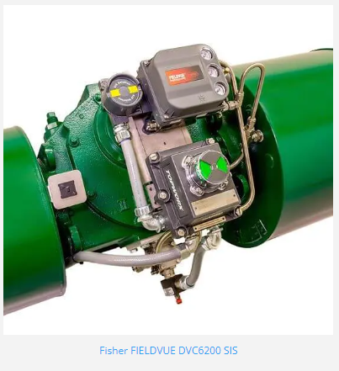
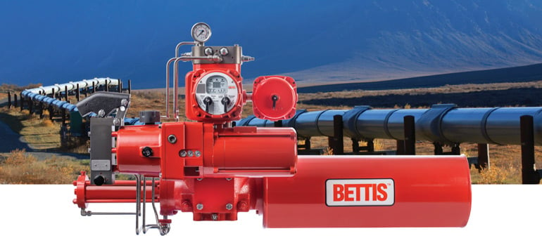
Partial Stroke Test
Partial Stroke proof test option is fitted in line with SIL recommendations (PST)
The valve will typically closes 20% for a short time and fully opened again. The test ensures the valve function is tested and working as required
PST requirement is stated in Data sheet
29/07/2024 CONFIDENTIAL KARACHAGANAK PETROLEUM OPERATING B.V

Slide 39
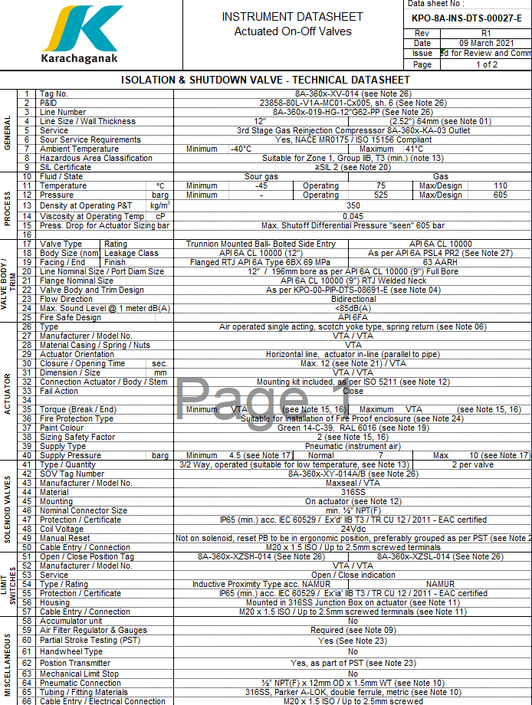
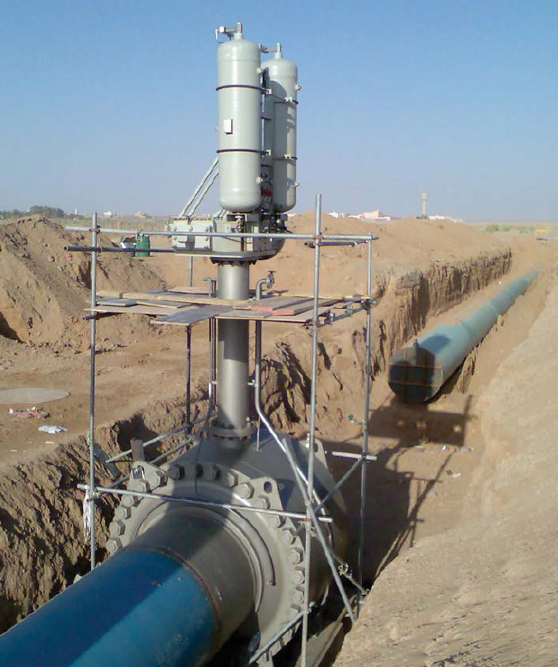
Actuated ON-OFF Data sheet
Details for ESD – BVD valves , Example as per adjacent Data sheet
Air solenoid 24 Vdc rated 3/2 Way , preferred Maxseal Eexd Auto reset -Manual reset only when specified in Data sheet
Limit switches NAMUR Inductive Exia
Accumulators if needed listed in data sheets
Example of Accumulator fitted on ESD Valve
29/07/2024 CONFIDENTIAL KARACHAGANAK PETROLEUM OPERATING B.V

Slide 40
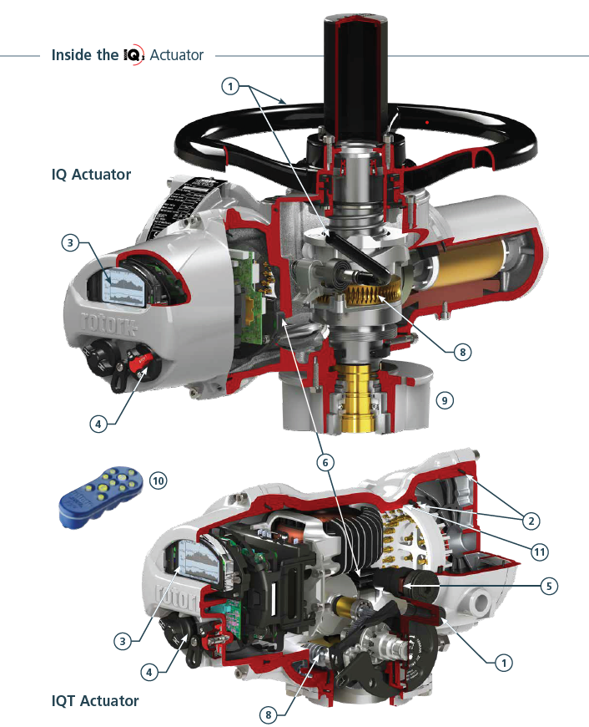
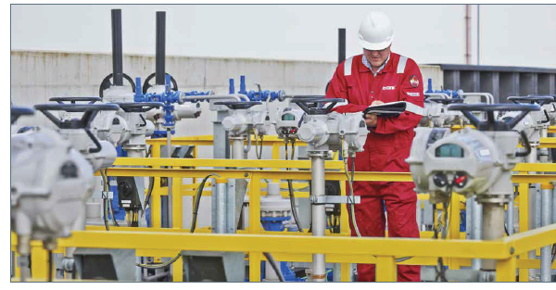
MOV Motor Operated Valves
MOV are used where Instrument air is not Available
Electric Actuators 3 Phase AC supply
KPO standardize on Rotork Intelligent Actuator
29/07/2024 CONFIDENTIAL KARACHAGANAK PETROLEUM OPERATING B.V

Slide 41
PSV Overview
Control & Isolation Valves
4

Slide 42
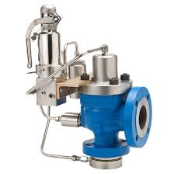
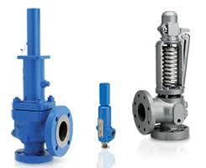
PSV
PSV are compliant with KPO-00-INS-SPC-00011-E
Spring loaded
Balanced Safety Relief Valve
Pilot Operated Safety Relief Valve
API RP 520 standard
Safety relief valves shall be of conventional direct-acting angle pattern, spring loaded, full nozzle entry
Valves used in sour gas service shall be balanced bellows closed bonnet type
sized for 10% back pressure unless otherwise specified on the project data sheet.
29/07/2024 CONFIDENTIAL KARACHAGANAK PETROLEUM OPERATING B.V

Slide 43
PSV
All flanges up to & including NPS 24 shall conform to ASME B16.5.
Class 150 & Class 300 flanges NPS 26 & larger shall conform to ASME B16.47 Series B.
Class 600 & above flanges NPS 26 & larger shall conform to ASME B16.47 Series A.
Valves designated for a design pressure of 10000 psi shall be as per API 6A, 6BX.
Dimensions of safety relief valves shall be in accordance with API RP 526.
Seat leakage procedure & seat leakage be as per API RP 527.
29/07/2024 CONFIDENTIAL KARACHAGANAK PETROLEUM OPERATING B.V

Slide 44
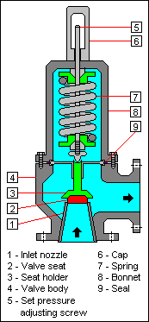
PSV Material
For sour Services “NACE MR0175 / ISO 15156 & KPO Specification KPO-00-PIP-SPC-00008
Springs UNS R30003, Elgiloy® or Phynox® or API 6A 718
MP35N UNS R30035 is acceptable if provided with satisfactory testing to meet NACE
Inconel 718 materials, where provided in accordance with API 6A 718.
Bolting shall be as follows:
LTCS & LAS Valves: A320 L7M bolts with A194 L7M Nuts, galvanised ASTM A153
Stainless Steel Valves: ASTM A320 Gr B8M bolts & ASTM A194 Gr 8MA nuts.
API 6A Valves: A453 Gr. 660 bolts with A194 L7M Nuts, galvanised ASTM A153.
Encapsulated bolts must meet NACE requirements.
29/07/2024 CONFIDENTIAL KARACHAGANAK PETROLEUM OPERATING B.V

Slide 45
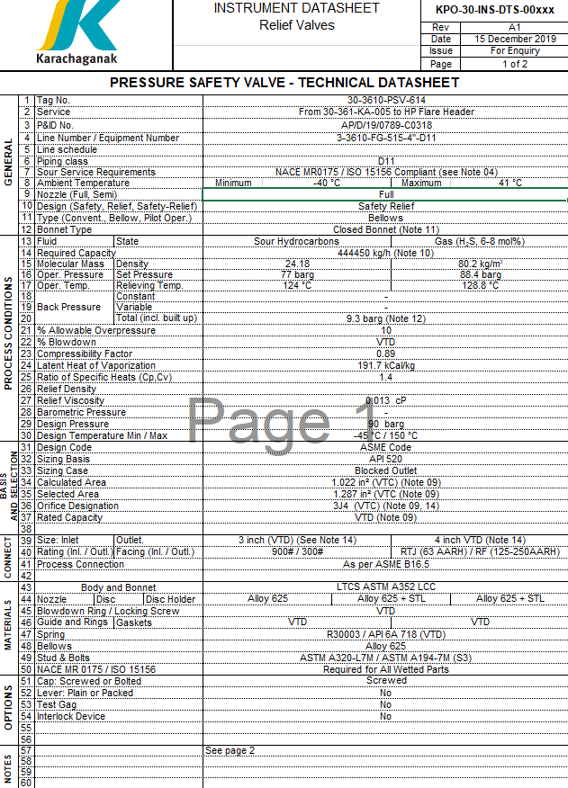
PSV Data sheet
29/07/2024 CONFIDENTIAL KARACHAGANAK PETROLEUM OPERATING B.V

Slide 46
KPO Frequently Used Valves and Forecasts
C

Slide 47
Summary mechanical Valve range frequently used
Type | Ball & DBB valve |  | Gate valve |  | Globe valve |  | Check valve
Pressure rating: | 150# - 2500# | 10000# | 150# - 2500# | 10000# | 150# - 2500# | 10000# | 150# - 2500# | 10000#
Size: | ½” – 24” | ¾” – 12” | ½” – 24” | 2” – 10” | ½” – 8” | - | ½” – 24” | 2” – 16”
Materials: | LTCS A350-LF2 / A352-LCC; SS A182-F316 / A351-CF8M; INCOLOY 825 B564 GR N08825; ALLOY 20 / B462-N08020; TITAN B381-F-2 API 6A 60K; A182 F22 Modified
Technical requirements: | All valves designed according to International Standards (API 6D, ASME B16.34, API 6A) Certified Fire Safe in accordance with API 607, API 6FA or BS EN ISO 10497 All metallic materials shall be manufactured, tested, and certified in accordance with NACE MR0175 / ISO 15156 All Valves shall be suitable for the Environmental Minimum Temperature of (minus) 45°C Material Certificates for all pressure containing component shall be in accordance with BS EN 10204 3.2 & 3.1 PMI mandatory for all valve body and internals
29/07/2024 CONFIDENTIAL KARACHAGANAK PETROLEUM OPERATING B.V

Slide 48
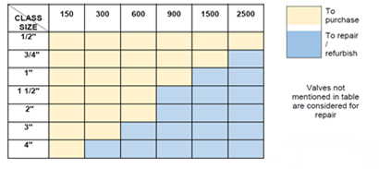
Valves historical consumption and forecast
Valve consumption
Yearly valve consumption depending on TA cycles and projects
Main type of valves used is Ball Valves
Yearly consumption increasing due to increasing installed valve base because of new projects
KGDBN
Valve type | 2014 | 2015 | 2016 | 2017 | 2018 | 2019 | 2020 | 2021 | 2022 | 2023
Ball Valves | 91 | 97 | 280 | 270 | 122 | 614 | 2400 | 354 | 628 | 265
Check Valves | 8 | 46 | 26 | 21 | 35 | 98 | 185 | 17 | 35 | 69
Gate Valves | 46 | 77 | 102 | 54 | 18 | 828 | 1343 | 32 | 246 | 180
Globe Valves | 19 | 72 | 49 | 18 | 18 | 169 | 196 | 26 | 97 | 37
Total | 164 | 292 | 457 | 363 | 193 | 1709 | 4124 | 429 | 1006 | 552
MTA Years
Valve forecast:
Forecast based on historical consumption and increasing installed valve base in KPO
Procurement/refurbishment strategy will be based on valve class/size as per picture below,
Valve type | 2024 | 2025 | 2026 | 2027 | 2028
Ball Valves | 276 | 289 | 604 | 316 | 330
Check Valves | 29 | 30 | 64 | 33 | 35
Gate Valves | 157 | 165 | 345 | 180 | 188
Globe Valves | 38 | 39 | 83 | 43 | 45
Total | 500 | 523 | 1095 | 572 | 598
MTA Year
29/07/2024 CONFIDENTIAL KARACHAGANAK PETROLEUM OPERATING B.V

Slide 49
Control-Isolation-PSV Valves Purchased Since 2020
 | Years
Type | 2021 | 2022 | 2023 | 2024 | Total
Control Valve | 116 | 189 | 35 | 44 | 384
Emergency Shutdown Valve | 5 | 18 | 1 | 3 | 27
Pressure Safety Valve | 430 | 42 | 33 | 20 | 525
Total | 551 | 249 | 69 | 67 | 936
This figures are indicative, above table indicate @ 950 Control valves purchased since 2021, doesn't include EPC Main Projects
29/07/2024 CONFIDENTIAL KARACHAGANAK PETROLEUM OPERATING B.V

Slide 50
Procurement history FFM dept
Procured valves since 2020 up to day
Valve type | Quantity
Ball | 179
DBB | 291
Gate | 540
Butterfly | 8
Check | 76
Globe | 83
Total | 1177
Main reasons of valves procurement:
Field is operating more than 20 years
Welded valves are replaced by flanged ones when required.
Updated requirements of COMPANY specifications
PIMA based modifications
Installation of new equipment
Requests (FRFA) for modifications (quantity: about 116).
Forecast demand for the next 3-4 years:
it is expected to procure approximately same quantity based on above reasons of valves procurement
At the moment, planned quantity of modifications is about 70 requests
29/07/2024 CONFIDENTIAL KARACHAGANAK PETROLEUM OPERATING B.V

Slide 51
Valves forecast for Project in our 5Y Business Plan
Project list | Ball & DBB | Check | Gate | Globe | PCV | PSV | ESD
Karachaganak Gas Plant (KGP) | 10000 | 500 | 2000 | 2000 | 700 | 1500 | 300
KPC Splitter Reflux Drum Free Water Removal | 4 | 2 | 20 | 2 | 2 | - | 2
Power Plant Project - GTG5+HRSG | 60 | 10 | 5 | 10 | 5 | 15 | 5
HRSG | 100 | 20 | 10 | 20 | 20 | 60 | 20
KEP 1B | 2000 | 300 | 1400 | 220 | 60 | 120 | 20
Unit 2 DGS (Dry Gas Seals) System Upgrade | 100 | 28 | 11 | 5 | 10 | 12 | 2
U3 DEG Overpressure protection and Integrity project | 60 | 10 | 0 | 2 | 10 | 2 | 2
U3 Methanol Vessel Replacement | 40 | 5 | 10 | 5 | 2 | 2 | -
Unidentified future projects - Infield pipelines | 100 | 20 | 10 | 10 | 5 | 10 | 3
7th Trunkline project (phase 2) - TL | 90 | 5 | 7 | 5 | 1 | 2 | 1
Landfill Phase 2 (16 Cells) | 100 | - | - | - |  | - | -
Construction of New Water Pipeline from ASTP to Konchubay Pump Station | 200 | 20 | 50 | 20 | 10 | 5 | 2
KATS Capacity Upgrade Project | 40 | 5 | - | 5 | 12 | - | 2
Well Program (27 new wells) | 2400 | 220 | 60 | 220 | 60 | - | 30
Total Estimation | 15294 | 1145 | 3583 | 2524 | 897 | 1728 | 389
Gran Total | 25560
Above table is only an estimation based on previous similar projects.
29/07/2024 CONFIDENTIAL KARACHAGANAK PETROLEUM OPERATING B.V

Slide 52
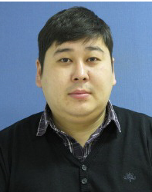
KPO Supplier Database
Yerlan Nugmanov
Senior Vendor Qualification Specialist

Slide 53
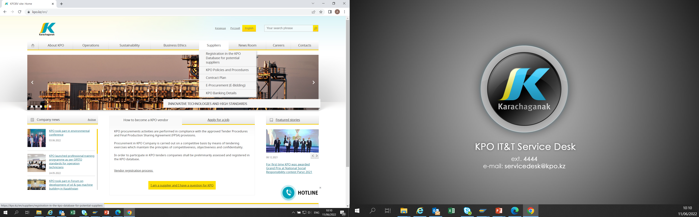
KPO SUPPLIERS DATABASE
29/07/2024 CONFIDENTIAL KARACHAGANAK PETROLEUM OPERATING B.V

Slide 54
VENDOR REGISTRATION
All potential suppliers shall be registered in KPO Database
REGISTRATION PROCESS
REGISTRATION
Provision of information on:
Technical Competency
Work Experience in the declared categories of goods and / or works and / or services
Personnel Availability
Financial Turnover
etc.
ETHICAL DUE DILIGENCE
Define an Ethical Due Diligence level in accordance with KPO Legal requirements:
Compliance with Kazakhstan and Foreign legislation
Compliance with Company internal regulations
Submission of potential suppliers shareholder lists
Vendor registration in KPO Vendor Database does not guarantee the participation in a tender or contract award, but suggests that a registered company may be considered as a market research participant for provision of goods, works and services for further pre-qualification process or tender as the need arises.
29/07/2024 CONFIDENTIAL KARACHAGANAK PETROLEUM OPERATING B.V

Slide 55
VENDOR REGISTRATION
To register in KPO Vendor Database, potential supplies shall:
  Download a questionnaire on KPO website – https://kpo.kz/ru/postavshchikam/registracija-v-baze-dannykh-postavshchikov-kpo
  Fill in the questionnaire for the preliminary vendor assessment and indicate activity codes
  Attach copies of required documents
  Submit the completed pack of documents for vendor assessment and registration by e-mail at MIVQ@kpo.kz
  Contact phone: +7 (711336) ext. 4943, 4946, 2192
  KPO encourages Suppliers to update registration data on an ongoing basis, related to:
    Work Experience in the declared categories of goods, works, services
    Certification, accreditation
    Reorganization
    Contact persons
29/07/2024 CONFIDENTIAL KARACHAGANAK PETROLEUM OPERATING B.V

Slide 56
MARKET RESEARCH
Purpose
  Define potential suppliers of goods, works, services who can perform as per KPO requirements
  Ensure free competition for KPO tenders
PROCESS
Demand determination and vendor searching
Issue of Invitation Letter for Expression of Interest
Market Intelligence Report
Approved
Tender List
Approvals
29/07/2024 CONFIDENTIAL KARACHAGANAK PETROLEUM OPERATING B.V

Slide 57
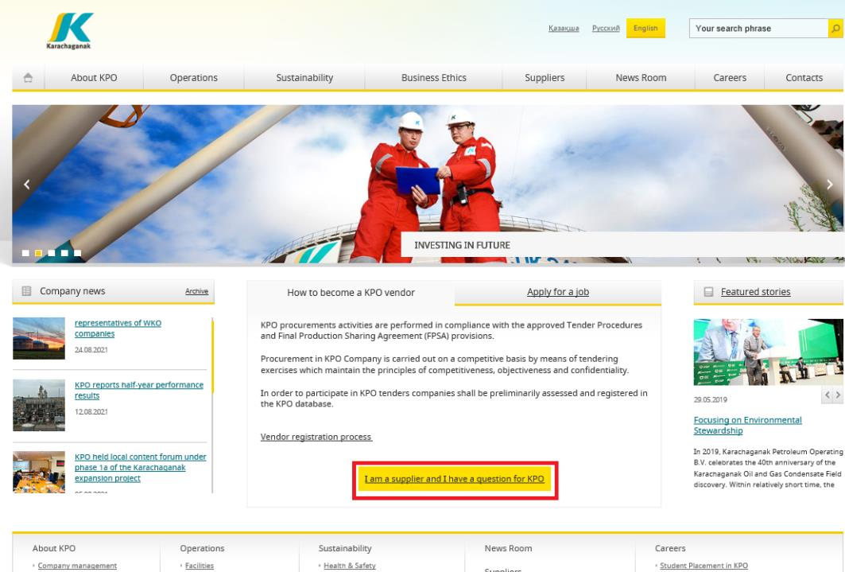
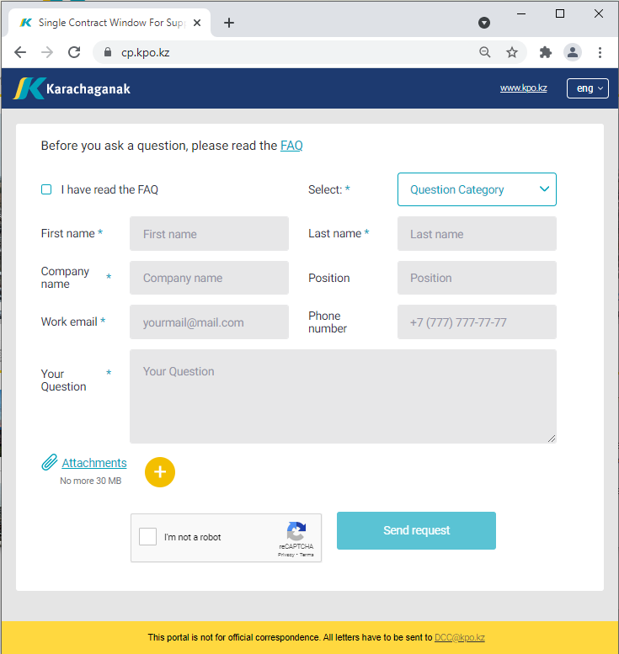
‘’SINGLE WINDOW’’ SYSTEM
29/07/2024 CONFIDENTIAL KARACHAGANAK PETROLEUM OPERATING B.V

Slide 58
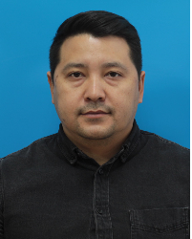
PROCUREMENT
PROCESS
Asset Zhakupov
Contracts and Procurement Compliance Manager
KPO

Slide 59
PROCUREMENT PROCESS
KPO shall perform the procurement activities in accordance with:
  the Final Production Sharing Agreement (confidential and intended only for the use of KPO, its Shareholders and the Republic) and the Joint Operating Committee’s Tender Procedures (JOC)
  current legislation
  approved budget and work program
PROCESS
MARKET RESEARCH / PREQUALIFICATION
INVITATION
TO TENDER
TENDERING PERIOD
TENDER DUE DATE
EVALUATION OF TENDERS
CONTRACT AWARD
CONTRACT
SIGNING
CONTRACT
PERFORMANCE
29/07/2024 CONFIDENTIAL KARACHAGANAK PETROLEUM OPERATING B.V

Slide 60
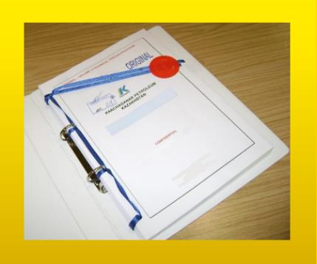



MAXIMUM ATTENTION SHALL BE PAID TO
TENDER PACKAGES SUBMISSION REQUIREMENTS
TENDER PACKAGES SUBMISSION REQUIREMENTS THROUGH E-BIDDING SYSTEM
(Link to the instructions)
INSTRUCTIONS
TO TENDERERS
TENDER DUE DATE / TIME
29/07/2024 CONFIDENTIAL KARACHAGANAK PETROLEUM OPERATING B.V

Slide 61
TENDER DOCUMENTATION CONTENTS
Cover letter
Forms, that shall be mandatorily signed, stamped and provided within timeframe specified:
Tender Acknowledgement and Confidentiality Agreement
Form of Tender
Certificate of Corporate Ownership and Declaration of Compliance
A package of documents related directly to the tender subject itself
Instructions to Tenderers
Form of Contract includes:
Form of Agreement
Schedule A – General Terms and Conditions
Schedule B – Scope of Goods/Services to be Supplied and Specifications
Schedule C – Compensation and Payment
Schedule D – Health, Safety and Environment (HSE) requirements
Schedule E – Special Conditions
Schedule F – Statement of Local Content
Schedule H – Industrial Relations
Questionnaire for Tender Participants
List of goods and technical delivery conditions (if applicable)
Instructions for preparing a tender proposal:
Instructions to Tender Participants
Bid marking template
29/07/2024 CONFIDENTIAL KARACHAGANAK PETROLEUM OPERATING B.V

Slide 62
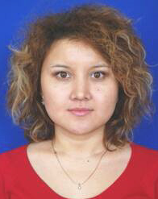
Venera Apiyeva
Local Content Interface and Planning Coordinator
Local Content
Mechanisms

Slide 63
KEY PRINCIPLES FOR KPO LOCAL CONTENT
In accordance with the FPSA, the Operator shall strive to maximize the use of GWS from Kazakhstani sources at each stage of the procurement process where procurement from such sources is justified in terms of price competitiveness, efficiency, operational parameters, terms of delivery and quality.
KPO, as one of the leading oil and gas companies in the Republic of Kazakhstan, strives to support the sustainable development of local suppliers in Kazakhstan and maximize opportunities for LC development, in accordance with the obligations of the FPSA and the legislation of the Republic of Kazakhstan.
The company fully supports the initiatives of the Government of the Republic of Kazakhstan aimed to the development of local suppliers, and recognizes the importance of attracting more local manufacturers to the Karachaganak project development. On this occasion, KPO is implementing various initiatives to develop local content.
Therefore, before implementing new processes, philosophies, optimization or development programs, KPO strives to:
1. Save the achieved LC level
2. Increase the share of LC
3. Continuously expand the range and list of purchased goods from local manufacturers
29/07/2024 CONFIDENTIAL KARACHAGANAK PETROLEUM OPERATING B.V

Slide 64
LOCAL CONTENT MECHANISMS
NAME OF THE MECHANISM | DESCRIPTION
Early tender | a form of Advance Procurement* The method of awarding the contract is a competitive tender process The goal is to organize the production of goods in the Republic of Kazakhstan. A tender for the supply of goods based on the results of which the Operator enters into a contract for the supply of goods with a suspensive condition or with a long-term delivery schedule until the Operator has a need for such goods.
Trial Order | Operator contract Contract award methods - Tender, Negotiation, Single source, Sole source. The purpose of such a contract is to purchase samples of Goods from Kazakhstani manufacturers for testing and checking for compliance with technical standards and operational requirements of KPO. Basic conditions of the Trial order Conformity of the Goods to the type for oil and gas operations Minimum purchase volume Objectivity of tests and inspections
*Advance Procurement means a form of procurement as a result of which the Operator agrees a contract for goods the delivery of which may be delayed or subject to a multi-year schedule depending on Operator’s requirement for such goods, including but not limited to Early Tenders.
29/07/2024 CONFIDENTIAL KARACHAGANAK PETROLEUM OPERATING B.V
64

Slide 65
LOCAL CONTENT MECHANISMS
NAME OF THE MECHANISM | DESCRIPTION
Contract in exchange for investment | A contract in exchange for investment is a long-term contract concluded on a Single source basis, under which the supplier undertakes to produce goods of local origin that are the subject of a procurement contract in the territory of the Republic of Kazakhstan. Methods of contract award are negotiations, Single source basis. The goal is to organize the production of goods in the Republic of Kazakhstan. Basic terms of the contract in exchange for investment Long - term contract; Single source basis; Obligation to organize the production of goods of local origin on the territory of the Republic of Kazakhstan.
Kazakh Tender | Procedure for participation of Kazakhstani suppliers The method of awarding the contract is a competitive tender process exclusively among Kazakhstan suppliers of GWS. The goal is to award contracts to Kazakhstani suppliers of GWS. Conditions for holding a tender among Kazakhstani suppliers Given that: Minimum number of Kazakhstan suppliers (ii) the presence of at least 5 pre-qualified Kazakhstan suppliers, the Contractor undertakes to conduct the tender exclusively among Kazakhstan suppliers.
29/07/2024 CONFIDENTIAL KARACHAGANAK PETROLEUM OPERATING B.V
65

Slide 67

29/07/2024 CONFIDENTIAL KARACHAGANAK PETROLEUM OPERATING B.V

